Slide 1
College Management System
Guided By : Prof. Archana Goel
Presented By : Miss.Pooja Mane

Slide 2
ACKNOWLEDGEMENT
I would like to take this opportunity to express my gratitude
towards all the people who have in various ways, helped in the successful completion of my project.
I must convey my gratitude to Prof. Akanksha Panday for giving me the constant source of inspiration and help in preparing the project, personally correcting my work and providing encouragement throughout the project

Slide 3
CONTENTS
Introduction
Objective
Existing System
Teacher Module
Teacher Module diagram
Student Module
Student Module diagram
System Diagram
ER diagram
outputs
Future scope
Reference
Conclusion

Slide 4
INTRODUCTION
The College management system is an automated version of manual
Student Management System. It can handle all details about a
student & teacher. The details include college details, Course details,
student details, etc...
In case of manual system they need a lot of time, manpower etc.
Here almost all work is computerized. So the accuracy is maintained.
Maintaining backup is very easy. It can do with in a few minutes. Our
system has two type of accessing modes, administrator and user.
Student management system is managed by an administrator. It is
the job of the administrator to insert update and monitor the whole
process. When a user log in to the system. He would
only view details of the student. He can't perform any changes .

Slide 5
OBJECTIVE
Main aim in developing College Management System
is to provide an easy way to automate all functionalities
of a college .The main objective of the college
Management system is to manage details of Student,
Teacher, Course. It manages all the information about
Student, Course, Teacher . The project is totally built as
administrative end and thus only the administrator is
guaranteed the access.

Slide 6
EXISTING SYSTEM
In Existing system all data of student and teacher are stored
manually .
In case of manual system they need a lot of time,
manpower etc. Here almost all work is computerized,
So the accuracy is maintained in College Management System.

Slide 7
MODULES
The main menu will contain six parts which are as follow:
Student
Teacher
Course

Slide 8
TEACHER MODULE
●Teacher can login with their username and
password then he or she directed to there
respective home page.
●Teacher can add registration throw this web
application and store the database And keep it for
future use.
●Teacher can add announcement for student.
●Teacher can view students and also course details.

Slide 9
TEACHER MODULE DIAGRAM
Add announcement
Teacher
View course detail
View student details

Slide 10
STUDENT MODUL
A student can register himself directly on the college application.
Student can check a announcement.
Student view check the course details.
student view and check the profile.

Slide 11
STUDENT MODULE DIAGRAM
view announcement
Student
View course details
View profile

Slide 12
SYSTEM DIAGRAM
Start
Authentication Process
Username and password
Admin Process
Teacher and student overall mentanence process
Teacher Accessing
Student detail, course detail, Announcement
Student Accessing
Course detail , view announcement
Stop

Slide 13
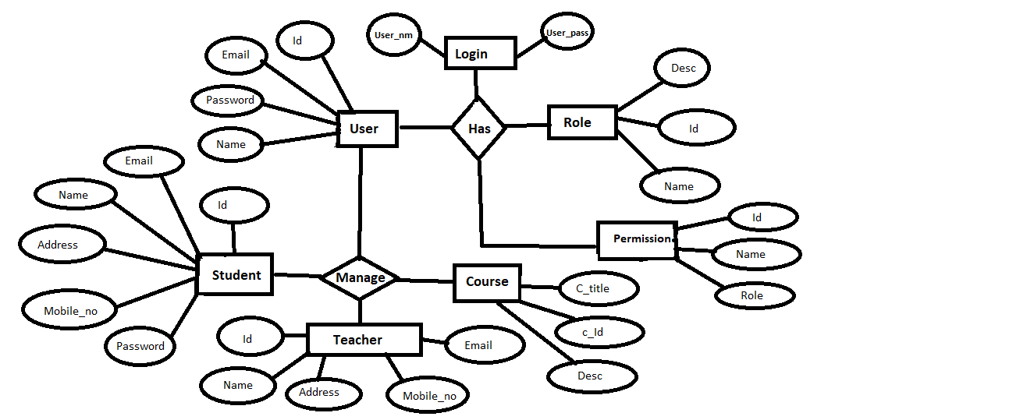
ER DIARAM

Slide 14
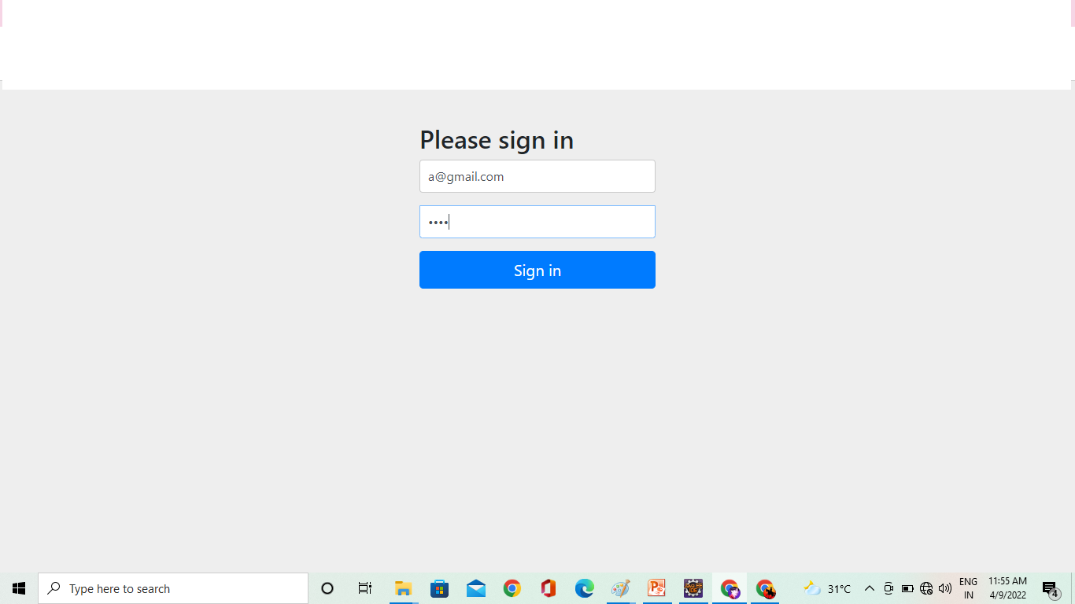
USER LOGIN

Slide 15
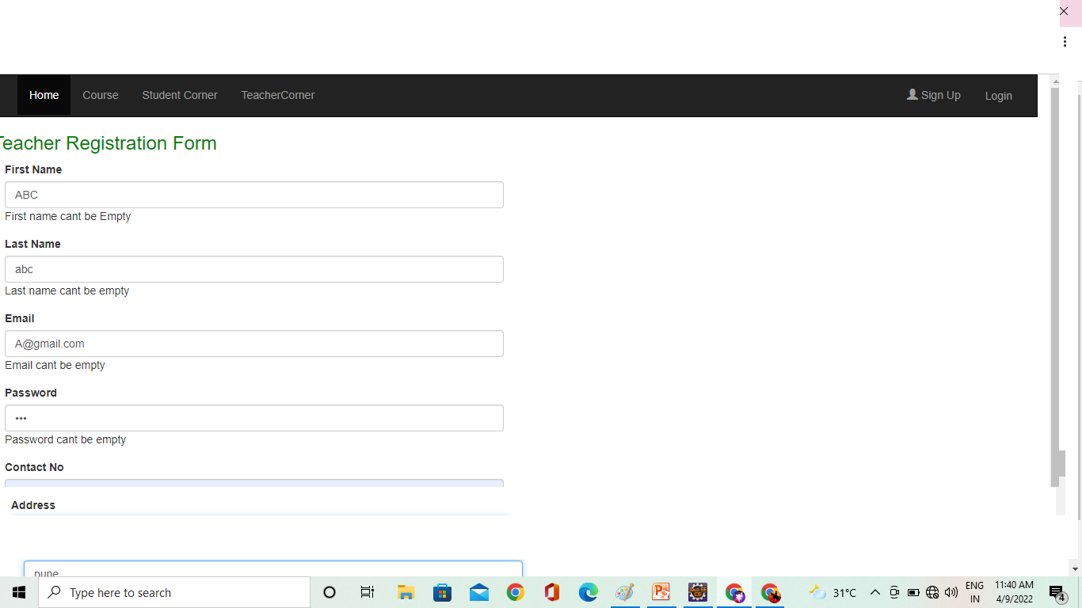
TEACHER REGISTRATION

Slide 16
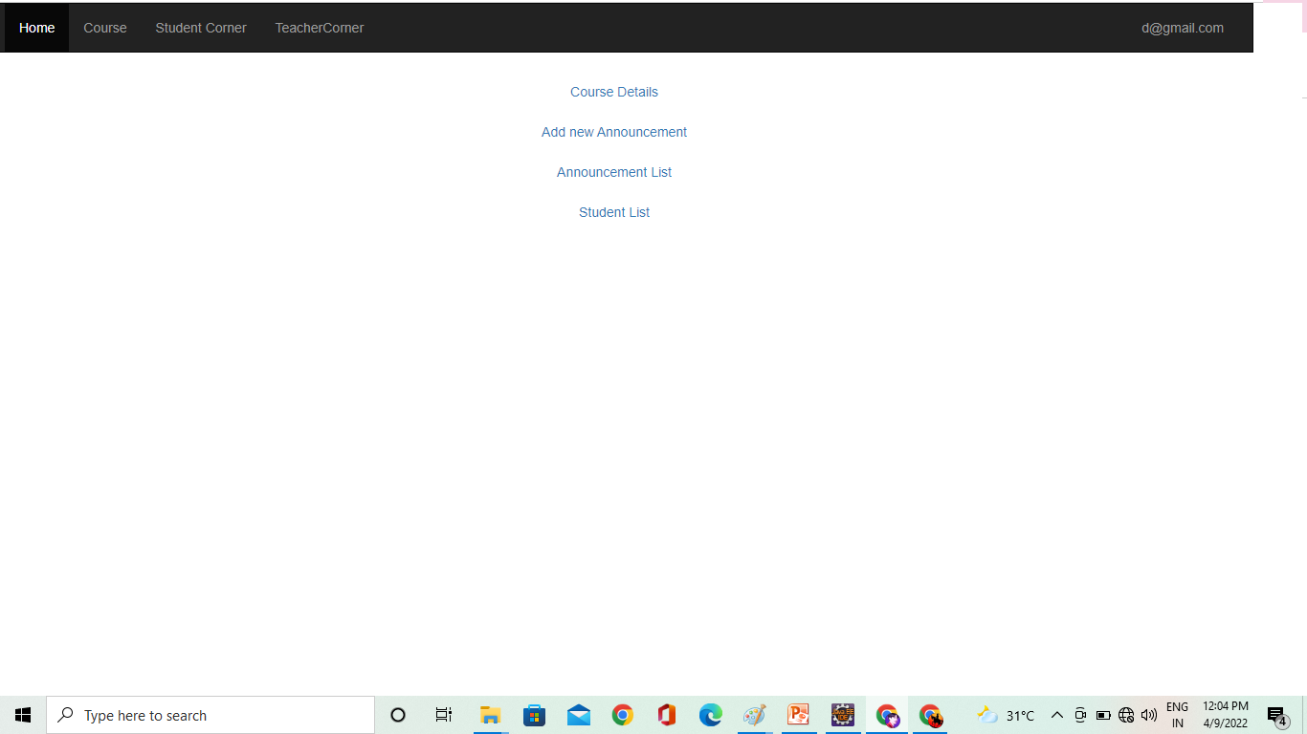
TEACHER PROFILE

Slide 17
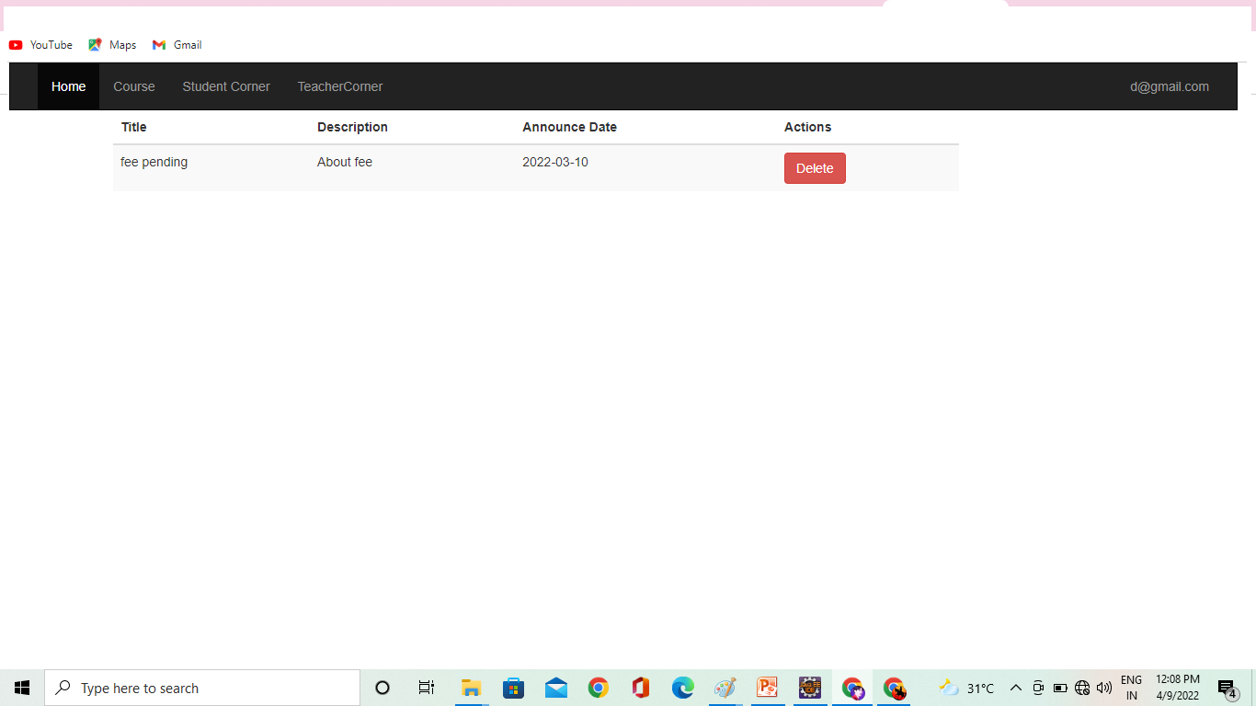
TEACHER ANNOUNCEMENT

Slide 18
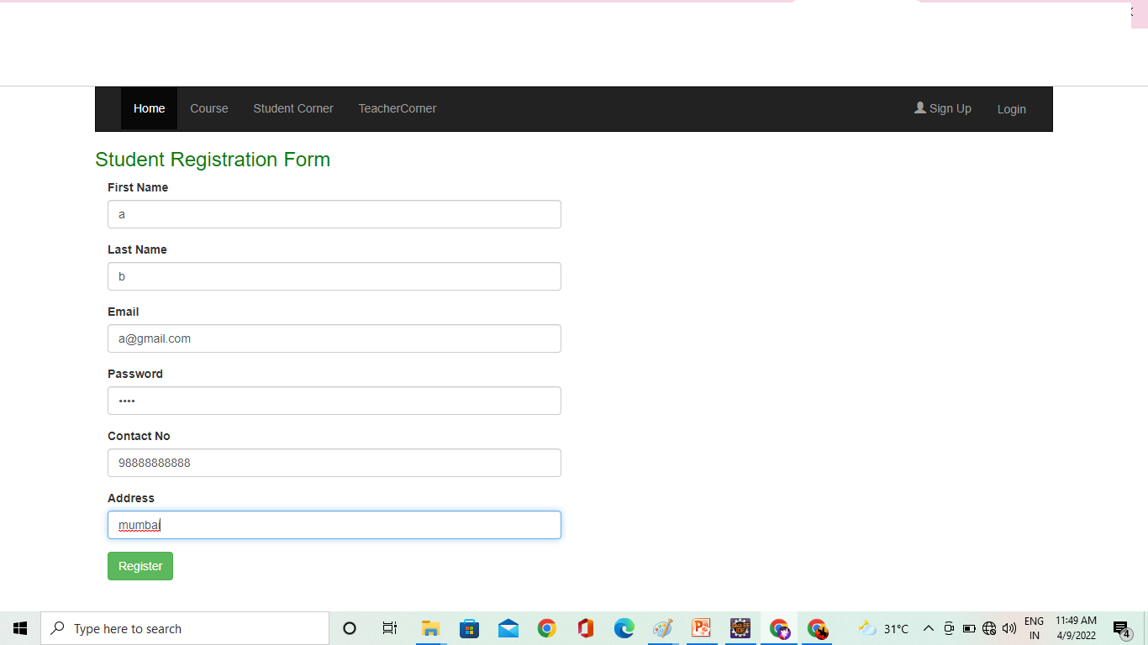
STUDENT REGISTRATION

Slide 19
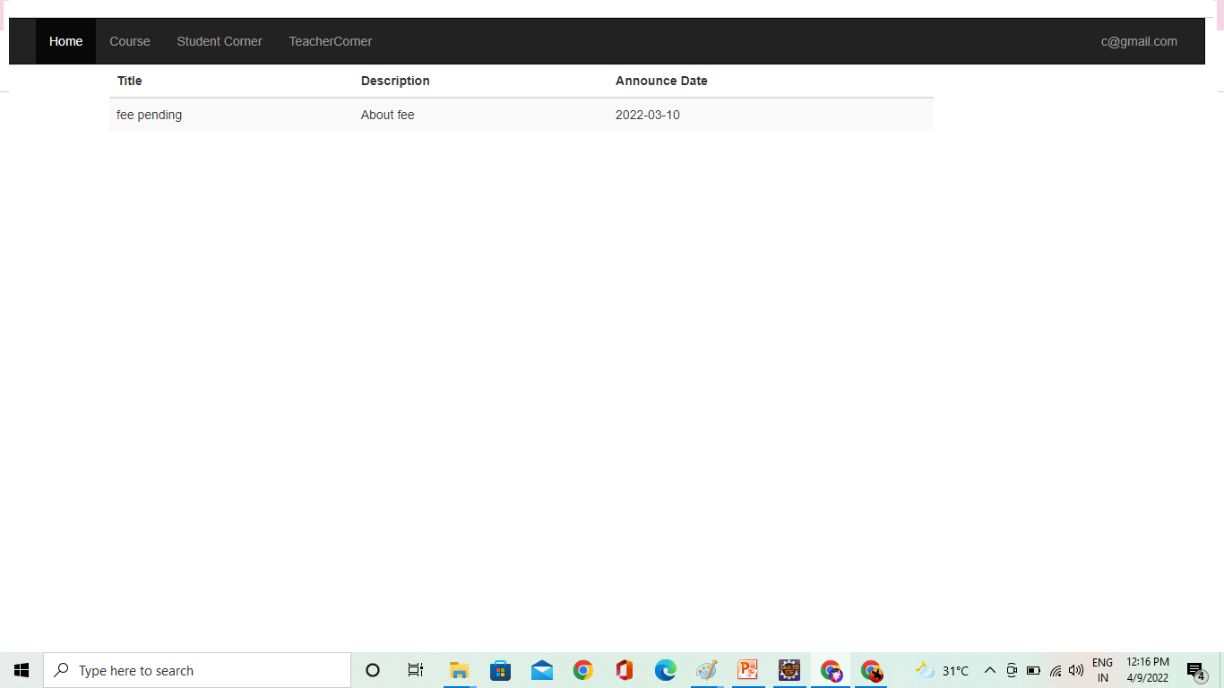
STUDENT ANNOUNCEMENT

Slide 20
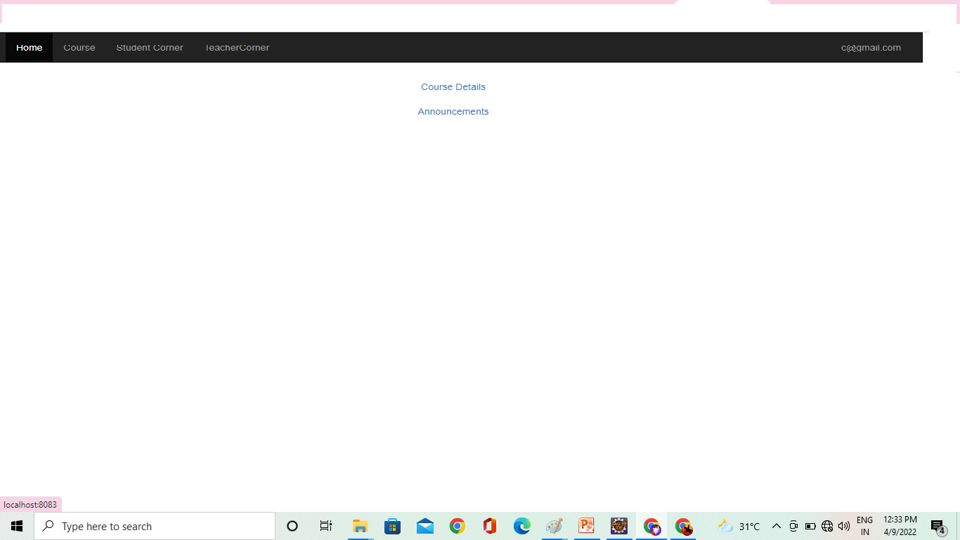
STUDENT PROFILE

Slide 21
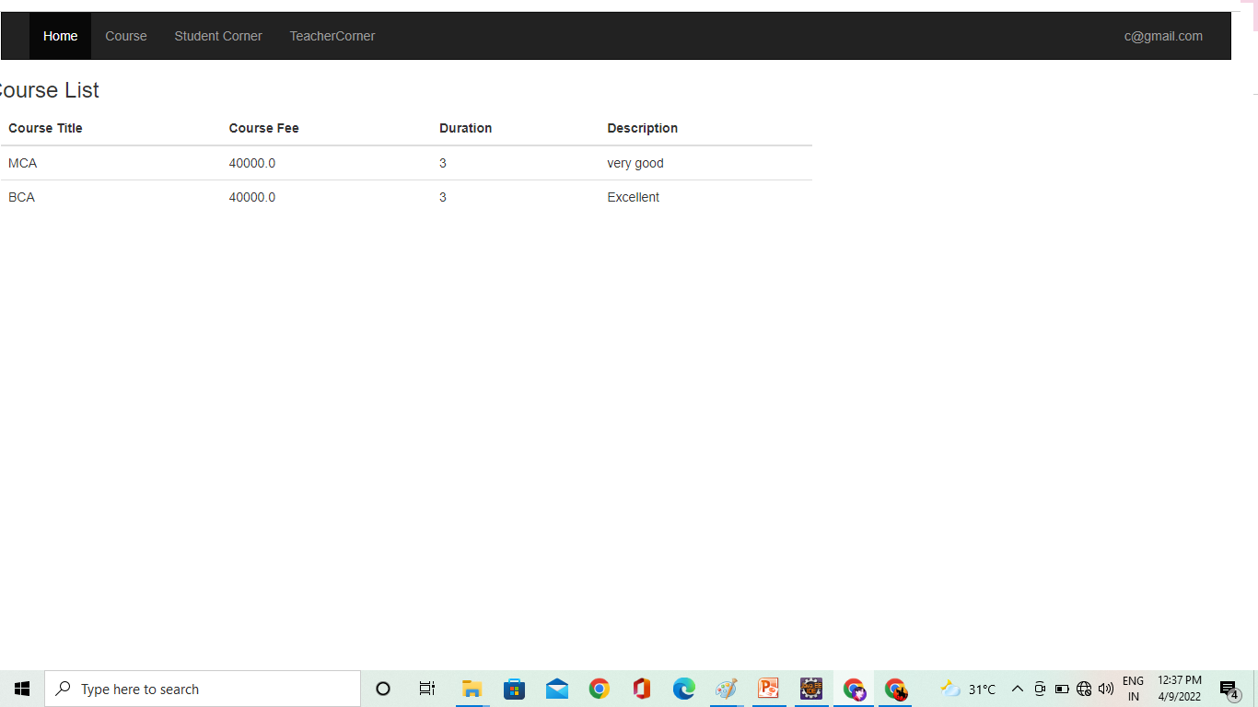
STUDENT COURSE

Slide 22
STUDENT ANNOUNCEMENT

Slide 23
Advantages
To reduce the headache of maintaining the record of students’ and teachers’ related documents.
To reduce the cumbersome job of maintaining several documents like.
Searching will become more efficient and fast in comparison to manual searching.
Overall, it will reduce the cost and time of the college head in taking care of the college.

Slide 24
FUTURE SCOPE
Some of the features of the proposed system are
Student Admission
Student Fee management
Student Attendance Management
Teacher Attendance Management

Slide 25
REFERENCES
www.google.com
http://www.lovelycoding.org/college-management-system
http://www..freeprojectz.com/uml-diagram/college-manegement-system-uml-digram
https://youtu.be/otPRAJWoft8

Slide 26
CONCLUSION
The project untitled as College Management System is the system that deals with all the data regarding of student , teacher and course manage with this system.

Slide 27
Thank you!!!

