Slide 1
Social buzz
Analysis to find out top 5 most popular categories of Social Buzz
Data Analytics Team
Accenture

Slide 2
AGENDA
Brief Introduction
Project Recap
​The Analytics Team
Process
Insights
​Summary​

Slide 3
introduction
Social Buzz is a Social media & content creation company. Over the past 5 years, they have scaled quicker than anticipated and need the help of an advisory firm to oversee their scaling process effectively. Due to their rapid growth and digital nature of their core product, the amount of data that they create, collect and must analyze is huge. Every day over 100,000 pieces of content, ranging from text, images, videos and GIFs are posted. All of this data is highly unstructured and requires extremely sophisticated and expensive technology to manage and maintain and so they need external help.

Slide 4
PROJECT RECAP
Looking to complete an IPO by the end of next year and need guidance to ensure that this goes smoothly.
Do not have the resources to manage the scale that they are currently at. They could hire more people, but they want an experienced practice to help instead.
Keen to understand how the world's biggest companies manage the challenges of big data to learn to manage their own massive amount of data.

Slide 5
Process
DATA UNDERSTANDING
DATA CLEANING
DATA MODELLING
DATA ANALYSIS
UNCOVER INSIGHTS

Slide 6
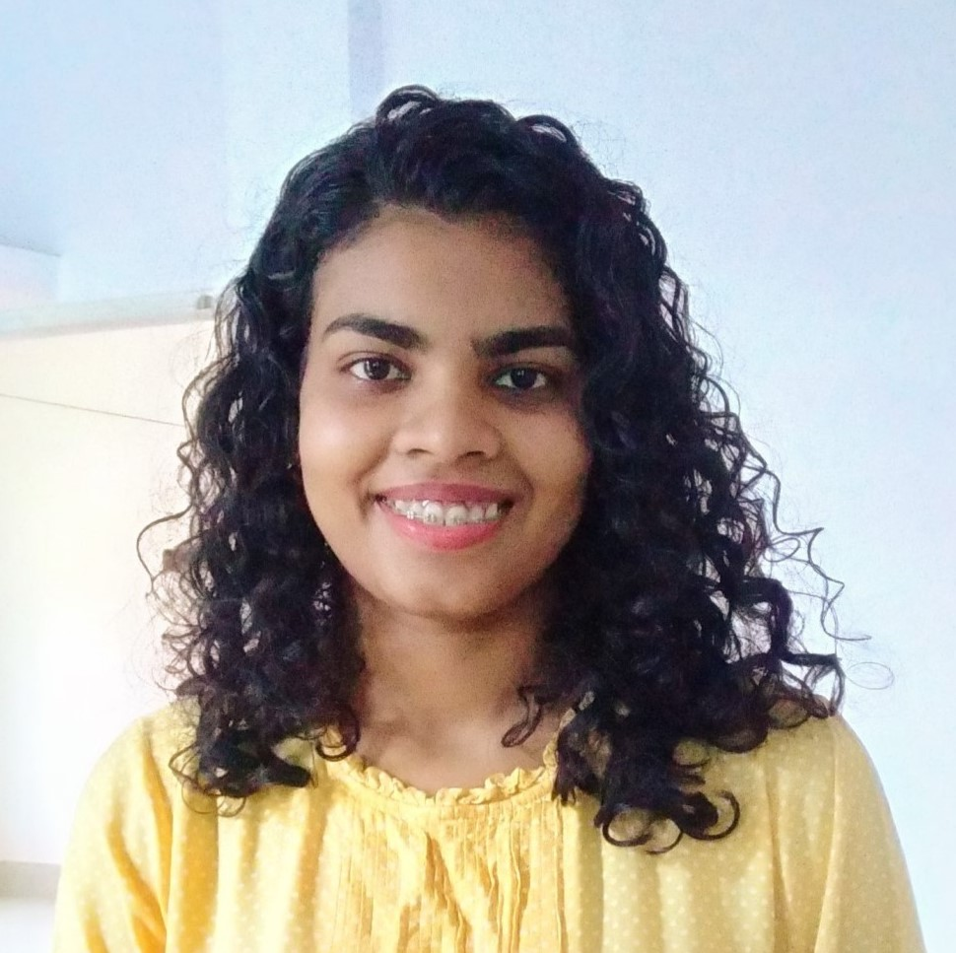
MEET OUR TEAM
Andrew fleming
Marcus Rompton
Pooja ml (me)
Chief Technical Architect
Senior Principal
Data Analyst

Slide 7
Cleaning Process
Tools Used-
MySQL
Power Query
Process-
Removal of rows of missing values
Checking for duplicates
Removal of irrelevant columns
Changing Datatypes wherever required
Changing of Column names to keep them distinct
Creation of new columns with acquired data
Merging of datasheets into a clean datasheet

Slide 8
Unique Categories
Most popular category
Reaction to food posts
Month with most posts
12
Tennis
2551
April, 2021
https://app.powerbi.com/links/9jnWZhoHxb?ctid=d5e40fe7-44b4-4af6-a72a-61099edbca16&pbi_source=linkShare

Slide 9
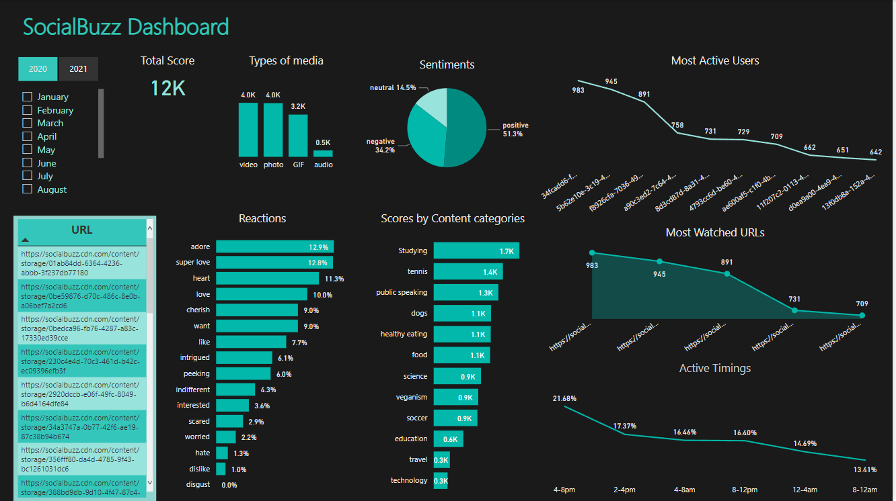
https://app.powerbi.com/links/9jnWZhoHxb?ctid=d5e40fe7-44b4-4af6-a72a-61099edbca16&pbi_source=linkShare

Slide 10
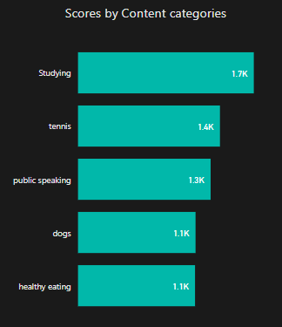
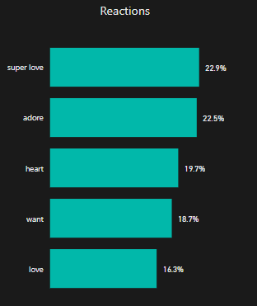
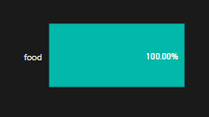
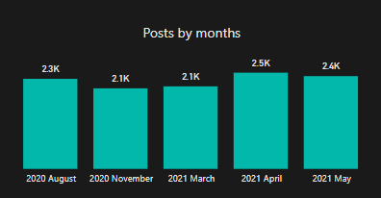
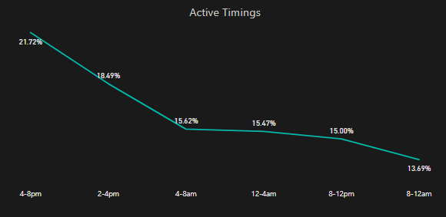
Top 5 categories
Top 5 reactions
Most liked category
Months of most posts
Most active timings
https://app.powerbi.com/links/9jnWZhoHxb?ctid=d5e40fe7-44b4-4af6-a72a-61099edbca16&pbi_source=linkShare

Slide 11
ANALYSIS
Most popular contents have been Tennis, Studying, Healthy eating, public speaking, food.
However popularity of Studying has increased recently to become the most popular .
More than 53% feedback on contents have been positive.
Most positive sentiments have been for food for both years but has decreased by 5%.
Videos are getting more liked than photos.
More than 26% of reviews are ‘superlove’ and ‘love’.
More than 40% watch contents between 2pm to 8pm.
Most watched content in both years is a video of food category but most liked were tennis and studying.
5% negative sentiments have increased over one year.
Most negative comments i.e 18% are for studying

Slide 12
INSIGHTS
Food is the common theme for both years with ‘healthy food’ ranking at the top. This gives an indication of the user base audience. You can use this insight to create a campaign and collaborate with healthy food brands to keep the audience engaged.
Popularity of ‘studying’ has increased but has most negative reviews too. You can work on improving its content as this category gives most yields.
As the negative sentiments have increased posts promoting peace, love, affection, sympathy would do better.
Mostly active timings are 2pm to 8pm, so live videos will get more audience during these durations.
Audio contents do not get engagement.

Slide 13
summary
This ad hoc analysis is insightful. We can take this analysis into large scale production for real time understanding of your business. We can show you how to do this.
PLEASE FEEL FREE TO ASK ANY QUESTIONS THAT YOU HAVE!

Slide 14
THANK YOU
Pooja ML
Data Analyst
poojamartinalakra@gmail.com
https://www.linkedin.com/in/pooja-martina-lakra-a8a989233

