Slide 1
MATOSHRI EDUCATION SOCIETY'S
MIT POLYTECHNIC & ENGINEERING, YEOLA
Department of Electronics and Telecommunication Engineering
OHM'S LAW
V = I × R
Pooja Santosh Mhais
Rutuja Ramesh Gaikwad
Shubham Madhukar Gaikwad
Roll No. 1
Roll No. 2
Roll No. 3
Under the Guidance of Miss. Beldar G.N.
Academic Year: 2025-2026

Slide 2
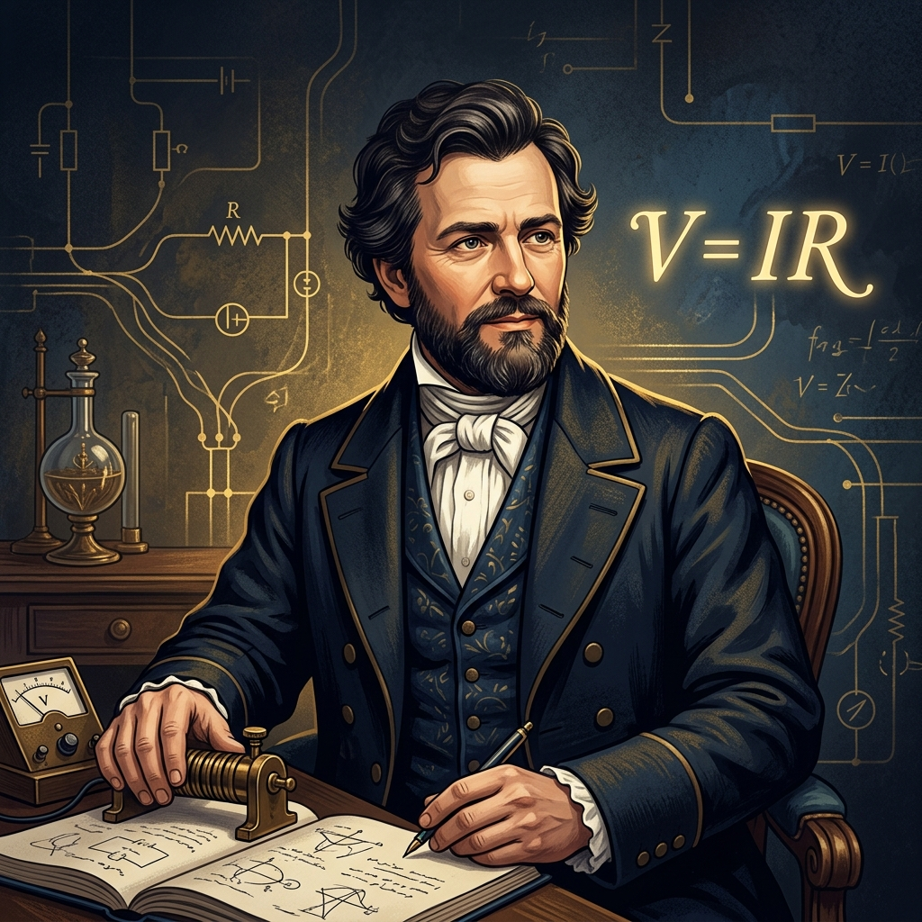
What is Ohm's Law?
Ohm's Law is the most fundamental relationship in electronics and telecommunication engineering. Discovered by Georg Simon Ohm in 1827, it describes how voltage, current, and resistance are interrelated in an electrical circuit.
V = I × R
⚡ Voltage (V)
The electrical pressure that pushes electrons through a conductor. Measured in Volts (V).
🌊 Current (I)
The rate of flow of electric charge through a conductor. Measured in Amperes (A).
🔥 Resistance (R)
The opposition to the flow of current in a circuit. Measured in Ohms (Ω).

Slide 3
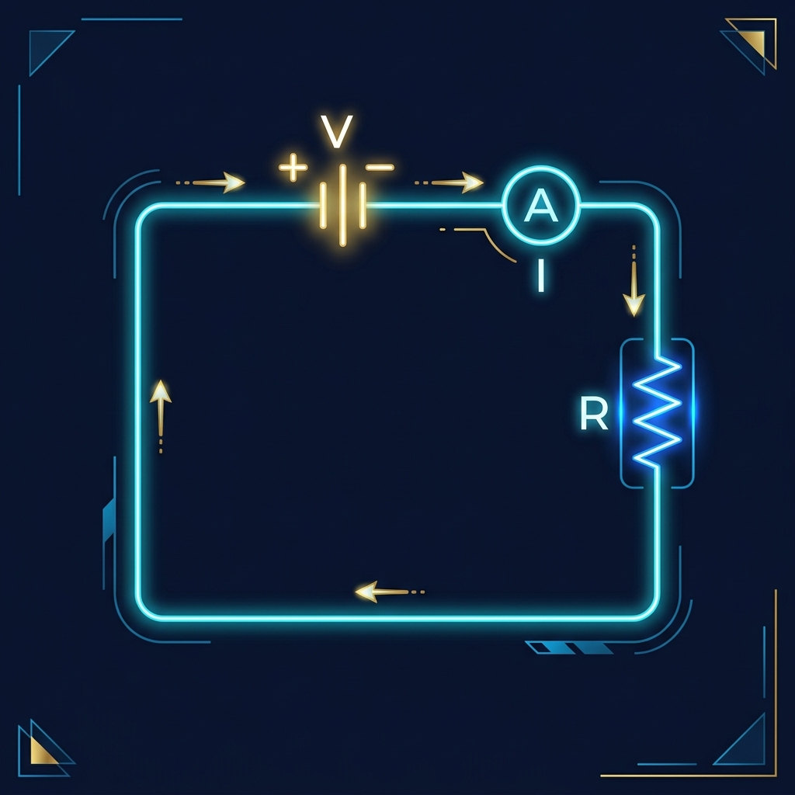
The Basic Circuit
A simple circuit consists of a voltage source (battery), a load (resistor), and connecting wires. Current flows from the positive terminal through the circuit and back to the negative terminal.
🔋 Voltage Source
Provides the electromotive force (EMF) to drive current through the circuit.
📐 Resistor
Opposes current flow. Color bands indicate its resistance value in Ohms.
Key Insight: If you increase the voltage while keeping resistance constant, the current increases proportionally.

Slide 4
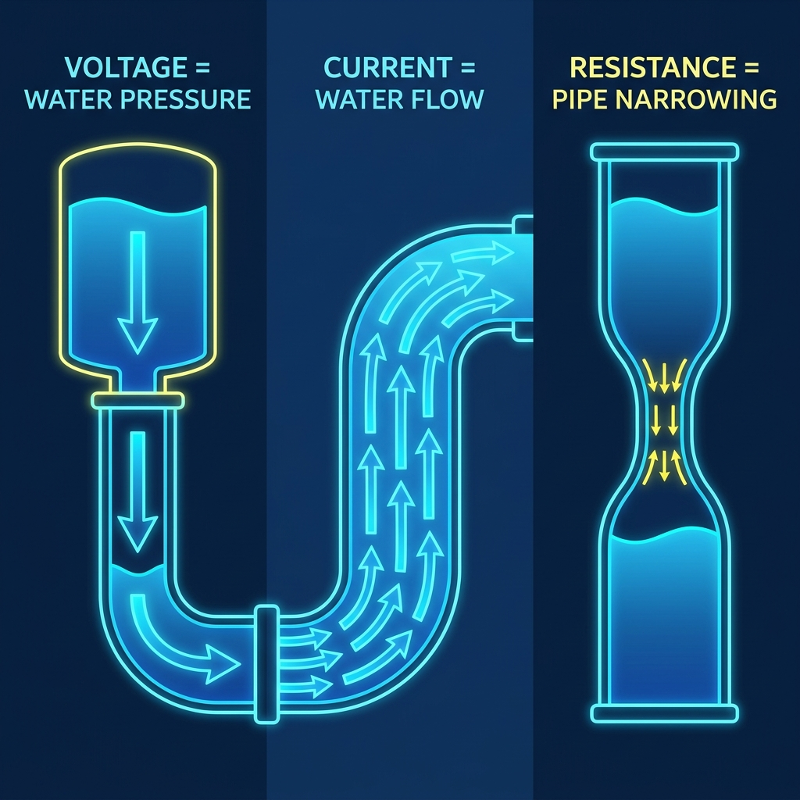
The Water Analogy
The easiest way to understand Ohm's Law is by comparing electricity to water flowing through pipes.
Voltage = Water Pressure
Like water pressure pushing water through a pipe, voltage pushes electrons through a wire.
Current = Water Flow Rate
The amount of water flowing per second is like current — the amount of charge flowing per second.
Resistance = Pipe Width
A narrow pipe restricts water flow, just as high resistance restricts electric current.

Slide 5
The Ohm's Law Triangle
Cover the variable you want to find — the remaining arrangement shows the formula!
V
I
×
R
Find Voltage:
Find Current:
Find Resistance:
V = I × R
I = V / R
R = V / I

Slide 6
Ohm's Law Simulator
Adjust voltage and resistance to see how current changes (Interactive version available in HTML)
Example 1
Example 2
Example 3
12V / 100Ω
24V / 8Ω
120V / 60Ω
Current
Current
Current
= 0.120 A
= 3.000 A
= 2.000 A
Power
Power
Power
1.44 W
72.00 W
240.00 W

Slide 7
Solved Examples
Example 1: Finding Current
Given: V = 24V, R = 8Ω
Solution: I = V / R = 24 / 8
Answer: I = 3 Amperes
Example 2: Finding Voltage
Given: I = 5A, R = 12Ω
Solution: V = I × R = 5 × 12
Answer: V = 60 Volts
Example 3: Finding Resistance
Given: V = 120V, I = 0.5A
Solution: R = V / I = 120 / 0.5
Answer: R = 240 Ohms

Slide 8
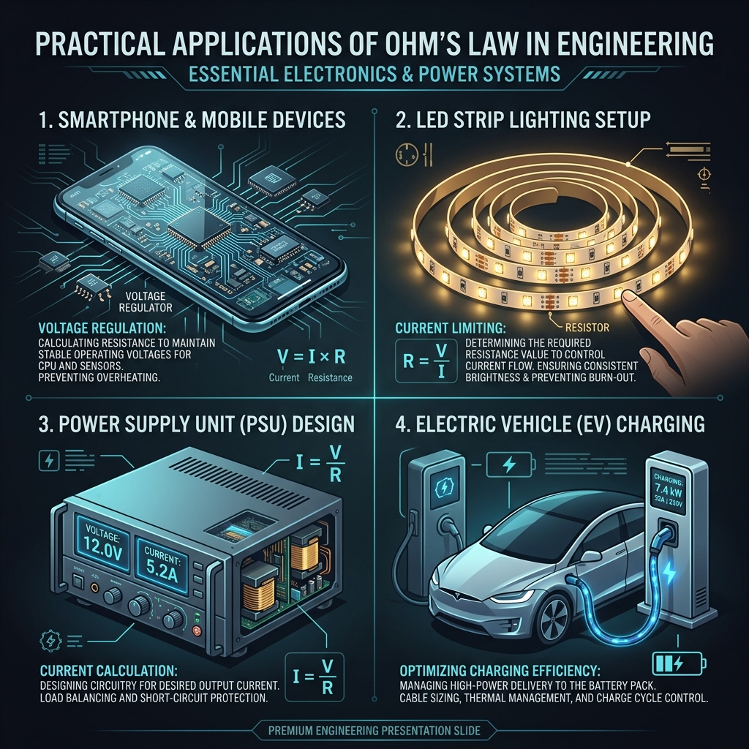
Practical Applications
💡 LED Circuit Design
Calculate the correct resistor value to safely drive an LED without burning it out.
🔌 Power Supply Design
Determine current draw and power dissipation in voltage regulator circuits.
🏠 Household Wiring
Calculate wire gauge requirements and fuse ratings for safe home electrical installations.
🔧 Troubleshooting
Diagnose faulty components by measuring voltage drops and comparing to expected values.

Slide 9
Limitations of Ohm's Law
Ohm's Law applies to ohmic (linear) conductors under constant physical conditions.
⚠️ Non-linear devices — Diodes, transistors, and LEDs do not obey Ohm's Law.
⚠️ Temperature dependence — Resistance changes with temperature.
⚠️ High-frequency AC circuits — Impedance must be considered.
⚠️ Semiconductors — Complex V-I characteristics vary with doping.
⚠️ Superconductors — Zero resistance at extremely low temperatures.

Slide 10
Thank You!
We hope this presentation helped you understand the fundamentals of Ohm's Law.
V = I × R
Pooja Santosh Mhais
Rutuja Ramesh Gaikwad
Shubham Madhukar Gaikwad
Roll No. 1
Roll No. 2
Roll No. 3
MIT Polytechnic & Engineering, Yeola • Electronics and Telecommunication Engineering

