Slide 1
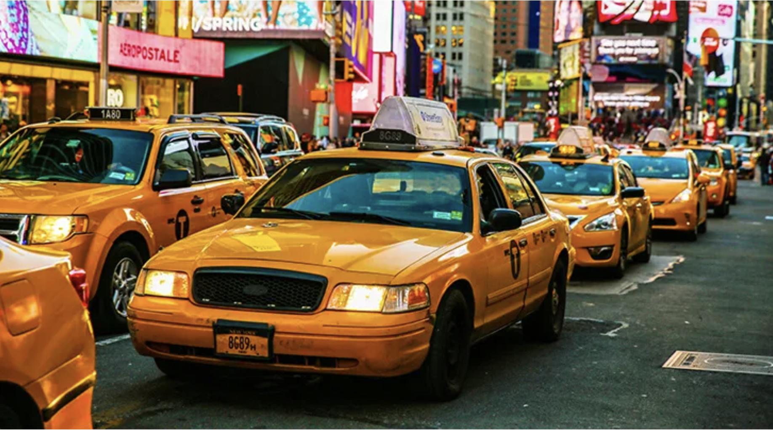
Behind the Meter
Tracking the Pulse of NYC
Notes:
When you think of New York City, chances are that you picture yellow taxis weaving through busy streets. And yea, for decades, they’ve been more than just a way to get around, they’ve been a symbol of movement, accessibility, and the rhythm of urban life. However, the rhythm has changed.

Slide 2
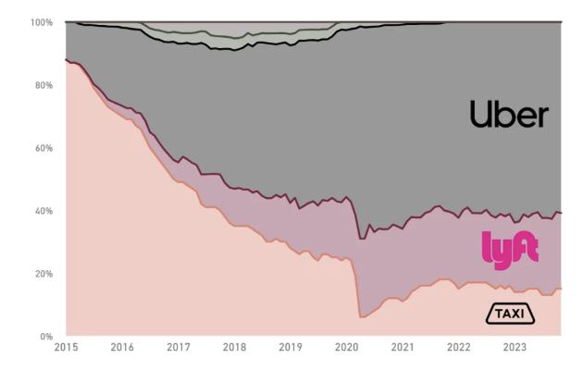
In less than a decade, uber & lyft crushed Taxis in NYC
Notes:
With the surge of ride-sharing apps, unpredictable traffic, and shifting public transit patterns, we asked: How is the iconic NYC taxi adapting? Where are cabs most in demand? Do pricing strategies reflect real rider behavior? How do seasons—and even specific hours of the day—affect safety and congestion?
We took on these questions with one goal: to tell the story of New York’s taxi system through data.
By blending taxi trip records, crash reports, subway ridership, and traffic logs, our project reveals the hidden patterns behind the city’s mobility. We hope our findings will spark ideas—not just for transit planners and policymakers—but for anyone curious about how New York really moves.”

Slide 3
The Big questions behind the yellow cabs 🤔
When and where are taxis most in demand?
Do fare patterns align with rider behavior?
How does seasonal travel impact safety?
And which areas of the city are under the most traffic pressure?

Slide 4
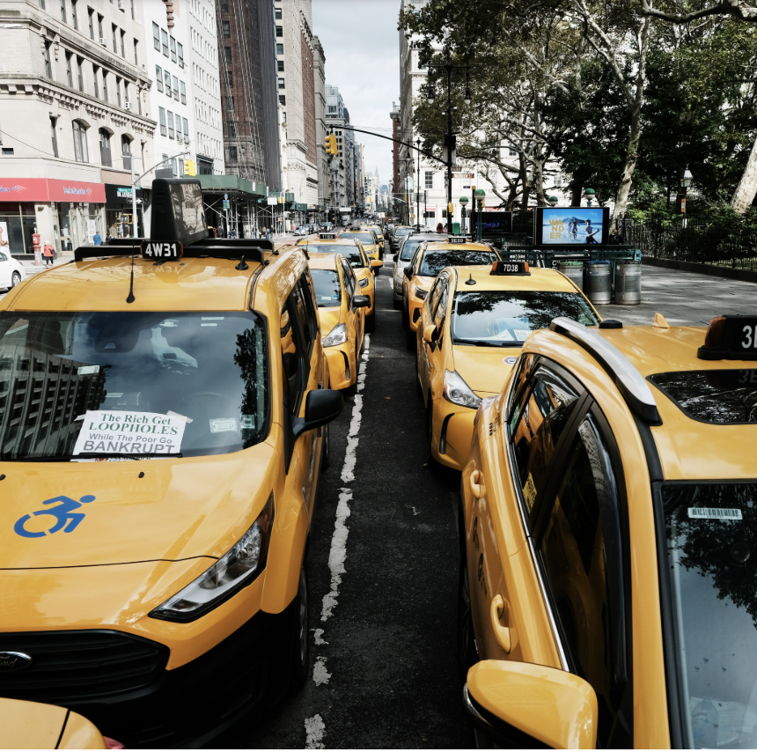
Citywide mobility and overview
Hourly dynamics – Demand VS pricing
Dec 13th taxi behavior
Mobility vs safety
Notes:
So today, we’re breaking our presentation into four parts, each powered by a dedicated dashboard we created using the 2024 Yellow Taxi Trip Dataset, MTA subway ridership dataset, and monthly crash reports from New York City’s open database.
The first part gives us the big picture on when and where people are moving, and how taxi usage varies across boroughs and times of day.
The second one helps us to understand not just when people are riding but how much they’re paying For the third part, we are gonna zoom into one specific day, December 13th, a particularly active day in the dataset. And we are gonna analyze taxi behavior in real time
Finally, we wrap up our presentation for the day by comparing ride volumes and crash reports to uncover potential trade-offs between speed, efficiency, and risk across the city.

Slide 5
Our Data & Toolkit
How We Turned Chaos Into Charts
You can’t analyze a city without some serious data Firepower.
Here’s what we used:
NYC Yellow Tripdata (2024 – all 12 months)
MTA Subway Daily Ridership (2020–2025)
Traffic Volume Logs
Crash Reports from TLC (Local Law 31)
Taxi Zone Lookup
Audience Q:
How big do you think the combined trip data file was? A. 20MB B. 200MB C. 2GB
Our toolbox: Python for cleaning, Tableau for storytelling, and Excel for mid-battle pivots.
Answer: Over 2GB. Our laptops begged for mercy.

Slide 6
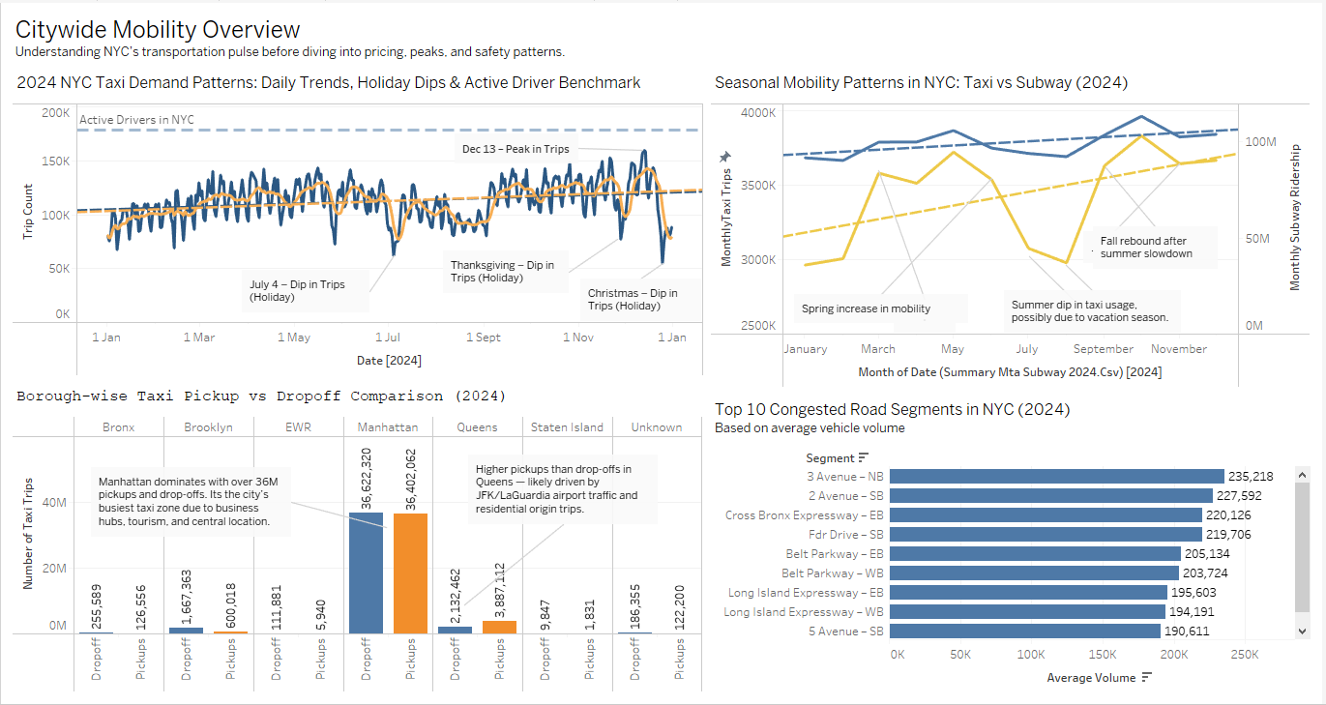
Dashboard - 1
By December, demand skyrockets, but drivers remain constant at ~178,834l
Congestion clusters on Cross Bronx and Long Island corridors
Daily taxi trips show strong weekday rhythm, dips on holidays
Manhattan dominates both pickups and drop-offs
Queens has more pickups than drop-offs — hello, airport runs

Slide 7
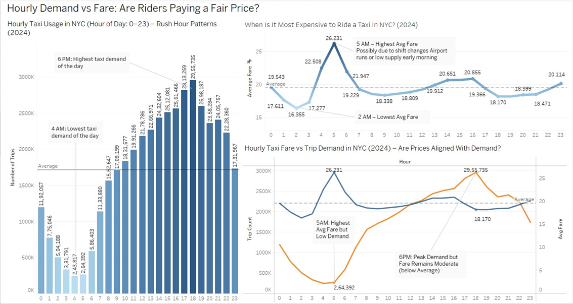
An image is worth a thousand words
Hourly Demand vs Fare
Dashboard - 2
Images reveal large amounts of data
Demand explodes at 6 PM: ~290,000 trips in 2024
Most expensive fares? Not rush hour — it’s 5 AM ($26 avg.)
That’s when few drivers are available, but people still need rides
Demand Peaks But Price Doesn’t?

Slide 8
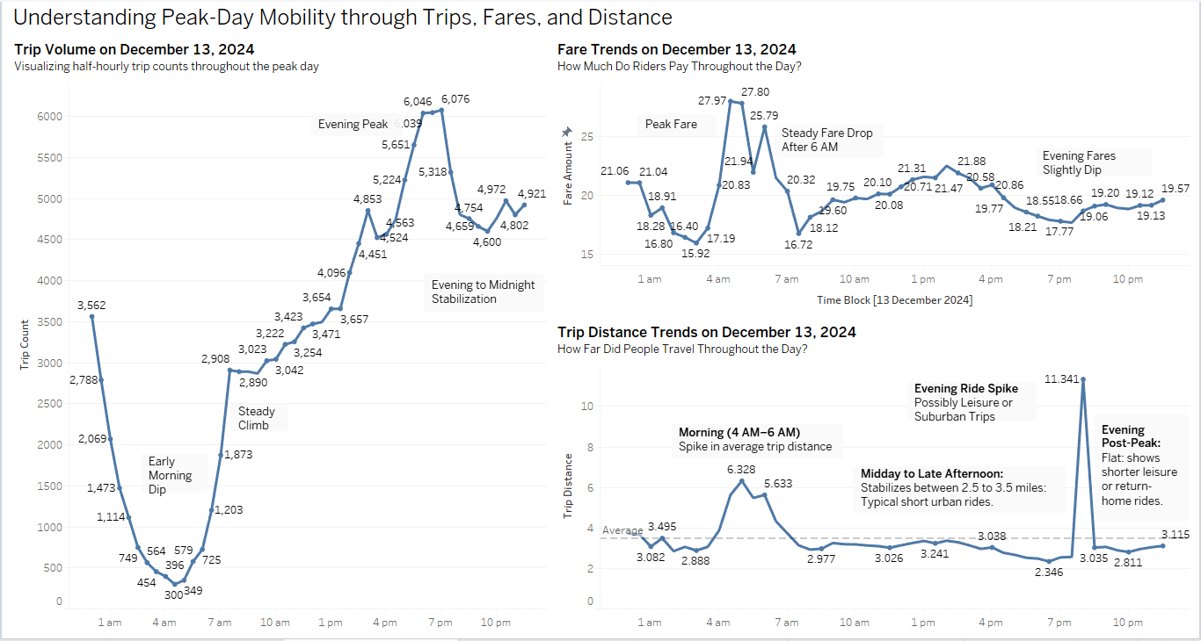
Dashboard - 3
Notes:
This dashboard zooms in on all taxi activity from December 13th, 2024—the busiest day of the year in our dataset.
We chose this day to explore taxi behavior from three different angles, starting with the line chart you see here.
Right away, you’ll notice that demand is surprisingly high around 1 AM, likely driven by people heading home from late dinners or young adults going out on a Thursday night. From there, we hit a sharp early morning dip around 4 to 5 AM, with trip volume dropping to just 300 rides.
Once the sun starts to rise, the demand picks back up and climbs gradually throughout the day. There’s a small dip between 2 to 4 PM, which could be a post-lunch, pre-commute slowdown.
Then we hit the Evening Peak—a surge between 5 to 6 PM, when trip volume increases to over 6,000 rides per half hour. This is when commuters, dinner plans, and weekend events all collide, making it the most active time period of the day.
If we look carefully at the second and third line chart, we would notice that the taxi fare and trip distance trends are tightly correlated with the trip volume trend. For example, fare is at its highest at around 5AM. It’s likely due to low supply but high demand. Speaking from my own experience, every time I go out in New York City and can’t get an Uber home at 4AM, I will turn to taxis as my last resort.
Now let’s take a look at the trip distance chart, There’s a noticeable spike around 5 AM, with average trip distance reaching 6.3 miles, likely driven by airport runs or early work commutes. The most dramatic jump occurs around 7 PM, where distances peak at 11.3 miles, suggesting longer evening rides to the suburbs, events, or cross-borough destinations as people head out for the night.

Slide 9
Mobility vs Safety
Dashboard - 4
Do More Taxi Trips Lead to More Crashes?
→ Peak in May and Oct. - Dec., dip in August
→ Spike in May and November, lowest in August

Slide 10

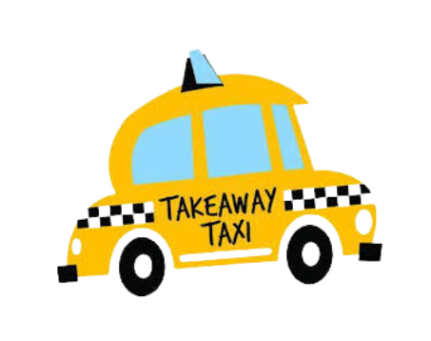
Demand is predictable; pricing isn’t
More movement = more risk
A System in Motion, But Not Always in Sync
Fare structures need tuning to match real-time demand
Congestion and crash zones match demand zones
The Big Picture – What We Learned

Slide 11
From Insight to Action
Recommendations That Matter…
Dynamic pricing tied to actual demand windows
Better driver deployment by borough and hour
Monthly safety alerts for crash-prone seasons
Add predictive dashboards to TLC fleet monitoring
And maybe... let’s give drivers an app that says: 'Avoid the CROSS BRONX today.

Slide 12
Our team
Poojan AJMERA
Kuan Hu
Michael Lin
Haiyang Huang
Jiacheng Liu
v

Slide 13
Questions, Comments, Taxi Stories…………….job?
Let’s Chitty Chat

