Slide 1
Digital Portfolio
STUDENT NAME: POOJANA M S
REGISTER NO AND NMID: 2426J1535 AND asbruaz2426j1535
DEPARTMENT: B.Sc. IT
COLLEGE: KPR College of Arts Science And Research

Slide 2
PROJECT TITLE
“Design and Development of an Interactive Personal Developer Portfolio using HTML, CSS, and JavaScript”

Slide 3


AGENDA
Problem Statement
Project Overview
End Users
Tools and Technologies
Portfolio design and Layout
Features and Functionality
Results and Screenshots
Conclusion
Github Link
3/21/2024 Annual Review

Slide 4

PROBLEM STATEMENT
Students often lack a structured and professional way to present their skills, projects, and achievements to recruiters. Traditional resumes are static and fail to highlight practical coding and technical skills effectively.

Slide 5

PROJECT OVERVIEW
This project aims to design and develop a personal developer portfolio website using HTML, CSS, and JavaScript. It will act as a digital resume + project showcase, enabling recruiters to easily access and evaluate technical capabilities.

Slide 6

WHO ARE THE END USERS?
Students / Job Seekers – showcase skills and projects.
Recruiters / Companies – evaluate candidate profiles.
Educators – assess student progress and achievements.

Slide 7

TOOLS AND TECHNIQUES
HTML5 – Structure
CSS3 – Styling & Layout
JavaScript (ES6) – Interactivity, animations, validation
VS Code / Sublime – Development IDE
GitHub Pages – Deployment

Slide 8
POTFOLIO DESIGN AND LAYOUT
Home Page – Name, tagline, navigation bar.
About Me – Career objective, education, skills.
Skills Section – Progress bars & animated charts.
Projects Section – Screenshots, GitHub/demo links.
Certifications & Achievements – Grid layout.
8

Slide 9
FEATURES AND FUNCTIONALITY
Responsive design (mobile-friendly).
Smooth scrolling navigation.
Dark/Light mode toggle.
Typing animation for role/title.
Interactive project gallery.

Slide 10
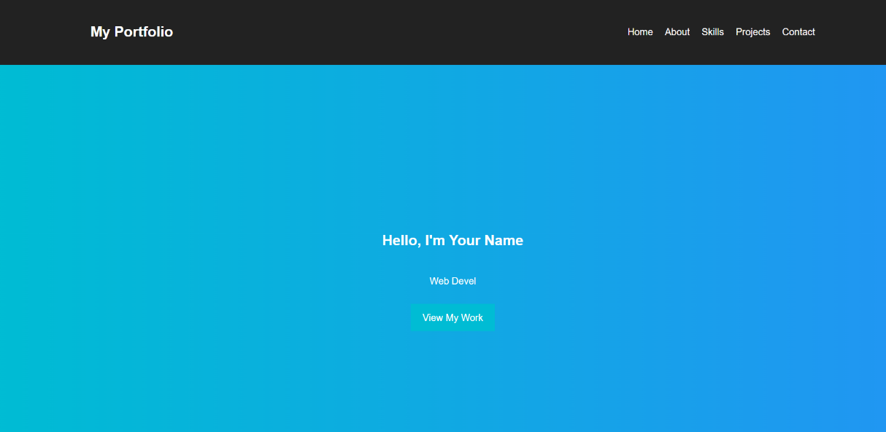
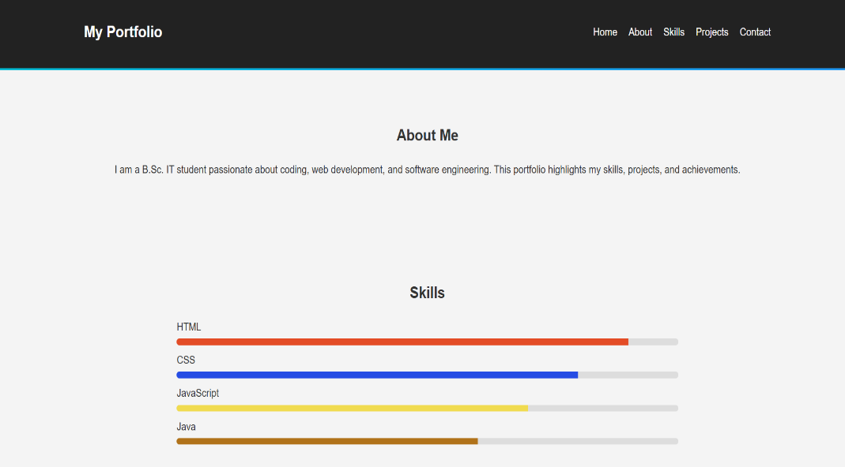

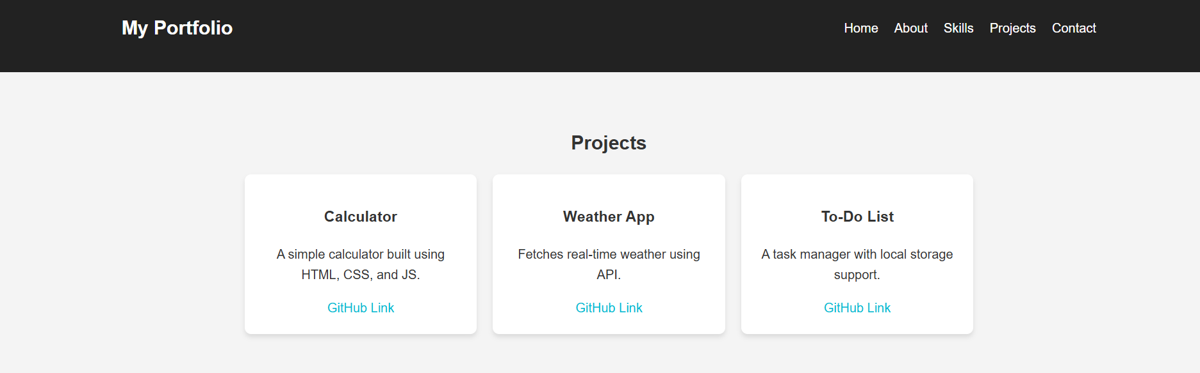
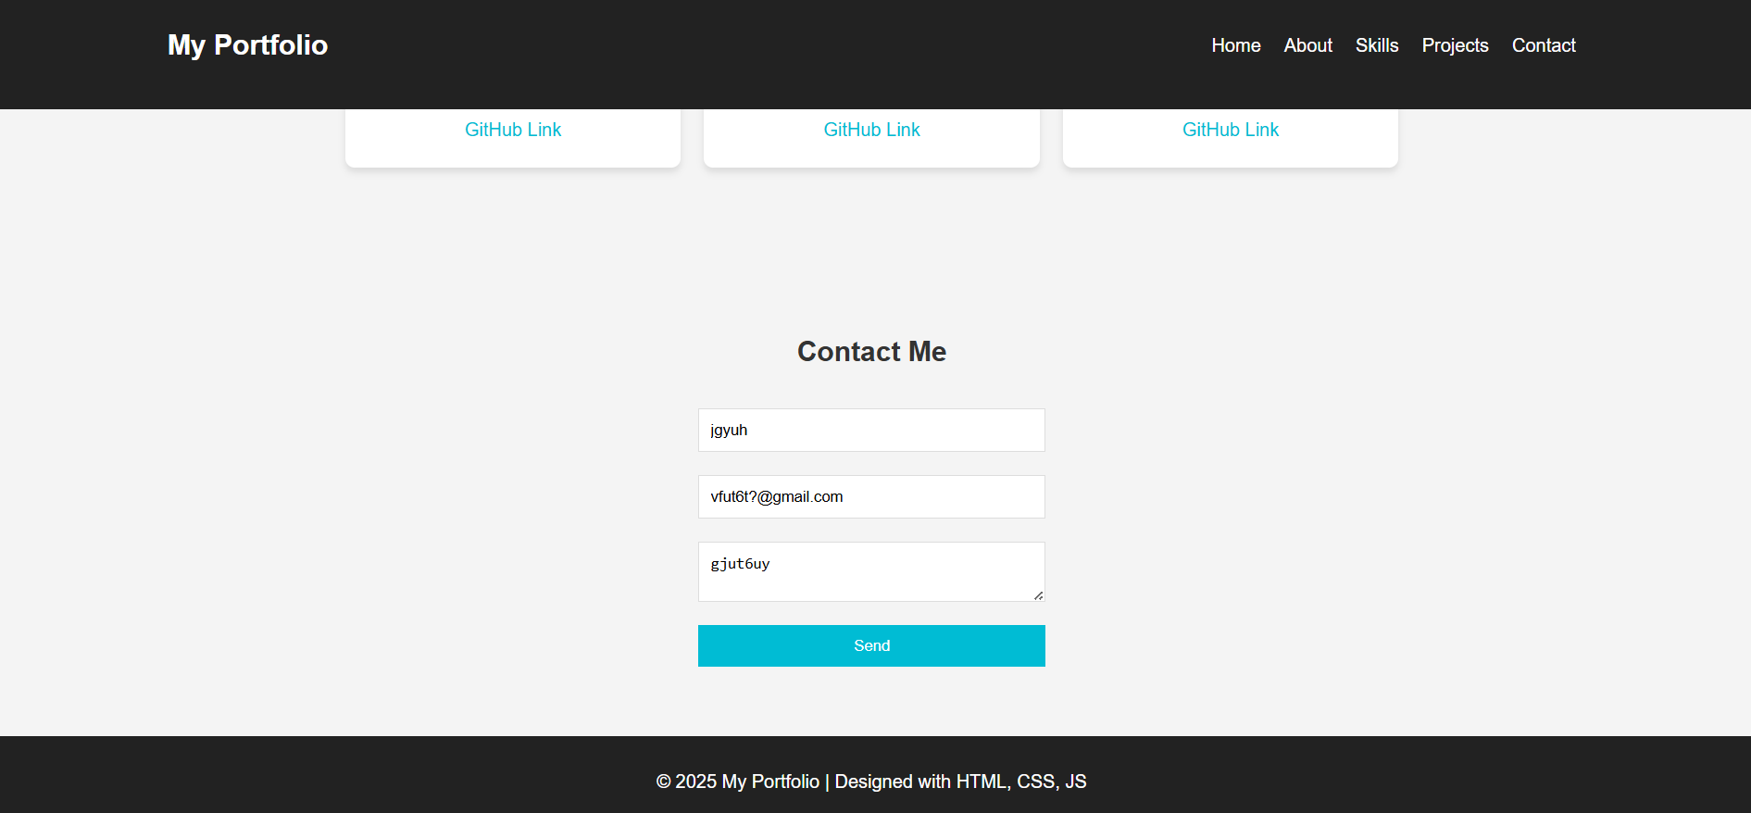
RESULTS AND SCREENSHOTS
3/21/2024 Annual Review
10

Slide 11
CONCLUSION
The Personal Developer Portfolio provides a professional, dynamic, and accessible way to present skills and projects. It enhances placement opportunities and serves as a career-ready digital
11

