Slide 1
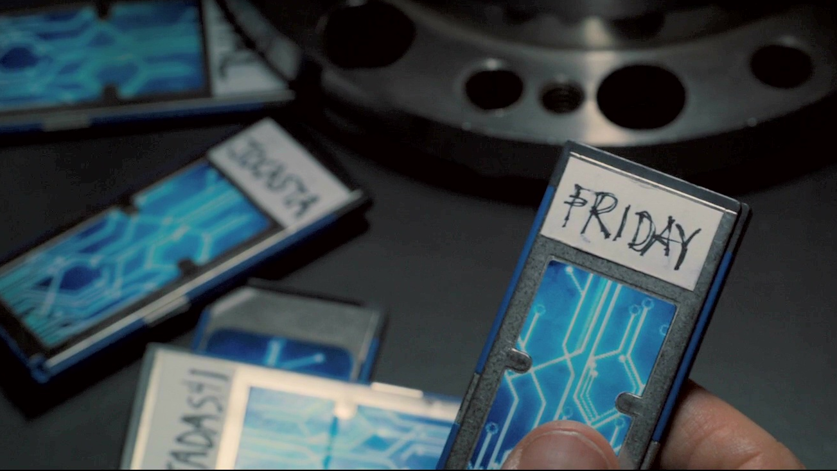
FRIDAY
VIRTUAL ASSISTANT

Slide 2

INTRODUCTION
VIRTUAL ASSISTANT NAMED “FRIDAY”.
SOFTWARE AGENT.
PERFORM TASKS OR SERVICES FOR AN INDIVIDUAL.

Slide 3

FEATURES
SPEAK NATURALLY.
PLAY’S MUSIC.
GIVE US INFORMATION.
TELLS TIME.

Slide 4

ADVANTAGES
EASY TO OPERATE.
ONLINE SHOPPING.
NON-STOP MUSIC.

Slide 5
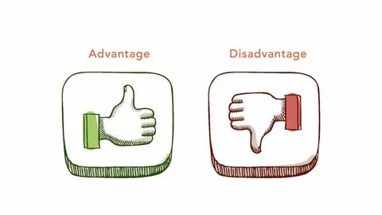
DISADVANTAGES
MISHEARING.
SLOW RESPONSE AND BLOATWARE.
CONNECT DROPS ARE THE MOST REPORTED.
PROBLEM WITH MUSIC.
SOMETIMES STOPS RESPONDING TO YOUR VOICE.

Slide 6
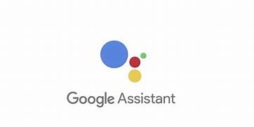
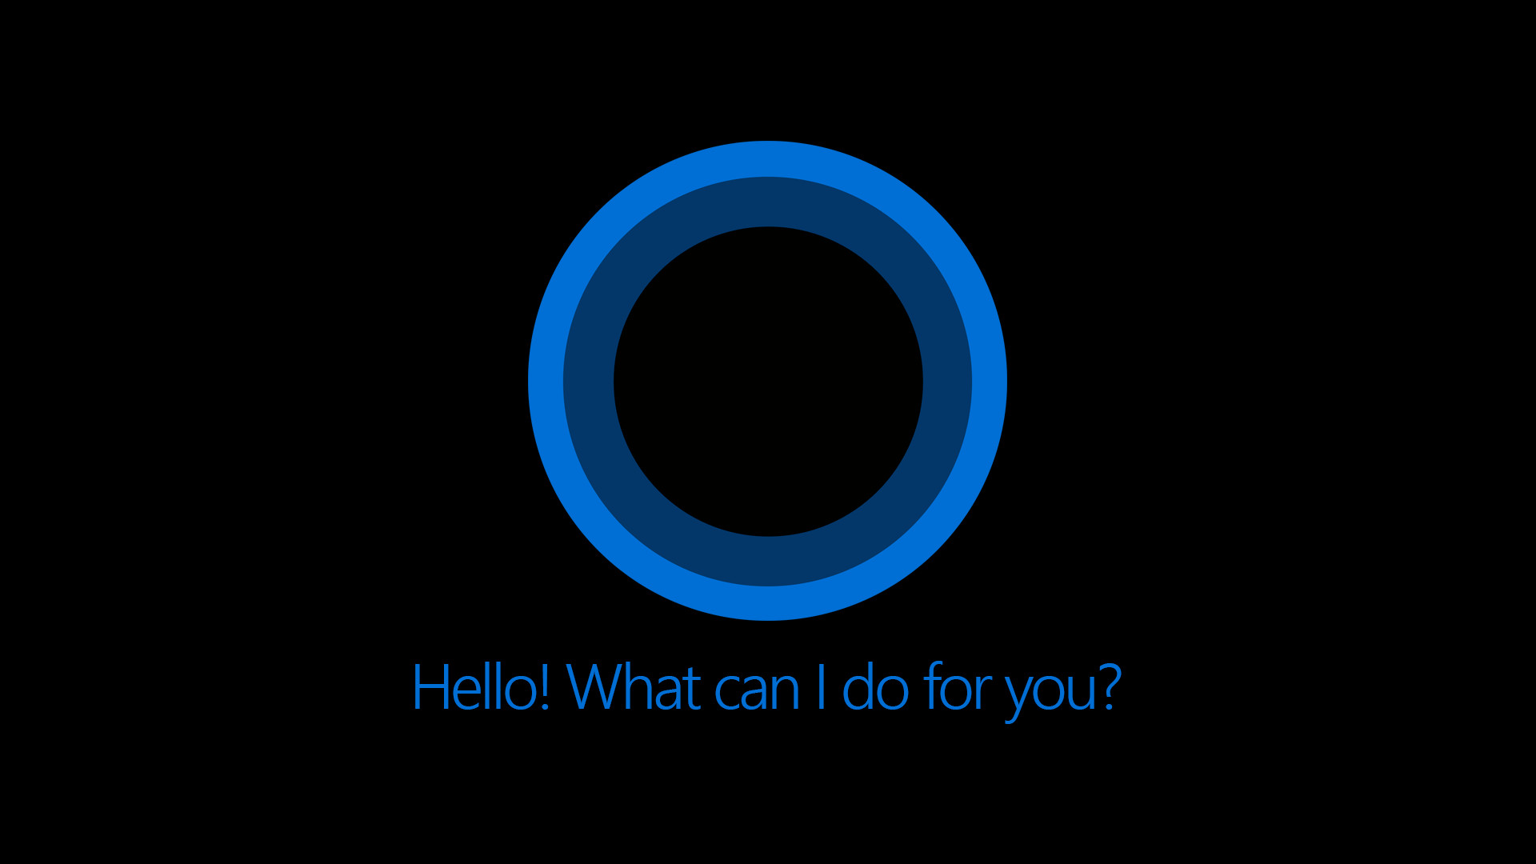
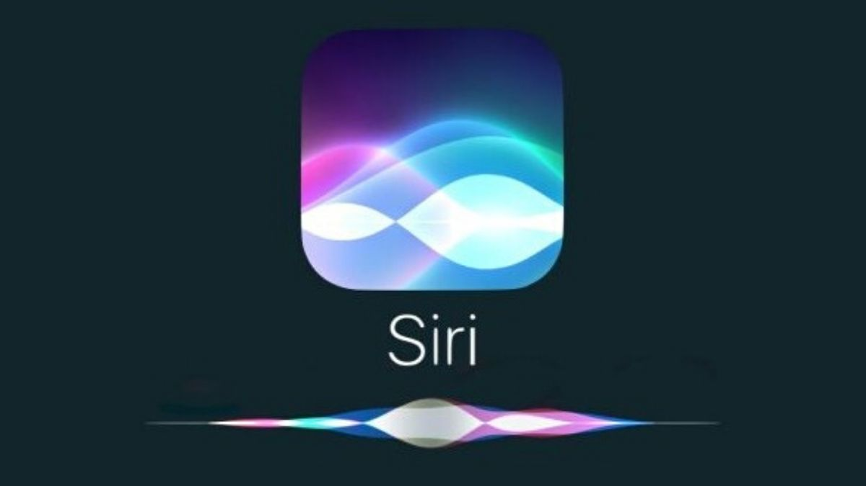
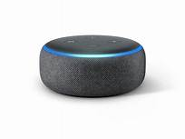
COMPETITORS
GOOGLE ASSISTANT.
MICROSOFT CORTANA.
APPLE SIRI.
AMAZON ALEXA.

Slide 7
CONCLUSION
BIG STEP FORWARD WHEN IT COMES TO VOICE CONTROL TECHNOLOGY.
IT’S ALWAYS ON MICROPHONES AND INTEGRATION WITH THIRD-PARTY APPS MEANS THAT THERE REALLY ARE A TON OF THINGS THAT YOU CAN DO USING JUST YOUR VOICE.
AS THE TECHNOLOGY CONTINUES TO IMPROVE, SO WILL THE NUMBER OF THINGS YOU CAN DO WITH “FRIDAY”.

Slide 8

Thank You

