Slide 1
Operating System Definition
OS is a resource allocator
Manages all resources
Decides between conflicting requests for efficient and fair resource use
OS is a control program
Controls execution of programs to prevent errors and improper use of the computer

Slide 2
Operating System Definition (Cont.)
No universally accepted definition
“The one program running at all times on the computer” is the kernel. Everything else is either a system program (ships with the operating system) or an application program.

Slide 3
Computer Startup
bootstrap program is loaded at power-up or reboot
Typically stored in ROM or EPROM, generally known as firmware
Initializes all aspects of system
Loads operating system kernel and starts execution

Slide 4
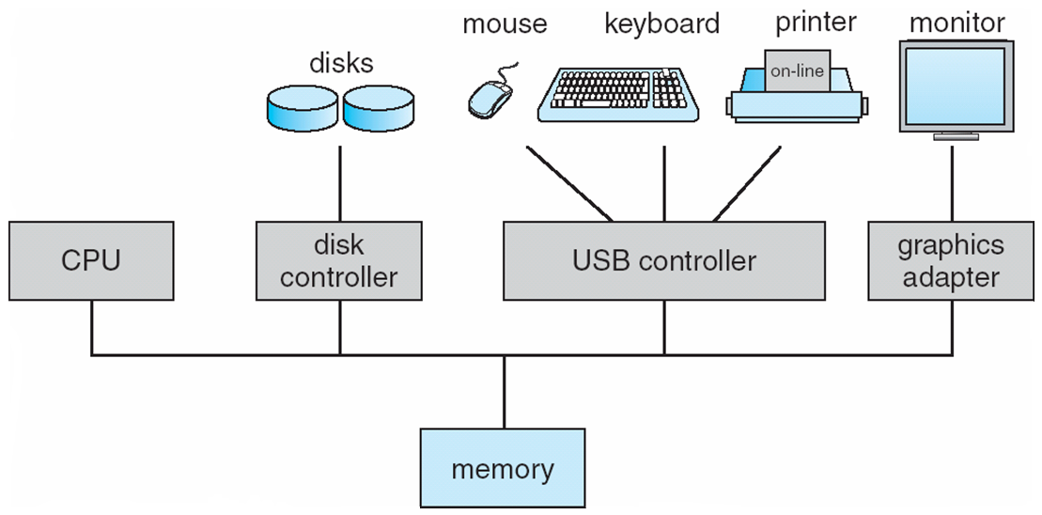
Computer System Organization
Computer-system operation
One or more CPUs, device controllers connect through common bus providing access to shared memory
Concurrent execution of CPUs and devices competing for memory cycles

Slide 5
Computer-System Operation
I/O devices and the CPU can execute concurrently
Each device controller is in charge of a particular device type
Each device controller has a local buffer
CPU moves data from/to main memory to/from local buffers
I/O is from the device to local buffer of controller
Device controller informs CPU that it has finished its operation by causing an interrupt

Slide 6
Common Functions of Interrupts
Interrupt transfers control to the interrupt service routine generally, through the interrupt vector, which contains the addresses of all the service routines
Interrupt architecture must save the address of the interrupted instruction
Incoming interrupts are disabled while another interrupt is being processed to prevent a lost interrupt
A trap is a software-generated interrupt caused either by an error or a user request
An operating system is interrupt driven

Slide 7
Interrupt Handling
The operating system preserves the state of the CPU by storing registers and the program counter
Determines which type of interrupt has occurred:
polling
vectored interrupt system
Separate segments of code determine what action should be taken for each type of interrupt

Slide 8
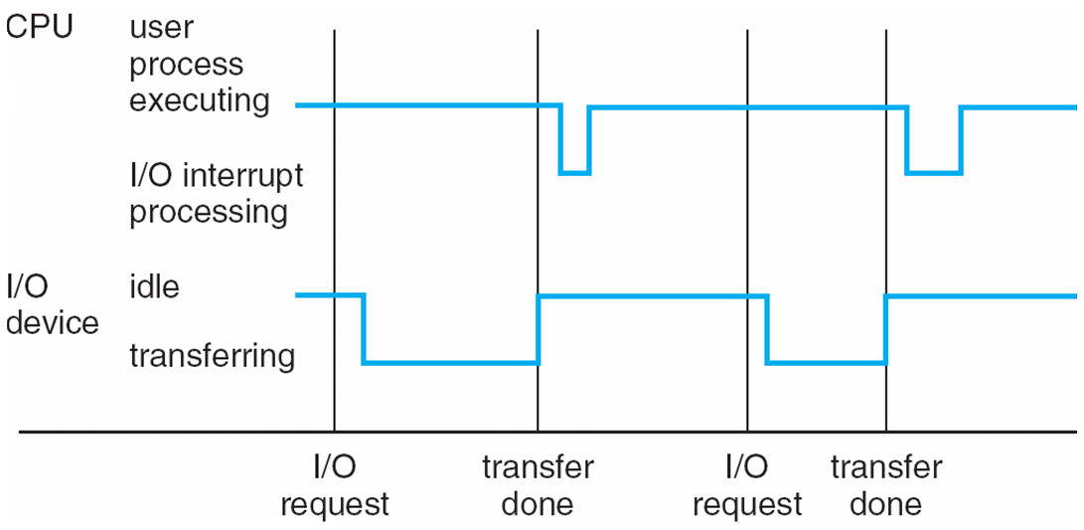
Interrupt Timeline

Slide 9
Direct Memory Access Structure
Used for high-speed I/O devices able to transmit information at close to memory speeds
Device controller transfers blocks of data from buffer storage directly to main memory without CPU intervention
Only one interrupt is generated per block, rather than the one interrupt per byte

Slide 10
Storage Hierarchy
Storage systems organized in hierarchy
Speed
Cost
Volatility
Caching – copying information into faster storage system; main memory can be viewed as a cache for secondary storage

Slide 11
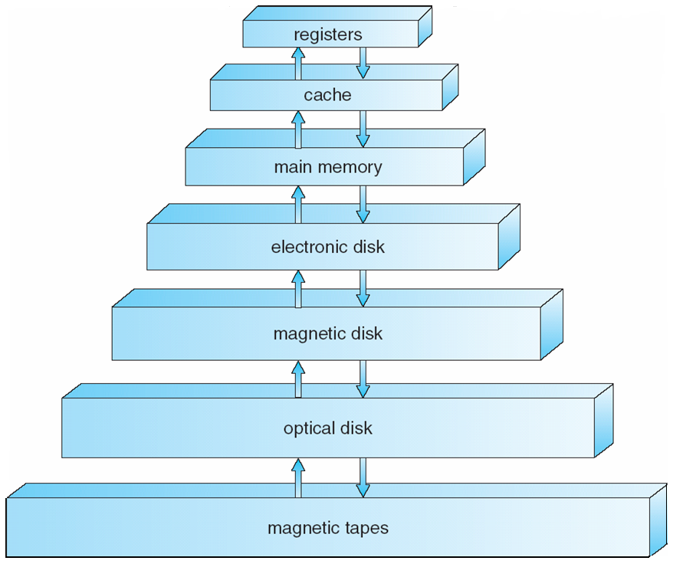
Storage-Device Hierarchy

Slide 12
Caching
Important principle, performed at many levels in a computer (in hardware, operating system, software)
Information in use copied from slower to faster storage temporarily
Faster storage (cache) checked first to determine if information is there
If it is, information used directly from the cache (fast)
If not, data copied to cache and used there
Cache smaller than storage being cached
Cache management important design problem
Cache size and replacement policy

Slide 13
Computer-System Architecture
Most systems use a single general-purpose processor (PDAs through mainframes)
Most systems have special-purpose processors as well
Multiprocessors systems growing in use and importance
Also known as parallel systems, tightly-coupled systems
Advantages include:
Increased throughput
Economy of scale
Increased reliability – graceful degradation or fault tolerance
Two types:
Asymmetric Multiprocessing
Symmetric Multiprocessing

Slide 14
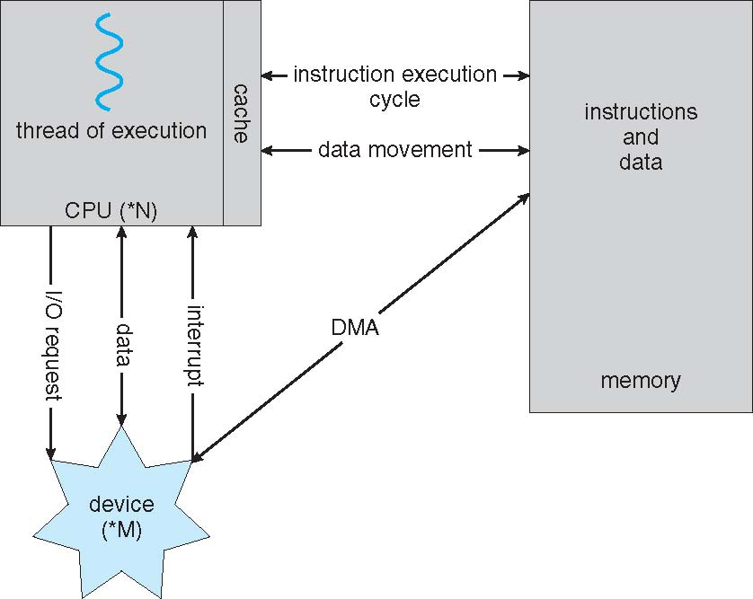
How a Modern Computer Works
A von Neumann architecture

Slide 15
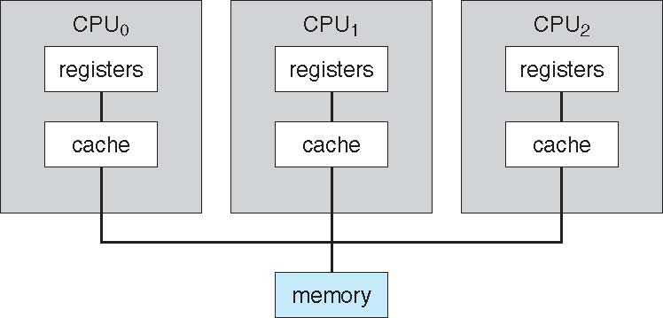
Symmetric Multiprocessing Architecture

Slide 16
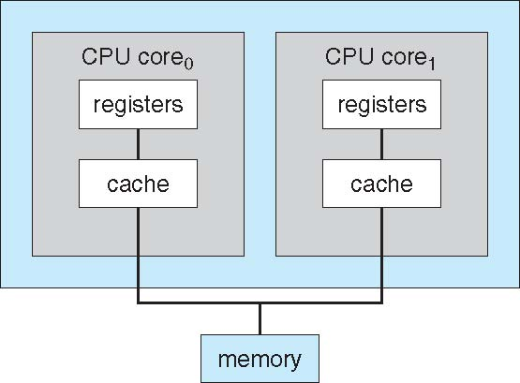
A Dual-Core Design

Slide 17
Clustered Systems
Like multiprocessor systems, but multiple systems working together
Usually sharing storage via a storage-area network (SAN)
Provides a high-availability service which survives failures
Asymmetric clustering has one machine in hot-standby mode
Symmetric clustering has multiple nodes running applications, monitoring each other
Some clusters are for high-performance computing (HPC)
Applications must be written to use parallelization

Slide 18
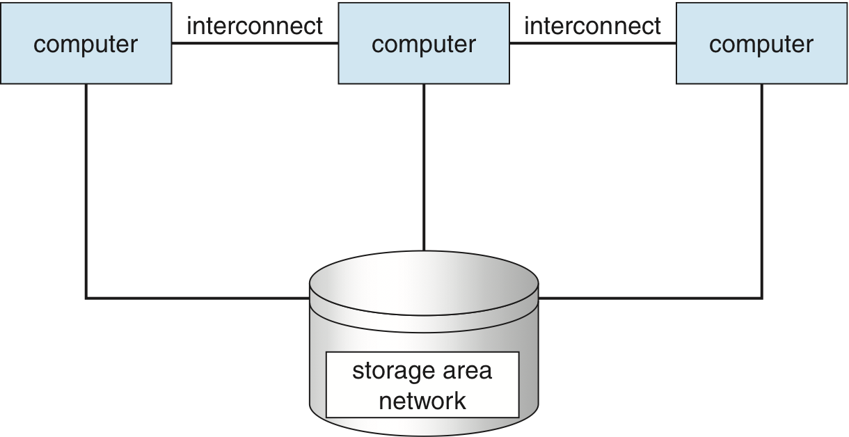
Clustered Systems

Slide 19
Operating System Structure
Multiprogramming needed for efficiency
Single user cannot keep CPU and I/O devices busy at all times
Multiprogramming organizes jobs (code and data) so CPU always has one to execute
A subset of total jobs in system is kept in memory
One job selected and run via job scheduling
When it has to wait (for I/O for example), OS switches to another job
Timesharing (multitasking) is logical extension in which CPU switches jobs so frequently that users can interact with each job while it is running, creating interactive computing
Response time should be < 1 second
Each user has at least one program executing in memory process
If several jobs ready to run at the same time  CPU scheduling
If processes don’t fit in memory, swapping moves them in and out to run
Virtual memory allows execution of processes not completely in memory

Slide 20
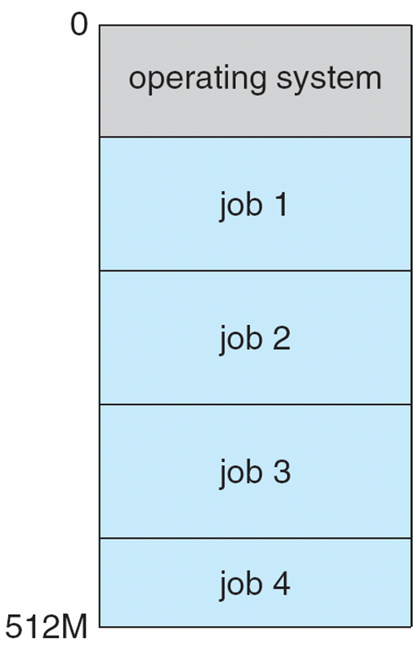
Memory Layout for Multiprogrammed System

Slide 21
Operating-System Operations
Interrupt driven by hardware
Software error or request creates exception or trap
Division by zero, request for operating system service
Other process problems include infinite loop, processes modifying each other or the operating system
Dual-mode operation allows OS to protect itself and other system components
User mode and kernel mode
Mode bit provided by hardware
Provides ability to distinguish when system is running user code or kernel code
Some instructions designated as privileged, only executable in kernel mode
System call changes mode to kernel, return from call resets it to user

Slide 22
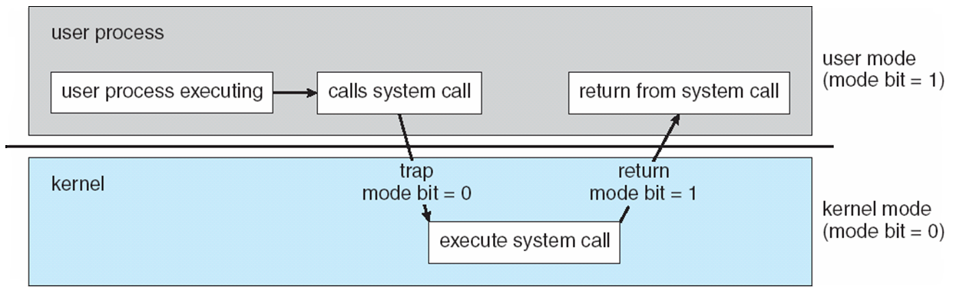
Transition from User to Kernel Mode
Timer to prevent infinite loop / process hogging resources
Set interrupt after specific period
Operating system decrements counter
When counter zero generate an interrupt
Set up before scheduling process to regain control or terminate program that exceeds allotted time

Slide 23
Process Management
A process is a program in execution. It is a unit of work within the system. Program is a passive entity, process is an active entity.
Process needs resources to accomplish its task
CPU, memory, I/O, files
Initialization data
Process termination requires reclaim of any reusable resources
Single-threaded process has one program counter specifying location of next instruction to execute
Process executes instructions sequentially, one at a time, until completion
Multi-threaded process has one program counter per thread
Typically system has many processes, some user, some operating system running concurrently on one or more CPUs
Concurrency by multiplexing the CPUs among the processes / threads

Slide 24
Storage Management
OS provides uniform, logical view of information storage
Abstracts physical properties to logical storage unit - file
Each medium is controlled by device (i.e., disk drive, tape drive)
Varying properties include access speed, capacity, data-transfer rate, access method (sequential or random)
File-System management
Files usually organized into directories
Access control on most systems to determine who can access what
OS activities include
Creating and deleting files and directories
Primitives to manipulate files and dirs
Mapping files onto secondary storage
Backup files onto stable (non-volatile) storage media

Slide 25
Mass-Storage Management
Usually disks used to store data that does not fit in main memory or data that must be kept for a “long” period of time
Proper management is of central importance
Entire speed of computer operation hinges on disk subsystem and its algorithms
OS activities
Free-space management
Storage allocation
Disk scheduling
Some storage need not be fast
Tertiary storage includes optical storage, magnetic tape
Still must be managed – by OS or applications
Varies between WORM (write-once, read-many-times) and RW (read-write)

Slide 26
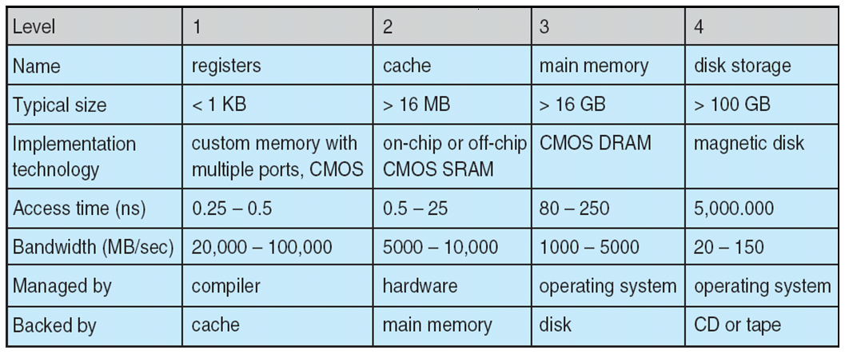
Performance of Various Levels of Storage
Movement between levels of storage hierarchy can be explicit or implicit

Slide 27
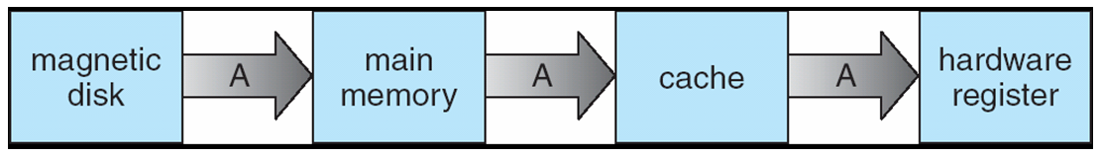
Migration of Integer A from Disk to Register
Multitasking environments must be careful to use most recent value, no matter where it is stored in the storage hierarchy
Multiprocessor environment must provide cache coherency in hardware such that all CPUs have the most recent value in their cache
Distributed environment situation even more complex
Several copies of a datum can exist

Slide 28
I/O Subsystem
One purpose of OS is to hide peculiarities of hardware devices from the user
I/O subsystem responsible for
Memory management of I/O including buffering (storing data temporarily while it is being transferred), caching (storing parts of data in faster storage for performance), spooling (refers to putting jobs in a buffer, a special area in memory or on a disk where a device can access them when it is ready)
General device-driver interface
Drivers for specific hardware devices

Slide 29
Protection and Security
Protection – any mechanism for controlling access of processes or users to resources defined by the OS
Security – defense of the system against internal and external attacks
Huge range, including denial-of-service, worms, viruses, identity theft, theft of service
Systems generally first distinguish among users, to determine who can do what
User identities (user IDs, security IDs) include name and associated number, one per user
User ID then associated with all files, processes of that user to determine access control
Group identifier (group ID) allows set of users to be defined and controls managed, then also associated with each process, file
Privilege escalation allows user to change to effective ID with more rights

