Slide 1
Chapter 4: Threads

Slide 2
Chapter 4: Threads
Overview
Multithreading Models
Thread Libraries
Threading Issues
Operating System Examples
Windows XP Threads
Linux Threads

Slide 3
Objectives
To introduce the notion of a thread — a fundamental unit of CPU utilization that forms the basis of multithreaded computer systems
To discuss the APIs for the Pthreads, Win32, and Java thread libraries
To examine issues related to multithreaded programming

Slide 4
Motivation
Threads run within application
Multiple tasks with the application can be implemented by separate threads
Update display
Fetch data
Spell checking
Answer a network request
Process creation is heavy-weight while thread creation is light-weight
Can simplify code, increase efficiency
Kernels are generally multithreaded

Slide 5
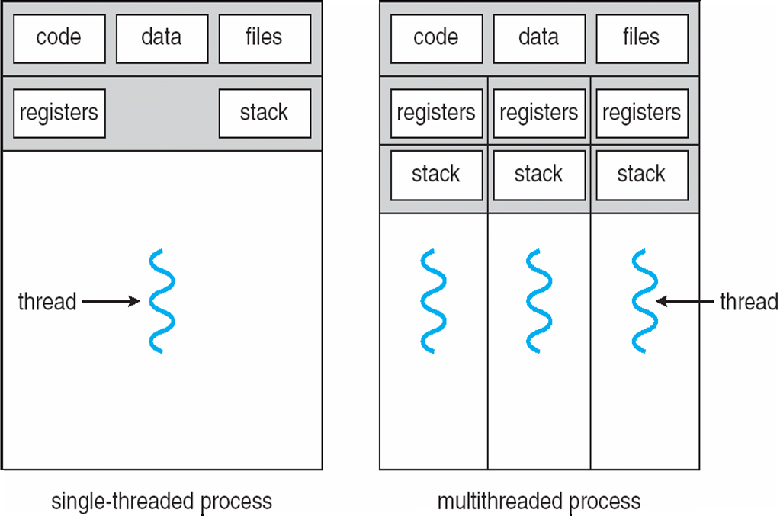
Single and Multithreaded Processes

Slide 6
Thread Definitions
A Thread is a basic unit of CPU utilization.
It comprises a thread ID, a program counter, a register set and a stack
It shares with other threads belonging to the same process its code section, data section and other operating-system resources such as open files and signals.
It’s a light-weight process
Examples :- word processor 1 thread for displaying graphics
2 Thread for responding to keystrokes
3 Thread for performing spelling and grammar

Slide 7
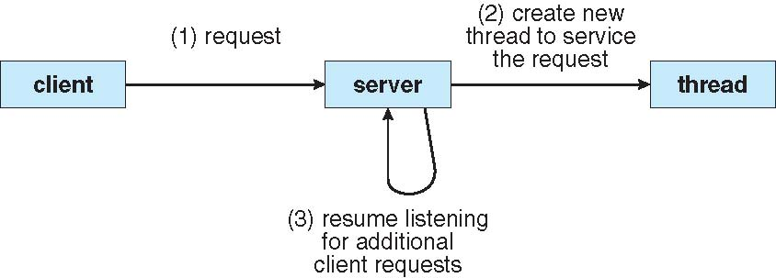
Multithreaded Server Architecture

Slide 8
Benefits
Responsiveness
Resource no need shared memory and message passing
Economy 30 times faster creation, 5 times faster switching
Scalability parallel processing

Slide 9
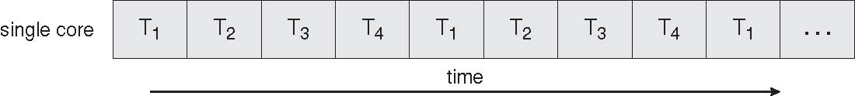
Concurrent Execution on a Single-core System

Slide 10
Multicore Programming
Multicore systems putting pressure on programmers, challenges include:
Dividing activities
Balance
Data splitting
Data dependency
Testing and debugging

Slide 11
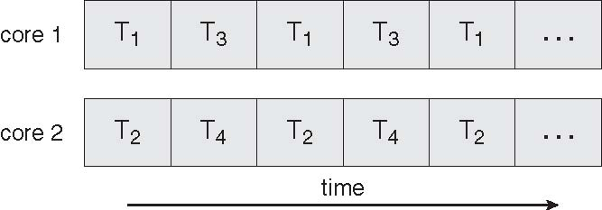
Parallel Execution on a Multicore System

Slide 12
Process | Thread
Process is heavy weight or resource intensive. | Thread is light weight taking lesser resources than a process.
Process switching needs interaction with operating system. | Thread switching does not need to interact with operating system.
In multiple processing environments each process executes the same code but has its own memory and file resources. | All threads can share same set of open files, child processes.
If one process is blocked then no other process can execute until the first process is unblocked. | While one thread is blocked and waiting, second thread in the same task can run.
Multiple processes without using threads use more resources. | Multiple threaded processes use fewer resources.
In multiple processes each process operates independently of the others. | One thread can read, write or change another thread's data.

Slide 13
User Threads
Thread management done by user-level threads library
Three primary thread libraries:
POSIX Pthreads
Win32 threads
Java threads

Slide 14
Kernel Threads
Supported by the Kernel
Examples
Windows XP/2000
Solaris
Linux
Tru64 UNIX
Mac OS X

Slide 15
Multithreading Models
Many-to-One
One-to-One
Many-to-Many

Slide 16
S.N. | User Level Threads | Kernel Level Thread
1 | User level threads are faster to create and manage. | Kernel level threads are slower to create and manage.
2 | Implementation is by a thread library at the user level. | Operating system supports creation of Kernel threads.
3 | User level thread is generic and can run on any operating system. | Kernel level thread is specific to the operating system.
4 | Multi-threaded application cannot take advantage of multiprocessing. | Kernel routines themselves can be multithreaded.

Slide 17
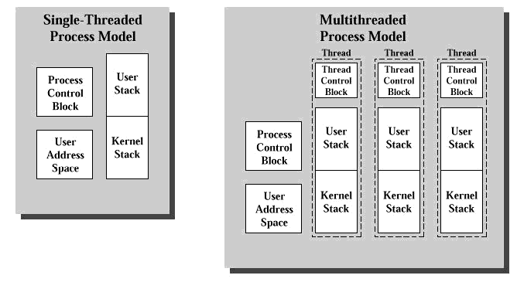

Slide 18
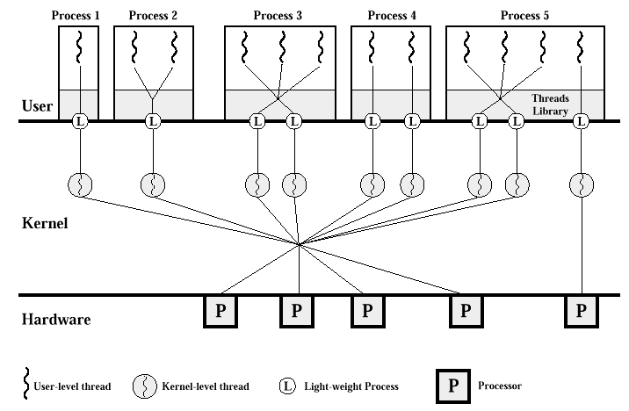

Slide 19
Many-to-One
Many user-level threads mapped to single kernel thread
Examples:
Solaris Green Threads
GNU Portable Threads

Slide 20
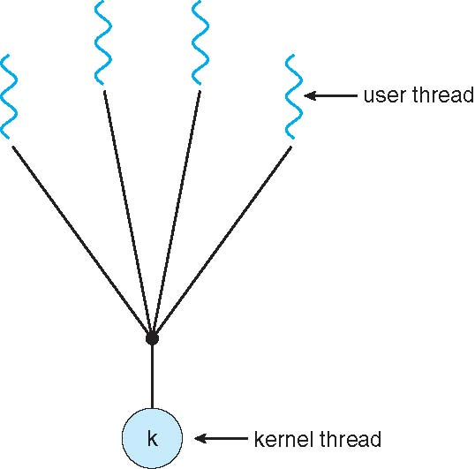
Many-to-One Model

Slide 21
One-to-One
Each user-level thread maps to kernel thread
Examples
Windows NT/XP/2000
Linux
Solaris 9 and later

Slide 22
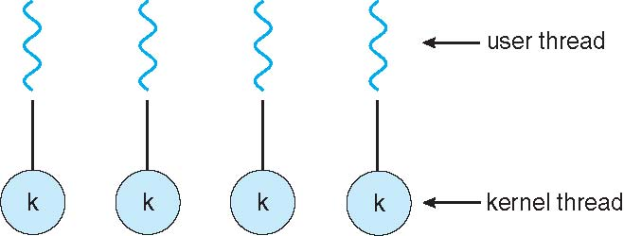
One-to-one Model

Slide 23
Many-to-Many Model
Allows many user level threads to be mapped to many kernel threads
Allows the operating system to create a sufficient number of kernel threads
Solaris prior to version 9
Windows NT/2000 with the ThreadFiber package

Slide 24
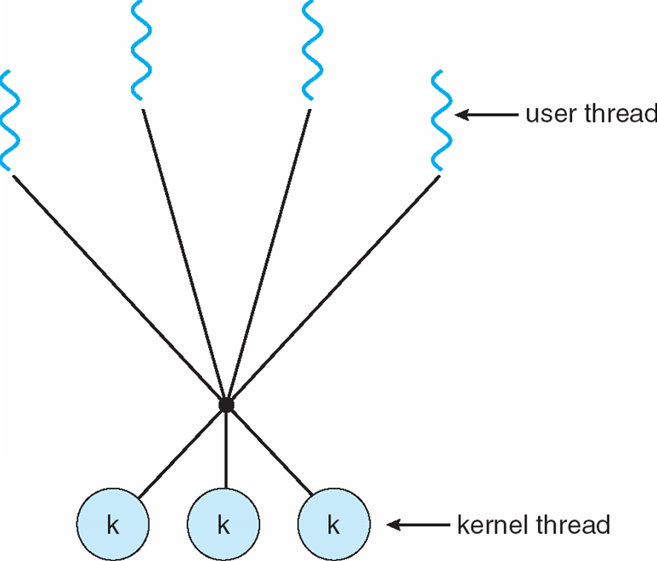
Many-to-Many Model

Slide 25
Two-level Model
Similar to M:M, except that it allows a user thread to be bound to kernel thread
Examples
IRIX
HP-UX
Tru64 UNIX
Solaris 8 and earlier

Slide 26
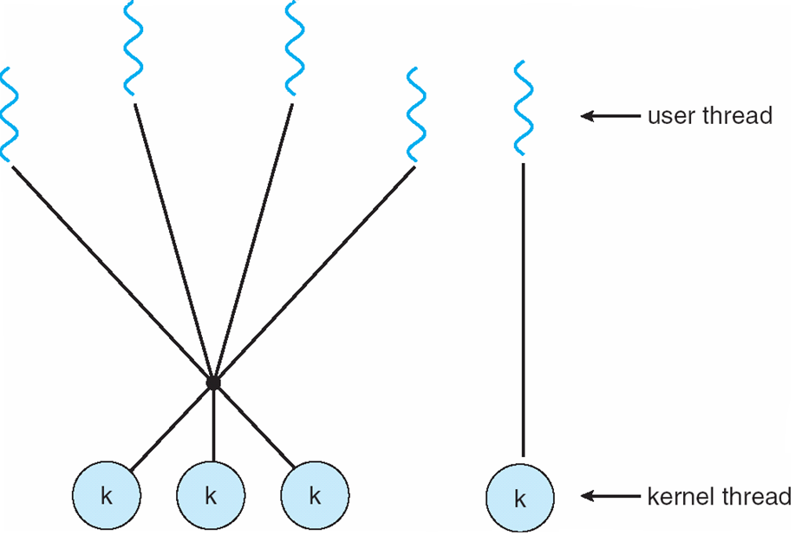
Two-level Model

Slide 27
Thread Libraries
Thread library provides programmer with API for creating and managing threads
Two primary ways of implementing
Library entirely in user space
Kernel-level library supported by the OS

Slide 28
Kernel Thread
Advantages:
Because kernel has full knowledge of all threads, Scheduler may decide to give more time to a process having large number of threads than process having small number of threads.
Kernel-level threads are especially good for applications that frequently block.
Disadvantages:
The kernel-level threads are slow and inefficient. For instance, threads operations are hundreds of times slower than that of user-level threads.
Since kernel must manage and schedule threads as well as processes. It require a full thread control block (TCB) for each thread to maintain information about threads. As a result there is significant overhead and increased in kernel complexity.

Slide 29
User thread
Advantages:
The most obvious advantage of this technique is that a user-level threads package can be implemented on an Operating System that does not support threads.
User-level threads does not require modification to operating systems.
Simple Representation: Each thread is represented simply by a PC, registers, stack and a small control block, all stored in the user process address space.
Simple Management: This simply means that creating a thread, switching between threads and synchronization between threads can all be done without intervention of the kernel.
Fast and Efficient: Thread switching is not much more expensive than a procedure call.

Slide 30
Disadvantages:
User-Level threads are not a perfect solution as with everything else, they are a trade off. Since, User-Level threads are invisible to the OS they are not well integrated with the OS. As a result, Os can make poor decisions like scheduling a process with idle threads, blocking a process whose thread initiated an I/O even though the process has other threads that can run and unscheduling a process with a thread holding a lock. Solving this requires communication between kernel and user-level thread manager.
There is a lack of coordination between threads and operating system kernel. Therefore, process as whole gets one time slice irrespective of whether process has one thread or 1000 threads within. It is up to each thread to relinquish control to other threads.
User-level threads requires non-blocking systems call i.e., a multithreaded kernel. Otherwise, entire process will blocked in the kernel, even if there are runnable threads left in the processes. For example, if one thread causes a page fault, the process blocks.

Slide 31
Pthreads
May be provided either as user-level or kernel-level
A POSIX standard (IEEE 1003.1c) API for thread creation and synchronization
API specifies behavior of the thread library, implementation is up to development of the library
Common in UNIX operating systems (Solaris, Linux, Mac OS X)

Slide 32
Pthreads Example
#include <pthread.h>
#include <stdio.h>
int sum; /* this data is shared by the thread(s) */
void *runner(void *param); /* the thread */
int main(int argc, char *argv[])
{
pthread_t tid; /* the thread identifier */
pthread.attr_t attr; /* set of thread attributes */
if (argc != 2) {
fprintf(stderr,"usage: a.out <integer value>\n");
return -1; }
if (atoi(argv[1]) < 0) {
fprintf(stderr,"%d must be >= 0\n",atoi(argv[1]));
return -1; }

Slide 33
Pthreads Example (Cont.)
Pthread_attr_init (&attr) ;/* get the default attributes */
Pthread_create(&tid,&attr,runner,argv[1]); /* create the thread */
pthread_join (tid, NULL) ; /* wait for the thread to exit */
printf("sum = %d\n",sum);
}
/* The thread will begin control in this function */
void *runner(void *param)
{
int i, upper = atoi(param);
sum = 0;
for (i = 1; i <= upper; i
sum += i;
pthread_exit (0) ;
}

Slide 34
Win32 API Multithreaded C Program
#inciude <windows.h>
#include <stdio.h>
DWORD Sum; /* data is shared by the thread(s) */
/* the thread runs in this separate function */
DWORD WINAPI Summation(LPVOID Param)
{
DWORD Upper = *(DWORD*)Param;
for (DWORD i = 0; i <= Upper; i++)
Sum += i;
return 0; }
int main(int argc, char *argv[])
{
DWORD Threadld;
HANDLE ThreadHandle;
int Param; /* perform some basic error checking */
if (argc != 2) {
fprintf(stderr,"An integer parameter is required\n");
return -1;
}
Param = atoi(argv[1]);

Slide 35
Win32 API Multithreaded C Program (Cont.)
if (Param < 0) {
fprintf(stderr,"An integer >= 0 is required\n");
return -1;
// create the thread
ThreadHandle = CreateThread(NULL, // default security attributes
0, // default stack size
Summation, // thread function
&Param, // parameter to thread function
0, // default creation flags
&Threadld); // returns the thread identifier
if (ThreadHandle != NULL) {
// now wait for the thread to finish
WaitForSingleObject(ThreadHandle,INFINITE);
// close the thread handle
CloseHandle(ThreadHandle);
printfC'sum = %d\n",Sum); } }

Slide 36
Java Threads
Java threads are managed by the JVM
Typically implemented using the threads model provided by underlying OS
Java threads may be created by:
Extending Thread class
Implementing the Runnable interface

Slide 37
Java Multithreaded Program
class Sum
{
private int sum;
public int getSumO {
return sum; }
public void setSum(ir.t sum) {
this.sum = sum; }
}
class Summation implements Runnable
{
private int upper;
public Summation(int upper, Sum sumValue)
this.upper = upper;
this.sumValue = sumValue;
public void run() {
int sum = 0;
for (int i = 0; i <= upper, i++)
sum += i;
sumValue.setSum(sum);
}

Slide 38
Java Multithreaded Program (Cont.)
public class Driver
{
public static void main(String[] args)
{
if (args.length > 0) {
if (Integer.parseint(args[0]) < 0)
System.err.println(args [0] + " must be >= 0.") ;
else { // create the object to be shared
Sum sumObject = new Sum();
int upper = Integer.parseint(args [0]) ;
Thread thrd = new Thread(new Summation(upper, sumObject)
thrd.start();
try {
thrd.join();
System.out.println ("The sum of "+upper+" is "+sumObject.getSum()
} catch (InterruptedException ie) { }
}
else
System.err.println("Usage: Summation <integer value>")

Slide 39
Threading Issues
Semantics of fork() and exec() system calls
Thread cancellation of target thread
Asynchronous or deferred (Cancellation Points)
Signal handling
Synchronous (illegal memory access, division by 0)
and asynchronous (<control><c>, timer expire)

Slide 40
Threading Issues (Cont.)
Thread pools
Thread-specific data
Create Facility needed for data private to thread
Scheduler activations

Slide 41
Semantics of fork() and exec()
Does fork() duplicate only the calling thread or all threads?

Slide 42
Thread Cancellation
Terminating a thread before it has finished
Two general approaches:
Asynchronous cancellation terminates the target thread immediately.
Deferred cancellation allows the target thread to periodically check if it should be cancelled.

Slide 43
Signal Handling
Signals are used in UNIX systems to notify a process that a particular event has occurred.
A signal handler is used to process signals
Signal is generated by particular event
Signal is delivered to a process
Signal is handled
Options:
Deliver the signal to the thread to which the signal applies
Deliver the signal to every thread in the process
Deliver the signal to certain threads in the process
Assign a specific thread to receive all signals for the process

Slide 44
Thread Pools
Create a number of threads in a pool where they await work
Advantages:
Usually slightly faster to service a request with an existing thread than create a new thread
Allows the number of threads in the application(s) to be bound to the size of the pool

Slide 45
Thread Specific Data
Allows each thread to have its own copy of data
Useful when you do not have control over the thread creation process (i.e., when using a thread pool)
Ex. Transaction-processing system

Slide 46
Scheduler Activations
Both M:M and Two-level models require communication to maintain the appropriate number of kernel threads allocated to the application
Scheduler activations provide upcalls - a communication mechanism from the kernel to the thread library
This communication allows an application to maintain the correct number kernel threads

Slide 47
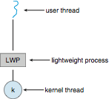
Lightweight Processes

Slide 48
Operating System Examples
Windows XP Threads
Linux Thread
Notes:
48

Slide 49
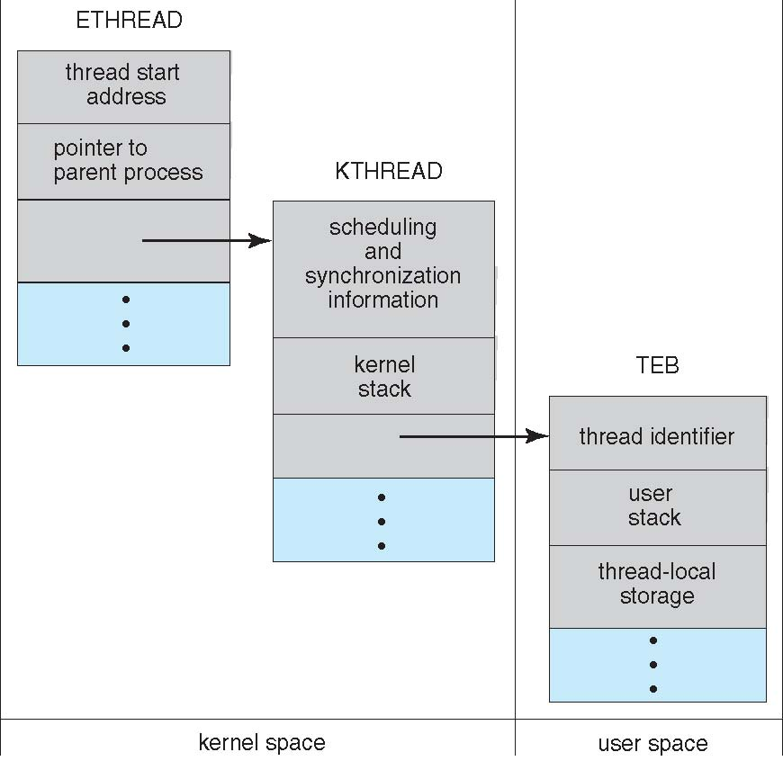
Windows XP Threads Data Structures

Slide 50
Windows XP Threads
Implements the one-to-one mapping, kernel-level
Each thread contains
A thread id
Register set
Separate user and kernel stacks
Private data storage area
The register set, stacks, and private storage area are known as the context of the threads
The primary data structures of a thread include:
ETHREAD (executive thread block)
KTHREAD (kernel thread block)
TEB (thread environment block)

Slide 51
Linux Threads
Linux refers to them as tasks rather than threads
Thread creation is done through clone() system call
clone() allows a child task to share the address space of the parent task (process)
struct task_struct points to process data structures (shared or unique)

Slide 52
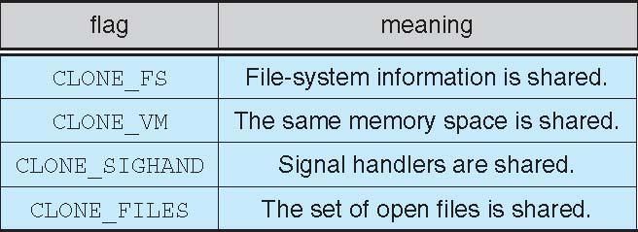
Linux Threads
fork() and clone() system calls
Doesn’t distinguish between process and thread
Uses term task rather than thread
clone() takes options to determine sharing on process create
struct task_struct points to process data structures (shared or unique)

Slide 53
Difference b/w fork and clone
clone() creates a new process, in a manner similar to fork(). It is actually a library function layered on top of the underlying clone() system call, hereinafter referred to as sys_clone. Unlike fork(), these calls allow the child process to share parts of its execution context with the calling process, such as the memory space, the table of file descriptors, and the table of signal handlers. The main use of clone() is to implement threads: multiple threads of control in a program that run concurrently in a shared memory space. When the child process is created with clone(), it executes the function application fn(arg). (This differs from fork(), where execution continues in the child from the point of the fork() call.) The fn argument is a pointer to a function that is called by the child process at the beginning of its execution. The arg argument is passed to the fn function.

Slide 54
End of Chapter 4

