Slide 1
Chapter 6
Process Synchronization
Cooperating Processes

Slide 2
Background
Concurrent access to shared data may result in data inconsistency
Maintaining data consistency requires mechanisms to ensure the orderly execution of cooperating processes
Suppose that we wanted to provide a solution to the consumer-producer problem that fills all the buffers. We can do so by having an integer count that keeps track of the number of full buffers. Initially, count is set to 0. It is incremented by the producer after it produces a new buffer and is decremented by the consumer after it consumes a buffer.

Slide 3
Producer Consumer
while (true) { /* Produce an item */
while (((in + 1) % BUFFER SIZE)== out);
/* do nothing -- no free buffers */
buffer[in] = item;
in = (in + 1) % BUFFER SIZE;
}
while (true) {
while (in == out);
// do nothing -- nothing to consume
// remove an item from the buffer
item = buffer[out];
out = (out + 1) % BUFFER SIZE;
return item;
}

Slide 4
Producer Consumer
while (true) {
while (counter == BUFFER_SIZE);
// do nothing
buffer [in] = nextProduced;
in = (in + 1) % BUFFER_SIZE;
counter++;
}
while (true) {
while (counter == 0);
// do nothing
nextConsumed = buffer[out];
out = (out + 1) % BUFFER_SIZE;
counter--;
}

Slide 5
Race Condition
counter++ could be implemented as register1 = counter register1 = register1 + 1 counter = register1
counter-- could be implemented as register2 = counter register2 = register2 - 1 count = register2
Consider this execution interleaving with “count = 5” initially:
S0: producer execute register1 = counter {register1 = 5} S1: producer execute register1 = register1 + 1 {register1 = 6} S2: consumer execute register2 = counter {register2 = 5} S3: consumer execute register2 = register2 - 1 {register2 = 4} S4: producer execute counter = register1 {count = 6 } S5: consumer execute counter = register2 {count = 4}
A situation like this, where several processes access and manipulate the same data concurrently and the outcome of the execution depends on the particular order in which the access takes places, is called a race condition

Slide 6
Critical Section Problem
Consider system of n processes {p₀, p₁, … p_{n-1}}
Each process has critical section segment of code
Process may be changing common variables, updating table, writing file, etc
When one process in critical section, no other may be in its critical section
Critical section problem is to design protocol to solve this
Each process must ask permission to enter critical section in entry section, may follow critical section with exit section, then remainder section
Especially challenging with preemptive kernels

Slide 7
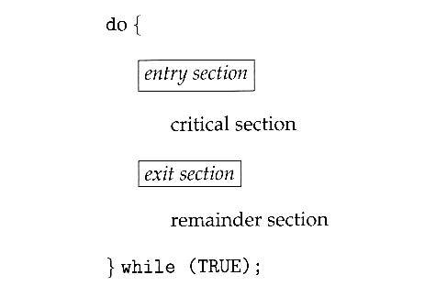
Critical Section
General structure of process p_{i} is

Slide 8
Solution to Critical-Section Problem
1. Mutual Exclusion - If process P_{i} is executing in its critical section, then no other processes can be executing in their critical sections
2. Progress - If no process is executing in its critical section and there exist some processes that wish to enter their critical section, then the selection of the processes that will enter the critical section next cannot be postponed indefinitely
3. Bounded Waiting - A bound must exist on the number of times that other processes are allowed to enter their critical sections after a process has made a request to enter its critical section and before that request is granted

Slide 9
Peterson’s Solution
Two process solution
Assume that the LOAD and STORE instructions are atomic; that is, cannot be interrupted
The two processes share two variables:
int turn;
Boolean flag[2]
The variable turn indicates whose turn it is to enter the critical section
The flag array is used to indicate if a process is ready to enter the critical section. flag[i] = true implies that process P_{i} is ready!

Slide 10
Algorithm for Process P_{i} and P_{j}
do {
flag[i] = TRUE;
turn = j;
while (flag[ j ] && turn == j);
critical section… counter++;
flag[ i ] = FALSE;
remainder section
} while (TRUE);
do {
flag[j] = TRUE;
turn = i;
while (flag[ i ] && turn == i);
critical section…. Counter - -;
flag[ j ] = FALSE;
remainder section
} while (TRUE);
Provable that
Mutual exclusion is preserved
Progress requirement is satisfied
Bounded-waiting requirement is met

Slide 11
Synchronization Hardware
Many systems provide hardware support for critical section code
Uniprocessors – could disable interrupts
Currently running code would execute without preemption
Generally too inefficient on multiprocessor systems
Modern machines provide special atomic hardware instructions
Atomic = non-interruptable
Either test memory word and set value
Or swap contents of two memory words

Slide 12
Solution to Critical-section Problem Using Locks
do {
acquire lock
critical section
release lock
remainder section
} while (TRUE);

Slide 13
TestAndSet Instruction
Definition:
boolean TestAndSet (boolean *target)
{
boolean rv = *target;
*target = TRUE;
return rv:
}

Slide 14
Solution using TestAndSet
Shared boolean variable lock, initialized to FALSE
Solution:
do {
while ( TestAndSet (&lock )) ; // do nothing
// critical section
lock = FALSE;
// remainder section
} while (TRUE);
boolean TestAndSet (boolean *target)
{
boolean rv = *target;
*target = TRUE;
return rv:
}

Slide 15
Swap Instruction
Definition:
void Swap (boolean *a, boolean *b)
{
boolean temp = *a;
*a = *b;
*b = temp:
}

Slide 16
Solution using Swap
Shared Boolean variable lock initialized to FALSE; Each process has a local Boolean variable key
Solution:
do {
key = TRUE;
while ( key == TRUE)
Swap (&lock, &key );
// critical section
lock = FALSE;
// remainder section
} while (TRUE);
void Swap (boolean *a, boolean *b)
{
boolean temp = *a;
*a = *b;
*b = temp:
}

Slide 17
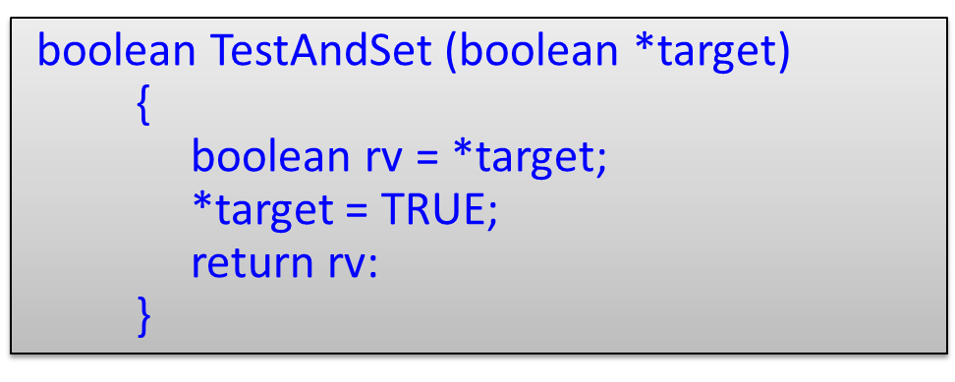
Bounded-waiting Mutual Exclusion with TestandSet()
do {
waiting[i] = TRUE; key = TRUE;
while (waiting[i] && key)
key = TestAndSet(&lock);
waiting[i] = FALSE;
// critical section
j = (i + 1) % n;
while ((j != i) && !waiting[j])
j = (j + 1) % n;
if (j == i)
lock = FALSE;
else waiting[j] = FALSE;
// remainder section
} while (TRUE);

Slide 18
Semaphore
Semaphore S – integer variable
Two standard atomic operations modify S: wait()-test and signal()-increment
Less complicated
Can only be accessed via two indivisible (atomic) operations
wait (S) {
while S <= 0
; // no-op
S--;
}
signal (S) {
S++;
}
Exercise :- 2 processes with 2 statements

Slide 19
Semaphore as General Synchronization Tool
Counting semaphore – integer value can range over an unrestricted domain
Binary semaphore – integer value can range only between 0 and 1;
can be simpler to implement
Also known as mutex (Mutual Exclusion) locks
Can implement a counting semaphore S as a binary semaphore
Provides mutual exclusion
Semaphore mutex; // initialized to 1
do {
wait (mutex);
// Critical Section
signal (mutex);
// remainder section
} while (TRUE);
wait (S) {
while S <= 0
; // no-op
S--;
}
signal (S) {
S++;
}

Slide 20
Semaphore Implementation
Must guarantee that no two processes can execute wait () and signal () on the same semaphore at the same time
Thus, implementation becomes the critical section problem where the wait and signal code are placed in the critical section
Could now have busy waiting in critical section implementation
But implementation code is short
Little busy waiting if critical section rarely occupied
Note that applications may spend lots of time in critical sections and therefore this is not a good solution

Slide 21
Semaphore Implementation with no Busy waiting
With each semaphore there is an associated waiting queue
Each entry in a waiting queue has two data items:
value (of type integer)
pointer to next record in the list
Two operations:
block – place the process invoking the operation on the appropriate waiting queue
wakeup – remove one of processes in the waiting queue and place it in the ready queue

Slide 22
Semaphore Implementation with no Busy waiting (Cont.)
Implementation of wait:
wait(semaphore *S) {
S->value--;
if (S->value < 0) {
add this process to S->list;
block();
}
}
Implementation of signal:
signal(semaphore *S) {
S->value++;
if (S->value <= 0) {
remove a process P from S->list;
wakeup(P);
}
}
typedef struct {
int value;
struct process *list;
} semaphore;

Slide 23
Deadlock and Starvation
Deadlock – two or more processes are waiting indefinitely for an event that can be caused by only one of the waiting processes
Let S and Q be two semaphores initialized to 1
P₀ P₁
wait (S); wait (Q);
wait (Q); wait (S);
. .
. .
signal (S); signal (Q);
signal (Q); signal (S);
Starvation – indefinite blocking
A process may never be removed from the semaphore queue in which it is suspended
Priority Inversion – Scheduling problem when lower-priority process holds a lock needed by higher-priority process
Solved via priority-inheritance protocol

Slide 24
Classical Problems of Synchronization
Classical problems used to test newly-proposed synchronization schemes
Bounded-Buffer Problem
Readers and Writers Problem
Dining-Philosophers Problem

Slide 25
Bounded-Buffer Problem
N buffers, each can hold one item
Semaphore mutex initialized to the value 1
Semaphore full initialized to the value 0
Semaphore empty initialized to the value N

Slide 26
Bounded Buffer Problem (Cont.)
The structure of the producer process
do {
// produce an item in nextp
wait (empty);
wait (mutex);
// add the item to the buffer
signal (mutex);
signal (full);
} while (TRUE);
The structure of the consumer process
do {
wait (full);
wait (mutex);
// remove an item from buffer to nextc
signal (mutex);
signal (empty);
// consume the item in nextc
} while (TRUE);

Slide 27
Readers-Writers Problem
A data set is shared among a number of concurrent processes
Readers – only read the data set; they do not perform any updates
Writers – can both read and write
Problem – allow multiple readers to read at the same time
Only one single writer can access the shared data at the same time
Several variations of how readers and writers are treated – all involve priorities
Shared Data
Data set
Semaphore mutex initialized to 1
Semaphore wrt initialized to 1
Integer readcount initialized to 0

Slide 28
Readers-Writers Problem (Cont.)
The structure of a writer process
do {
wait (wrt) ;
// writing is performed
signal (wrt) ;
} while (TRUE);
The structure of a reader process
do {
wait (mutex) ;
readcount ++ ;
if (readcount == 1)
wait (wrt) ;
signal (mutex)
// reading is performed
wait (mutex) ;
readcount - - ;
if (readcount == 0)
signal (wrt) ;
signal (mutex) ;
} while (TRUE);

Slide 29
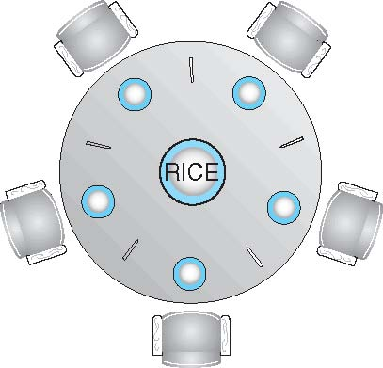
Dining-Philosophers Problem
Philosophers spend their lives thinking and eating
Don’t interact with their neighbors, occasionally try to pick up 2 chopsticks (one at a time) to eat from bowl
Need both to eat, then release both when done
In the case of 5 philosophers
Shared data
Bowl of rice (data set)
Semaphore chopstick [5] initialized to 1

Slide 30
Dining-Philosophers Problem Algorithm
The structure of Philosopher i:
do {
wait ( chopstick[i] );
wait ( chopStick[ (i + 1) % 5] );
// eat
signal ( chopstick[i] );
signal (chopstick[ (i + 1) % 5] );
// think
} while (TRUE);
What is the problem with this algorithm?

Slide 31
Problems with Semaphores
Incorrect use of semaphore operations:
signal (mutex) …. wait (mutex)
wait (mutex) … wait (mutex)
Omitting of wait (mutex) or signal (mutex) (or both)
Deadlock and starvation

Slide 32
Monitors
A high-level abstraction that provides a convenient and effective mechanism for process synchronization
Abstract data type, internal variables only accessible by code within the procedure
Only one process may be active within the monitor at a time
But not powerful enough to model some synchronization schemes
monitor monitor-name
{
// shared variable declarations
procedure P1 (…) { …. }
procedure Pn (…) {……}
Initialization code (…) { … }
}
}

Slide 33
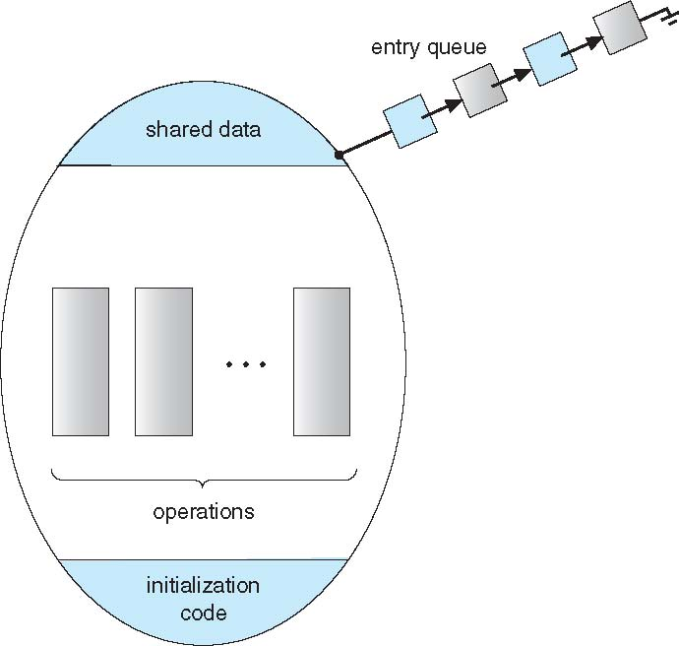
Schematic view of a Monitor

Slide 34
Condition Variables
condition x, y;
Two operations on a condition variable:
x.wait () – a process that invokes the operation is suspended until x.signal ()
x.signal () – resumes one of processes (if any) that invoked x.wait ()
If no x.wait () on the variable, then it has no effect on the variable

Slide 35
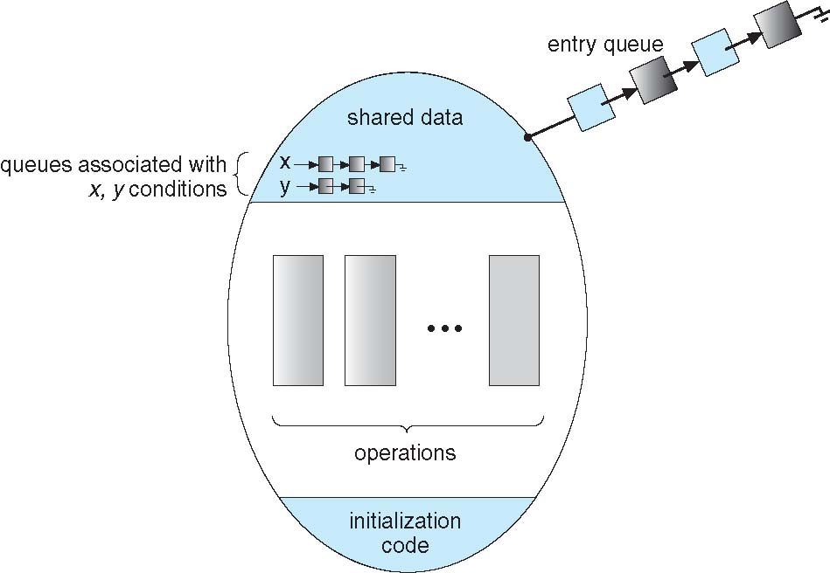
Monitor with Condition Variables

Slide 36
Condition Variables Choices
If process P invokes x.signal (), with Q in x.wait () state, what should happen next?
If Q is resumed, then P must wait
Options include
Signal and wait – P waits until Q leaves monitor or waits for another condition
Signal and continue – Q waits until P leaves the monitor or waits for another condition

Slide 37
Solution to Dining Philosophers
monitor DiningPhilosophers
{
enum { THINKING; HUNGRY, EATING) state [5] ;
condition self [5];
void pickup (int i) {
state[i] = HUNGRY;
test(i);
if (state[i] != EATING)
self [i].wait;
}
void putdown (int i) {
state[i] = THINKING;//test left and right neighbors
test((i + 4) % 5);
test((i + 1) % 5);
}
void test (int i)
{
if ( (state[(i + 4) % 5] != EATING) &&(state[i] == HUNGRY) &&
(state[(i + 1) % 5] != EATING) )
{
state[i] = EATING ;
self[i].signal () ;
}
}
initialization_code() {
for (int i = 0; i < 5; i++)
state[i] = THINKING;
}
}

Slide 38
Solution to Dining Philosophers (Cont.)
Each philosopher i invokes the operations pickup() and putdown() in the following sequence:
DiningPhilosophers.pickup (i);
EAT
DiningPhilosophers.putdown (i);
No deadlock, but starvation is possible

Slide 39
End of 6

