Slide 1
Unix system calls
fork( )
wait( )
exit( )

Slide 2
How To Create New Processes?
Underlying mechanism
  A process runs fork to create a child process
  Parent and children execute concurrently
  Child process is a duplicate of the parent process
parent
fork()
child

Slide 3
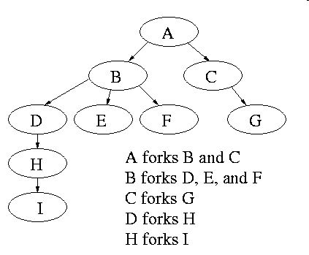
Process Creation
After a fork, both parent and child keep running, and each can fork off other processes.
A process tree results. The root of the tree is a special process created by the OS during startup.
A process can choose to wait for children to terminate. For example, if C issued a wait() system call, it would block until G finished.

Slide 4
Fork System Call
Current process split into 2 processes: parent, child
Returns -1 if unsuccessful
Returns 0 in the child
Returns the child’s identifier in the parent
fork()
Stack
Stack
ret = 0
Data
Data
Text
ret = xxx
Text

Slide 5
Fork System Call
The child process inherits from parent
  identical copy of memory
  CPU registers
  all files that have been opened by the parent
Execution proceeds concurrently with the instruction following the fork system call
The execution context (PCB) for the child process is a copy of the parent’s context at the time of the call

Slide 6
How fork Works (1)
pid = 25
Data
Resources
Text
Stack
PCB
File
ret = fork();
switch(ret)
{
case -1:
  perror(“fork”);
  exit(1);
case 0: // I am the child
<code for child >
exit(0);
default: // I am parent ...
  <code for parent >
  wait(0);
}
UNIX

Slide 7
How fork Works (2)
pid = 25
pid = 26
Data
Resources
Data
Text
Text
Stack
Stack
PCB
File
PCB
ret = 0
ret = 26
ret = fork();
switch(ret)
{
case -1:
  perror(“fork”);
  exit(1);
case 0: // I am the child
<code for child >
exit(0);
default: // I am parent ...
  <code for parent >
  wait(0);
}
ret = fork();
switch(ret)
{
case -1:
  perror(“fork”);
  exit(1);
case 0: // I am the child
<code for child >
exit(0);
default: // I am parent ...
  <code for parent >
  wait(0);
}
UNIX

Slide 8
How fork Works (3)
pid = 25
pid = 26
Data
Resources
Data
Text
Text
Stack
Stack
PCB
File
PCB
ret = 0
ret = 26
ret = fork();
switch(ret)
{
case -1:
  perror(“fork”);
  exit(1);
case 0: // I am the child
<code for child >
exit(0);
default: // I am parent ...
  <code for parent >
  wait(0);
}
ret = fork();
switch(ret)
{
case -1:
  perror(“fork”);
  exit(1);
case 0: // I am the child
<code for child >
exit(0);
default: // I am parent ...
  <code for parent >
  wait(0);
}
UNIX

Slide 9
How fork Works (4)
pid = 25
pid = 26
Data
Resources
Data
Text
Text
Stack
Stack
PCB
File
PCB
ret = 0
ret = 26
ret = fork();
switch(ret)
{
case -1:
  perror(“fork”);
  exit(1);
case 0: // I am the child
<code for child >
exit(0);
default: // I am parent ...
  <code for parent >
  wait(0);
}
ret = fork();
switch(ret)
{
case -1:
  perror(“fork”);
  exit(1);
case 0: // I am the child
<code for child >
exit(0);
default: // I am parent ...
  <code for parent >
  wait(0);
}
UNIX

Slide 10
How fork Works (5)
pid = 25
pid = 26
Data
Resources
Data
Text
Text
Stack
Stack
PCB
File
PCB
ret = 0
ret = 26
ret = fork();
switch(ret)
{
case -1:
  perror(“fork”);
  exit(1);
case 0: // I am the child
<code for child >
exit(0);
default: // I am parent ...
  <code for parent >
  wait(0);
}
ret = fork();
switch(ret)
{
case -1:
  perror(“fork”);
  exit(1);
case 0: // I am the child
<code for child >
exit(0);
default: // I am parent ...
  <code for parent >
  wait(0);
}
UNIX

Slide 11
How fork Works (6)
pid = 25
Data
Resources
Text
Stack
Process Status
File
ret = 26
ret = fork();
switch(ret)
{
case -1:
  perror(“fork”);
  exit(1);
case 0: // I am the child
<code for child >
exit(0);
default: // I am parent ...
  <code for parent >
  wait(0);
< … >
UNIX

Slide 12
Orderly Termination: exit()
To finish execution, a child may call exit(number)
This system call:
  Saves result = argument of exit
  Closes all open files, connections
  Deallocates memory
  Checks if parent is alive
  If parent is alive, holds the result value until the parent requests it (with wait); in this case, the child process does not really die, but it enters a zombie/defunct state
  If parent is not alive, the child terminates (dies)

Slide 13
Waiting for the Child to Finish
Parent may want to wait for children to finish
  Example: a shell waiting for operations to complete
Waiting for any some child to terminate: wait()
  Blocks until some child terminates
  Returns the process ID of the child process
  Or returns -1 if no children exist (i.e., already exited)
Waiting for a specific child to terminate: waitpid()
  Blocks till a child with particular process ID terminates
#include <sys/types.h>
#include <sys/wait.h>
pid_t wait(int *status);
pid_t waitpid(pid_t pid, int *status, int options);

Slide 14
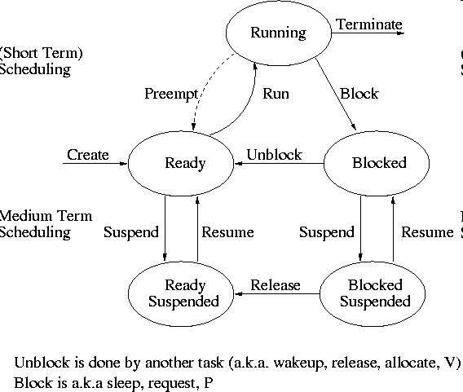
State Transition on wait and exit Calls

Slide 15
Other useful system calls: getpid, getppid
getpid returns the identifier of the calling process. Example call (pid is an integer):
pid = getpid();
getppid returns the identifier of the parent.
Note:
        ps -ef

Slide 16
Fork Example 1: What Output?
int main()
{
pid_t pid;
int x = 1;
pid = fork();
if (pid != 0) {
printf(“parent: x = %d\n”, --x);
exit(0);
} else {
printf(“child: x = %d\n”, ++x);
exit(0);
}
}

Slide 17
Fork Example 2
Key Points
  Both parent and child can continue forking
  No of process =2^{n} (n – no of forks)
void fork2()
{
printf("L0\n");
fork();
printf("L1\n");
fork();
printf("Bye\n");
}
Bye
L1
Bye
Bye
L0
L1
Bye

Slide 18
Fork Example 3
void fork3()
{
printf("L0\n");
fork();
printf("L1\n");
fork();
printf("L2\n");
fork();
printf("Bye\n");
}
Bye
L2
Bye
Bye
L1
L2
Bye
Bye
L2
Bye
Bye
L0
L1
L2
Bye

Slide 19
Fork Example 4
void fork4()
{
printf("L0\n");
pid1=fork();
if (pid1!=0) {
printf("L1\n");
pid2=fork();
if (pid2!= 0) {
printf("L2\n");
fork();
}
}
printf("Bye\n");
}

Slide 20
Fork Example 5
void fork5()
{
printf("L0\n");
if (fork() == 0) {
printf("L1\n");
if (fork() == 0) {
printf("L2\n");
fork();
}
}
printf("Bye\n");
}

Slide 21
Summary
Fork
  Creates a duplicate of the calling process
  The result is two processes: parent and child
  Both continue executing from the same point on
Exit
  Orderly program termination
  Unblocks waiting parent
Wait
  Used by parent
  Waits for child to finish execution

Slide 22
Unix system calls
execv
execl

Slide 23
Unix’s execv
The system call execv executes a file, transforming the calling process into a new process. After a successful execv, there is no return to the calling process.
    execv(const char * path, char * const argv[])
  path is the full path for the file to be executed
  argv is the array of arguments for the program to execute
    each argument is a null-terminated string
    the first argument is the name of the program
    the last entry in argv is NULL

Slide 24
How execv Works (1)
pid = 25
pid = 26
Data
Resources
Data
Text
Text
Stack
Stack
PCB
File
PCB
char * argv[ ] = {“/bin/ls”, 0};
<…>
int cpid = fork( );
if (cpid = = 0) {
execv(argv[0], argv);
exit(0);
}
<parent code>
wait(&cpid);
cpid = 26
cpid = 0
char * argv[ ] = {“/bin/ls”, 0};
<…>
int cpid = fork( );
if (cpid = = 0) {
execv(argv[0], argv);
exit(0);
}
<parent code>
wait(&cpid);
/bin/ls
UNIX kernel

Slide 25
How execv Works (2)
pid = 25
pid = 26
Data
Resources
Text
Stack
PCB
File
char * argv[ ] = {“/bin/ls”, 0};
<…>
int cpid = fork( );
if (cpid = = 0) {
execv(argv[0], argv);
exit(0);
}
<parent code>
wait(&cpid);
cpid = 26
Exec destroys the process image of the calling process. A new process image is constructed from the executable file (ls).
/bin/ls
UNIX kernel

Slide 26
How execv Works (3)
pid = 25
pid = 26
Data
Resources
Data
Text
Text
Stack
Stack
PCB
File
PCB
char * argv[ ] = {“/bin/ls”, 0};
<…>
int cpid = fork( );
if (cpid = = 0) {
execv(argv[0], argv);
exit(0);
}
<parent code>
wait(&cpid);
cpid = 26
<first line of ls>
<…>
<…>
<…>
exit(0);
/bin/ls
UNIX kernel

Slide 27
Example: A Simple Shell
Shell is the parent process
  E.g., bash
Parses command line
  E.g., “ls –l”
Invokes child process
  Fork, execvp
Waits for child
  Wait
bash
fork
execvp
wait
ls

Slide 28
execv Example
#include <stdio.h>
#include <unistd.h>
char * argv[] = {“/bin/ls”, “-l”, 0};
int main()
{
int pid, status;
if ( (pid = fork() ) < 0 )
{
printf(“Fork error \n”);
exit(1);
}
if(pid == 0) { /* Child executes here */
execv(argv[0], argv);
printf(“Exec error \n”);
exit(1);
} else /* Parent executes here */
wait(&status);
printf("Hello there! \n”);
return 0;
}
Note the NULL string
at the end

Slide 29
execv Example – Sample Output
Sample output:
  total 282
  drwxr-xr-x 2 mdamian faculty 512 Jan 29 14:02 assignments
  -rw-r--r-- 1 mdamian faculty 3404 Jan 29 14:05 index.html
  drwxr-xr-x 2 mdamian faculty 512 Jan 28 15:02 notes
  Hello there!

Slide 30
execl
Same as execv, but takes the arguments of the new program as a list, not a vector:
Example:
  execl(“/bin/ls”, “/bin/ls”, “-l”, 0);
Is equivalent to
  char * argv[] = {“/bin/ls”, “-l”, 0};
  execv(argv[0], argv);
execl is mainly used when the number of arguments is known in advance
Note the NULL string at the end

Slide 31
General purpose process creation
In the parent process:
int childPid;
char * const argv[ ] = {…};
main {
childPid = fork();
if(childPid == 0)
{
  // I am child ...
  // Do some cleaning, close files
  execv(argv[0], argv);
}
else
{
  // I am parent ...
  <code for parent process>
  wait(0);
}
}

Slide 32
Combined fork/exec/wait
Common combination of operations
  Fork to create a new child process
  Exec to invoke new program in child process
  Wait in the parent process for the child to complete
Single call that combines all three
  int system(const char *cmd);
Example
int main()
{
system(“echo Hello world”);
}

