Slide 1
CS 4476/6476 Project 2
Pooja Pache
ppache3@gatech.edu
ppache3
903813050

Slide 2
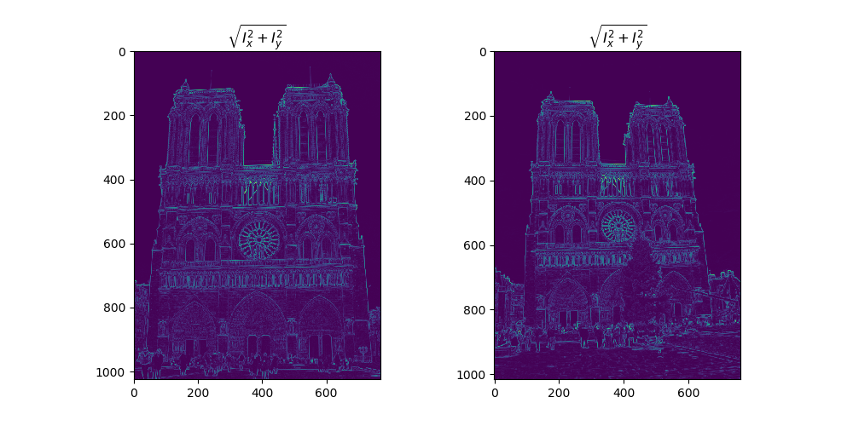
Part 1: Harris corner detector
[insert visualization of \sqrt(I_{x}² + I_{y}²) for Notre Dame image pair from proj2.ipynb here]
[Which areas have highest magnitude? Why?
A. The corners have highest magnitudes.
B. Corners have changes in both directions and hence they are unique.
C. If a patch is cut and shifted to other place it won’t look the same as the content in its neighborhood.

Slide 3
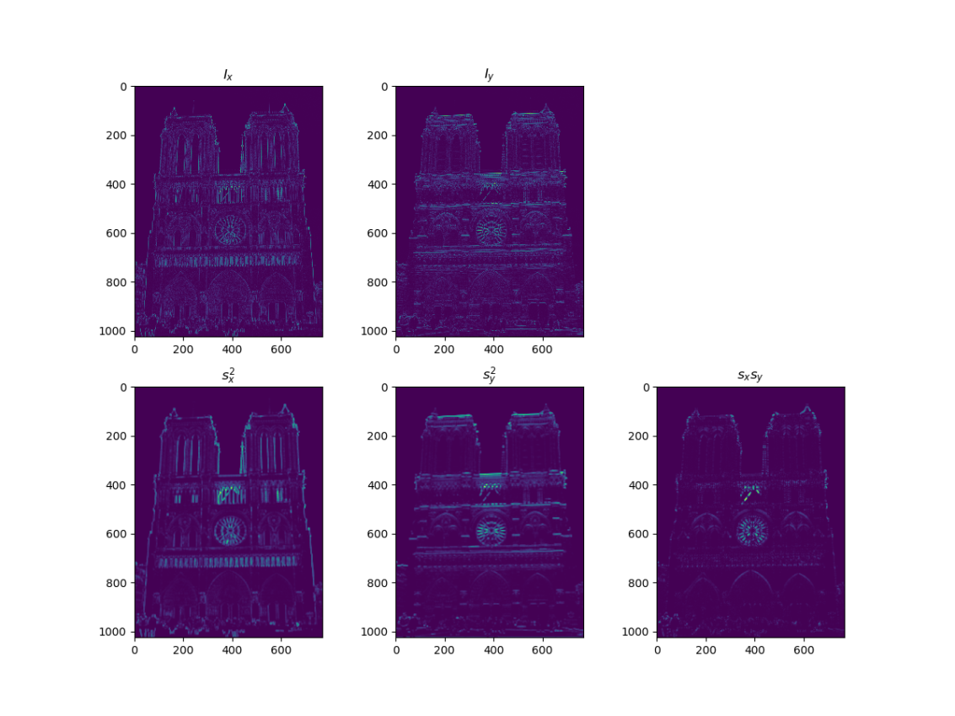
Part 1: Harris corner detector
[insert visualization of I_{x}, I_{y}, s_{x}², s_{y}², s_{x}s_{y} for Notre Dame image pair from proj2.ipynb here]

Slide 4
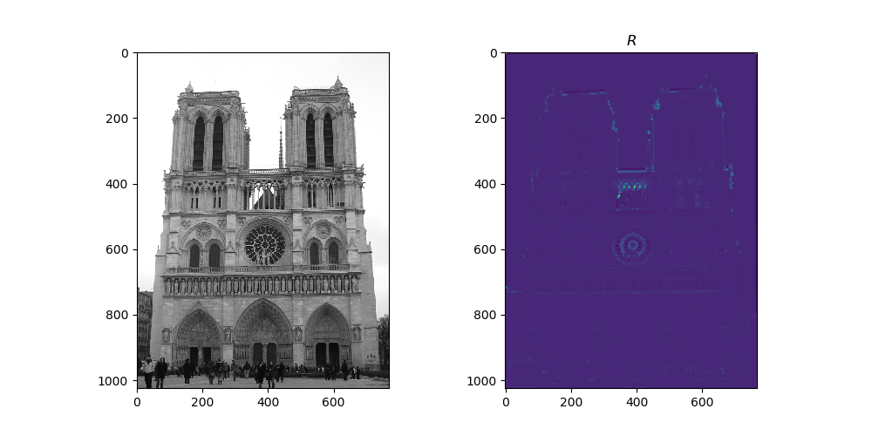
Part 1: Harris corner detector
[insert visualization of corner response map of Notre Dame image from proj2.ipynb here]
[Are gradient features invariant to both additive shifts (brightness) and multiplicative gain (contrast)? Why or why not? See Szeliski Figure 3.2]
Yes, gradient features are invariant to both additive shifts and multiplicative gain. In Harris detector, corners are used. A change in image contrast in which each pixel value is multiplied or added by a constant will multiply or add gradients by the same constant, so this contrast/brightness change will be cancelled by vector normalization.

Slide 5
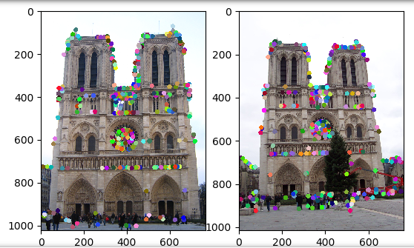
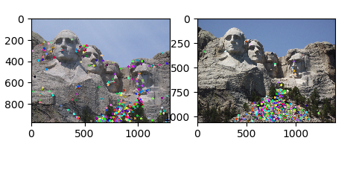
Part 1: Harris corner detector
[insert visualization of Notre Dame interest points from proj2.ipynb here]
[insert visualization of Mt. Rushmore interest points from proj2.ipynb here]

Slide 6
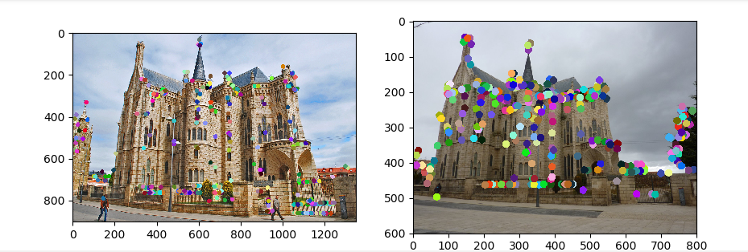
Part 1: Harris corner detector
[insert visualization of Gaudi interest points from proj2.ipynb here]
[What are the advantages and disadvantages of using maxpooling for non-maximum suppression (NMS)?]
The following are advantages of NMS:
It is parameter free. Hence, there is no risk of over-fitting.
It is often more accurate.
The following are disadvantages of NMS:
A. It is expensive. B. More hyper parameters are required.

Slide 7
Part 1: Harris corner detector
[What is your intuition behind what makes the Harris corner detector effective?]
The main intuition behind selecting Harris corner detector was: A. The interest points should be easily recognizable through a small window.
B. If the window is shifted in any directed then it should give a large change in intensity.
C. This can be determined by calculating the gradients of the pixels in the image. If a pixel has a large gradient in both the x- and the y- directions, then we know that shifting a window around this pixel would case a large change in intensity. In other words, if the pixel has a large gradient, then we know that it must be a corner point. In the Harris corner detector, we calculate cornerness scores for all the pixels of the image and select the highest points as interest points.

Slide 8
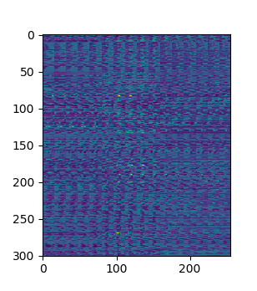
Part 2: Normalized patch feature descriptor
[insert visualization of normalized patch descriptor from proj2.ipynb here]
[Why aren't normalized patches a very good descriptor?]
Normalized patches aren’t a very good descriptor because even if the image is slightly shifted then there will be large changes. These patches are sensitive to spatial changes. This is because in the real world scenario there can be some amount of slack or difference in spatial orientation. In this case, normalized patches won’t prove to be a good descriptor.

Slide 9
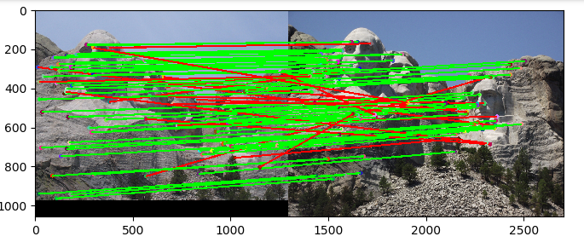
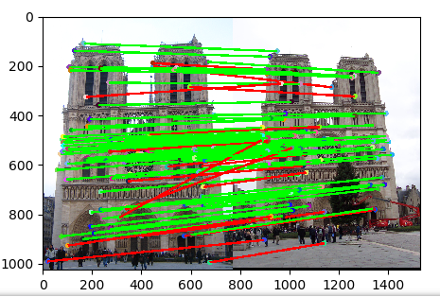
Part 3: Feature matching
[insert visualization of matches (with green/red lines for correct/incorrect correspondences) for Notre Dame image pair from proj2.ipynb here]
# matches (out of 100): 87
Accuracy:70%
[insert visualization of matches for Mt. Rushmore image pair from proj2.ipynb here]
# matches (out of 100): : 87
Accuracy:69%

Slide 10
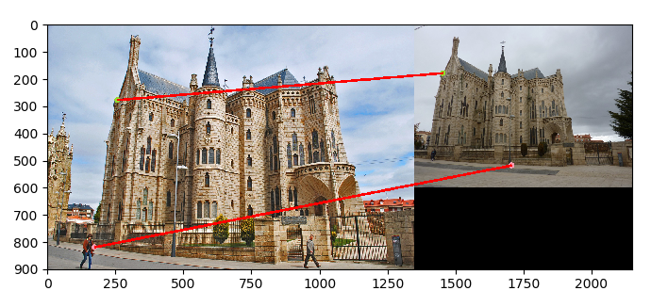
Part 3: Feature matching
[insert visualization of matches for Gaudi image pair from proj2.ipynb here]
# matches (out of 100): 2
Accuracy:0%
[Describe your implementation of feature matching here]
Compute feature distances for features1 and features2
Loop through distances array:
Store ith distance row in x
Get indexes of sorted x array and store them in variable y using argsort()
Store the first minimum distance value and second minimum distance value in d1 and d2 respectively.
Check if d1/d2 < threshold If d1/d2 < threshold then add to matches. Also add d1/d2 to confidences.
End Loop

Slide 11
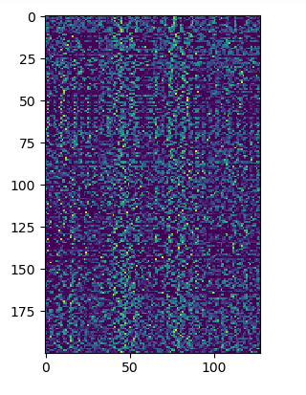
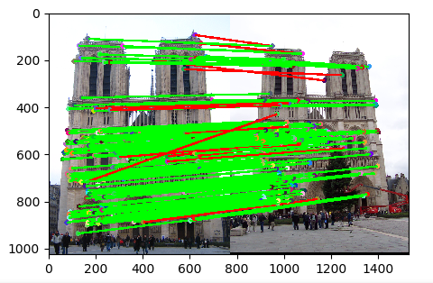
Part 4: SIFT feature descriptor
[insert visualization of SIFT feature descriptor from proj2.ipynb here]
[insert visualization of matches (with green/red lines for correct/incorrect correspondences) for Notre Dame image pair from proj2.ipynb here]
# matches (out of 100): 164
Accuracy: 92.07%

Slide 12
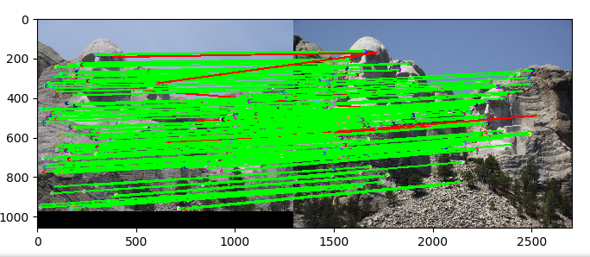
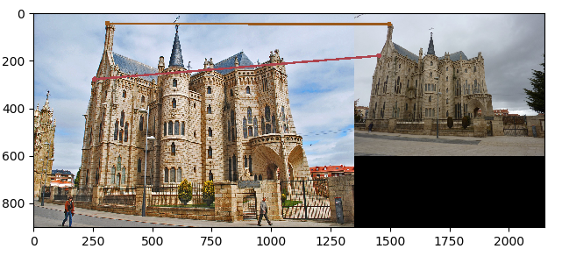
Part 4: SIFT feature descriptor
[insert visualization of matches for Mt. Rushmore image pair from proj2.ipynb here]
# matches (out of 100): 148
Accuracy: 94.59%
[insert visualization of matches for Gaudiimage pair from proj2.ipynb here]
# matches (out of 100): 2
Accuracy: 0%

Slide 13
Part 4: SIFT feature descriptor
[Describe your implementation of SIFT feature descriptors here]
Compute image gradients and get Ix and Iy.
Get magnitudes and orientations using Ix and Iy.
Loop over coordinate array:
Get feature vector for each x-coordinate and y-coordinate. get_gradient_histogram_vec_from_patch() is called internally from get_feat_vec().
Append the result
END Loop
[Why are SIFT features better descriptors than the normalized patches?]
Sift features are more abstract than normalized patches with regards to the actual pixel values of the image. Therefore, it is more difficult to match up key points using normalized patches as there is less data about the images.

Slide 14
Part 4: SIFT feature descriptor
[Why does our SIFT implementation perform worse on the given Gaudi image pair than the Notre Dame image and Mt. Rushmore pairs?]
The SIFT implementation did not perform well on the given Gaudi image because there is a difference in both illumination and scale between the two images. The interest points which we found are very dependent on scale, therefore the interest point finder does a poor job of finding image features in the left image that correspond to image features in the right image.
In addition to this, it is clear by looking at the results from the interest points that the SIFT-like feature descriptor used here is not scale invariant.
Hence, there are poor results even when good corresponding interest points are found in the two images.

Slide 15
Part 5: SIFT Descriptor Exploration
Describe the effects of changing window size around features. Did different values have better performance?
SIFT descriptors are scale invariant because the descriptors are extracted relative to the key point detection scales, that is, a descriptor's actual window size is 16*scale x 16 *scale not 16x16.
For example, if the scale of an object is doubled then the actual descriptor window relative to the current scaled object becomes 32x32. The dimensionality of the descriptor remains 128 because the orientation binning cells in which sum pooling occurs will also proportionately scale from 4x4 to 8x8.

Slide 16
Part 5: SIFT Descriptor Exploration
Describe the effects of changing the number of local cells in a window around a feature? Did different values have better performance?
If a grid of 1 is selected for feature-width of 16 then the performance was terrible. However, it improves if the grid-size is 8 or 16. The optimal performance was observed when grid-size was 8.

Slide 17
Part 5: SIFT Descriptor Exploration
Describe the effects of changing number of orientations (bins) per histogram. Did different values have better performance?

Slide 18
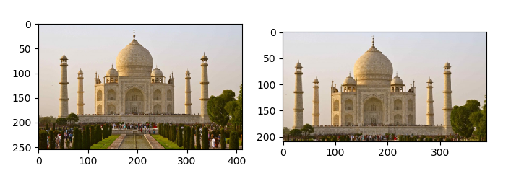
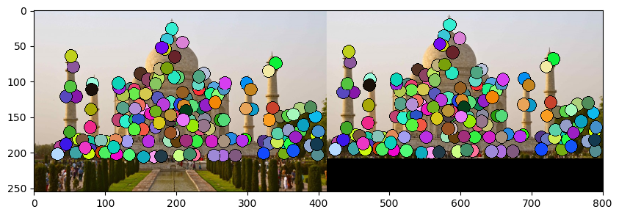
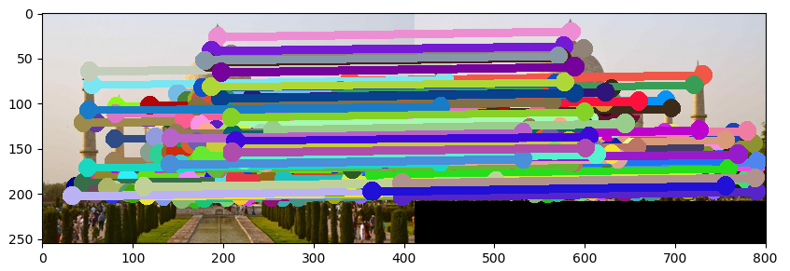
Part 5: SIFT Descriptor Exploration
[insert visualization of matches for your image pair from proj2.ipynb here]
Taj Mahal

Slide 19
Part 5: SIFT Descriptor Exploration
[Discuss why you think your SIFT pipeline worked well or poorly for the given building. Are there any characteristics that make it difficult to correctly match features]? The algorithm used is not scale-invariant. Therefore, the algorithm worked well for images of Notre Dame, Rushmore. But it failed to provide accurate results for Gaudi and Taj Mahal as the scales of two images used were different. Therefore, the algorithm had a hard time matching them. There can be images like circles

Slide 20
Conclusion
[Why aren't our version of SIFT features rotation- or scale-invariant? What would you have to do to make them so?]
SIFT descriptors are scale invariant because the descriptors are extracted relative to the key point detection scales, that is, a descriptor's actual window size is 16*scale x 16 *scale not 16x16.
For example, if the scale of an object is doubled then the actual descriptor window relative to the current scaled object becomes 32x32. The dimensionality of the descriptor remains 128 because the orientation of binning cells in which sum pooling occurs will also proportionately scale from 4x4 to 8x8.

