Slide 1

Reinforcement Learning for Generation of Novel Non-toxic Molecules
Machine Learning for Pharmacology Fall 2022
William Ladd
Rutwik Palaskar
Pooja Parameswaran
Slide 1

Slide 2
Overview
Project Description
Problem Description
About the Dataset
Approach
Reinforcement Learning (Predictive Model + Generative Model)
Results
Predictive Models
Picking a Predictive Model for Reinforcement Learning
Generative Model
Molecules generated
Improvements from Reinforcement Learning
Conclusions
Slide 2

Slide 3
Problem Description:
In drug discovery, molecules can be found that accomplish some biological goal using chemical mechanisms. Despite discovering an optimal drug for activating a chemical mechanism, that drug is not useable if it is toxic.
Motivation: Need a way to discover new non-toxic molecules
Using Tox21 as a dataset of toxic molecules
Generate non-toxic molecules with machine learning?
Slide 3

Slide 4
About The Dataset (Tox21):
Tox21 (Toxicology in the 21st Century) (https://tox21.gov/) is a government program by multiple US Federal agencies
The purpose was to create a dataset of toxic chemicals for machine learning
Chemicals are tested in assays for their ability to disrupt specific biological chemical pathways (https://ncats.nih.gov/tox21/projects/assays)
Assay results make up the dataset
Results of the assay are binary (1 or 0)
Slide 4

Slide 5
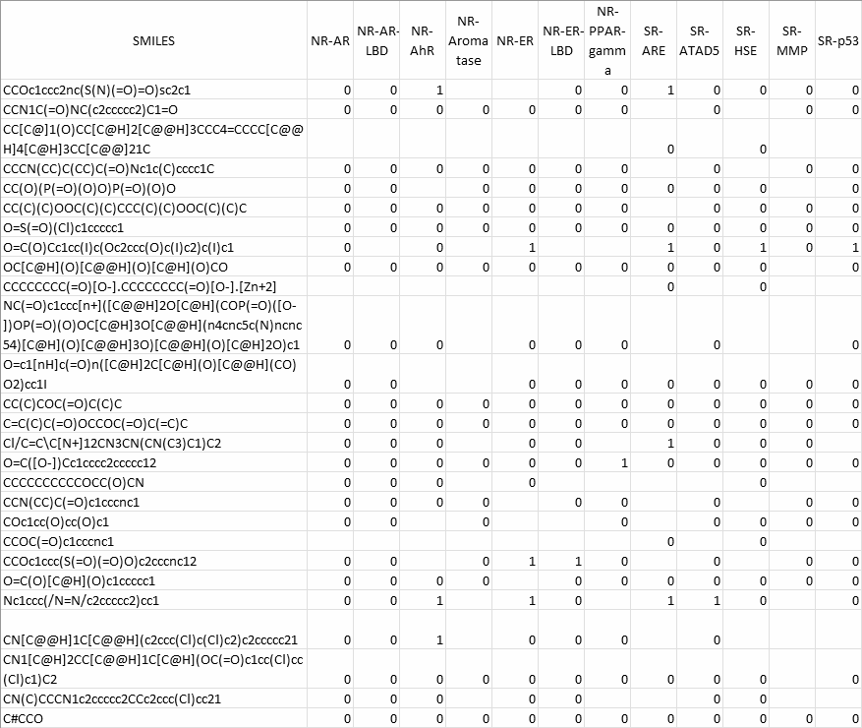
Data
Data consists of SMILES for each molecule and its performance on 12 of the assays
Notice blank entries
Dataset is also not very large (8014 smiles)
Slide 5

Slide 6
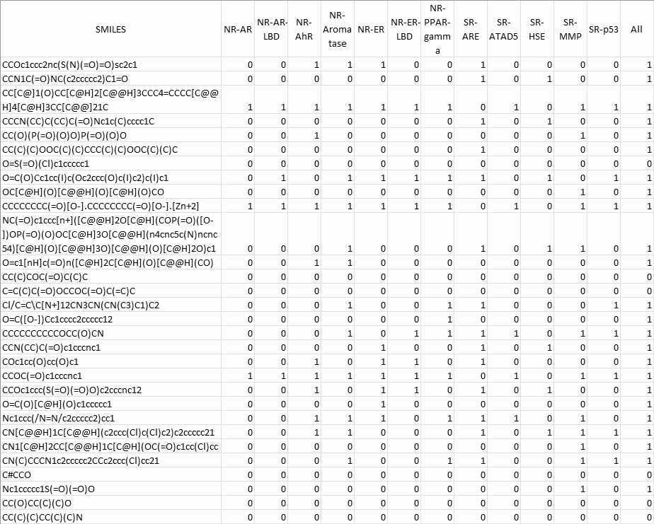
Data with Assumptions
We assume blank entries indicate toxic
We also create a new category “All” which is an overall measure of toxicity
If chemical is toxic in one assay then it is toxic overall
We utilize the ‘All’ column and ‘SMILES’ in our problem
Slide 6

Slide 7
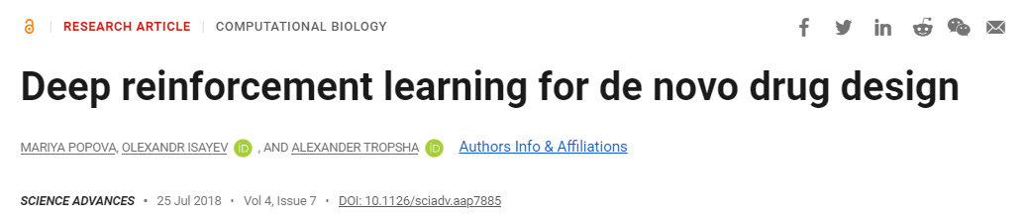
Approach
Goal: To create novel non-toxic molecules with knowledge from the Tox21 dataset (knowing some toxic and non-toxic chemicals)
Solution: Use Reinforcement Learning on a Generative Model
We adapted code from the paper below with an existing reinforcement learning framework:
Mariya Popova, Olexandr Isayev, Alexander Tropsha. Deep Reinforcement Learning for de-novo Drug Design. Science Advances, 2018, Vol. 4, no. 7. DOI: 10.1126/sciadv.aap7885
Slide 7

Slide 8
Reinforcement Learning
Two Parts: a predictive model and a generative model
Code from paper takes each of these as inputs and runs reinforcement learning on them
The generative model is trained using the predictive model
Initialization Process
Train the predictive model on a dataset of choice
Train the generative model for many epochs on a dataset of many CHEMBL smiles
Reinforcement Training Process
Generative model generates molecules
Predictive model predicts a property of those molecules
Predicted property value is transformed into a reward value using a reward function
Generative model is trained for another epoch using reward values
Slide 8

Slide 9
Reinforcement Learning Framework
Initial Training on Large CHEMBL Dataset
Initial Training on
Tox21 ALL Dataset
Generated
SMILES
Generative Model
Predictive Model
Reward Values
(to train for another epoch)
Reward Function
Predicted
Property Value
Slide 9

Slide 10
Models and Rewards for Reinforcement Learning
Predictive Models:
Random Forest, Support Vector Machine, Multi-Layer Perceptron
SVM had the best recall score so we chose SVM as our predictive model.
Trained with Morgan Fingerprints
Generative Model: Recurrent Neural Network (RNN)
We used the RNN implemented in the code from the paper as the generative model
Reward Function:
We reinforced creating non-toxic molecules by rewarding novel non-toxic molecules
Reward of 11 for every non-toxic molecule generated
Reward of 1 for every toxic molecule generated
Slide 10

Slide 11
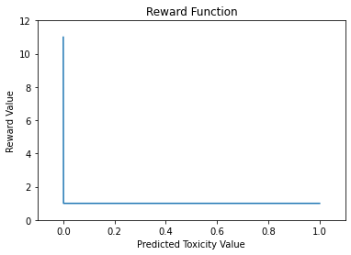
Reward Function
If predicted toxicity = 0, reward = 11
If predicted toxicity ≠ 0, reward = 1
Optimizes neural network to move towards what we seek
Seeking non-toxic molecules, so function ‘rewards’ non-toxic molecule production
Slide 11

Slide 12
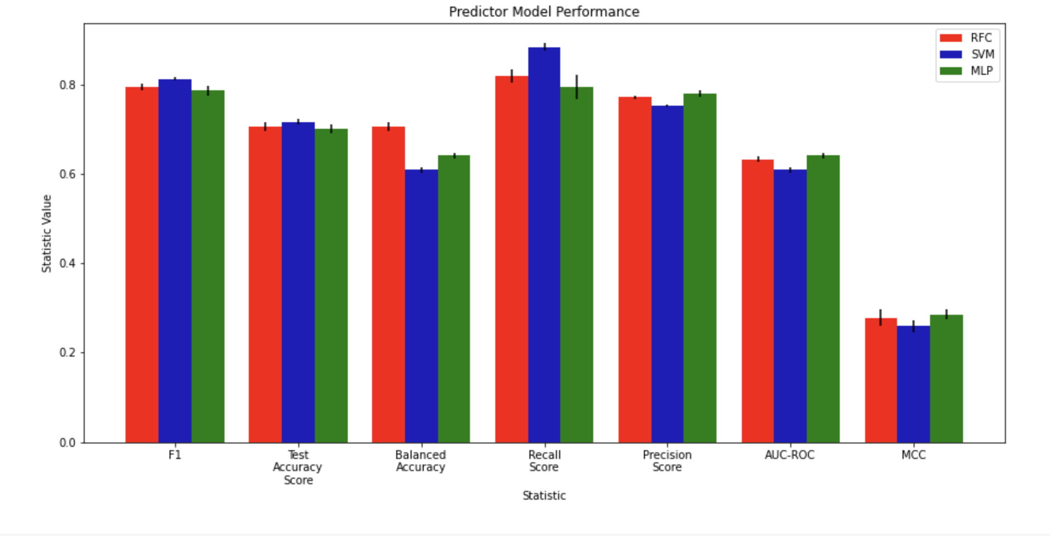
Predictive Model Performance
0.883
0.812
0.819
0.793
0.794
0.786
0.772
0.779
0.715
0.752
0.705
0.700
0.705
0.641
0.632
0.641
0.608
0.609
SVM has low MCC, but not by significant value
0.278
0.285
0.259
Evaluating Diff Models:
High Recall, Low Precision
Slide 12
Slide 12

Slide 13
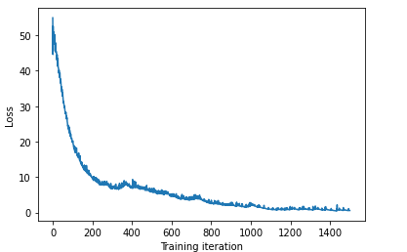
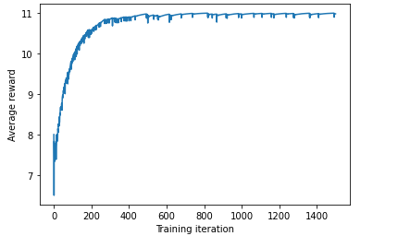
Reinforcement Learning Results
Loss Decreases over Training iterations
Loss at latest iteration: ~ 0.30
Average Reward Increases over Training Iterations
Reward at latest iteration: ~ 10.99
Loss Per Iteration
Average Reward Per Iteration
Slide 13

Slide 14
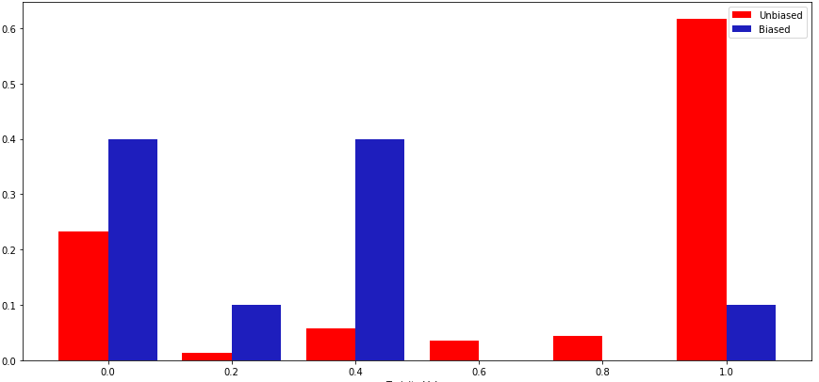
Results - 10,000 Generated Samples Distribution
Toxicity prediction value was lower for most valid molecules generated by generator model after (biased) than before (unbiased) reinforcement learning
Proportion of Valid Samples
Toxicity Prediction Value
Slide 14
Notes:
Pooja

Slide 15
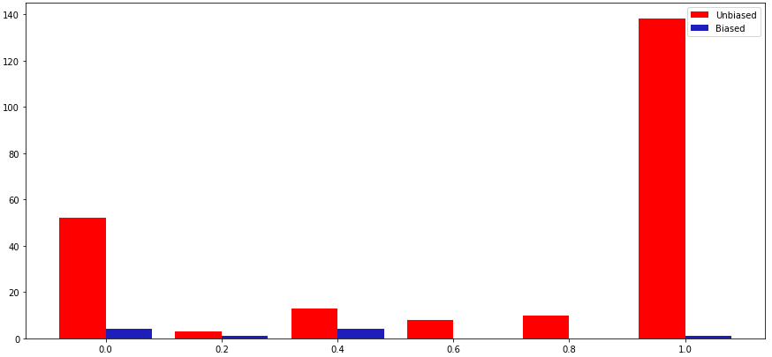
Results - 10,000 Generated Samples Distribution
Fewer molecules generated after reinforcement learning were valid molecules
Amount of Samples
Toxicity Prediction Value
Slide 15
Notes:
Pooja

Slide 16
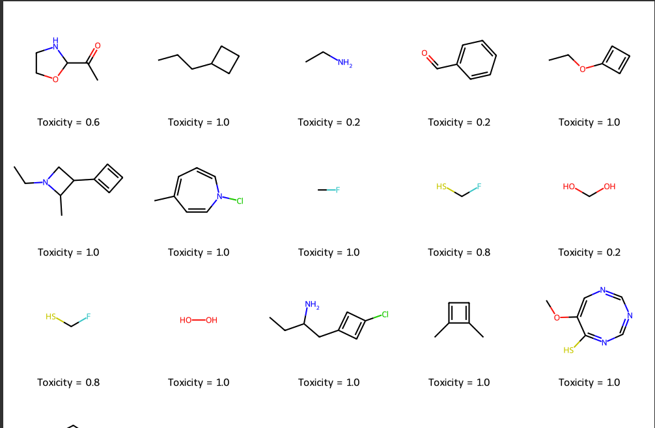
No Reinforcement Learning- Novel Molecules Produced
Slide 16
Slide 16
Notes:
Values are in between because

Slide 17
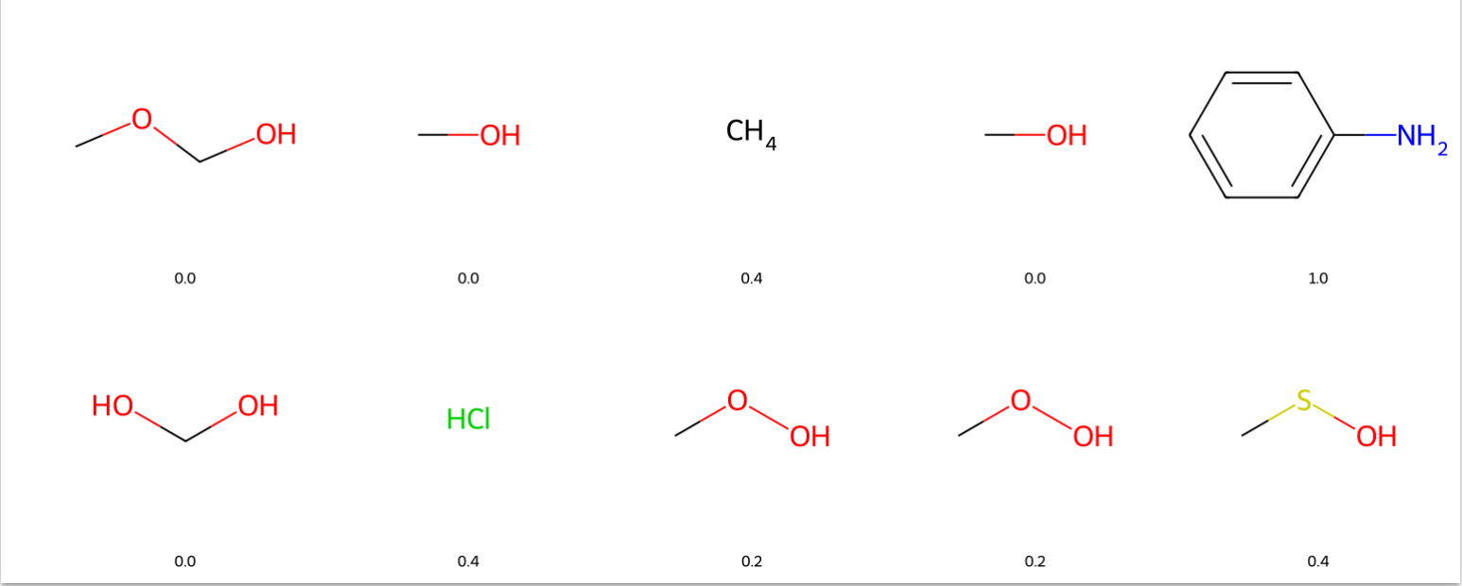
Novel Molecules Produced
A Sample of Novel Molecules Created :
Slide 17
Slide 17

Slide 18
Conclusion:
The Predictor Models had decent performance. We chose SVM because it had the highest recall and low precision scores (broader model).
The generated valid molecules prove to be more non-toxic after reinforcement learning
Rewarding Non-toxic molecules allows the RNN to understand to produce non-toxic structures
The majority of novel structures produced are unique.
Slide 18

Slide 19
Potential Next Steps:
Apply methods like hyperparameter optimization for boosting the performance of the predictive models.
Try different fingerprints/descriptors in the reinforcement framework
Testing Novel molecules in lab
Implementing different reward functions:
Sigmoidal
Exponential
Linear
Slide 19

Slide 20
Thank You
Slide 20

Slide 21
Questions Time
Slide 21

