Slide 1
Time Series- What does it mean?
Pooja Parameswaran and Lucy Chikwetu

Slide 2

Load the Dataset
Features
Classes
Target | X | Y | Z
Eating | 9.471462 | 0.29179335 | -3.2248402
Not-eating | 12.435484 | -5.8636994 | -1.3118728
Eating | 12.658144 | -2.4806921 | -3.1625907
Eating | 13.970167 | -4.6570215 | -3.3373675
Eating | 10.1226845 | -5.480627 | -1.9463364
Read the data, can be done with the noted code
Separate the features into one variable
Separate the targets of that feature into another variable
The data must be separated into training and testing
Can use a specific column and split accordingly to that
Notes:
def readucr(filename):
data = np.loadtxt(filename, delimiter="\t")
y = data[:, 0]
x = data[:, 1:]
return x, y.astype(int)
root_url = "https://raw.githubusercontent.com/hfawaz/cd-diagram/master/FordA/"
x_train, y_train = readucr(root_url + "FordA_TRAIN.tsv")
x_test, y_test = readucr(root_url + "FordA_TEST.tsv")

Slide 3
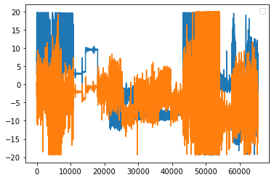
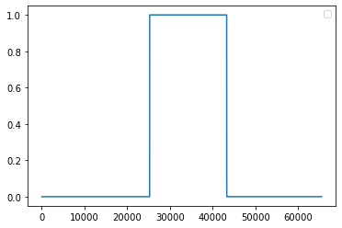
Read the data
Take the data and plot each variable as a function of time
‘xyz’ looks like this plotted
’target’ looks like this plotted over time
‘1’ is eating

Slide 4
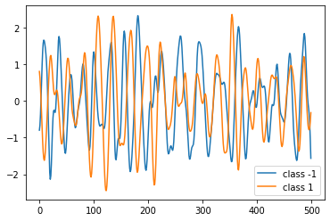
Visualize the Dataset
Visualize the data from each class over a function of time
Questions
Since we only have eating and non-eating. The graph does not fluctuate as a result
Time stamp also varies, but all in terms of 8.09E13 – 9.04E13
Notes:
classes = np.unique(np.concatenate((y_train, y_test), axis=0))
plt.figure()
for c in classes:
c_x_train = x_train[y_train == c]
plt.plot(c_x_train[0], label="class " + str(c))
plt.legend(loc="best")
plt.show()
plt.close()

Slide 5
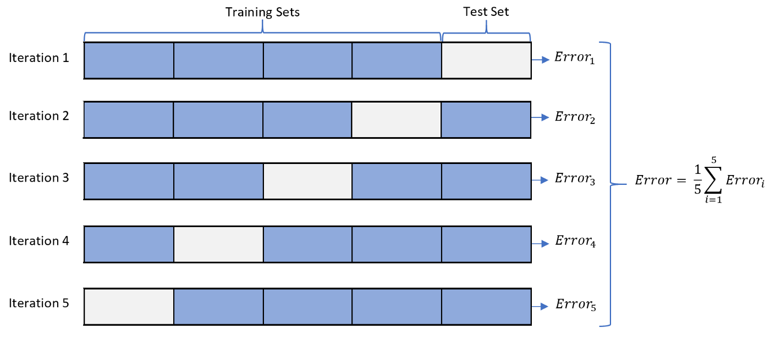
Cross- Validation
Overfitting problem
Resampling method using different portions of data to test and train the model on different iterations. Mostly used in settings where the goal is prediction
Important for prediction models
How accurate predictive model with perform
Notes:
Cross-validation is a resampling method that uses different portions of the data to test and train a model on different iterations. It is mainly used in settings where the goal is prediction, and one wants to estimate how accurately a predictive model will perform in practice

Slide 6
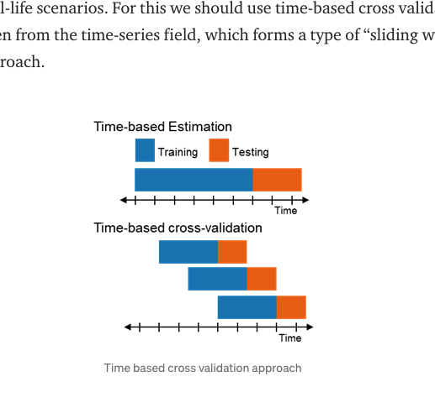

Slide 7
Processing the data to be relevant
Some functions have outliers within the given time range
Applying a sliding window with a given frame of time will allow the time series data to capture the signal.
The window size is the size of the sliding window
For eating algorithm
Not given as function of time but rather each activity has one timee stamp in terms of Unix time
Examples of sliding window
plt.plot(ts.rolling(window=12,center=False).mean(),label='Rolling Mean’);
plt.plot(ts.rolling(window=12,center=False).std(),label='Rolling sd’);
Some functions have outliers within the given time range
When the data has values in varying ranges, it must be normalized
Standardize the labels to positive integers

Slide 8
Feature Engineering
Process of selecting, manipulating, and transforming raw data into features
Methods
Log Transform
Skewed distribution into a normal or less-skewed distribution
Scaling
Similar features become more similar in terms of range
Binning
Prevent overfitting but regularizes the data into bins
- Normalization
All values are scaled in a specified range between 0 and 1
- One hot encoding
Finite set is represented by the index in the set and only one elment has a value of ‘1’. Each case is assigned a unique value – based on class

Slide 9
Train the Model
For a machine learning network, this includes making a convolutional neural network
Support Vector Machines
Find a hyperplane in an N-dimensional space (N – number of features) that distinguishes between data points
Random Forest
Randomly picks observations from training data to build a decision tree and take an average. The average is applied for predictions
Decision Trees
All input features is taken as data and the model formulates a set of rules to make predictions on further data
Can simply call DecisionTreeClassifier(), and fit the model accordingly
K-clustering
Plot all features and note how similar features cluster
Define k number of centroids

Slide 10
Categorize the Model (RandomForestClassifier or DecisionTreeClassifier)
Define the activities trying to classify
Eating and Non-eating
Call the features you are looking to analyze, and the activity it corresponds with
k = df.iloc[:,:-3][(df.activity == i)]
Plot the features according to class
Based off training dataset
In 3d coordinates, how do we do this over time
Create a boundary line differentiating between the classes
Check model accuracy with predictions testing data
Notes:
correct = 0 total = 0 for i in activities: k = df.iloc[:,:-3][(df.activity == i)] preds = model.predict(k) print(i + ': ' + str(((preds == i).sum() / len(preds))*100) + '%') correct += (preds == i).sum() total += len(preds) print('total: ' + str(correct / total * 100) + '%')

Slide 11
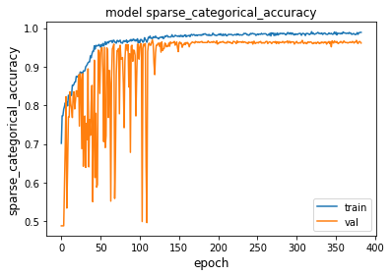
Evaluate model on test data using model metrics
Accuracy
Loss
Recall
Precision
These metrics are shown performing over epochs
Notes:
model = keras.models.load_model("best_model.h5")
test_loss, test_acc = model.evaluate(x_test, y_test)
print("Test accuracy", test_acc)
print("Test loss", test_loss)
metric = "sparse_categorical_accuracy" plt.figure() plt.plot(history.history[metric]) plt.plot(history.history["val_" + metric]) plt.title("model " + metric) plt.ylabel(metric, fontsize="large") plt.xlabel("epoch", fontsize="large") plt.legend(["train", "val"], loc="best") plt.show() plt.close()

Slide 12
Links
Time Series
https://keras.io/examples/timeseries/timeseries_classification_from_scratch/
Model to predict type of activity
https://www.kaggle.com/code/bennowilkeit/model-to-predict-type-of-activity
K-cluster
https://towardsdatascience.com/understanding-k-means-clustering-in-machine-learning-6a6e67336aa1
SVM
https://towardsdatascience.com/support-vector-machine-introduction-to-machine-learning-algorithms-934a444fca47
Sliding Window
https://towardsdatascience.com/fast-and-robust-sliding-window-vectorization-with-numpy-3ad950ed62f5

Slide 13
link
Sliding window with cross validatin
https://towardsdatascience.com/time-based-cross-validation-d259b13d42b8
Pandas Sliding window
https://pandas.pydata.org/docs/user_guide/window.html

