Slide 1
INVESTMENT ASSIGNMENT SUBMISSION
Name: Pooja Rani Patra

Slide 2
Abstract
Problem solving methodology
Analysis
Results
Conclusion

Slide 3
Problem solving methodology
Understanding the raw data and extracting a clean data for analysis.
Best funding type based on the investment bracket for the company.
Countries for the top 9 investment type and Top 3 English Speaking Countries
Obtaining the top companies to invest in the respective countries.
Analyzing the top investment sectors for the top 3 countries in the range of investment.
Analyzing the sectors to get the primary sectors and mapping it to respective main sectors

Slide 4
Data Analysis
Raw data was cleaned to obtain a readable data for analysis.
The Suitable Funding Type for Sparks Funds was analyzed
From the funding type the top 3 companies to invest was determined.
The top sectors was analyzed for the countries.
This gives us the names of companies where Sparks Funds can invest.

Slide 5
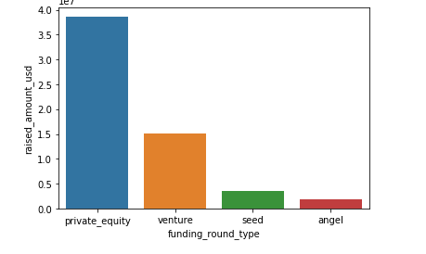
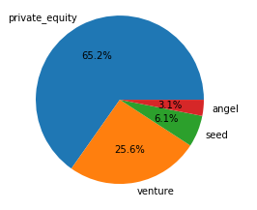
Results
The pie chart below shows the fraction of investments in funding types globally. Bar chart besides it is to show the average investment amount in the top 3 funding types. Clearly it can be seen that Venture Type is best suited for Spark Funds.

Slide 6
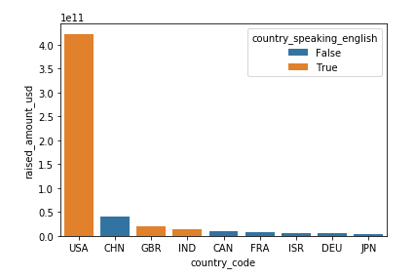
Results
Plot showing the top 9 countries against the total amount of investments of funding type FT. This should make the top 3 countries (Country 1, Country 2, and Country 3) very clear.

Slide 7
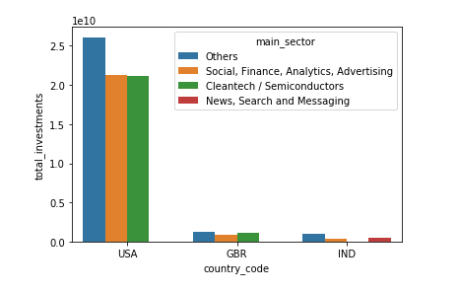
Results
Plot showing the number of investments in the top 3 sectors of the top 3 countries on one chart (for the chosen investment type FT).

Slide 8
Conclusions
The company Spark Fund can invest in companies like Flipcart, Mediavast, Freescale, Pinterest and many more with a venture funding type.
The countries that should be preferred for investment is USA, Britain and India.

