Slide 1
Risk Analysis Case Study
[Consumer Finance Company]

Slide 2
Business Understanding
If the applicant is likely to repay the loan, then not approving the loan results in a loss of business to the company
If the applicant is not likely to repay the loan, i.e. he/she is likely to default, then approving the loan may lead to a financial loss for the company

Slide 3
Case Statement
In this case study, you will use EDA to understand how consumer attributes and loan attributes influence the tendency of default.

Slide 4
Data Cleaning and Manipulations
Initially the total columns were 111
After removing all the columns with all values with NAN, total no of columns came down to 57
After that found out the total percentage of null values in columns having NAN, then fixed the threshold to 30 and removed all the columns having greater that 30% null values.
For rest with less than 30% null values, replaced the missing values by calculations as in next slide.

Slide 5
Replacing Missing values
Emp_title: This column had around 6% null values. Since this is a categorical variable, I calculated the mode and replaces the missing values with mode - US Army
1
title: This column had around title 0.03 % null values. Since this is a categorical variable, I calculated the mode and replaces the missing values with mode - Debt Consolidation
2
revol_util:This column had missing values of 0.13%, since its numerical value and value id too small percentage, replacing it with 0.0
3
last_pymnt_d: Since this is a date column and number is too small, replacing this with mode
4
collections_12_mths_ex_med, chargeoff_within_12_mths, pub_rec_bankruptcies, tax_liens – Since these are numerical values and percentage of nulls are too low, replacing all the NAN values with 0.0
5
emp_length: replacing this categorical variable with mode
6

Slide 6
Replacing the Types of columns for univariate analysis
Getting all the type details with loans_df.info(verbose=True)
Replacing int_rate to float using > loans_df['int_rate'].str.rstrip("%").astype(float)
Parsing and using only year for analysis for issued_year column using loans_df["issued_year"] = loans_df["issue_d"].str[4:] and loans_df["issued_year"].astype(int)

Slide 7

Univariate Analysis
First we need to create the separate dataframes for analysis.
For this we consider loan_status column, one df with chargedOff and df column with FullyPaid for analysis.

Slide 8
Default/Non-Default analysis
100*(loans_df.loan_status.value_counts())/ (len(loans_df))
By using above calculations> result was,
Fully Paid 82.961956
Charged Off 14.167737
Current 2.870307
Around 86% are non-default and around 14% is default

Slide 9
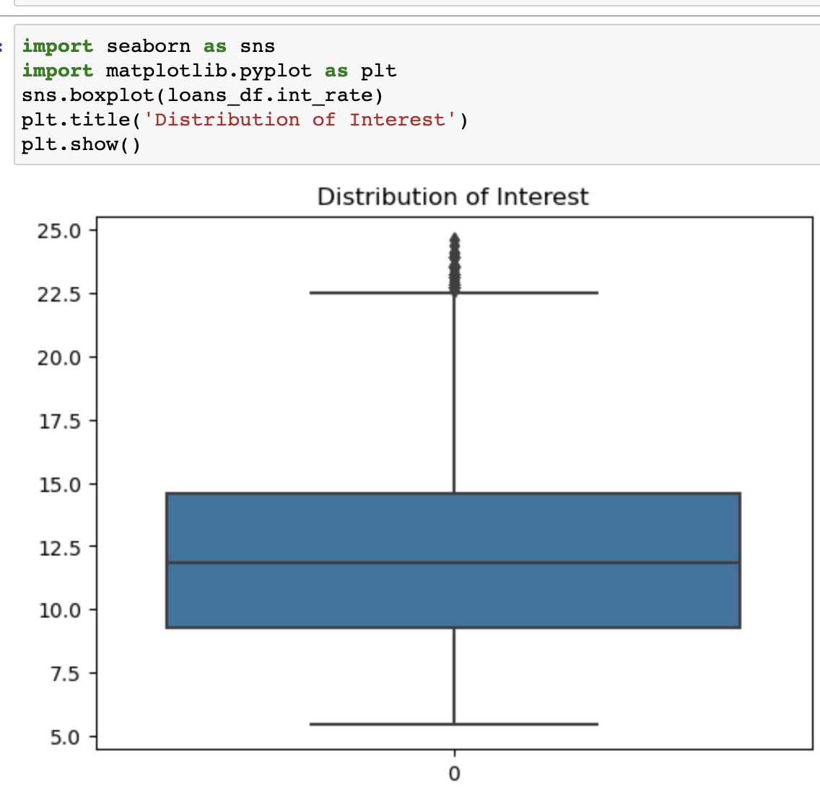
Univariate Analysis – Int_Rate
Plot shows the distribution of interest
Bin the interest rates to low, medium and high and
doing univariate analysis

Slide 10
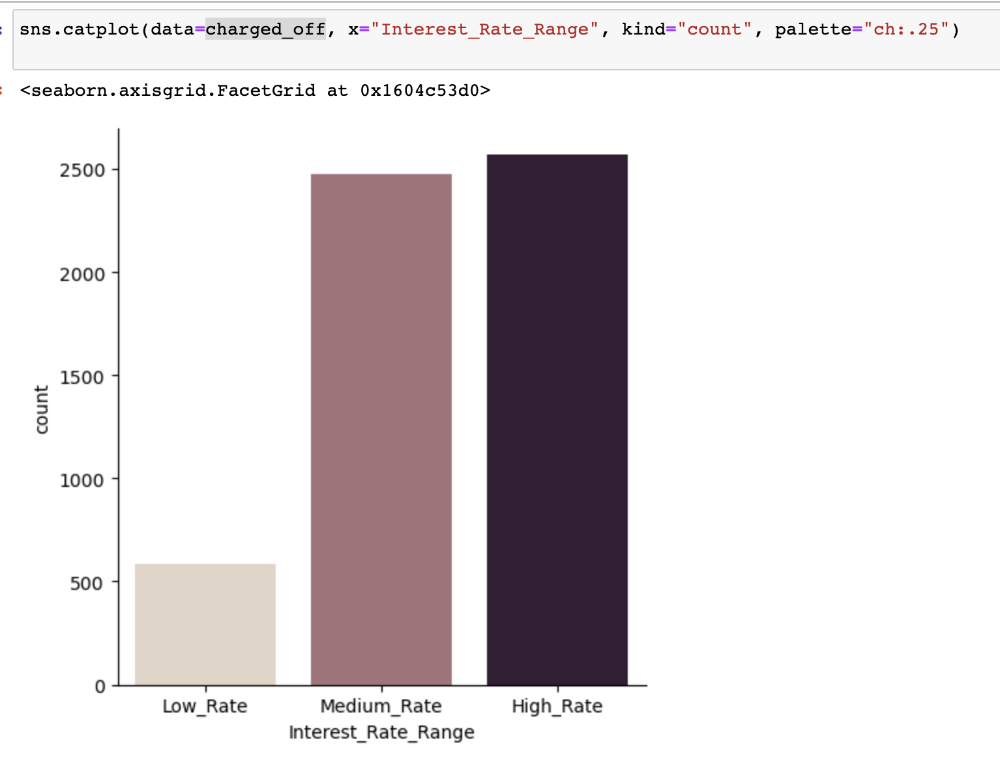
Univariate analysis - Int_Rate
One with higher interest range is to default more

Slide 11
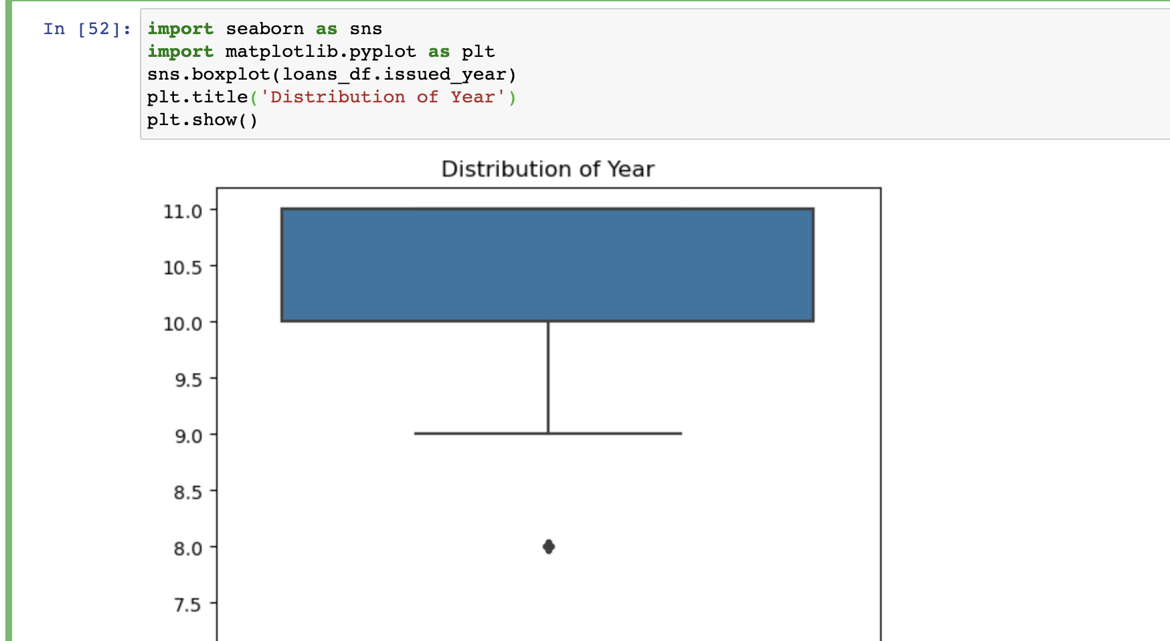
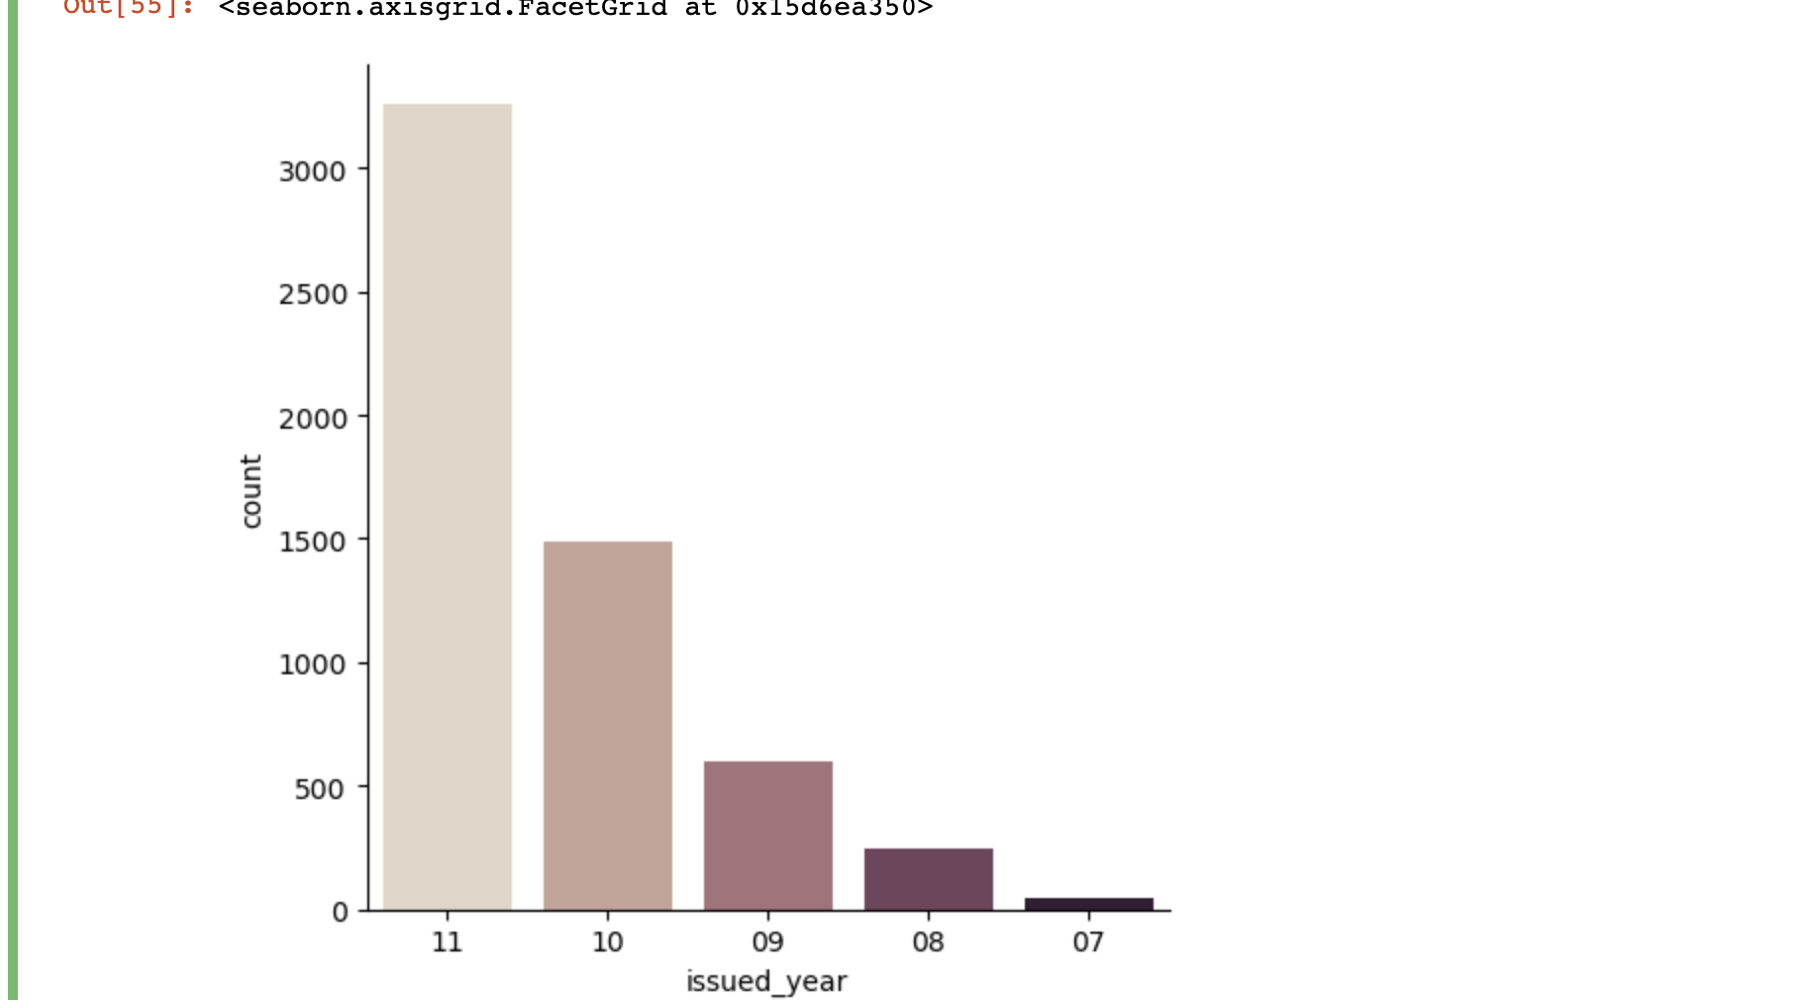
Univariate Anlaysis - issue_d
Compared to year on year,
every every has increasing rate of defaults

Slide 12
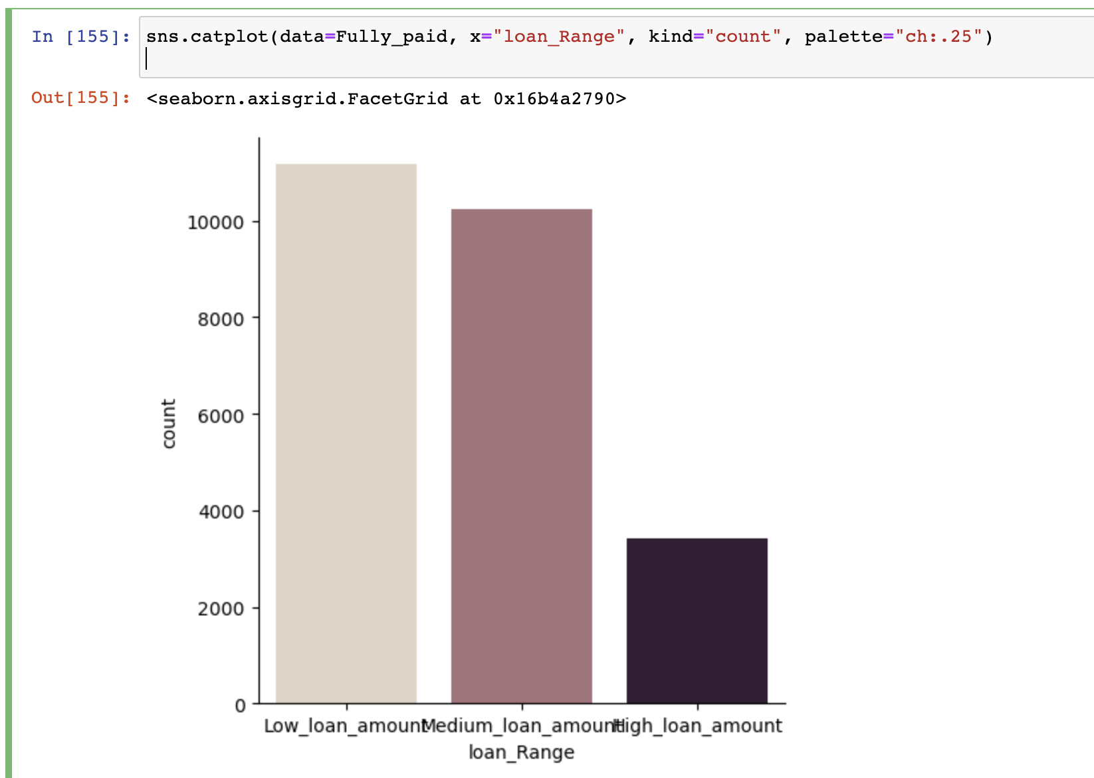
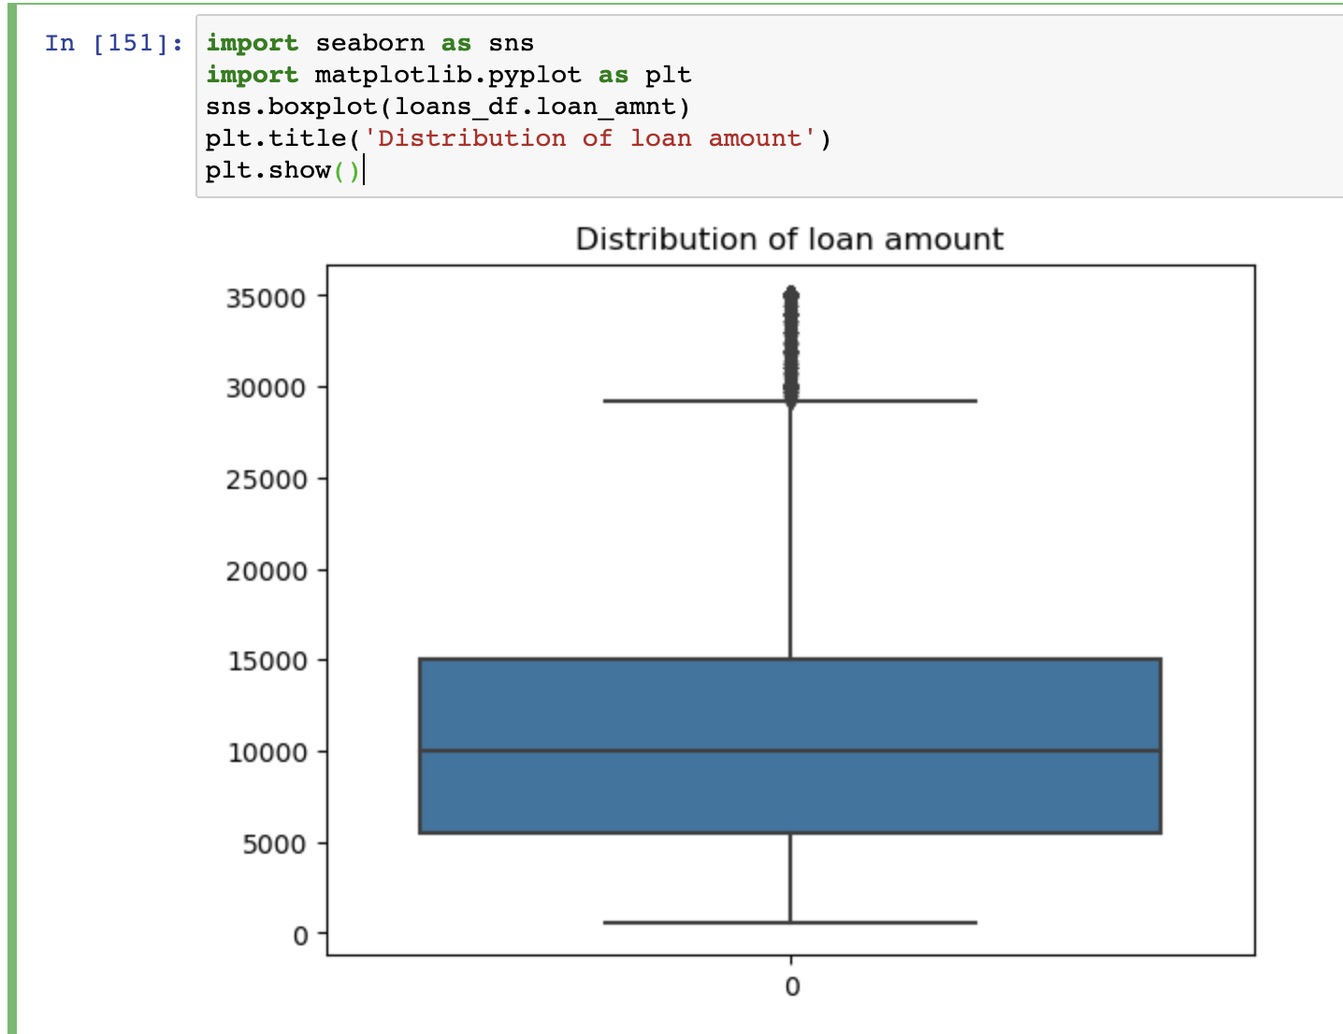
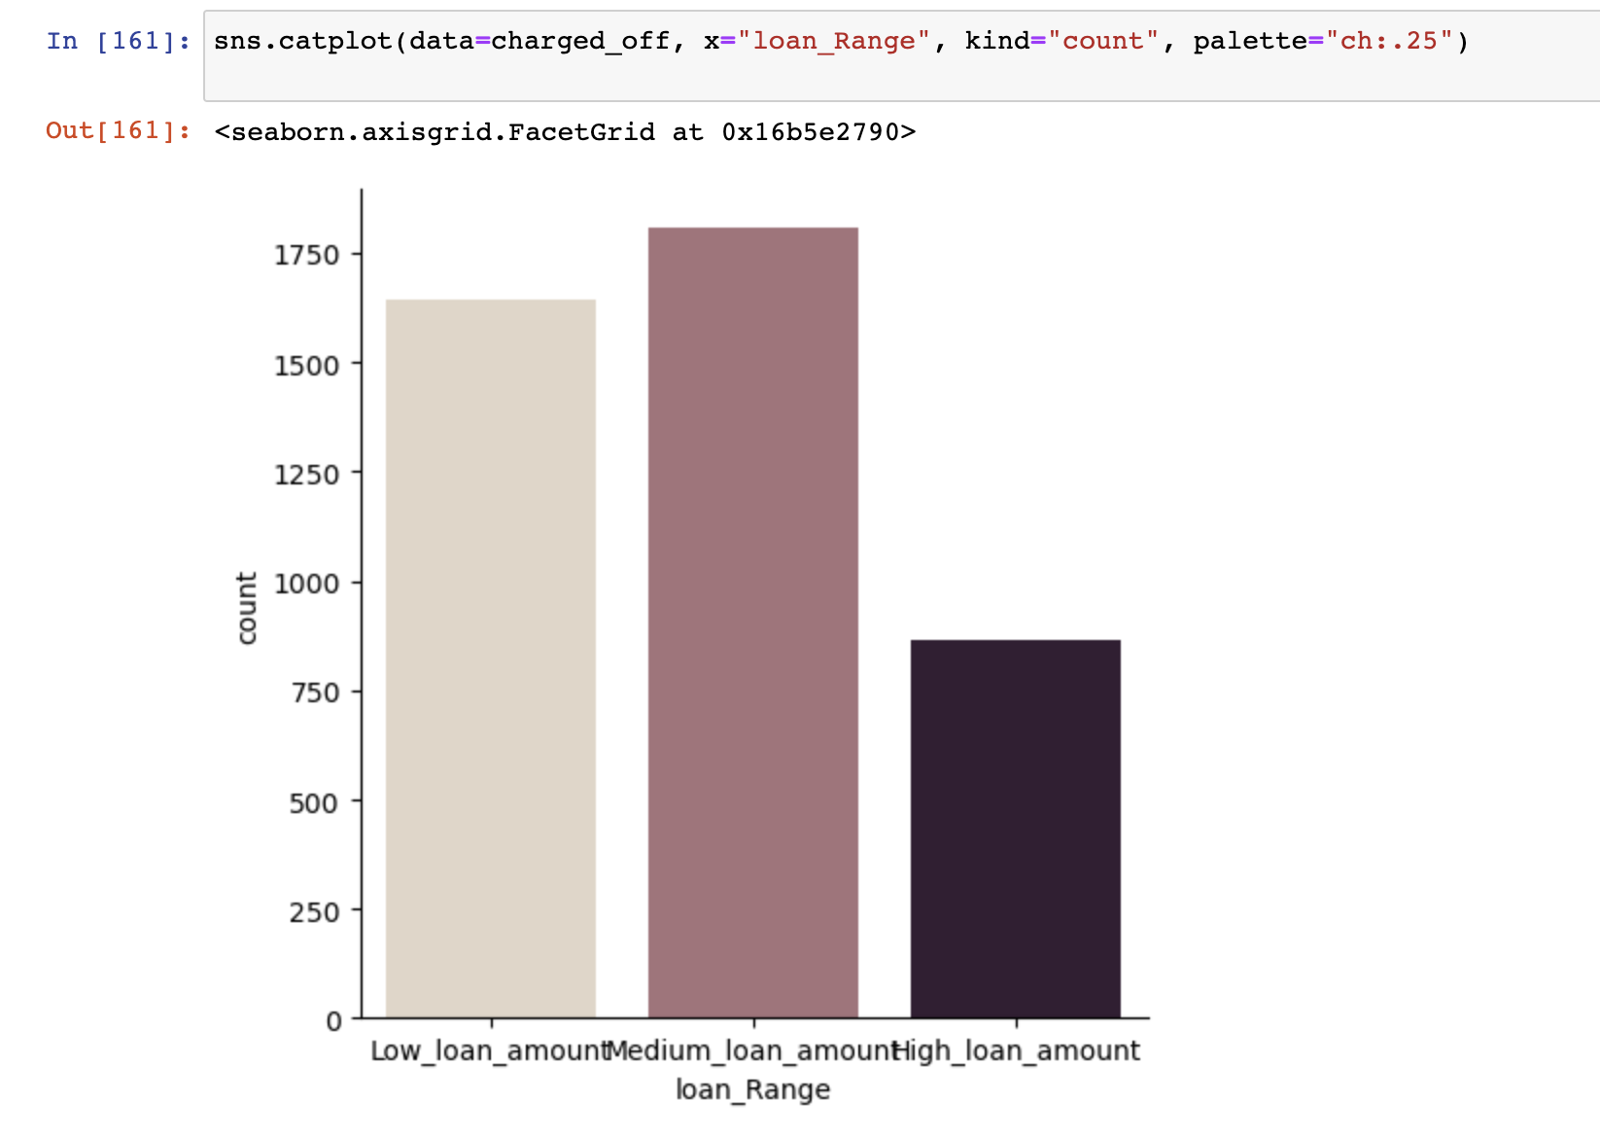
Univariate analysis – laon_amt
Binning the loan values to low, medium and higher range
One who falls under medium loan range is said to
default the most
One with low loan amount has paid fully.

Slide 13
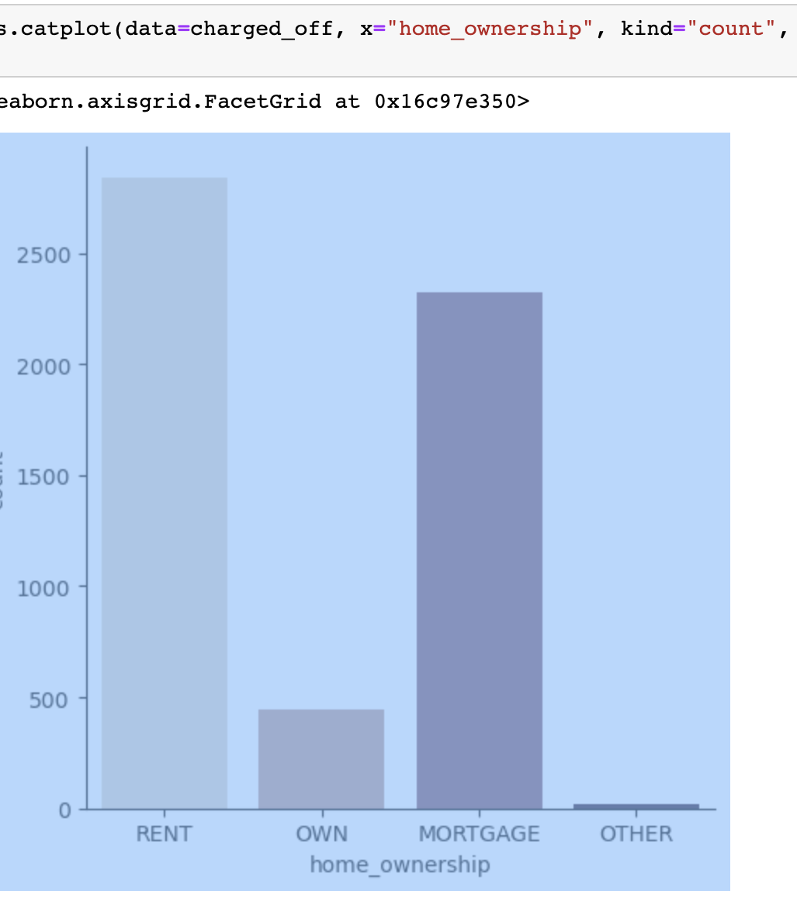
Univariate Analysis – Home_ownership
One who are in rent/mortage are to
default the most

Slide 14
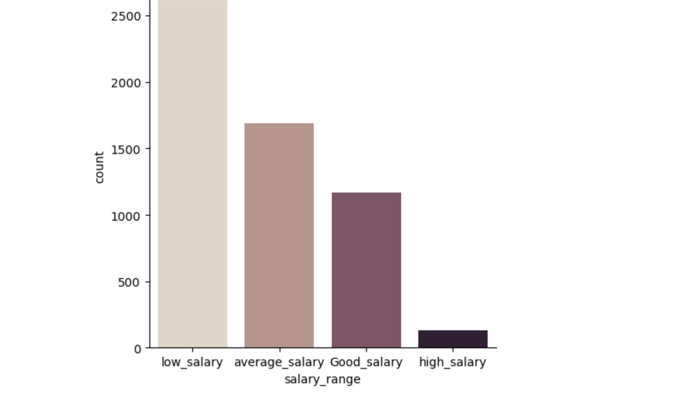
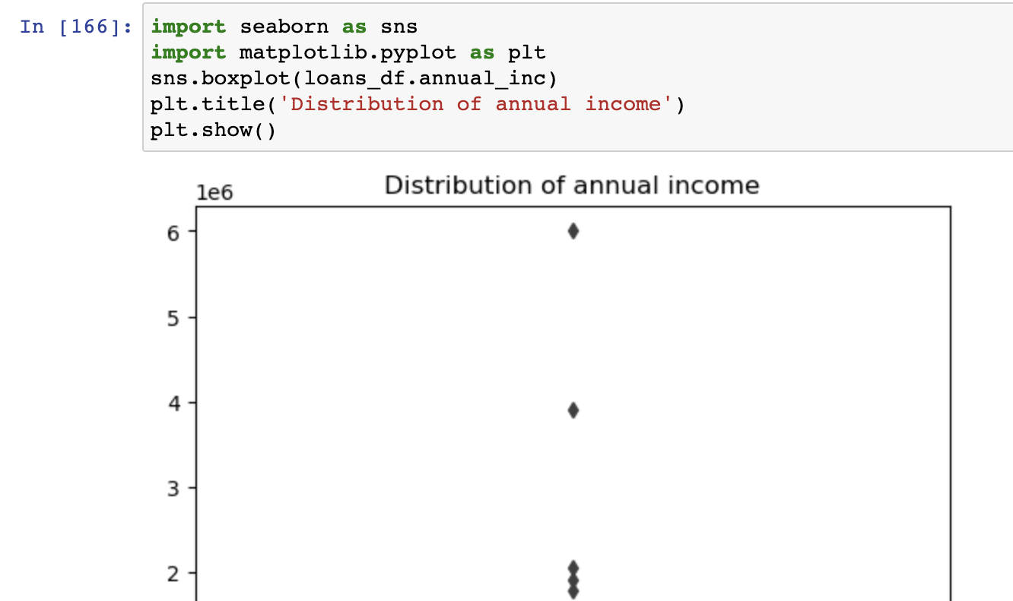
Univariate Analysis – Salary range
One with low salary is to default the
most compared to one with high salary

Slide 15
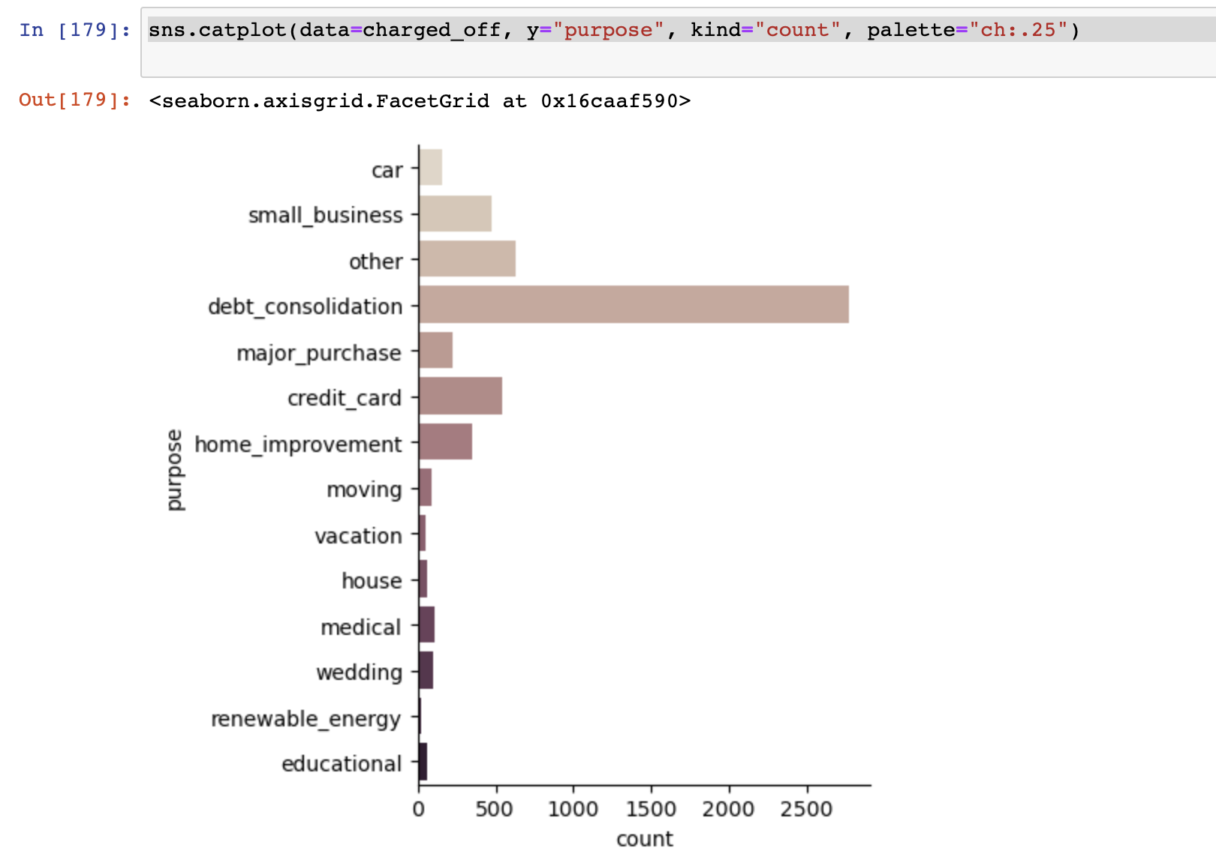
Univariate Analysis - purpose
One who has taken loan for purpose of
debt consolidation is to default the most
compared to others

Slide 16
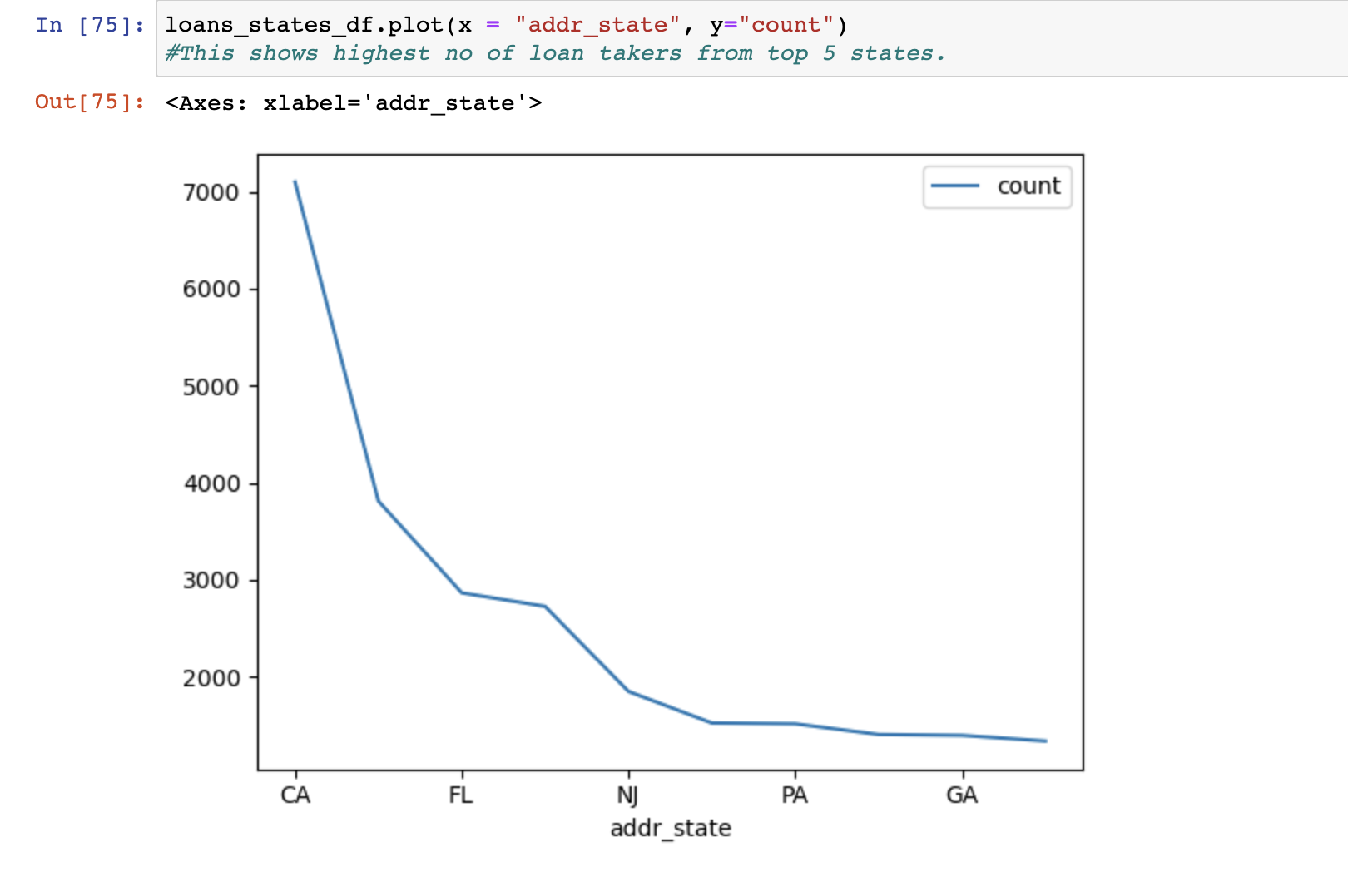
Segmented Univariate – addr_state
Grouping by state Grouping by state and checking which top 5 states has taken most loans
As we can see, California, Florida, New Jersey, Pennsylvania, Georgia has taken more loans

Slide 17
Bivariate analysis – default correlation
 | VAR1 | VAR2 | Correlation
32 | member_id | id | 0.99
98 | funded_amnt | loan_amnt | 0.98
593 | total_pymnt_inv | total_pymnt | 0.97
195 | installment | funded_amnt | 0.95
194 | installment | loan_amnt | 0.93
131 | funded_amnt_inv | funded_amnt | 0.93
130 | funded_amnt_inv | loan_amnt | 0.91
625 | total_rec_prncp | total_pymnt | 0.91
657 | total_rec_int | total_pymnt | 0.90
658 | total_rec_int | total_pymnt_inv | 0.89
As we can see, the top 10 highly correlated variables for defaults

Slide 18
Bivariate Analysis – Non-defaults correlation
VAR1 | VAR2 | Correlation
611 | total_rec_prncp | funded_amnt | 1.00
32 | member_id | id | 0.99
610 | total_rec_prncp | loan_amnt | 0.98
580 | total_pymnt_inv | funded_amnt_inv | 0.98
625 | total_rec_prncp | total_pymnt | 0.98
547 | total_pymnt | funded_amnt | 0.98
98 | funded_amnt | loan_amnt | 0.98
593 | total_pymnt_inv | total_pymnt | 0.97
546 | total_pymnt | loan_amnt | 0.97
131 | funded_amnt_inv | funded_amnt | 0.96
As we can see, the top 10 highly correlated variables for Non - Defaults

Slide 19
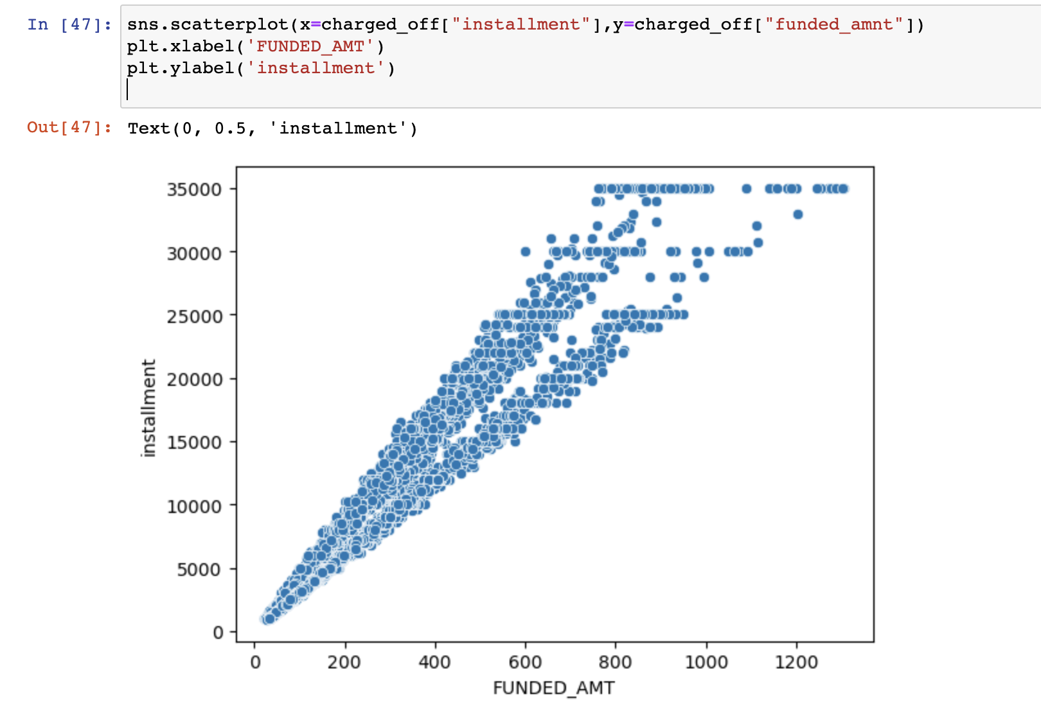
Example of correlation b/w installment and funded amount
As you can see, the graph is almost linear showing
that both are highly correlated

Slide 20
Bivariate analysis - Conclusions
Correlation with defaults and non defaults is almost the same, with slight differences.

Slide 21

Thank You

