Slide 1
DETECTING FAKE USER ACCOUNTS ON TWITTER
By
Pooja Poddutoori(00762928)
Pavan kumar kandimalla(00751432)
Pavan kumar marella(00753828)

Slide 2
Contents
Abstract
Goal
Modules Description
Machine Learning Models
Implementation
Approach
Output
Conclusion
Thank you

Slide 3
ABSTRACT
In this project machine learning-based methods are used to detect fake accounts that could mislead people.
For this purpose, the dataset generated was pre-processed and fake accounts were determined by machine learning algorithms.
Naïve Bayes, SVC(Support Vector Classifier), K-Nearest neighbour algorithms are used for the detection of fake accounts.
Classification performances of these methods are compared and the logistic regression proved to be more successful than the others.
We used these algorithms to calculate the accuracy and error rate of classifiers by displaying the results of each classifier using bar graph.

Slide 4
Goal
To detect fake accounts on twitter
We have investigated the nature of spam users on Twitter with the goal to improve detection mechanisms.

Slide 5
Modules description
Data collection: This project includes one datasets from kaggle for fake accounts of size 1001 rows respectively. The twitter users data based analysis is performed and various factors like the number of redirections, domain lookup response time, etc. are considered for analysis.
Literature survey: A literature survey in a project report represents the study done to assist in the completion of a project. A literature survey also describes a survey of the previous existing material on a topic of the report.
Exploratory data analysis: Exploratory data analysis(EDA) is used by data scientists to analyze and investigate data sets and summarize their main characteristics, often employing data visualization methods. It can also help determine if the statistical techniques you are considering for data analysis are appropriate.

Slide 6
Machine learning modelling: A machine learning model is a file that has been trained to recognize certain types of patterns. You train a model over a set of data, providing it an algorithm that it can use to reason over and learn from those data. Classification model has been used in this project due to the presence of categorical values. A set of classification models have been tried and tested upon the dataset.
Model metrics and fitness checking: Model metrics include accuracy score, confusion matrix, classification report, precision scores, recall score and f1 scores.

Slide 7
Machine Learning Models
We trained the dataset to a variety of machine learning algorithms namely:
KNN Classifier
Multinomial Naïve Bayes
Linear SVC

Slide 8
IMPLEMENTATION Machine Learning Algorithms
Multinomial Naive Bayes:
KNN(K- Nearest Neighbour) Classifier
Linear SVC(Support Vector Classifier)
It’s a probabilistic learning method
It calculates each tags likelihood for a given sample
Output the tag with the greatest chance.
Supervised machine learning algorithm
Suitable for classification with discrete features
Used to solve both classification and regression problems
It fits to the data we provide by returning best fit hyperplane which divides or categorizes the data we provide
Classifies the data point on how its neighbor is classified
Implemented in terms of liblinear

Slide 9
Approach
We used python language to develop the above mentioned classification methods. We trained and tested our models with the dataset in 80:20 ratio respectively. This model can also take manual entry data of a particular user to determine the account type, but in order to predict the manual data first we have to train the models with the datasets.

Slide 10
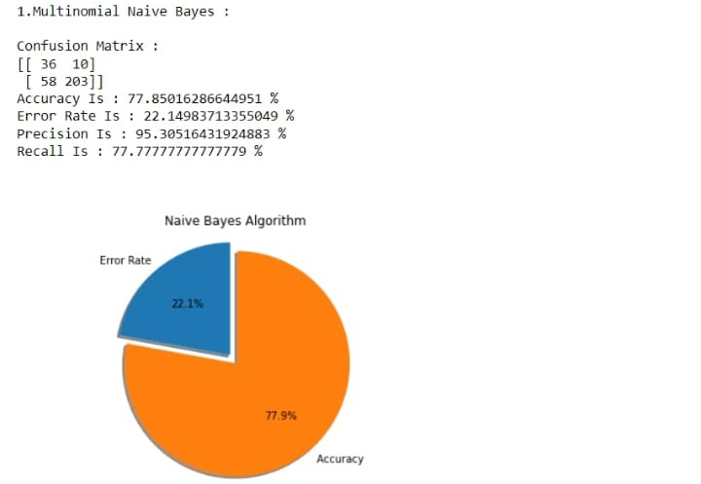
OUTPUT Graph
OO
Multinomial Naïve bayes model metrix and fitness checking

Slide 11
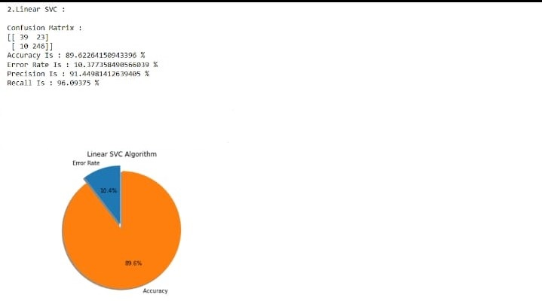
Graph
Linear svc model metrix and fitness checking

Slide 12
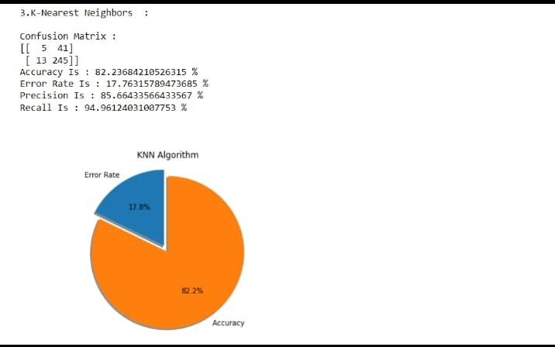
Graph
Knn model metrix and fitness checking

Slide 13
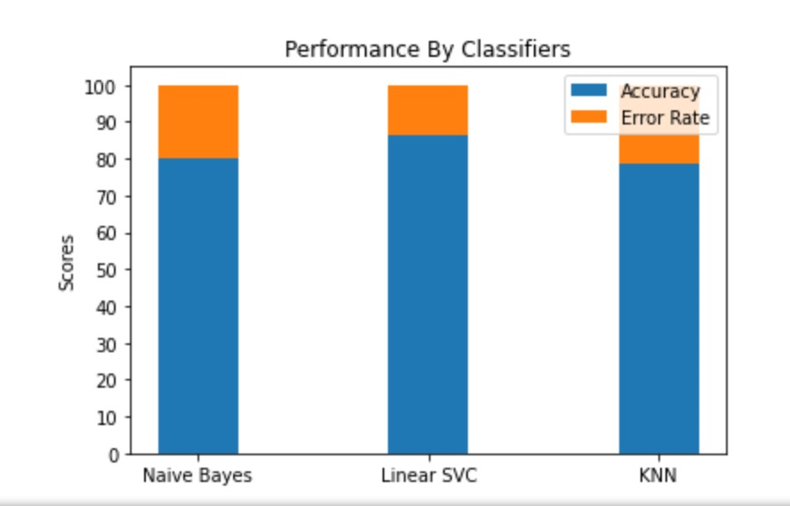
Graph
Classifier comparison

Slide 14
Conclusion
Here, detecting fake accounts on twitter has been solved by using Supervised learning Algorithm it is used to identify the effective feature set for fake accounts detection in the twitter social network.
The classification algorithms are proposed to improve detecting fake accounts on social networks

Slide 15


