Slide 1
Flood and Rainfall Forecasting using ML
A Climate Resilience Initiative
Meghana v b [01JST22UCS083]
Neha m [02JST22UCS068]
POOJA N R [02JST22UCS074]
SUSHMA R SOGALI [02JST22UCS120]

Slide 2
Introduction
Floods are increasingly frequent due to climate change.
Accurate rainfall prediction helps in disaster management.
This project leverages ML to forecast rainfall regionally.

Slide 3
Dataset Overview
Source: Rainfall in India (1901–2015) dataset.
Features include: YEAR, SUBDIVISION (state), MONTHLY, SEASONAL, ANNUAL rainfall (mm).
Data is grouped and preprocessed per region.

Slide 4
Preprocessing Steps
Lowercased region names (SUBDIVISION).
Sorted data year-wise for each region.
Normalized ANNUAL rainfall using MinMaxScaler.
Created sliding windows of 5 years for sequence input.

Slide 5
Model Used: LSTM
LSTM (Long Short-Term Memory) neural networks.
Excellent for time-series forecasting tasks.
Captures temporal dependencies across multiple years.

Slide 6
Model Architecture
Input: 5-year window of normalized rainfall (shape: 5x1).
LSTM layer: 50 units with ReLU activation.
Dense output layer: 1 unit predicting next year's rainfall.
Loss: Mean Squared Error (MSE)
Optimizer: Adam.

Slide 7
Training Setup
Each region (state) has an independent model.
Models trained for 100 epochs silently (verbose=0).
Saved in `.h5` format (TensorFlow models).

Slide 8
Input and Output Summary
Input: 5 previous years' rainfall (mm).
Output: Next year's predicted rainfall (mm).
Used to flag years with above-normal rainfall (flood risk).

Slide 9
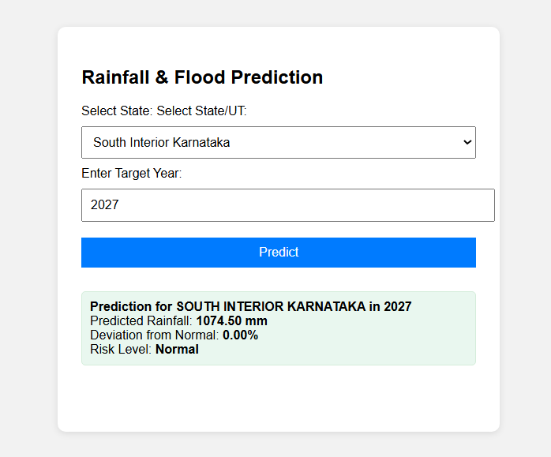
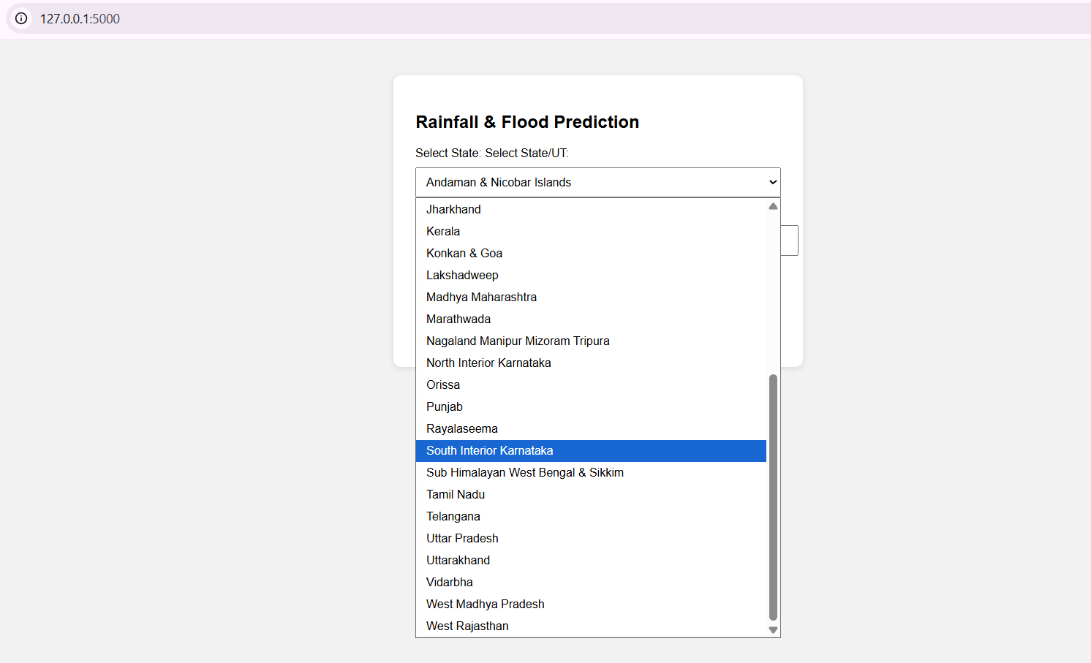

Slide 10
Regional Prediction Models
Separate LSTM model for each region (e.g., Kerala, Bihar, Assam).
Predicts future rainfall trends specific to that geography.
Custom models improve regional accuracy.

Slide 11
Application Interface
Backend API built in Flask or FastAPI.
Frontend: Basic HTML interface for predictions.
Users select region → system returns predicted rainfall.

Slide 12
Climate Change Impact
Helps detect anomalies from historical rainfall patterns.
Enables proactive flood response and infrastructure planning.
Contributes to data-driven climate change mitigation.

Slide 13
FUTURE SCOPE
Integrate real-time weather APIs
SMS-based alert system
Partner with disaster response agencies

Slide 14
Conclusion
ML-based rainfall forecasting supports flood preparedness.
LSTM models offer regional precision using historical data.
Scalable for use in government disaster management systems.

