Slide 1
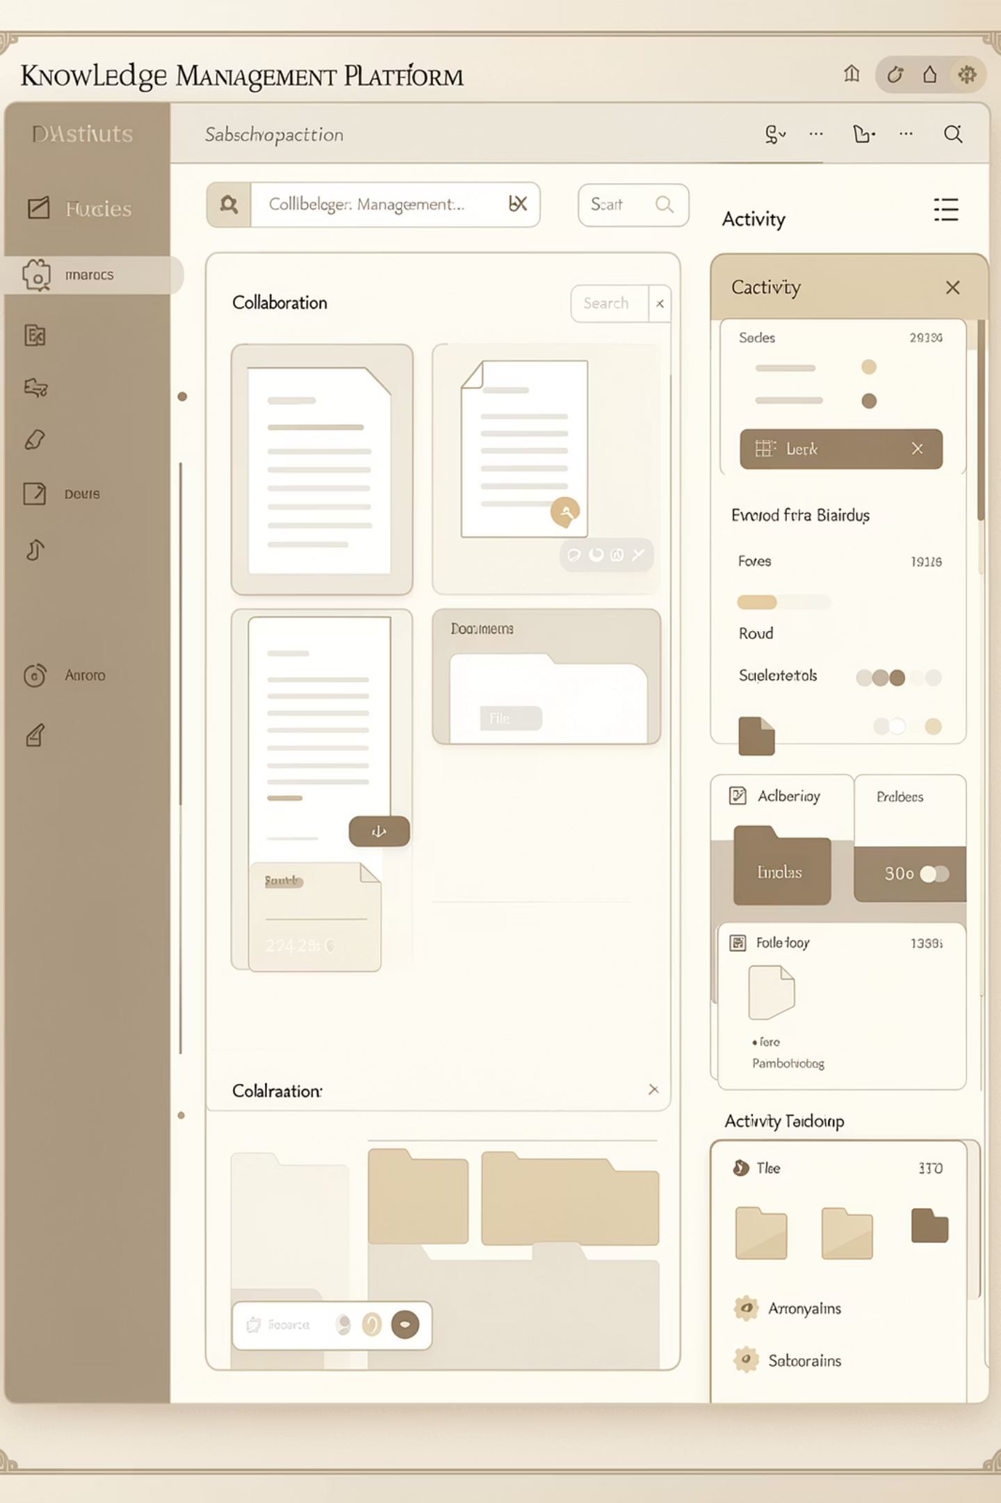
KnowHub
A web-based Knowledge Management System built on the MERN stack — designed to store, organize, search, and share knowledge resources in one centralized platform for organizations and educational institutions.
MERN STACK
ROLE-BASED ACCESS
ANALYTICS

Slide 2

The Problem
In many organizations, knowledge is scattered across folders, emails, chats, and local drives — making it difficult to search, reuse, and collaborate effectively.
Duplication of Effort
Poor Collaboration
Teams recreate work already done because existing knowledge is hard to find.
Siloed information prevents effective teamwork and knowledge sharing.
Wasted Time
Employees spend excessive time searching instead of producing.

Slide 3

KnowHub's Solution & Objectives
KnowHub provides a single platform where authorized users can upload, search, view, discuss, and manage knowledge resources efficiently.
Centralized Repository
Easy Categorization & Search
One place for all knowledge resources.
Locate documents by keyword, tag, or category.
Role-Based Collaboration
Activity Tracking
Secure, controlled access for all user types.
Monitor user contributions and engagement.

Slide 4
System Modules
KnowHub is organized into six core modules covering the full knowledge lifecycle.
User Authentication
Knowledge Repository
Registration, login, JWT auth, and role-based access (Admin / Contributor / Viewer).
Upload, store, view, download, and delete resources (PDFs, PPTs, videos, notes).
Search & Filter
Discussion Forum
Locate resources by keyword, topic, tags, author, or category.
Comment on resources and exchange ideas with team members.
Analytics Dashboard
Admin Panel
Track views, downloads, uploads, and top contributors.
Manage users, categories, permissions, and content moderation.

Slide 5
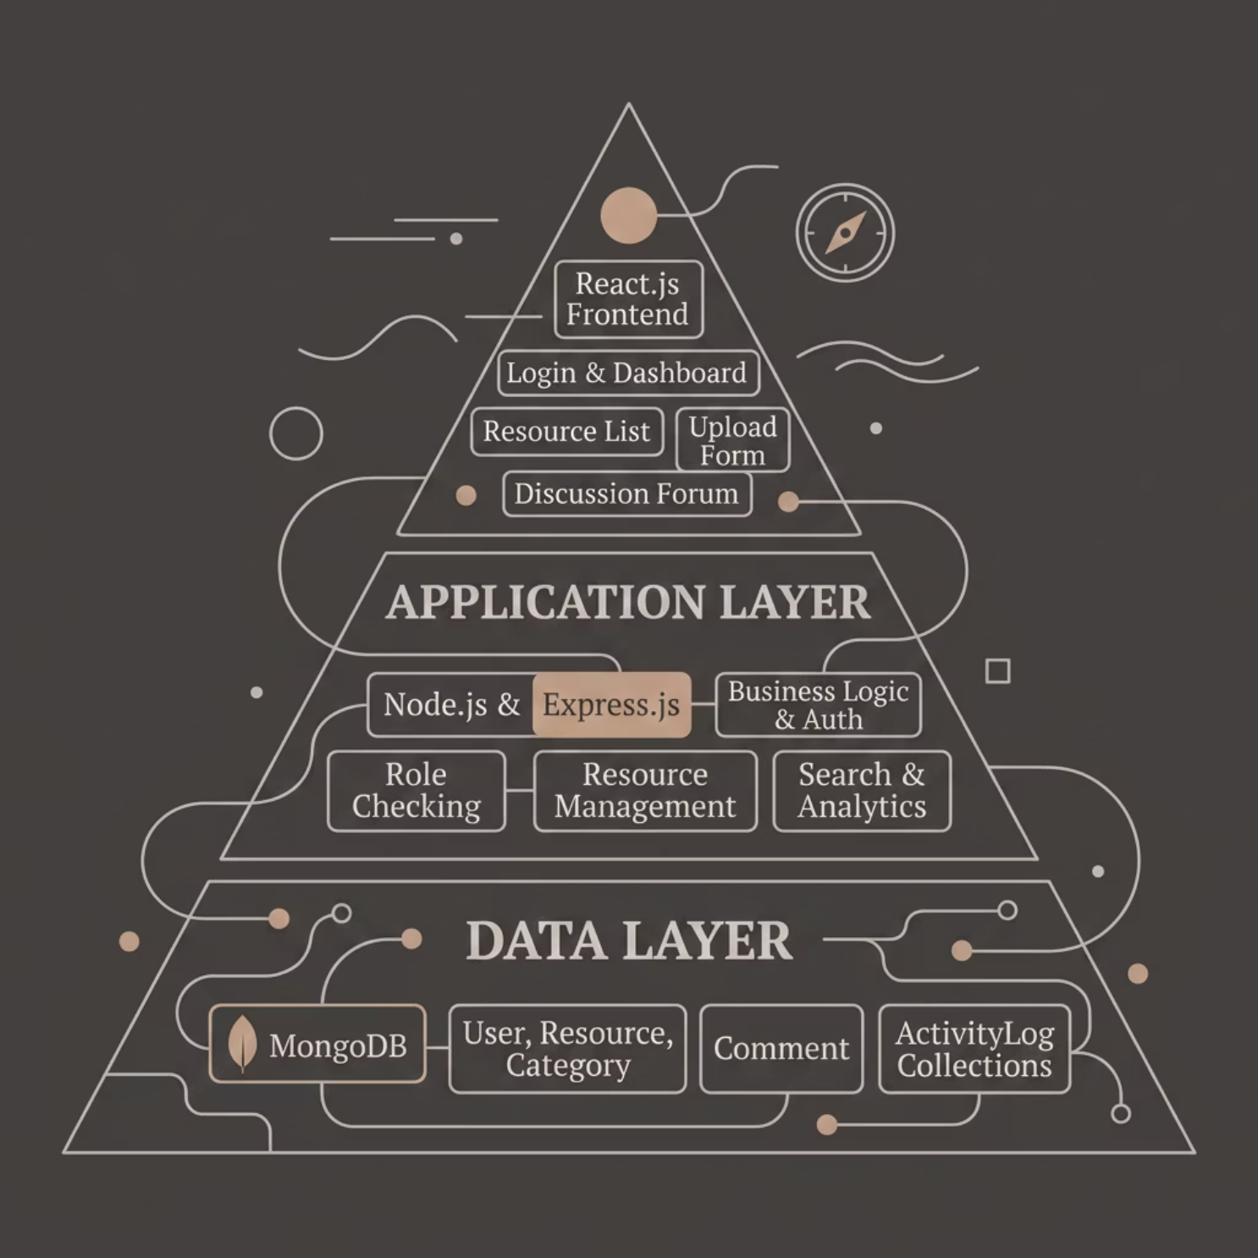

Three-Tier MERN Architecture
KnowHub follows a standard three-tier architecture — separating presentation, application, and data layers for easier development, testing, and scaling.
Presentation Layer
React.js — renders UI, accepts input, sends API requests.
Application Layer
Node.js + Express.js — handles business logic, validation, and role-based access control.
Data Layer
MongoDB — stores users, resources, comments, categories, and activity logs.

Slide 6

System Flow
Validate & Auth
Read/Write DB
Return Response
User React
Send Request
This architecture supports secure role-based access, ensuring users with different permissions interact with the system safely and appropriately.

Slide 7
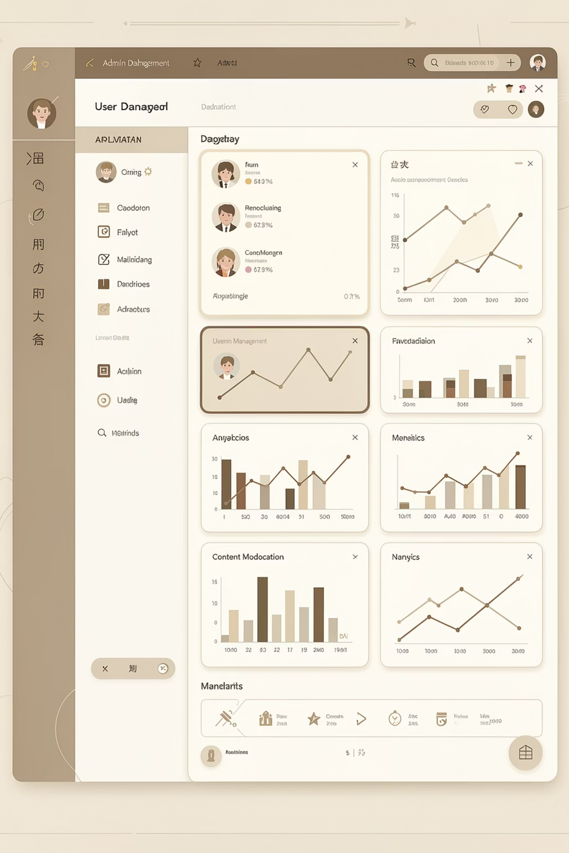
Administrator Module
The Admin module provides complete control over resources, users, analytics, and system configuration.
Resource Lifecycle
Manage upload, update, and deletion of all resources.
User Administration
Administer accounts, roles, and permissions.
Analytics & Reports
View download activity, usage stats, and system reports.
Comment Moderation
Oversee and moderate discussion threads across resources.

Slide 8

REST API Design
KnowHub exposes RESTful APIs using standard HTTP methods across four modules.
Method
Endpoint
Description
Role
POST
/api/auth/register
Create new user
Public
POST
/api/auth/login
User login
Public
POST
/api/resources
Upload resource
Contributor
DELETE
/api/resources/:id
Delete resource
Admin
POST
/api/categories
Create category
Admin
POST
/api/comments
Add comment
Authenticated
Error Responses: 400 Bad Request · 401 Unauthorized · 403 Forbidden · 404 Not Found · 500 Internal Server Error

Slide 9
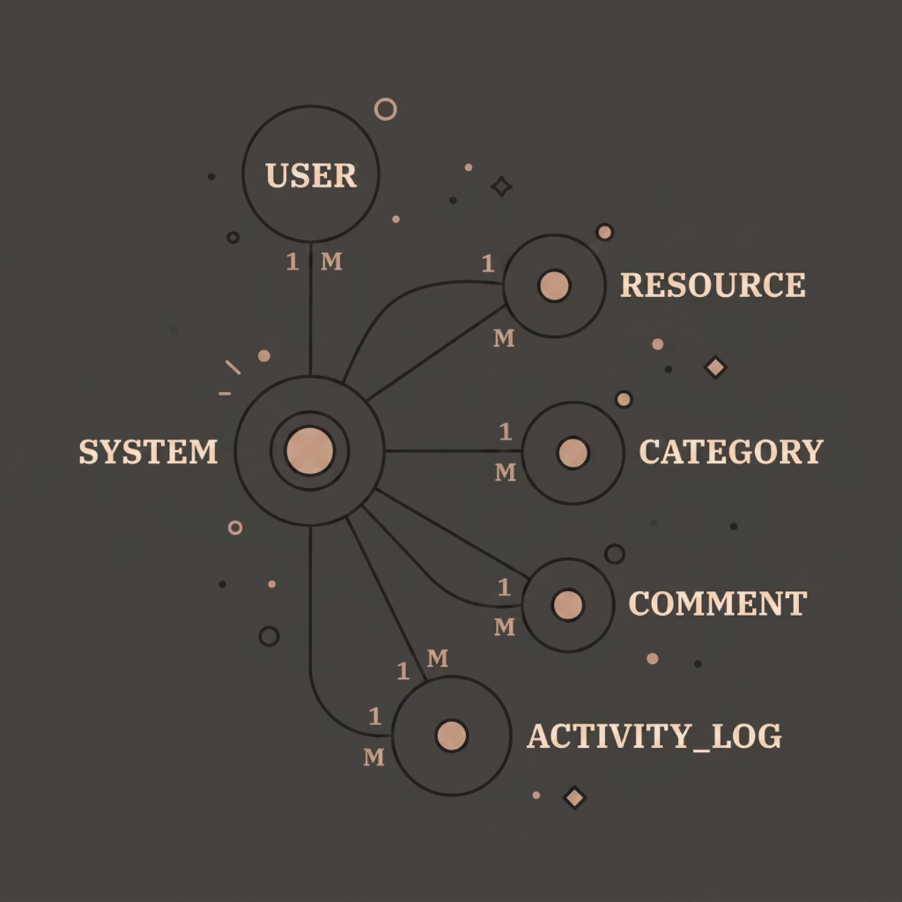

Data Model & Relationships
Five MongoDB collections form the data backbone of KnowHub, linked through foreign-key relationships.
USER
RESOURCE
CATEGORY
COMMENT
Accounts, roles, status
Documents, metadata, file URLs
Resource classification
Discussion threads & replies
ACTIVITY_LOG
Views, downloads, uploads

Slide 10

Conclusion & Future Roadmap
KnowHub delivers a production-ready knowledge management system using MERN stack architecture — successfully implementing secure authentication, resource sharing, interactive commenting, and comprehensive analytics through well-designed UML diagrams (use case, class, sequence, activity, DFD).
Delivered
Secure auth, resource sharing, commenting, analytics, and full UML documentation.
Next Up
Real-time collaboration features and AI-powered content recommendations.

