Slide 1
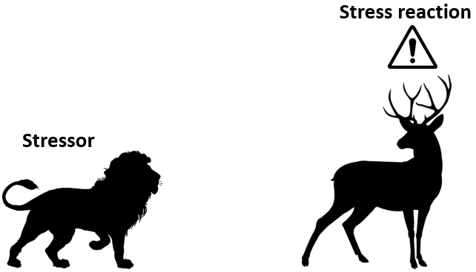
Stress
Definition
Stressor – the object or event causing stress
E.g. the lion
Stress – “the non-specific response of the body to any demand for change”
– physical or emotional response to stressor
E.g. the deer running away in fear

Slide 2
Stress
Causes of stress
Performance pressure
E.g. before an evaluation or assessment
Stressors – object or event causing stress
E.g. physical (pain, disease etc.), psychosocial(conflicts, getting bullied etc.), socioeconomic (money problems, poverty), sensory (noise, bright light etc.), life events, crisis, anticipation, acute or chronical stress (stressed for long periods)……
Personal characteristics
E.g. hormonal problems (cortisol not produced), chronical increased tension (small things trigger response, uncontrollable emotions etc.), no coping strategy, psychological illness (depression, anxiety etc.)
Courtesy: Katharina slides

Slide 3
Stress
Eustress vs Distress
Eustress – positive stress
Feels motivated, excited
E.g. new job, buying house, marriage
Distress – negative stress
Feels anxious, concerned
E.g. job insecurity, interpersonal conflicts
Psychological signals (heart rate, cortisol etc.) are similar
Cite Hans Selye

Slide 4
Workplace stress
Time Stress
worry about lack of time, rushing to meet deadline
may effect quality of work
Possible scenarios?
complete work in 5min but robot is slow
worker interrupted but robot keeps working, now worker has to catch up
Anticipatory Stress
future stress – stress about upcoming event
frustrated (because nothing can be done about it yet)
Possible scenarios?
explain the work or demo (maybe along with robot?)
waiting for evaluation of work
‘Stress and the Manager’ by Dr Karl Albrecht

Slide 5
Workplace stress
Situational Stress
tense situations (or conflict situations) with no control
feels powerless, lack of support
Possible situations?
robot suddenly starts making a lot of mistakes/ “mis-behaving”
Encounter Stress
meeting stress – about interaction with others (esp. unpredictable, dissatisfied or unfriendly bosses/colleagues/clients)
Possible situations?
repeated unfriendly and dominant behavior from robot
‘Stress and the Manager’ by Dr Karl Albrecht

Slide 6
Stress datasets

Slide 7
Data
Sensors & Signals
Video/images?
Facial expressions
Gestures
Body posture
Audio recordings
Eye gaze tracking
Physiological signals
Cortisol level
Heart rate
Blood pressure
Skin temperature

Slide 8
Approach
Survey
Find most common types of stress in workplace
Dataset
Design experiment to simulate common stress scenario
Annotate recorded data – NOVA, physiological signals
Machine learning
Neural networks for detecting stress in signals
Explainability
Transfer learning for persons with ASD(Autism Spectrum Disorders)

