Slide 1
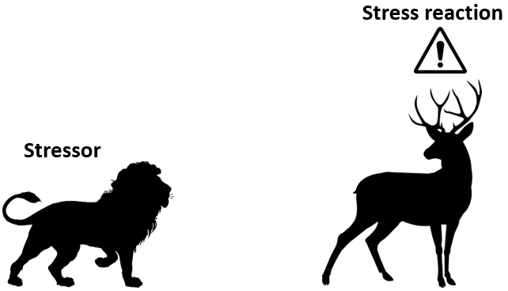
Stress
Definition
Stressor – the object or event causing stress
E.g. the lion
Stress – “the non-specific response of the body to any demand for change”
– physical or emotional response to stressor
E.g. the deer running away in fear

Slide 2
Stress
Causes of stress
Performance pressure
E.g. before an evaluation or assessment
Stressors – object or event causing stress
E.g. physical (pain, disease etc.), psychosocial(conflicts, getting bullied etc.), socioeconomic (money problems, poverty), sensory (noise, bright light etc.), life events, crisis, anticipation, acute or chronical stress (stressed for long periods)……
Personal characteristics
E.g. hormonal problems (cortisol not produced), chronical increased tension (small things trigger response, uncontrollable emotions etc.), no coping strategy, psychological illness (depression, anxiety etc.)
Courtesy: Katharina slides

Slide 3
Stress
Eustress vs Distress
Eustress – positive stress
Feels motivated, excited
E.g. new job, buying house, marriage
Distress – negative stress
Feels anxious, concerned
E.g. job insecurity, interpersonal conflicts
Psychological signals (heart rate, cortisol etc.) are similar
Cite Hans Selye

Slide 4
Workplace stress
Time Stress
worry about lack of time, rushing to meet deadline
may effect quality of work
Possible scenarios
complete work in 5min but robot is slow
worker interrupted but robot keeps working, now worker has to catch up
Anticipatory Stress
Situational Stress
Encounter Stress
‘Stress and the Manager’ by Dr Karl Albrecht

