Slide 1

Sprocket Central Pty Ltd
Data analytics approach
Pooja Rao

Slide 2
Agenda
Introduction
Data Exploration
Model Development
Interpretation

Slide 3
Introduction
Project's Recap
Approach for data analysis
Sprocket Central Pty Ltd is a company that specializes in high-quality bike and accessories.
The company is looking to boost sales.
To target 1000 new customers that will bring highest value to business.
Bike purchased in past 3 years
Top industry contributing the maximum profit
Wealth segment
Number of cars owned in each states
Customer classification

Slide 4
Data Exploration
Data quality issues found in Customer Demographic, Customer Address, Transactions datasets:
CustomerDemographic | Gender column is inconsistent | DOB column of customers is inaccurate | Job_title, tenure columns is incomplete | Default column unnecessary
CustomerAddress | States column is inconsistent
Transactions | Online_orders, Brand, product_line, product_class, product_size, standard_cost, product_first_sold_date columns is incomplete

Slide 5
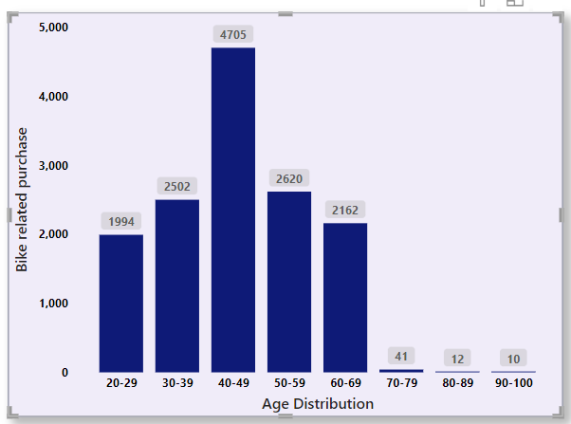
Data Exploration
Bike related purchase over the past 3 years based on age distribution
The data suggests that individuals in the age group of 40-49 years are the primary demographic for bike-related purchases.
This middle-aged group appears to be one of the most promising customer segments.
Understanding and catering to this age groups specific needs and preferences could be a key strategy for Sprocket Central to capitalize on this potential customer base.

Slide 6
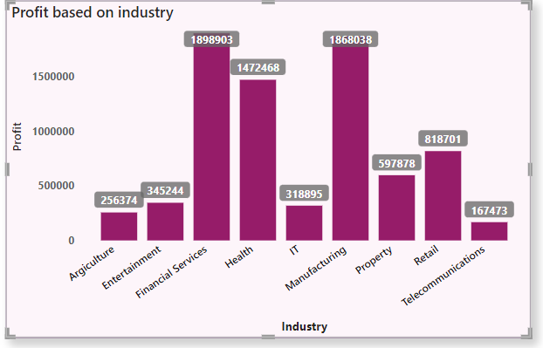
Data Exploration
Top industry contributing to the maximum profit & bike related purchase
Top 3 Industrial sectors bringing maximum profits are Financial services, Manufacturing, Health.
Industry which bought least profit is Telecommunication.

Slide 7
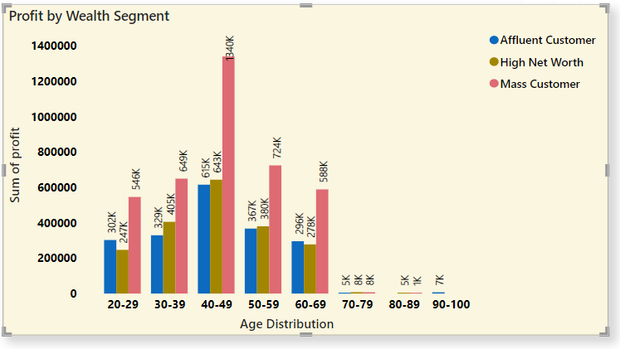
Data Exploration
Profit of wealth segment by age distribution
Mass customers, particularly those aged between 40-49, generate the highest profits across various age distributions.
This age group, in particular, stands out as a significant contributor to profitability, suggesting that Sprocket Central should pay special attention to serving this demographic to maximize their earnings.

Slide 8
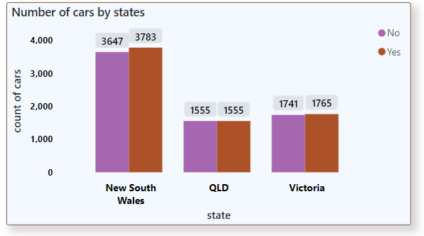
Data Exploration
Number of cars owned in each states
New South Wales, Victoria, and QLD appear to be potential markets for the company.
Notably, New South Wales stands out as a promising opportunity since it has an equal number of customers who own cars and those who do not.

Slide 9
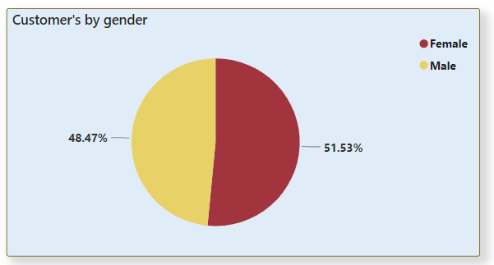
Data Exploration
Costumer's distribution on gender
From the data the highest number of customer is Female compared to Male.

Slide 10
Model Development
Customer classification
Based on the data analysis and the generated visuals, here are the high-value customer segments that should be targeted:
Customers between the ages of 40 to 49 years.
Customers who work in financial services, health, and manufacturing.
Customers who live in New South Wales and Victoria.
Female customers.
Customers of mass wealth segment.

Slide 11
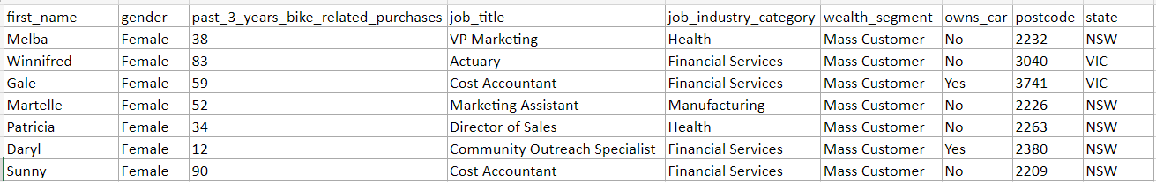
Interpretation
Here is the list of few customer based on our analysis that comes under high value customer classification:

Slide 12
Thank You

