Slide 1
MongoDb

Slide 2
What is MongoDb
Document oriented DB
Cross platform
Works on concept of json document and collections

Slide 3
Json document
Set of key value pair elements
{“name”:”tom”}

Slide 4
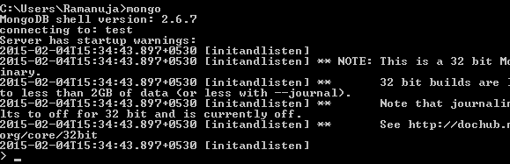
Mongod -dbpath “e:\mongodata”
Mongo command

Slide 5


DDL
Create or switch to DB
To list all databases
To Drop database
Switch to the database using use command
use mydb
db.dropdatabase()

Slide 6

Collections
Collection refers to a table in DB
Create Collection
db.createCollection(“emps”)
Show collections
Drop collections
Syntax :db.collectionname.drop()
Ex: db.emps.drop()

Slide 7
DML - Insert
To insert document
db.emps.insert({“emp-id”:1001,
“ename”:”tom”})
If “_id” parameter is nor defined then mongodb assigns unique ID

Slide 8
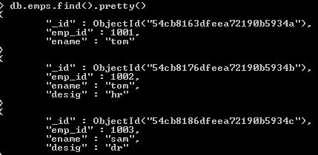
Query
To display all the documents in the collection

Slide 9

Filtering document
Equivalent to where clause
Displaying all the employees whose desig is “hr”
Using relational operators

Slide 10
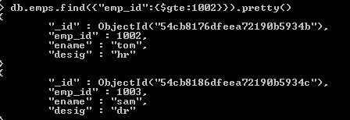
Filtering document
Using relational operators
$lt, $gt, $eq, $ne , $lte, $gte

Slide 11

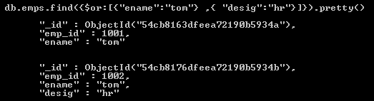
AND / OR
AND -- db.col.find({k:v, k:v})
OR -- db.col.find({$or: [ {k:v}, {k:v} ]})

Slide 12

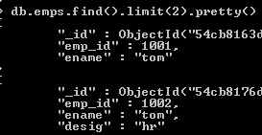
Projection
Selecting specific pair in document
Limit document (limit rows)

Slide 13
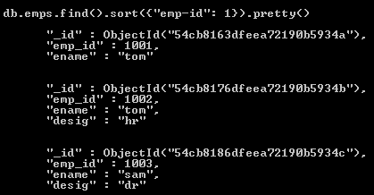
Sort document
If value is set to -1 for emp-id then it displays in descending order

Slide 14
Update document
Update (selection criteria, updated data)
Remove data
db.col.remove()
Removes all document
db.col.remove(selection criteria)
Removes only selected document
db.emps.update({‘emp_id’:1001},
{$set: {‘ename’:’amit’}}, {“multi”: true})

Slide 15
Aggregations
$sum
$avg
$max
$min
$group
$match

Slide 16
Aggregations
To find sum and average of salary
db.employee.aggregate({$group:
{"_id":0,
"total":{$sum:"$sal"},
"avrge":{$avg:"$sal"}
}
});
_id: 0 → not grouping on any field

Slide 17
To find sum and average in each department
db.employee.aggregate({$group:
{
"_id":"$dept",
"total":{$sum:"$sal"},
"average":{$avg:"$sal"}
}
});

Slide 18
To find no of employee in each department
db.employee.aggregate({$group:
{
"_id":"$dept",
"noofemployee":{$sum:1}
}
});

Slide 19
Indexes
To view all indexes for the collection
db.collection_name.getIndexes()
db.employee.getIndexes()
To create index on single field
db.collexction_name.ensureIndex({})
db.employee.ensureIndex({“ename”:1})
To create index on single field
db.employee.ensureIndex({“sal”:1,”dept”:1})
To drop index by name
db.employee.dropIndex(“ename_1)

Slide 20
TextSearch
Create the index
db.employee.ensureIndex({“ename”:”text”})
Query
db.employee.find($text:{$search:”ram”}).pretty()
Ex: It views with ename having
ram
ram raj
raja ram

