Slide 1

Activity #1: Starbucks market 2021S_CBD 2214_1 BIG DATA FUNDAMENTALS - DATA STORAGE NETWORKING
Presented by
Lekshmi Chandran Sheela
Parvathy Vysakh
Patricia Adolph
Pooja Selby
Suchithra Chandrasekharan

Slide 2
Contents
Introduction
Data Exploration
Analysis
Analysis & Observation - #1
Analysis & Observation - #2
Analysis & Observation - #3
Conclusion
References

Slide 3
Introduction
Aim : to predict customer behavior and loyalty to help Starbucks make better decisions
Dataset used :based on a survey taken from a customers at Starbucks(Malaysia)
21 features of 122 customers.
These features include :
Starbucks satisfactory survey.csv Source:Kaggle
Starbucks satisfactory survey encode cleaned.csv
Demographic information like gender, age range, employment status, income range
Their current behavior in buying Starbucks
Facilities and features of Starbucks that contribute to the behavior
Notes:
<<< What is the data about>>>
<<<From where we took the data>>>
<<<How many variables and observations rows and columns>>>
<<<What is our target and objective>>>
<<< Add hyperlink of main data csv fiile>>>
Refer kaggle for the above info

Slide 4
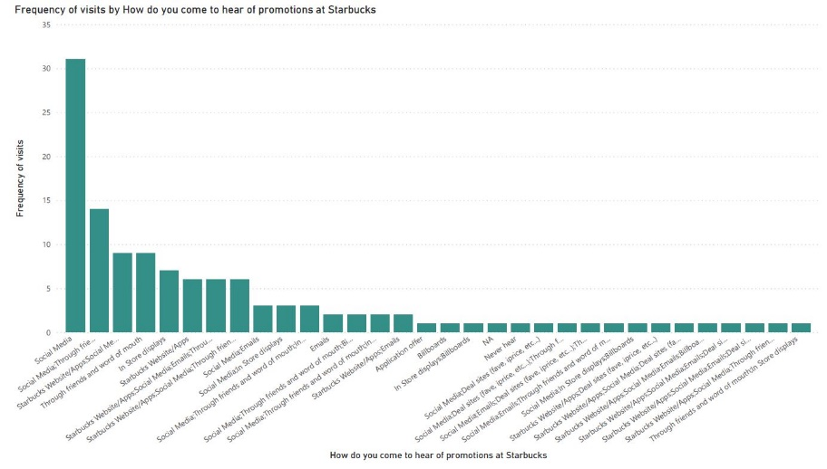
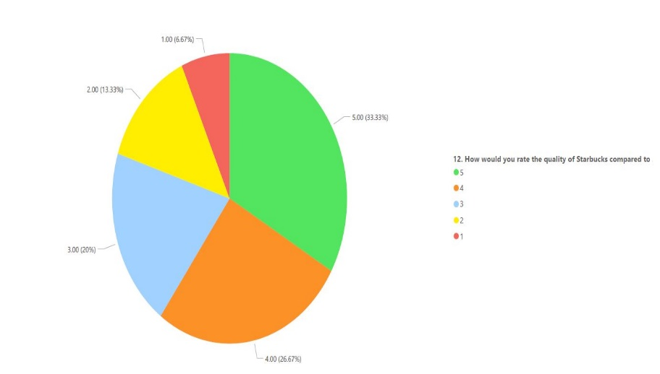
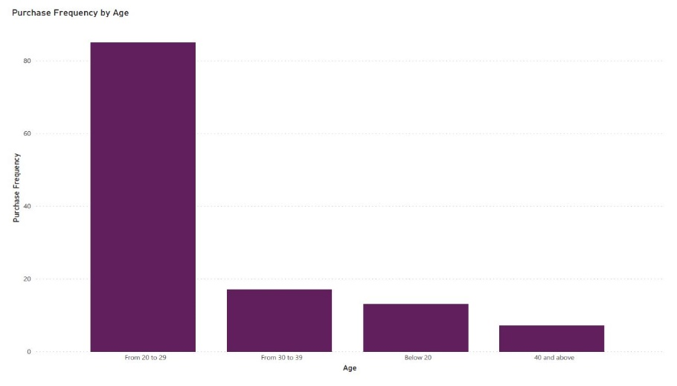
Data Exploration using Power BI and Python
Variable_Summary.xlsx
Notes:
<<<Add more images in power-bi like 4 by 4 simple plots>>>
<<Add Hyperlink of summary csv file>>>

Slide 5
Analysis
Data Visualization
Statistical Test
Machine Learning Technique

Slide 6
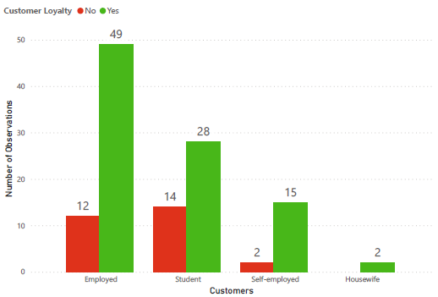
Analysis & Observation-1
Data Visualization Using Power-Bi

Slide 7
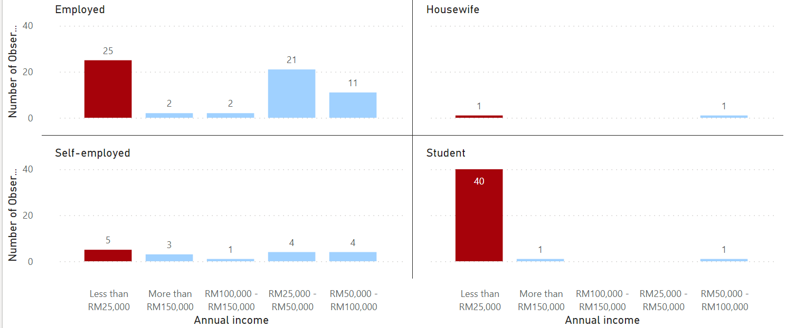
Analysis & Observation-1

Slide 8
Recommendation-1
Focus more on students by giving complimentary packs so that we can attract loyal student customers.
Focus on employed people with less income by introducing new offer packs like “minimum budget packs” or “Happy Wednesday offers”(flat % off)

Slide 9
Analysis & Observation-2
Chi – Square Test of Independence
Technique used to test independence between two categorical variables.
H0: There is no relationship between two variables.
H1: There is a significant relationship between two variables.
P < alpha (0.05) Reject H0

Slide 10
Analysis & Observation-2..
Using Chi – Square Test
Aim : To conclude whether serviceRate and wifiRate are related to each other.
H0: There is no relationship between serviceRate and wifiRate.
H1: There is a significant relationship serviceRate and wifiRate.
P-value = 4.3283758926926855e-09 (which is < 0.05)
Conclusion : Found significant relationship between serviceRate and wifiRate.
Performed Chi –Square test for the following set of variables and found a significant correlation between them.
serviceRate and ambianceRate
serviceRate and priceRate

Slide 11
Recommendation-2
The analysis using Chi-Square test proves that the overall service ratings provided by customers are dependent on the ambience and quality of Wi-Fi at the outlet.
The loyalty of the customers could be improved by refurbishing and depending on a superior high-speed Wi-Fi set up

Slide 12

Decision Tree
It is a graphical representation for getting all the possible solutions to a problem/decision based on given conditions.
Internal nodes represent the features of a dataset, branches represent the decision rules, and each leaf node represents the outcome.
In a Decision tree, there are two nodes, which are the Decision Node and Leaf Node. Decision nodes are used to make any decision and have multiple branches, whereas Leaf nodes are the output of those decisions and do not contain any further branches.
Figure1:Decision Tree(https://www.javatpoint.com/machine-learning-decision-tree-classification-algorithm,2021)

Slide 13
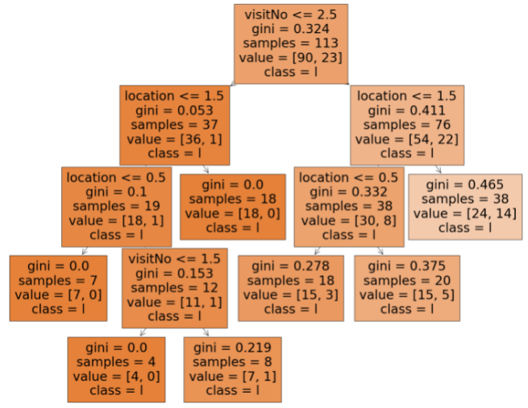
Analysis & Observation-3
Using Decision Tree
Features taken : Location of customers and number of visits
Analysed from Decision tree : As distance (location) increases , customer visits decreases.
Notes:
<<<Say about Decision Tree>>>>
Why we choose decision tree?
Due to the in-built tree structure decision tree, it is easy to understand the intuition behind the split of data.
It is widely used as a part of data exploration.
It has very little human intervention.
Decision Trees usually mimic human thinking ability while making a decision, so it is easy to understand.
The logic behind the decision tree can be easily understood because it shows a tree-like structure.

Slide 14
Recommendation-3
The customers who are travelling more than 3 km to Starbucks outlet seems to have high customer churning tendency. These customers only visit the store rarely, but the probability of churn is high.
Recommendation is to open a new outlet so as to promote more customers coming from a distant locality(<3km).

Slide 15
Conclusion
From knowledge Level
Focus students by giving complimentary packs.(Data visualization)
Focus low income employed people by reducing the price of products.(Data visualization)
Set-up superior high-speed Wi-fi.(Chi-Square test)
Open new outlet to promote more customers coming from a distant locality i.e., >3km.(Decision tree)
From data Level
Provide more options on drinks and pastries especially for elderly age group and fitness freaks( diabetic coffee, high protein drinks, gluten-free pastries etc.).

Slide 16
Reference
Hamzah, M. (2020, May 16). Starbucks Customer Survey. Kaggle. https://www.kaggle.com/mahirahmzh/starbucks-customer-retention-malaysia-survey
(20), F. (n.d.). Understanding Decision Trees with Python. Agency. https://datascience.foundation/sciencewhitepaper/understanding-decision-trees-with-python
..\starbucks activity.rar
Decision Tree Classification in Python Tutorial. DataCamp Community. (n.d.). https://www.datacamp.com/community/tutorials/decision-tree-classification-python
Gini Impurity Author: Fatih Karabiber Ph.D. in Computer Engineering & Fatih Karabiber Ph.D. in Computer Engineeringhttps://www.learndatasci.com/glossary/gini-impurity/
Python - Pearson's Chi-Square Test. GeeksforGeeks. (2020, June 23). https://www.geeksforgeeks.org/python-pearsons-chi-square-test/
Machine Learning Decision Tree Classification Algorithm - Javatpoint. www.javatpoint.com. (n.d.). https://www.javatpoint.com/machine-learning-decision-tree-classification-algorithm
Hillier, W., Will Hillier Will Hillier A British-born writer based in Berlin, Will Hillier Will Hillier, Hillier, W., & A British-born writer based in Berlin. (2021, May 12). What Is a Decision Tree and How Is It Used? CareerFoundry. https://careerfoundry.com/en/blog/data-analytics/what-is-a-decision-tree/
Notes:
<<< Add all datsets and ipynb files and power-bi files as a zip object here>>>

Slide 17
Thank you…

