Slide 1

AR – VR

Slide 2
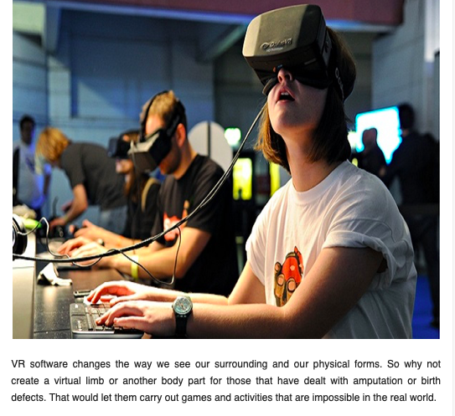
The Rise Of Virtual And Augmented Reality For PwD
Notes:
https://www.thegenius.ca/the-rise-of-virtual-and-augmented-reality-for-the-disabled/

Slide 3
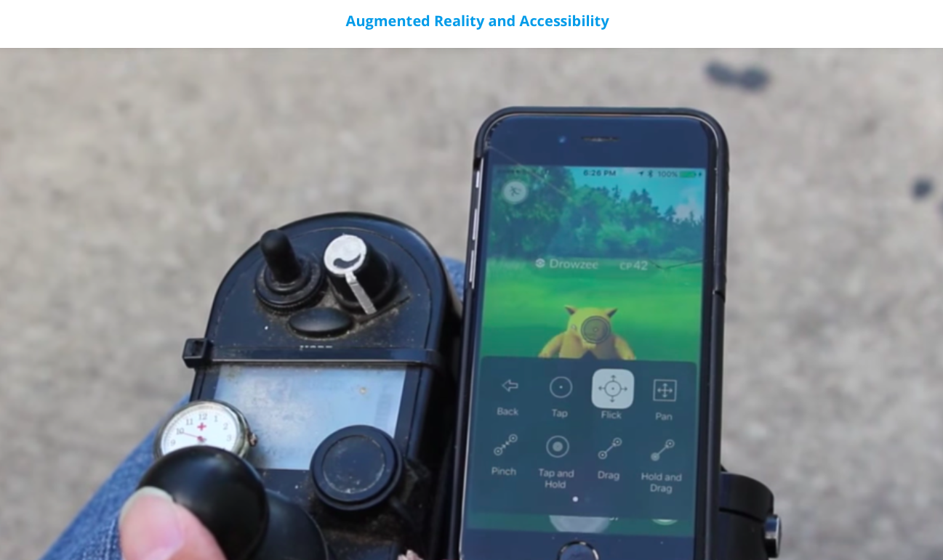
Notes:
https://gettecla.com/blogs/news/augmented-reality-and-accessibility

Slide 4
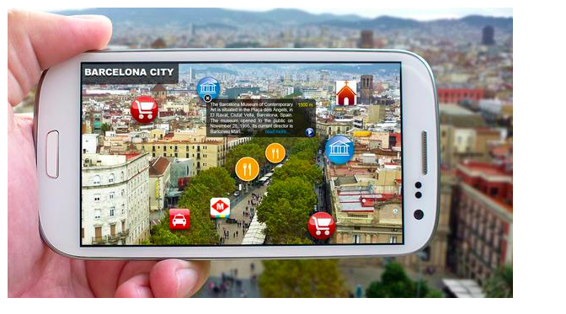

Slide 5
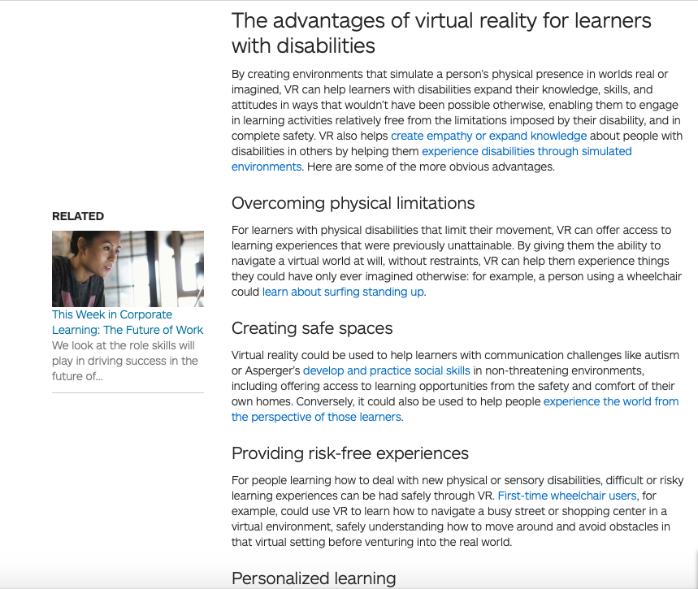
How Virtual Reality Can Transform the Way People with Disabilities Learn
Notes:
https://www.d2l.com/corporate/blog/gaad-virtual-reality-people-disabilities-learn/

Slide 7
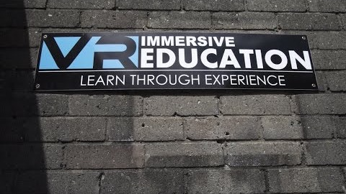

Slide 8
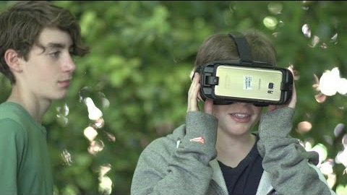
How VR Can Help Students with Dyslexia
Notes:
https://blog.dyslexia.com/help-dyslexic-students/

Slide 9
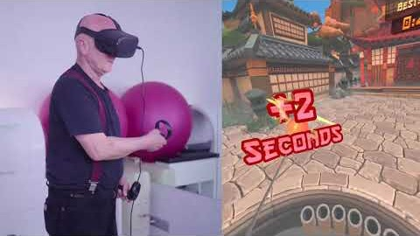
WalkinVR: Making VR More Accessible for People with Disabilities
Notes:
https://www.digitalbodies.net/virtual-reality/walkinvr-making-vr-more-accessible-for-people-with-disabilities/

Slide 10
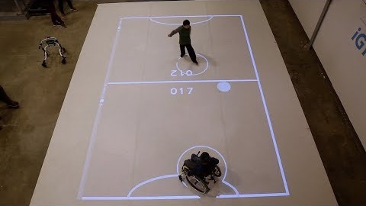
AR Technology is Letting Children With Disabilities Play Sports
Notes:
https://www.vrfitnessinsider.com/ar-technology-is-letting-children-with-disabilities-play-sports/

Slide 11
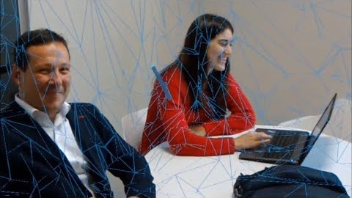
Notes:
DEMO - HoloBlindSupport - HoloLens Solution

Slide 12


Slide 13



Slide 14
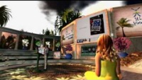

Slide 15
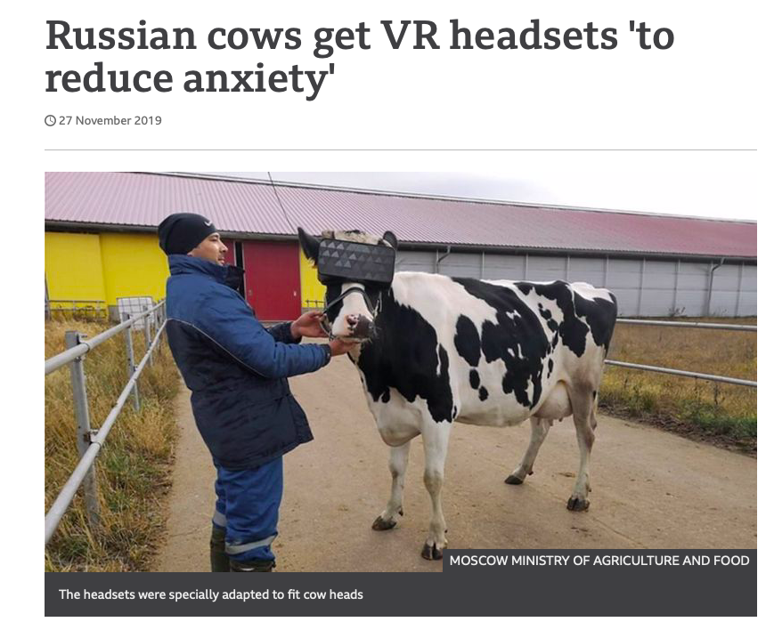
Notes:
https://www.bbc.com/news/world-europe-50571010

Slide 16
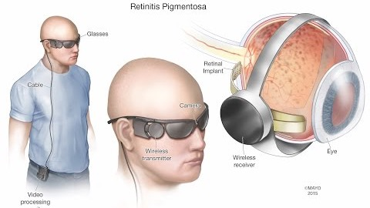

Slide 17
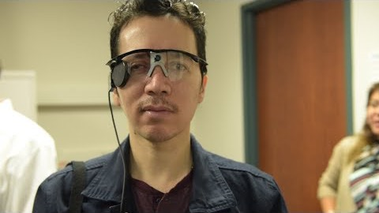

Slide 18
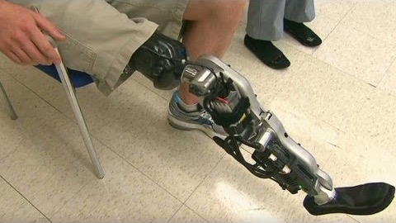
Bionic leg can 'read' brain signals to walk

Slide 19
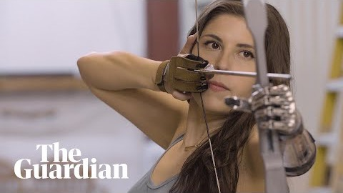
Beyond bionics: how the future of prosthetics is redefining humanity

Slide 20
