Slide 1
Stack Overflow 2018 Developers Analysis
Group Members
MaryLu Granja
Pooja Sheelvanth
Peter Park

Slide 2
SUMMARY
Used Stack Overflow 2018 Developers Survey to analyze the hypothesis Young Male Developers who earn more are Satisfied.
Questions asked to the data are:
What is the typical demographics of Stack Overflow Users? Is the Industry too young? Which Countries have more Stack Overflow Users?
What’s their Formal Education, Profession? How many hours do they code?
How much do they earn? Are they Satisfied with their Career? What’s their Hobby?
Successfully analyzed all the above questions with the finding, Young Men in the Age Group “25-34 years” who earn above “ salary here” having formal education “ formal education here” and coding for “hours of coding” hours are Mostly Satisfied

Slide 3
Questions & Data
Elaborate on the questions you asked, describing what kinds of data you needed to answer them, and where you found it

Slide 4
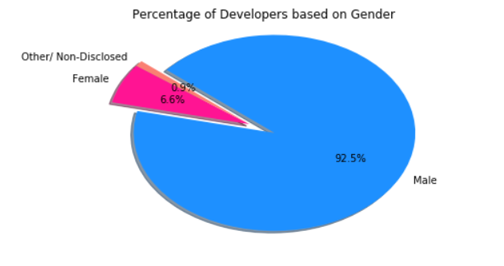
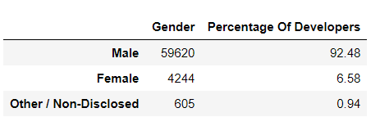
Data Cleanup & Exploration
Split Original Data Frame into several individual Data Frames such as Gender Demographics, Age Demographics, Education Demographics, Occupation Demographics.
Gender Demographics:

Slide 5
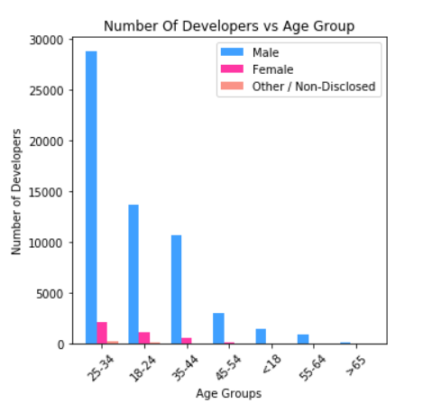
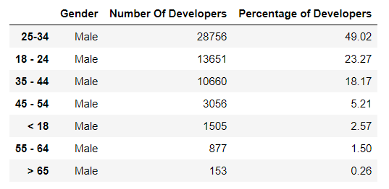
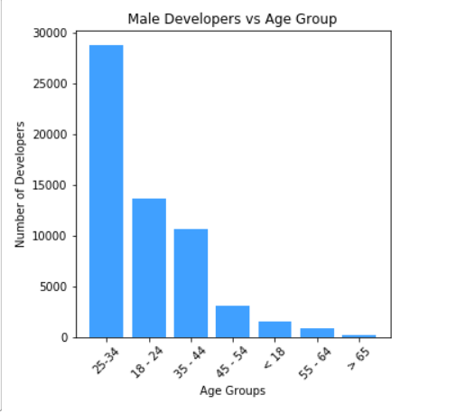
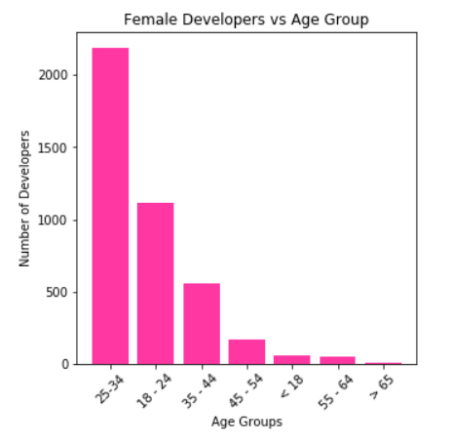
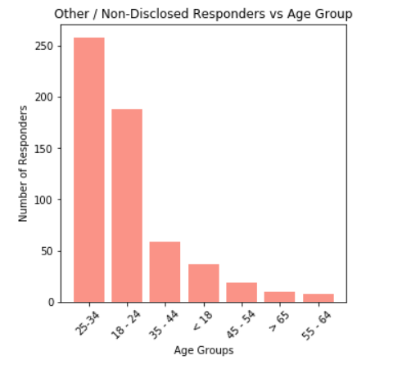
DataFrame Looks as Below

Slide 6
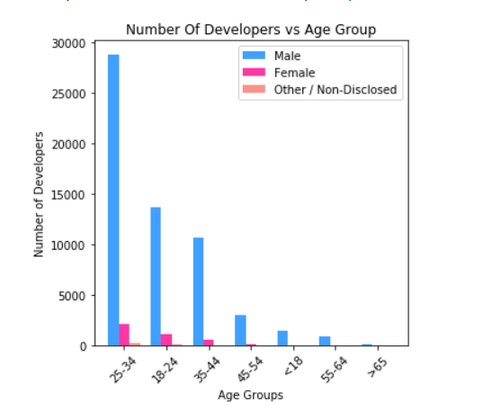
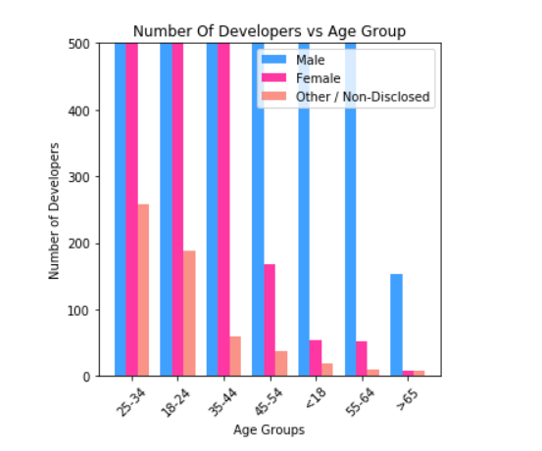
Number Of Developers Vs Age Group

Slide 7
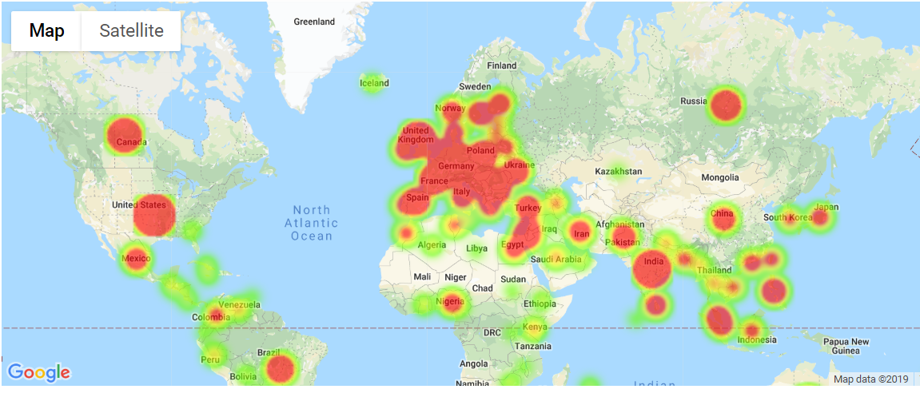
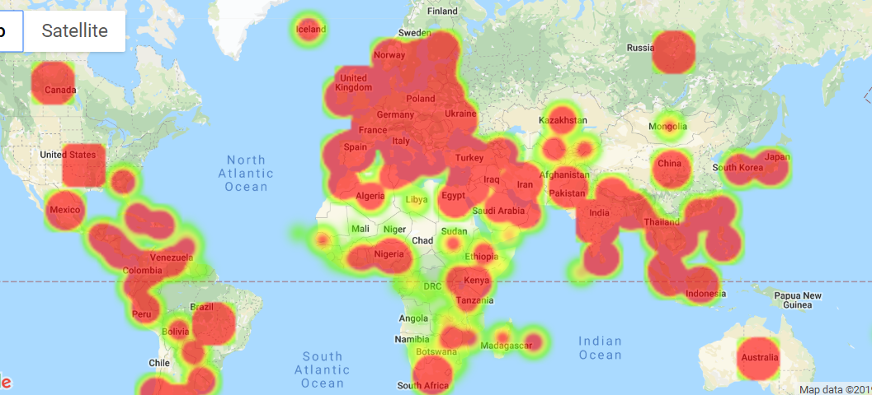
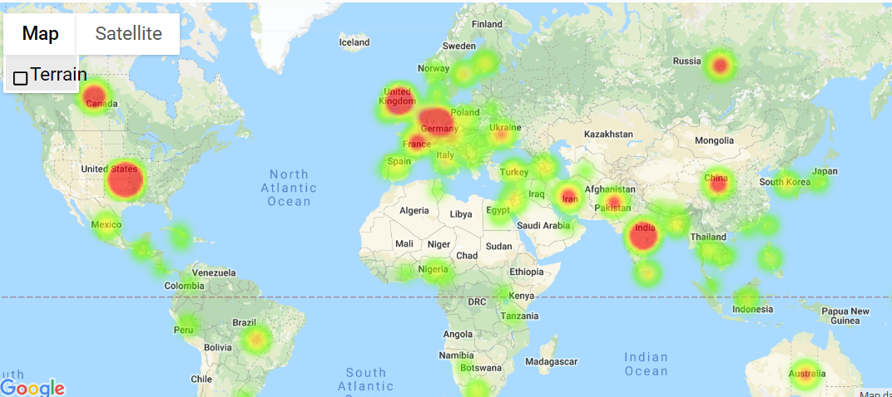
Female Developers
Male Developers
Other Developers

Slide 8
Problems while Data Cleanup & Exploration
Country Column in Data Frame had some garbage value entered. We eliminated those garbage countries by dropping those rows.

Slide 9
Data Analysis
Discuss the steps you took to analyze the data and answer each question you asked in your proposalPresent and discuss interesting figures developed during analysis, ideally with the help of Jupyter Notebook

Slide 10
Discussion
Discuss your findings. Did you find what you expected to find? If not, why not? What inferences or general conclusions can you draw from your analysis?

Slide 11
Post Mortem
Data File was Too Large to Upload. We installed git LFS to Upload the Data File to Git Hub.
Discuss any additional questions that came up, but which you didn't have time to answer:
What would you research next, if you had two more weeks?

Slide 12
Questions
Open-floor Q&A with the audience

