Slide 1
PYTHON PROJECT PRESENTATION
Advanced Scientific
Calculator
123.456
A desktop calculator application built with Python and Tkinter
sin
cos
tan
7
8
9
4
5
6
1
2
=
PRESENTED BY
Pooja Shree Singh
Nexthikes IT Solutions
SCIENTIFIC • INTUITIVE • DESKTOP-READY

Slide 2
01 / PROJECT OVERVIEW
Purpose & project objectives
The project delivers a user-friendly desktop calculator that combines everyday arithmetic with commonly used scientific operations in one interface.
One interface
Ease of use
Accuracy & control
Bring basic and scientific calculations together without switching tools.
Provide a clear keypad, readable display and direct keyboard interaction.
Support angle modes, reusable answers and common mathematical constants.
PROJECT GOAL
Make scientific calculations accessible through a lightweight Python desktop application.
NEXTHIKES IT SOLUTIONS | 02

Slide 3
02 / FUNCTIONAL SCOPE
Core features & user capabilities
01
02
03
Arithmetic
Scientific functions
Logarithmic tools
Addition, subtraction, multiplication, division, brackets and percentage.
Trigonometry, inverse trigonometry, square root, powers and factorial.
Natural logarithm, base-10 logarithm, exponential and absolute value.
04
05
06
Constants & angles
Memory & answers
Productivity
π and e constants, with selectable degree (DEG) or radian (RAD) mode.
MC, MR, M+, M− and Ans for reusing values during a session.
Keyboard input, backspace, clear controls and calculation history.
NEXTHIKES IT SOLUTIONS | 03

Slide 4
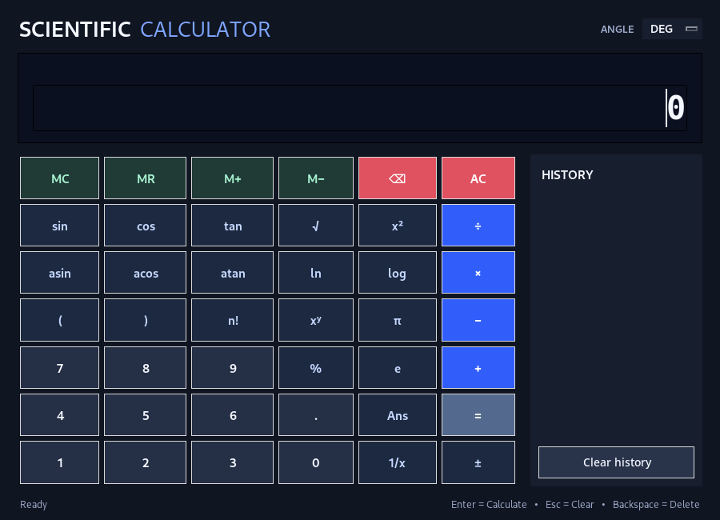
03 / USER EXPERIENCE
Interface design & calculation workflow
01
Input
Enter an expression using the keypad or keyboard.
02
Interpret
The application parses the expression and checks allowed operations.
03
Calculate
Mathematical functions and operators are evaluated.
04
Present
The result appears in the display and is added to session history.
NEXTHIKES IT SOLUTIONS | 04

Slide 5
04 / TECHNICAL IMPLEMENTATION
Technology stack & application design
Python 3
Tkinter
Python standard library
Core programming language for application logic and mathematical operations.
Standard Python GUI toolkit used to build the desktop interface and controls.
math, ast, operator and re support calculations and safe expression parsing.
IMPLEMENTATION FLOW
Tkinter UI
Input handling
Expression parser
Math functions
Display & buttons
Keyboard / keypad
AST validation
Operations & result
RELIABILITY CONSIDERATION
A restricted AST-based evaluator accepts only supported numeric expressions, operators, constants and functions instead of executing arbitrary Python input.
NEXTHIKES IT SOLUTIONS | 05

Slide 6
05 / OUTCOME & NEXT STEPS
Project outcome, validation & future scope
PROJECT OUTCOME
Delivered capabilities
Validation focus
Future enhancements
A desktop scientific calculator with scientific functions, angle modes, memory, answer recall and session history.
Verify arithmetic, function boundaries, division by zero, invalid expressions, factorial constraints and DEG/RAD behavior.
Graph plotting, equation solving, persistent history, themes, improved shortcuts and automated unit tests.
KEY TAKEAWAY
A lightweight, user-friendly scientific calculator demonstrating Python GUI development, mathematical operations and controlled expression evaluation.
NEXTHIKES IT SOLUTIONS | 06

Slide 7
THANK YOU
For your time and consideration
Pooja Shree Singh
Nexthikes IT Solutions
ADVANCED SCIENTIFIC CALCULATOR
PYTHON • TKINTER • SCIENTIFIC COMPUTING

