Slide 1
Employee Data Analysis using Excel
STUDENT NAME:POOJA.L
REGISTER NO:312212836/2022g86
DEPARTMENT:3rd B.com (General)
COLLEGE:Mahalashmi women's college of arts and science.

Slide 2
PROJECT TITLE
Employee Performance Analysis using Excel

Slide 3


AGENDA
Problem Statement
Project Overview
End Users
Our Solution and Proposition
Dataset Description
Modelling Approach
Results and Discussion
Conclusion
3/21/2024 Annual Review

Slide 4

PROJECT PROBLEM
Employee performance analysis is made to identify the performance level of an employee in each department.
It helps to track the activities and growth of the employees in wholly by department wise.
And it helps to grant remuneration or appreciation for the respected one.

Slide 5

PROJECT OVERVIEW
Analyzing the performance of the employees by considering the various factors like rating,performance level,gender,zone,type etc.
In order to identify the trend and performance on different cateogory in a company or in an organisation.
And it helps to identify which sector’s performance is high,better and low

Slide 6

WHO ARE THE END USERS?
Companies like IT sectors.
Industries.
Banks.
Marketing field.
It helps to analyze the current status of their companies or organisations by hierarchical members.

Slide 7

OUR SOLUTION AND ITS VALUE PROPOSITION
Employee data downloaded from edunet dashboard.
Features:
Totally 26 features were available. In that 11 features were considered.
Employee ID - in numbers
Names - in text
Employee type.
Performance level.
Gender- male,female.
Employee rating

Slide 8
Dataset Description
Employee data downloaded from edunet dashboard.
Features:
Totally 26 features were available. In that 11 features were considered.
Employee ID - in numbers
Names - in text
Employee type.
Performance level.
Gender- male,female.
Employee rating

Slide 9

THE "WOW" IN OUR SOLUTION
Data Collection
Downloaded the data from edunet student’s dashboard.
Feature Collection:
Highlighted data which is required using the fill option.
Data Cleaning:
Identified the missing values using conditional formatting.
Removed / Filtered the missing data using filter-filter by colour.
Performance level:
Performance Analysis is based on Department type is filtered by gender (Male employees)
3/21/2024 Annual Review
9

Slide 10
MODELLING
Data Collection
Downloaded the data from edunet student’s dashboard.
Feature Collection:
Highlighted data which is required using the fill option.
Data Cleaning:
Identified the missing values using conditional formatting.
Removed / Filtered the missing data using filter-filter by colour.
Performance level:
Performance Analysis is based on Department type is filtered by gender (Male employees)
10

Slide 11
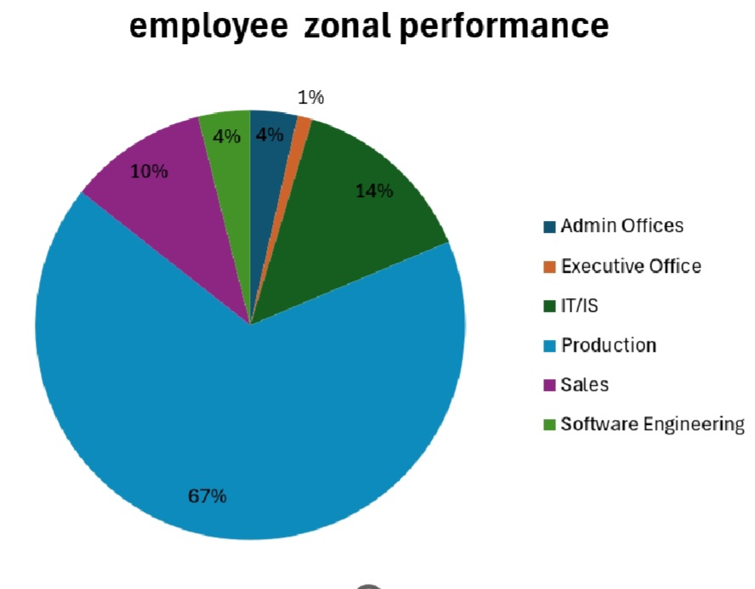
RESULTS
11

Slide 12
conclusion
Therefore the production department employees performs higher comparing to other department and whereas admin offices performs lower comparing to other department. . Hence the Production department employees works more efficiently and effectively comparing to other departments according to the employee data given.

