Slide 1
EMPLOYEE DATA ANALYSIS USING EXCEL
STUDENT NAME: POOJASREE.K
REGISTER NO :312204600 0F26B19C66B4EADB470491D8EEC649AD
DEPARTMENT : COMMERCE
COLLEGE : K.C.S KASI NADAR COLLEGE OF ARTS & SCIENCE

Slide 2
PROJECT TITLE
Employee Data Analysis

Slide 3


AGENDA
End Users
Project Overview
Problem Statement
Our Solution and Proposition
Dataset Description
Modelling Approach
Results and Discussion
Conclusion
3/21/2024 Annual Review

Slide 4

PROBLEM STATEMENT
The problem is to identify employee wise salary, department and recruitment analysis.

Slide 5

PROJECT OVERVIEW
In this analysis, I aim to streamline the process of identifying the employee wise salary, department wise salary and recruitment wise salary using excel, with the help of below stated tools in excel
Tables
Pivot chart (line chart and pie chart)
Dashboard
Slicers

Slide 6

WHO ARE THE END USERS?
Admin offices
Sales department
Production department
IT/IS department
Software department

Slide 7

OUR SOLUTION AND ITS VALUE PROPOSITION
Advanced Analytical Tools.
Scenario Analysis.
User-Friendly Interface.
Visual Representation.
Comprehensive Data Management.

Slide 8
DATASET DESCRIPTION
DATA OVERVIEW :
The employee data analysis provides a summary of key metrics, including salary, performance and recruitment source. The data is organized to identify trends and patterns. This overview aids in making informed HR decisions.
DATA FIELDS :
Employee name
Employee id
Department
Gender
Recruitment source
Salary per month

Slide 9
MODELLING APPROACH
Data cleaning.
Creating table.
Creating pivot chart.
Creating dashboard.
Inserting pivot chart in dashboard.
Inserting formulas in dash board to make interaction.
Creating interactive dashboard by putting all together elements
9

Slide 10
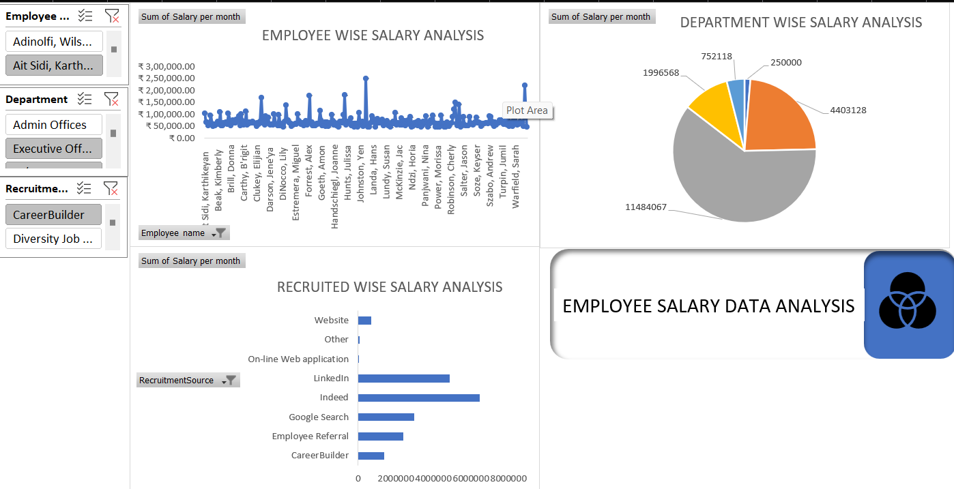
RESULTS
(click to open file)
10

Slide 11
CONCLUSION
The employee data analysis reveals critical insights into the recruitment source, gender, department and salary per month, highlighting areas of strength and potential improvement. The data shows consistent performance across key metrics, but also points to gaps in diversity and retention that require attention. By focusing on these areas, the organization can enhance employee satisfaction and productivity. The analysis provides a solid foundation for making data-driven HR decisions that align with the company's long-term goals.

