Slide 1
Computer Vision - Final Project
Pooja Srinivas (20171403)
Nitin Kandpal (2018802004)
Srivyshnavi.T (20161235)

Slide 2
Introduction
In visual information processing, high-resolution (HR) images are still desired for more useful information.
However, due to the limitation of physical devices, we can only obtain low-resolution (LR) images of the specific object in some scenes such as a long-distance shooting.
The super-resolution (SR) technique is usually employed to recover the lost information in the source image to handle this problem.
In this paper, the idea proposed is of a new model called deep network cascade (DNC) to gradually upscale low-resolution images layer by layer, each layer with a small scale factor.

Slide 3
Conventional method
This method attempts to recover the source image by solving the ill-posed inverse problem, y = Hx + v.
Where x is the unknown high resolution image to be estimated,
y is the observed low resolution image,
H is the degradation matrix and
v is the additional noise vector.

Slide 4
Drawbacks of Conventional method
Under the scarcity of observed low resolution images, the inverse process is a underdetermined problem, thus the solution is not unique.
To find a reasonable solution, some sophisticated statistical priors of natural images are usually incorporated into the reconstruction process.
However, these reconstruction based methods have a limit of magnification factor.

Slide 5
DNC Structure
Non-Local Self Similarity (NLSS) search
Standard Auto-encoder
Stack Auto-encoder

Slide 6
Non-Local Self Similarity (NLSS)
The NLSS is applied on the input image to enhance textural high-frequency information.
Natural image patches recur many times within an image and even across different scales.
we can find some similar patches using K-nearest neighbour method for a given patch.
Before super-resolution,the bicubic interpolation is imposed on the input image to generate the initialized SR image.

Slide 7
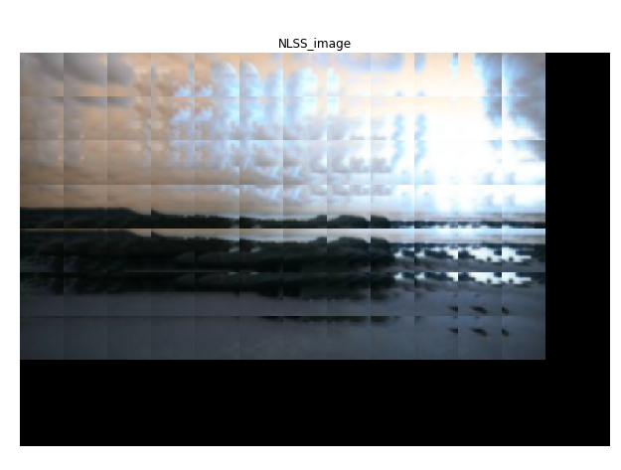

NLSS Results
Fig . NLSS result for two nearest neighbors

Slide 8
Standard Auto-encoder
Enhanced patch results from NLSS search is given as input to auto-encoder to suppress the noises and collaborate the overlapping reconstructed patches.
In Auto-encoder, an extra step of weight-tying on all patches and L1 sparse constraint on hidden neurons is performed. This is done to reduce the learnable parameters and make auto-encoder easily controllable.

Slide 9
Stack Auto-encoder model
Each loop is comprised of the above two steps forms a cascade layer named Stack Auto-encoder model.
Multiple SA models can be successively concatenated into the deep network cascade, where the higher layer takes the output SR image of the lower layer as input.
With the increase of network layers, the magnification factor of the learned SR image can be enlarged gradually.

Slide 10
DNC Architecture
A greedy layer-wise optimization strategy is adopted to train the DNC model.
Back propagation
Minor distortions and estimation errors might propagate and accumulate from layer to layer, which easily leads to a large deviation from the source HR image for the final SR result and to reduce this effect, a global back-projection constraint is used.

Slide 11
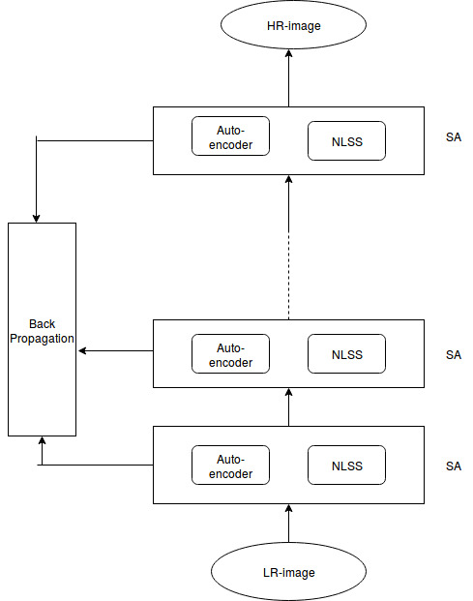

Slide 12
Training data generation:
We used 1200 high resolution images and generated 1200 LR images by down sampling the HR images.
We applied the NLSS search for LR images with 50 percentage overlap and perform the same process patching with for HR image without NLSS search.
We generated around 1 lakh 56 x 56 patches of NLSS and corresponding SR patches which we used to train the auto encoder.
We perform the same process with 8x8 size patches and store 4000000 training patches.

Slide 13


Continue
Training Data
Label Data

Slide 14
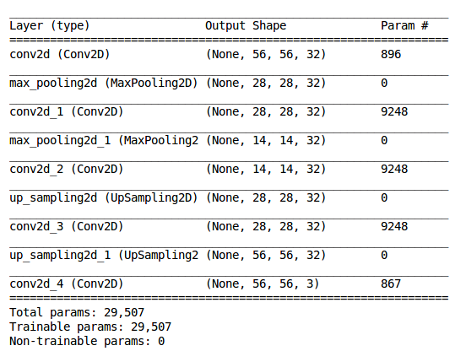
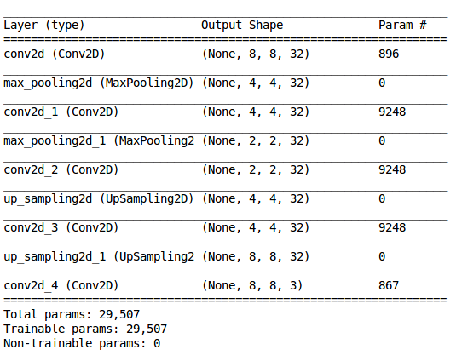
Summary of Denoising Autoencoder
Parameters :
Optimizer : Adam
Epoch : 100
Batch Size : 128
Loss function : MSE

Slide 15
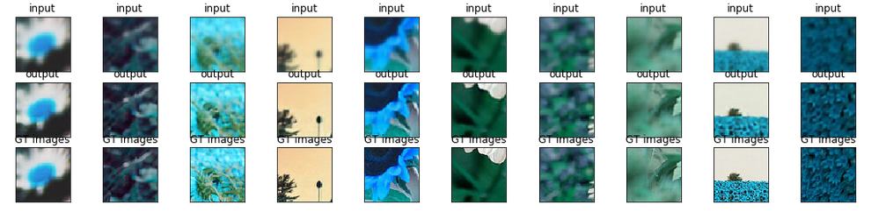
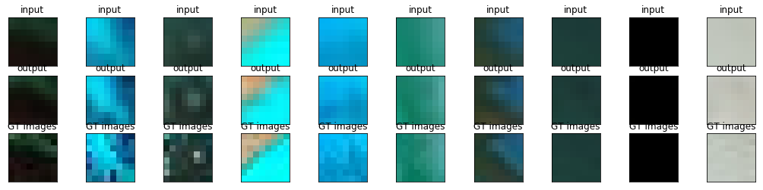
Autoencoder Result
56x56 patch size
8x8 patch size

Slide 16
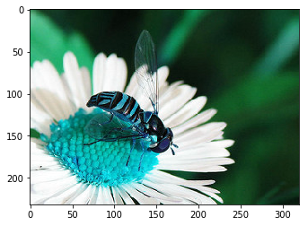
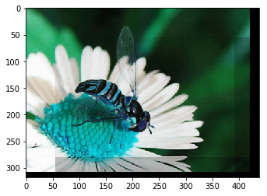
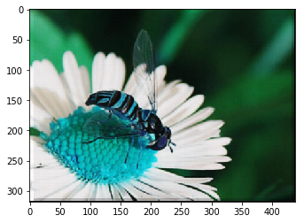
Results:
Input image
Output patch size 56
Output patch size 8
The above results 1 level cascade with patch sized 8 and 56. We have to deal with boundary condition as well while reconstructing the result.

Slide 17
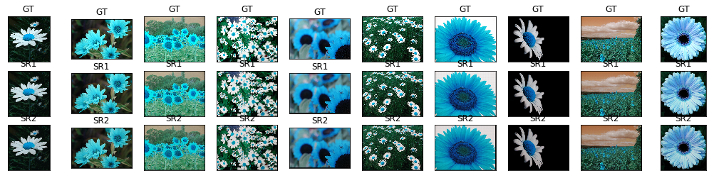
Continue..
Result of cascade of 2 level autoencoder size of patch 8 x8

Slide 18
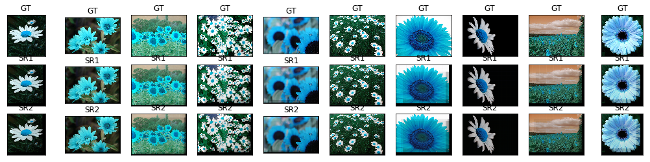
Continue . . .
Result of cascade of 2 level autoencoder size of patch 56 x 56

Slide 19
Conclusion

Slide 20
Github link
https://github.com/savera2020/super-resolution

Slide 21
Thanks

