Slide 1
GIT AND GITHUB
- POOJA SUNDAR

Slide 2
WHAT IS VCS ?
Version Control Systems is systems that records changes to a file or set of files over time.
The development need the complexity to manage the particular product updations and maintain the multiple versions of the entire product. So VCS helps from the this issues.

Slide 3
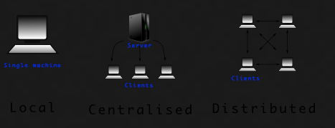
TYPES OF VCS -
Local Version Control System.
Centralized Version Control System.
Distributed Version Control System

Slide 4
WHAT IS GIT ( GLOBAL INFORMATION TRACKER ) ?
Git is a DevOps tool used for source code management. It is a free and open-source version control system used to handle small to very large projects efficiently. Git is used to tracking changes in the source code, enabling multiple developers to work together on non-linear development.

