Slide 1
GIT AND GITHUB
- POOJA SUNDAR

Slide 2
WHAT IS VCS ?
Version Control Systems is systems that records changes to a file or set of files over time.
The development need the complexity to manage the particular product updations and maintain the multiple versions of the entire product. So VCS helps from the this issues.

Slide 3
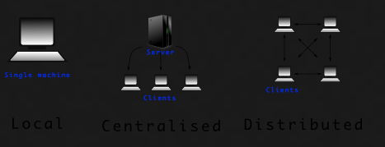
TYPES OF VCS -
Local Version Control System.
Centralized Version Control System.
Distributed Version Control System

Slide 4
WHAT IS GIT ( GLOBAL INFORMATION TRACKER ) ?
Git is a DevOps tool used for source code management. It is a free and open-source version control system used to handle small to very large projects efficiently. Git is used to tracking changes in the source code, enabling multiple developers to work together on non-linear development.

Slide 5
WHAT IS GITHUB ?
GitHub is a Git repository hosting service, but it adds many of its own features. While Git is a command line tool, GitHub provides a Web-based graphical interface. It also provides access control and several collaboration features, such as a wikis and basic task management tools for every project.
Is absolutely more flexible.

Slide 6
WHAT IS BITBUCKET ?
Bitbucket is a cloud-based service that helps developers store and manage their code, as well as track and control the changes to their code. Bitbucket provides a cloud-based Git repository hosting service. Its interface is user-friendly enough so even novice coders can take advantage of Git.
Bitbucket allows users to have free private repository but with maximum of five collaborators

Slide 7
COMPARISON BETWEEN GIT AND GITHUB ?
GITHUB
GIT
GitHub is a service
It is a graphical user interface
You can’t use Github without using Git.
Its hosted on web based cloud service.
Focused on Source code hosting.
Hosting service for Git repositories
Git is a software​
Git is a command line tool​
You don’t need Github to use Git.
Git is installed locally on the system known as local host.
Focused on VCS and Code Sharing.
Git is a version control system helps to manage source code history.

Slide 8
GIT COMMANDS :-
Git init
Git add
Git commit
Git status
Git remove
Git push
Git pull

Slide 9
Git merging
Git log
Git branching
Git hard reset
Git soft reset
Git stash
Git stash apply

Slide 10
THANK YOU

