Slide 1

E-Commerce

Slide 2
What is an E-Commerce Test?
An E-Commerce Test will validate that an E-Commerce portal is functioning correctly. The eValid ability to function as a normal browser allows validating E-Commerce portals that use cookies or other methods to maintain browser state throughout the test.

Slide 3
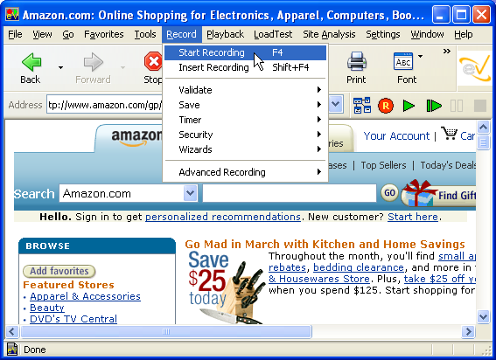
E-Commerce: Begin Recording
Step 1 of 9
Begin the E-Commerce test by going to the portal Web page and select
Record > Start Recording,
from the menu.

Slide 4
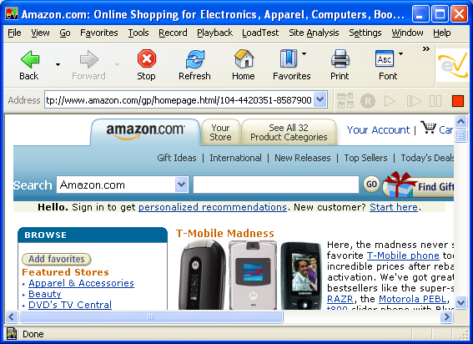
E-Commerce: Select An Item To Purchase
Step 2 of 9
Navigate through the catalog and select an item to purchase. If needed you can validate text samples to ensure proper search engine and database output.

Slide 5
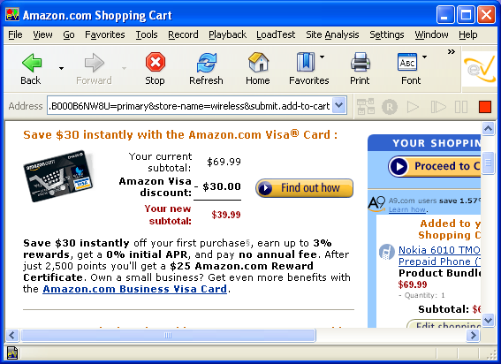
E-Commerce: Add Item to Shopping Cart
Step 3 of 9
Add an item to the shopping cart

Slide 6
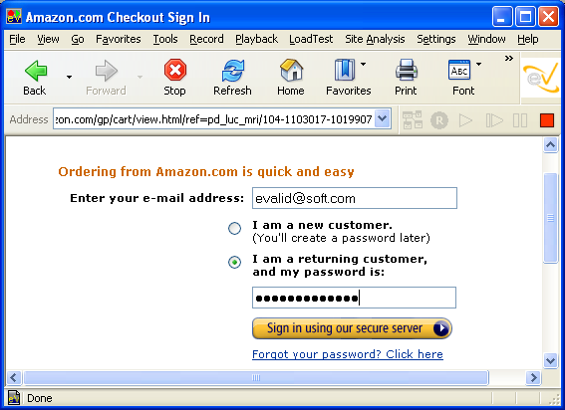
E-Commerce: Login
Step 4 of 9
and login through the authentification system if needed.

Slide 7
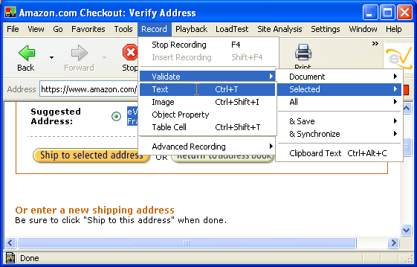
E-Commerce: Validate User Information
Step 5 of 9
You can validate that the correct user information was retrieved by first selecting text pertaining to the user. Just click Record > Validate > Selected > Text.

Slide 8
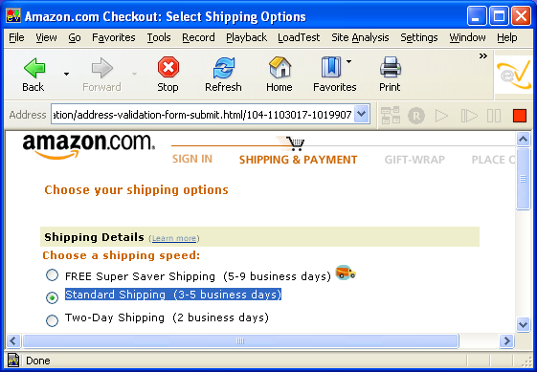
E-Commerce: Validate Step In Order
Step 6 of 9
To ensure that the order is progressing normally, validate by highlighting some text at each step in the ordering process.

Slide 9
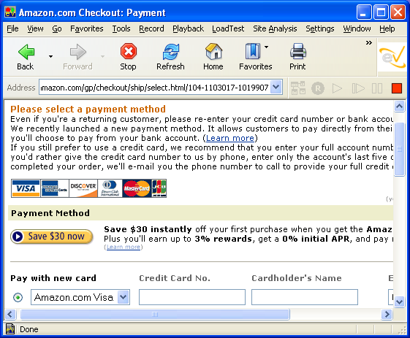
E-Commerce: Enter Payment Information
Step 7 of 9
When you reach the payment section of the order, enter synthetic payment information (to avoid transaction charges).

Slide 10
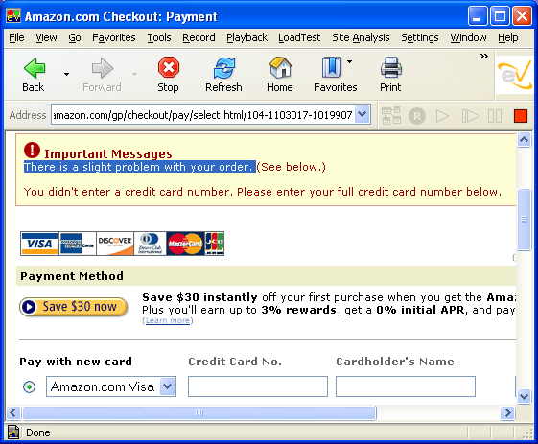
E-Commerce: Validate Feedback
Step 8 of 9
Validate the order by selecting and validating feedback that indicates a successful order.

Slide 11
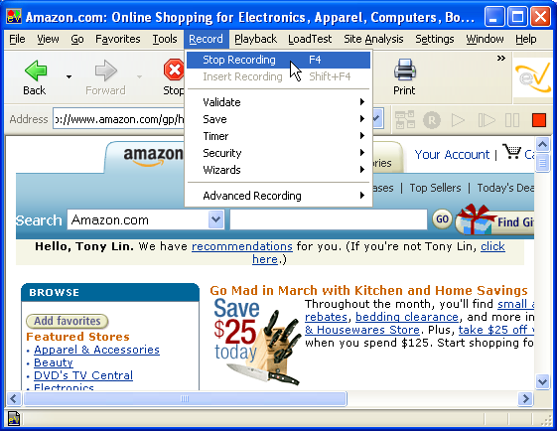
E-Commerce: Enter Payment Information
Step 9 of 9
When you are finished testing your E-Commerce portal, select Record > Stop Recording. You tested this portal successfully.

