Slide 1
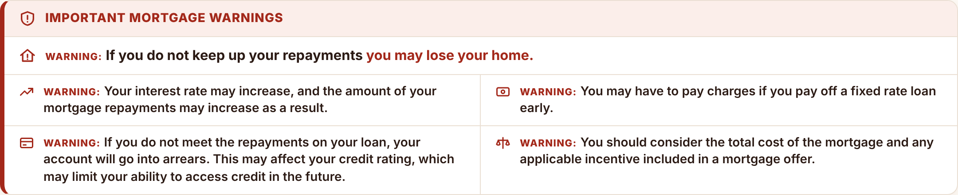
Proposed design: mortgage warnings
Wording unchanged. All five warnings visible. Compliance to approve the final presentation.

