Slide 1
Governance
The term governance refers to the process of establishing and enforcing rules and policies.
A good governance strategy helps you maintain control over the cloud applications and resources you manage.
Azure Role-based access control (RBAC)
Resource Lock
Learning Objectives
Tags
Azure Policy
Azure Blueprints
Cloud Adoption Framework

Slide 2

Azure Tags
name-value pairs that help to organize the Azure resources

Slide 3

Azure Tags
Azure tags are the name-value pairs that help to organize the Azure resources in the Azure portal.
Azure Tags are simply labels that you can attach to your Azure resources.
You can use tags to easily group and classify resources and assets in Azure.
For example, explore of the costs generated by resources having the same tag applied.
Tagging is a primary way to understand the data in any cost or billing reporting.
Resources don’t inherit any Azure tags applied at the Resource Group level.
It’s a fundamental part of any well-manage environment. It’s also the first step in establishing proper governance of any
environment.
Azure Policy can be used to enforce tagging rules and conventions.
For example, you can require that certain tags be added to new resources as they are provisioned.

Slide 4

Azure Policy
Achieve real-time cloud compliance at scale with consistent resource governance

Slide 5

Azure POlicy
Azure Policy can help you control or restrict or audit your resources.
Enforce rules on Azure resources configurations to make sure they remain compliant with corporate standards.
You can apply individual policy or group of policy (initiatives).
Two imp tasks
Prevent noncompliant resources from being created
Highlights existing resources that aren't compliant with the policies.
Examples:
Allows only a certain SKU size for the virtual machines (VMs) to be provisioned.
Mandatory tags to be created while provisioning resources
MFA should be enabled on accounts with write permissions on your subscription
Assign policy within a specific scope (management group, a single subscription, or a resource group.)
Policy assignments are inherited by all child resources within that scope
You can exclude specific child resources you need to be exempt from the policy assignment
You can review the noncompliant policy results and take any action that's needed.

Slide 6

Azure Blueprints
Enabling quick, repeatable creation of governed environments

Slide 7



Azure Blueprints
Chair Blueprint
A blueprint is a set of instructions, a pattern, or a design for creating anything.

Slide 8
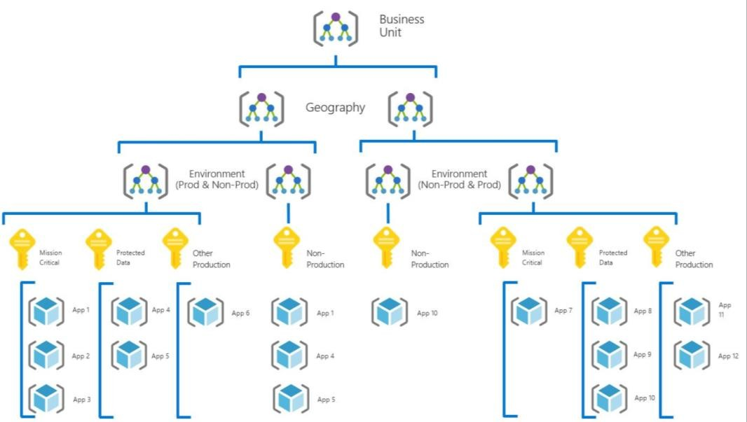
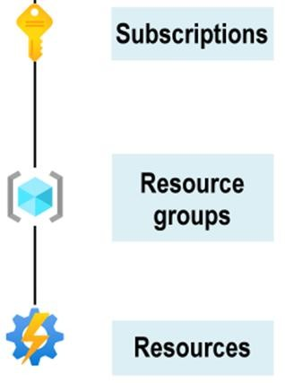
Azure Blueprints
Create and deploy a replaceable set of Azure resources that meet specific requirements and standards.
It can be easier to make new environments that are always in line with the company's rules.
They can do this much faster than if they had to start from scratch each time.

Slide 9

Azure Blueprints
You can make it easier to set up large-scale Azure deployments by putting together environment artifacts in a single blueprint
definition.
Each component in the blueprint definition is known as an artifact.
Role assignments
Policy assignments
Azure Resource Manager templates
Resource groups
Fast and without manual error
Blueprint is assigned at the subscription level
You can also fine-tune control and management through versioning.

Slide 10
Role-based access control
Who has access to which Azure resources
Security Principle, Roles and Scope
▪
Resource Locks
Help prevent accidental delete or update of your Azure resources. Tags
⮚
Name-value pairs, group and classify resources
Azure Policy
Learning Outcome
Control or restrict or audit your resources
Azure Blueprints
Large-scale Azure deployments across subscriptions by putting together environment artifacts in a single blueprint definition.
Cloud Adoption Framework
Set of tools, best practices, guidelines and documentation to help companies with their migration journey

