Slide 1

Project name : Air Quality Monitoring
DEPARTMENT OF INFORMATION TECHNOLOGY
Team name : Proj_22478_Team_2
Team members :
Harini M(113321205017)
Kokila Sruthi P(113321205025) Pooja V(113321205035) Indhra A (113321205018)

Slide 2
PROBLEM DEFINITION:
▶ AIR POLLUTION CONCERNS: Rising levels of air pollution in urban areas pose significant health and environmental risk
▶ LACK OF REAL TIME DATA : Existing air quality monitoring systems often provide data with delays, hindering timely responses.
▶ LIMITED ACCESSIBILITY: Access to air quality data is restricted, making it challenging for the public to make informed decisions.

Slide 3
OBJECTIVES:
▶ Real-Time Monitoring: Provide up-to-the-minute air quality data to the public and relevant authorities.
▶ Data Analysis: Enable data-driven decision-making for pollution control and health alerts.
▶ Cost-Efficiency: Reduce the cost of air quality monitoring compared to traditional methods.

Slide 4
PROPOSED SYSTEM:
▶ IoT Sensors and Devices:
Deploy a network of IoT sensors and devices throughout the water distribution network, including water treatment plants, reservoirs, pipelines, and consumer premises.
These sensors will continuously monitor parameters such as water flow rate, pressure, temperature, pH levels, turbidity, and contaminants.
▶ Real-time Data Collection:
Collect real-time data from the sensors and devices, providing a comprehensive view of the entire water system's status.
Use wireless communication protocols (e.g., LoRaWAN, NB-IoT) to transmit data securely and efficiently.

Slide 5
IoT SENSOR DESIGN:
▶ Iot Sensor Selection: Choose sensors for measuring5 common pollutants like PM2.5, PM10, CO2, and NO2.
▶ Data Transmission: Use wireless communication (e.g., Wi-Fi or cellular) to send data to the cloud.
▶ Power Efficiency: Design sensors to be energy-efficient for prolonged operation.

Slide 6
INTEGRATION BENEFITS:
▶ Improved Public Health: Timely information enables people to make healthier choices.
▶ Environmental Protection: Better data informs policies and initiatives to reduce air pollution.
▶ Efficient Transit: Enhanced transit services lead to improved commuter experiences and reduced pollution exposure.

Slide 7
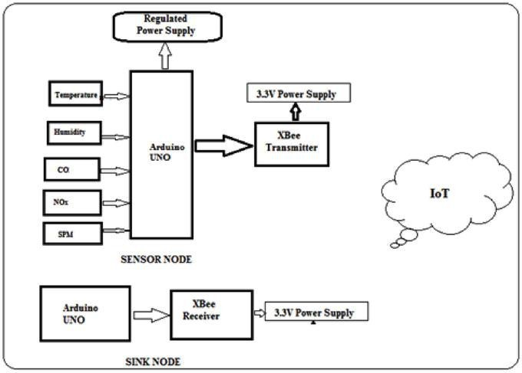

Slide 8
REAL-TIME TRANSIST INFORMATION PLATFORM:
▶ Real time transist Integration : Collaborate with public transit agencies to integrate air quality data into their systems.
▶ Alerts and Routing: Provide real-time air quality alerts to commuters and suggest alternative routes.
▶ Health Recommendations: Offer health advice based on air quality, promoting public well-being.

Slide 9
INTEGRATION APPROACH:
▶ API Integration: Develop APIs to share air quality data with transit agencies and other stakeholders.
▶ User-Friendly Apps: Create user-friendly applications for both smartphones and websites.
▶ Machine Learning: Use AI and machine learning algorithms for predictive analysis and health recommendations.

Slide 10
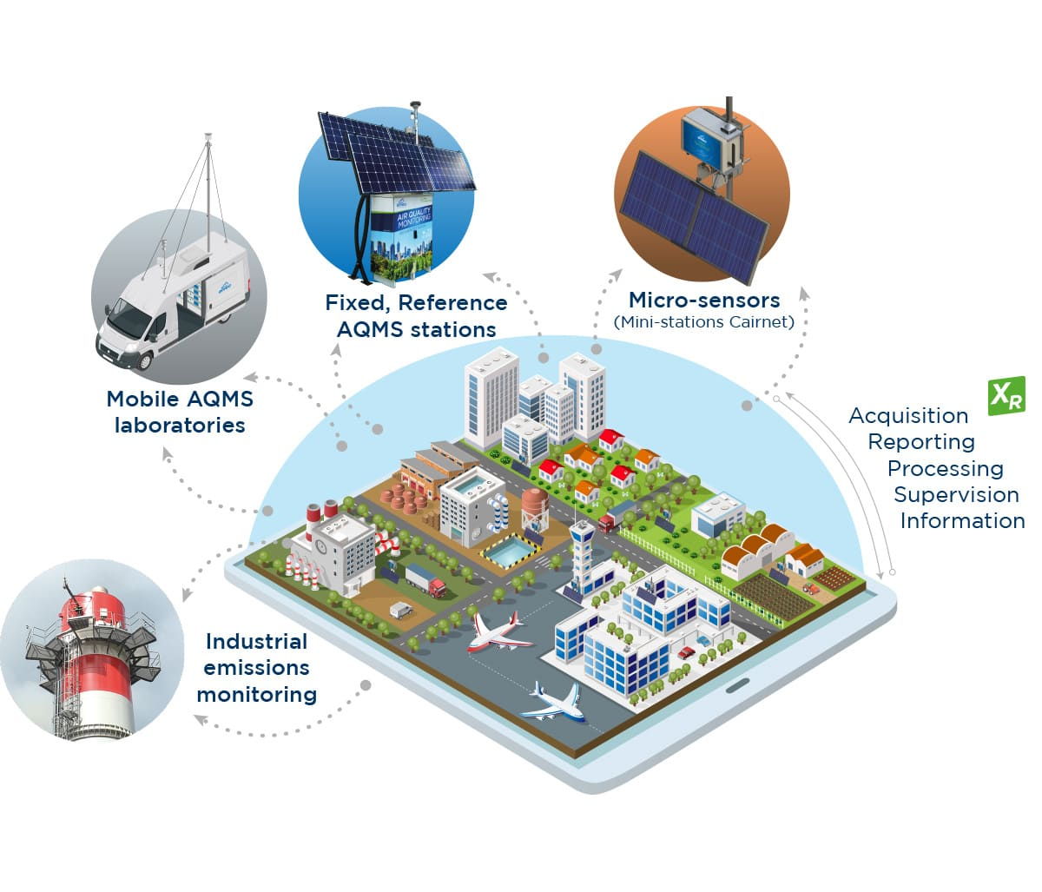

Slide 11
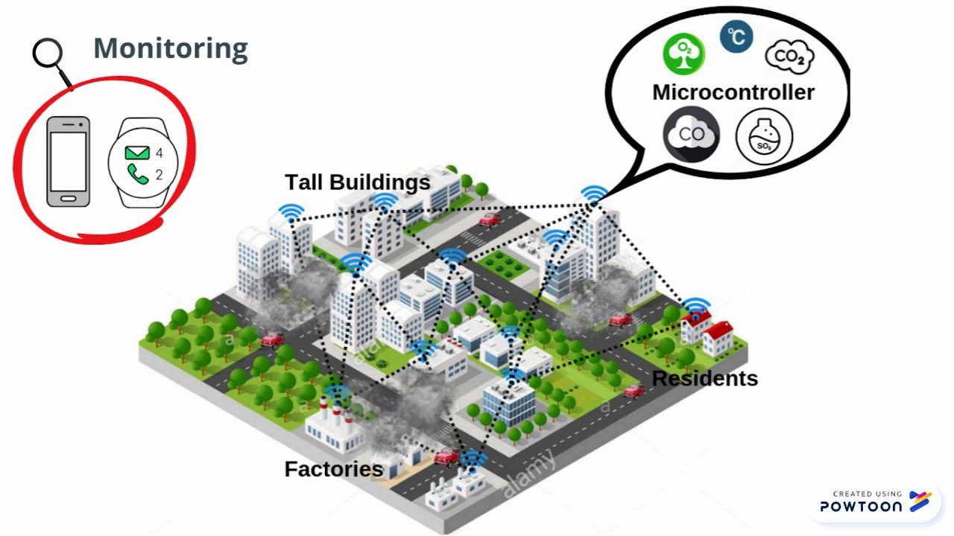

Slide 12
THANK YOU

