Slide 1
Python: Iterables, Generators & Comprehensions
• Beginner-friendly concepts with simple examples
• Learn how to loop, generate values, and write shorter code
1

Slide 2
Learning Outcomes
• Understand what an iterable is
• Identify iterables and iterators
• Create a generator using yield
• Use list, set and dictionary comprehensions
2

Slide 3
1. What Is an Iterable?
• An iterable is an object we can loop through, one item at a time.
• Common examples: list, tuple, string, dictionary and set.
fruits = ['apple', 'mango', 'banana']
for fruit in fruits:
print(fruit)
3

Slide 4
Iterable Example: String
• A string is also iterable.
• The for loop visits each character in order.
word = 'CAT'
for letter in word:
print(letter)
# Output: C A T (on separate lines)
4

Slide 5
Iterable vs Iterator
• Iterable: a collection we can loop over.
• Iterator: remembers the current position and returns the next item.
• Use iter() to create an iterator and next() to read values.
numbers = [10, 20, 30]
it = iter(numbers)
print(next(it)) # 10
print(next(it)) # 20
5

Slide 6
2. What Is a Generator?
• A generator produces values one at a time, when needed.
• It uses yield instead of return to provide successive values.
• Useful when we do not want to store all values at once.
6

Slide 7
Generator Example
• Calling the function creates a generator object.
• Each next() resumes execution until the next yield.
def count_up():
yield 1
yield 2
yield 3
g = count_up()
print(next(g)) # 1
print(next(g)) # 2
7

Slide 8
Generator with a for Loop
• A for loop automatically asks the generator for each value.
• After the last yield, the generator is exhausted.
def squares(n):
for x in range(1, n + 1):
yield x * x
for value in squares(4):
print(value) # 1, 4, 9, 16
8

Slide 9
3. What Is Comprehension?
• Comprehension is a short way to build a collection.
• It combines an expression and a for loop in one line.
• Start with list comprehension: [expression for item in iterable].
9

Slide 10
List Comprehension
• Create a list of squares from 1 to 5.
• Compare the short form with the ordinary loop.
squares = [x*x for x in range(1, 6)]
print(squares) # [1, 4, 9, 16, 25]
10

Slide 11
List Comprehension with if
• Add an if condition to keep only matching values.
• Here, we keep only even numbers.
evens = [x for x in range(1, 11) if x % 2 == 0]
print(evens) # [2, 4, 6, 8, 10]
11

Slide 12
Set Comprehension
• Curly braces create a set.
• Sets automatically remove duplicate values.
numbers = [1, 2, 2, 3, 3]
unique_squares = {x*x for x in numbers}
print(unique_squares) # {1, 4, 9}
12

Slide 13
Dictionary Comprehension
• Create key-value pairs in one expression.
• Use a colon between the key and the value.
square_map = {x: x*x for x in range(1, 4)}
print(square_map) # {1: 1, 2: 4, 3: 9}
13

Slide 14
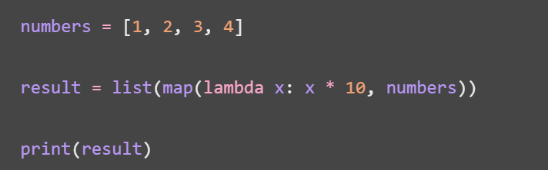
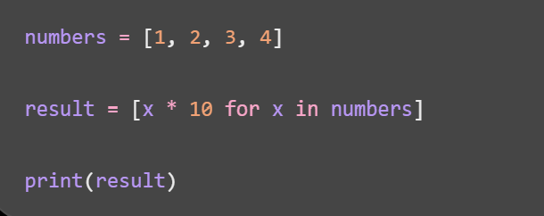
Example: Multiply every number by 10
Using map() Using comprehension
17

Slide 15
Is comprehension a function?
• No. Comprehension is Python syntax, not a function.
• map() is a built-in Python function.
• List comprehension creates a list using an expression.
• Generator expression creates a generator using an expression.
2

Slide 16
What is map()?
• Applies a function to each item in an iterable.
• Syntax: map(function, iterable)
• Returns a lazy map iterator, not a list.
• Use list() when you want to see all values as a list.
3

Slide 17
Example 1 — Squares using map()
numbers = [1, 2, 3, 4, 5]
squares = list(map(lambda x: x**2, numbers))
print(squares)
Output: [1, 4, 9, 16, 25]
4

Slide 18
What is list comprehension?
• A short, readable syntax for creating a new list.
• Syntax: [expression for item in iterable]
• Can include an if condition for filtering.
• Creates the list immediately (eager evaluation).
5

Slide 19
Example 2 — Squares using comprehension
numbers = [1, 2, 3, 4, 5]
squares = [x**2 for x in numbers]
print(squares)
Output: [1, 4, 9, 16, 25]
6

Slide 20
Same task — Two different approaches
• map(): list(map(lambda x: x**2, numbers))
• Comprehension: [x**2 for x in numbers]
• Both produce [1, 4, 9, 16, 25].
• map() applies a function; comprehension uses an expression.
7

Slide 21
Example 3 — Multiply each number by 10
numbers = [1, 2, 3, 4]
# Using map()
a = list(map(lambda x: x * 10, numbers))
# Using list comprehension
b = [x * 10 for x in numbers]
print(a)
print(b)
Output: Both: [10, 20, 30, 40]
8

Slide 22
Filtering — Squares of even numbers
• Goal: keep only even numbers and square them.
• Input: [1, 2, 3, 4, 5, 6]
• Expected output: [4, 16, 36]
9

Slide 23
Filtering using list comprehension
numbers = [1, 2, 3, 4, 5, 6]
result = [x**2 for x in numbers if x % 2 == 0]
print(result)
Output: [4, 16, 36]
10

Slide 24
Filtering using map() and filter()
numbers = [1, 2, 3, 4, 5, 6]
result = list(map(lambda x: x**2, filter(lambda x: x % 2 == 0, numbers)))
print(result)
Output: [4, 16, 36]
11

Slide 25
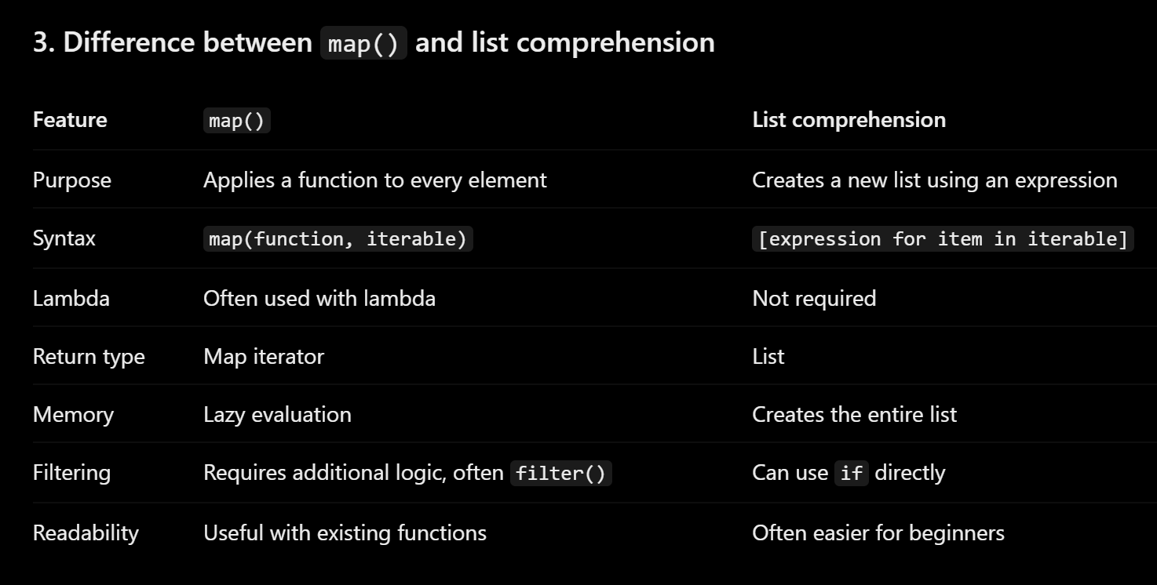
17

Slide 26
Key differences — map() vs comprehension
• map() is a function; list comprehension is syntax.
• map() returns an iterator; list comprehension returns a list.
• map() evaluates lazily; list comprehension evaluates eagerly.
• map() takes a function; comprehension writes the expression directly.
• Filtering is usually clearer with comprehension and if.
12

Slide 27
Memory and evaluation
• map(): values are computed when requested.
• List comprehension: computes and stores the complete list.
• Lazy processing is useful for large data or streams.
15

Slide 28
When should we use each?
• Use list comprehension for simple transformations and filtering.
• Use map() when applying an existing function to each item.
• Choose clarity and readability first.
16

Slide 29
Practice for students
• 1. Double [2, 4, 6] using map().
• 2. Double [2, 4, 6] using list comprehension.
• 3. Select odd numbers from [1, 2, 3, 4, 5] using comprehension.
• 4. Create a generator expression for cubes of 1 to 5.
18

Slide 30
Generator Expression
• Looks like list comprehension, but uses parentheses.
• Produces items on demand rather than building a list immediately.
g = (x*x for x in range(1, 4))
print(next(g)) # 1
print(next(g)) # 4
print(list(g)) # [9]
14

Slide 31
Quick Comparison
• Iterable: can be looped over (example: a list).
• Generator: yields items one by one (example: yield).
• Comprehension: concise syntax to build collections.
• Generator expression: concise syntax for lazy values.
15

Slide 32
Practice Questions
• Print each character of your name using a for loop.
• Write a generator that yields numbers 1 to 5.
• Use list comprehension to make cubes of 1 to 5.
• Use comprehension to select odd numbers from 1 to 10.
16

Slide 33
Recap
• Iterable → something you can loop through.
• Generator → produces the next value when requested.
• Comprehension → shorter, readable collection creation.
• Tip: learn the regular for loop first, then simplify it.
17

