Slide 1
Heart Attack Risk Assessment Using Deep Learning with Feature Optimization
Project Guide:
Project Coordinator:
Team Members :
Mr.Shashank Tiwari
Mrs. G.Srisudha
Ch. Rishitha (21AG1A6676)
G. Poojitha (21AG1A6683)
B. Sahith (22AG5A6608)

Slide 2
Abstract
This project aims to develop a deep learning-based system for predicting heart attack risk by analyzing lifestyle and medical data. The system collects user input, including factors like age, cholesterol levels, and heart rate, to assess the likelihood of a heart attack. Using feature optimization, the system selects the most relevant data points and feeds them into a deep learning model to predict the risk. The results are visualized through interactive charts to make the risk level easily understandable. Based on the prediction, the system provides personalized lifestyle recommendations to help users reduce their risk. The ultimate goal is to empower users to make informed health decisions, visualizing the potential benefits of lifestyle changes in reducing heart attack risk.
Keywords: Deep Learning, Feature Optimization, Heart Attack Risk, Visualization

Slide 3
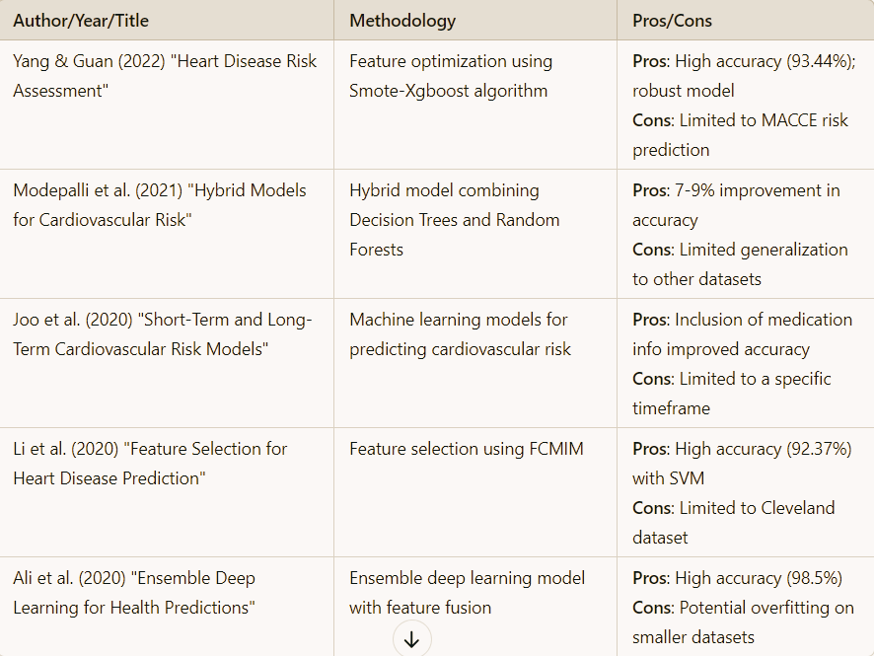
Literature Survey

Slide 4
Existing System
Conventional methods use statistical models such as Framingham Risk Score or QRISK to estimate the likelihood of a heart attack.
Most models do not provide personalized recommendations or suggestions based on lifestyle factors.
Existing systems do not use deep learning, which limits their ability to capture complex relationships in the data.
Current systems do not provide a clear visualization of risk, making it harder for patients to understand their condition.

Slide 5
Disadvantages
Lack of Feature Optimization: Traditional methods do not use modern optimization techniques to enhance prediction accuracy.
No Personalization: Risk calculators offer generalized recommendations.
Visualization: Few models provide intuitive visual feedback to individuals regarding the impact of lifestyle changes on heart attack risk.
Complexity: Medical professionals need to interpret the results, making it less accessible to the general public.

Slide 6
Proposed System
Utilizes deep learning algorithms to predict the risk of heart attacks based on user health data.
Implements feature selection techniques to improve the prediction accuracy by focusing on the most relevant health factors.
Provides a clear, visual representation of the predicted heart attack risk, making it easier for users to understand their health status.
Suggests personalized lifestyle changes (diet, exercise, etc.) to reduce the heart attack risk, based on user-specific data.

Slide 7
Advantages
Improved Accuracy: Deep learning models with feature optimization provide more accurate risk prediction.
Personalized: Tailored lifestyle suggestions based on the user's individual health data.
Visual: Risk visualization helps users understand their heart health better.
Scalability: Can process large datasets efficiently, allowing it to be scaled for public health initiatives.

Slide 8
Requirements
Hardware:
Processors such as Intel Core i5 or higher
At least 16 GB of RAM for smooth execution.
A dedicated GPU for deep learning model training.
Sufficient storage space (minimum 500 GB).
Software:
Operating System: Windows 10/11 or a Linux-based distribution.
Programming Environment: Python 3.8 or higher.
Frameworks and Libraries:TensorFlow, Keras, NumPy, pandas, matplotlib.
Tools: Jupyter Notebook,Visual Studio Code for development.

Slide 9
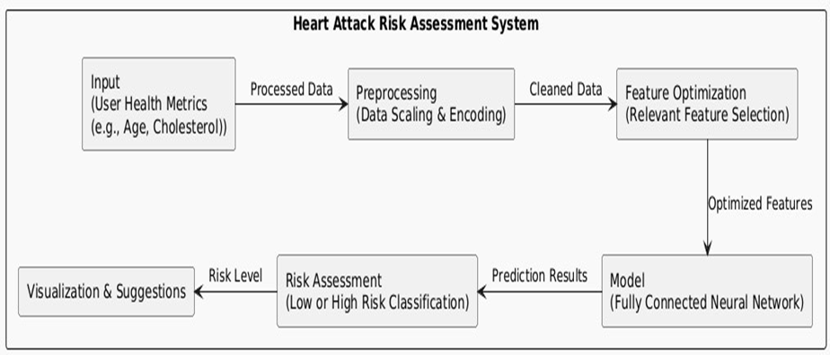
Architecture

Slide 10
Algorithm
1.Data Input:
Collect input data from users, which includes features like age, cholesterol, maxHR, and other relevant health metrics.
2.Data Preprocessing:
Normalize or scale the input data to ensure all features are on the same scale.
Split the dataset into training, validation, and test sets.
3.FCN Model Architecture:
Input Layer: Accept the input features (e.g., age, cholesterol, maxHR).
Hidden Layers: Use multiple fully connected layers with activation functions (e.g., ReLU).
Output Layer: A single neuron with a sigmoid activation function for binary classification (low risk vs. high risk).

Slide 11
4.Model Training:
Train the FCN model using labeled data.
Optimize weights using backpropagation and appropriate loss function.
5.Evaluation:
Use the validation set to evaluate the model's performance after each epoch.
Compute metrics such as accuracy, precision, recall, and F1 score.
6.Model Optimization:
Apply feature optimization and tuning methods to enhance performance.
Test with different architectures and hyperparameters to improve accuracy.
7.Output:
Predict heart attack risk for new data.
Visualize the risk and provide lifestyle change recommendations if the risk is high.

Slide 12
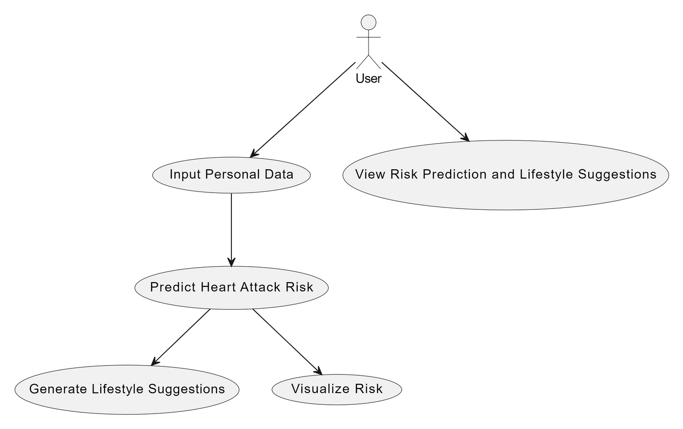
Use Case Diagram

Slide 13
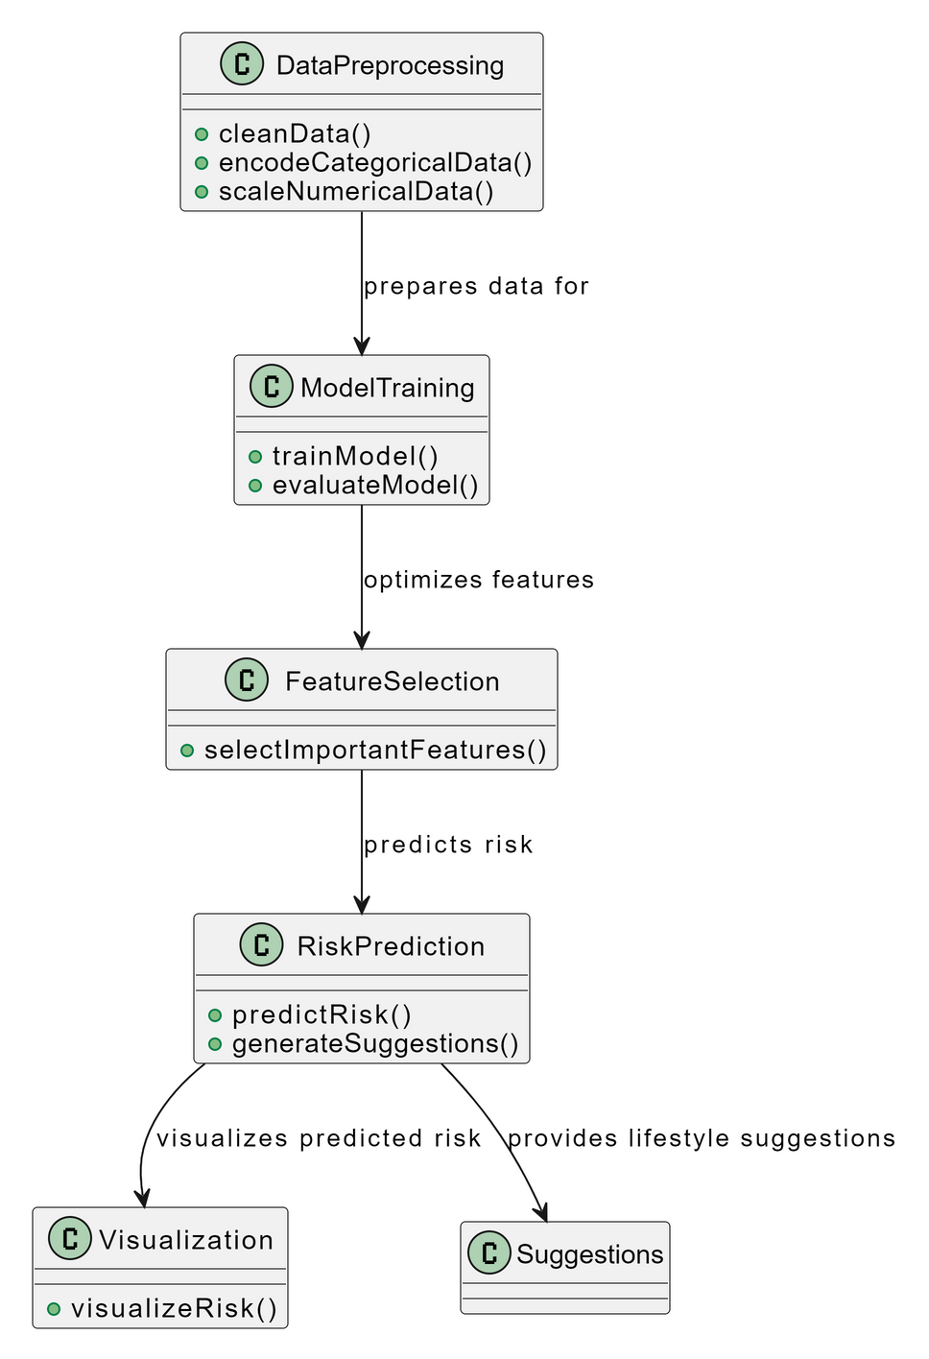
Class diagram

Slide 14
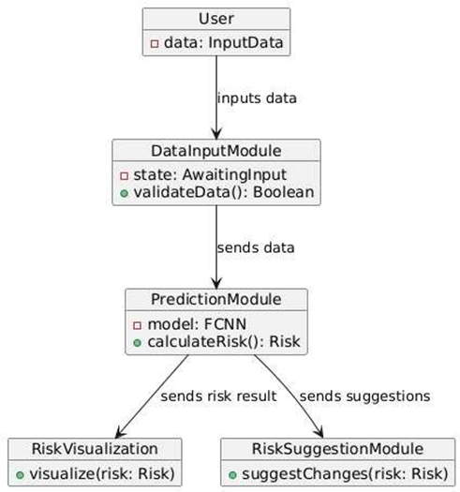
Object diagram

Slide 15
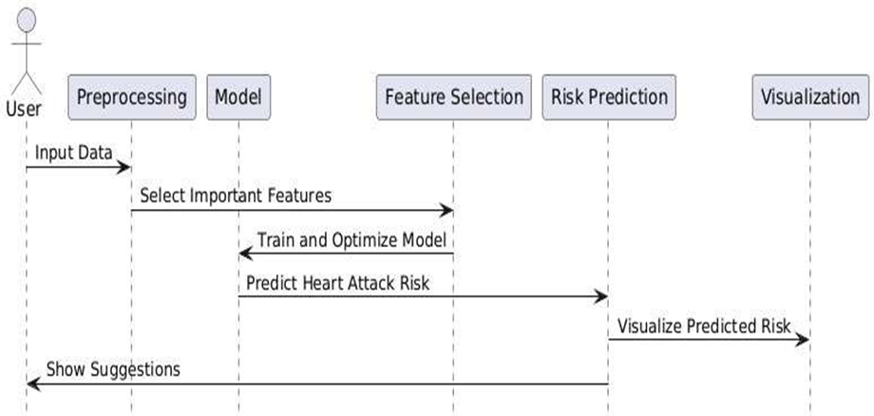
Sequence diagram

Slide 16
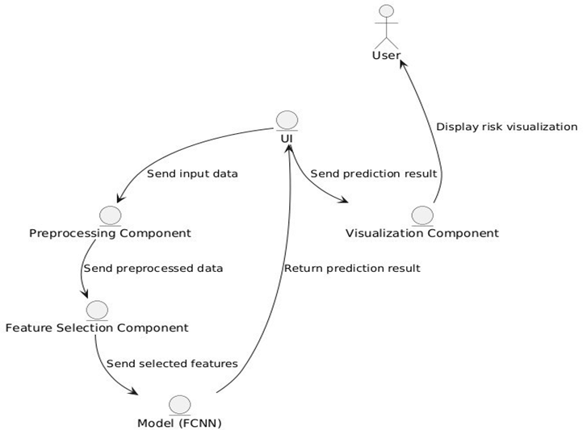
Collaboration diagram

Slide 17
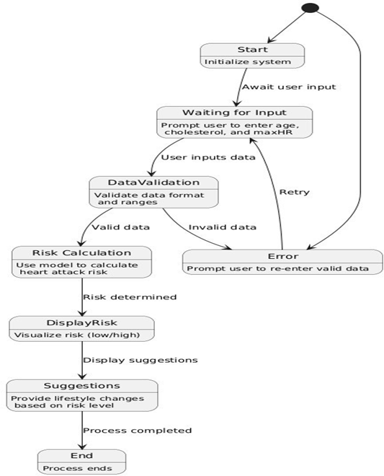
State chart diagram

Slide 18
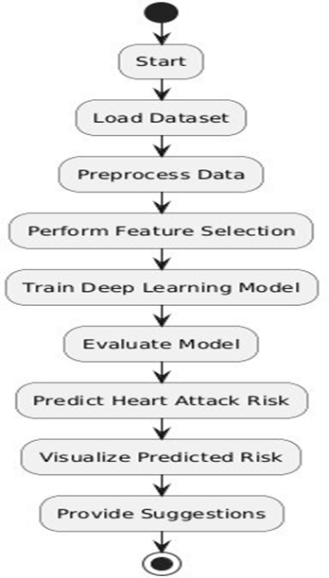
Activity diagram

Slide 19
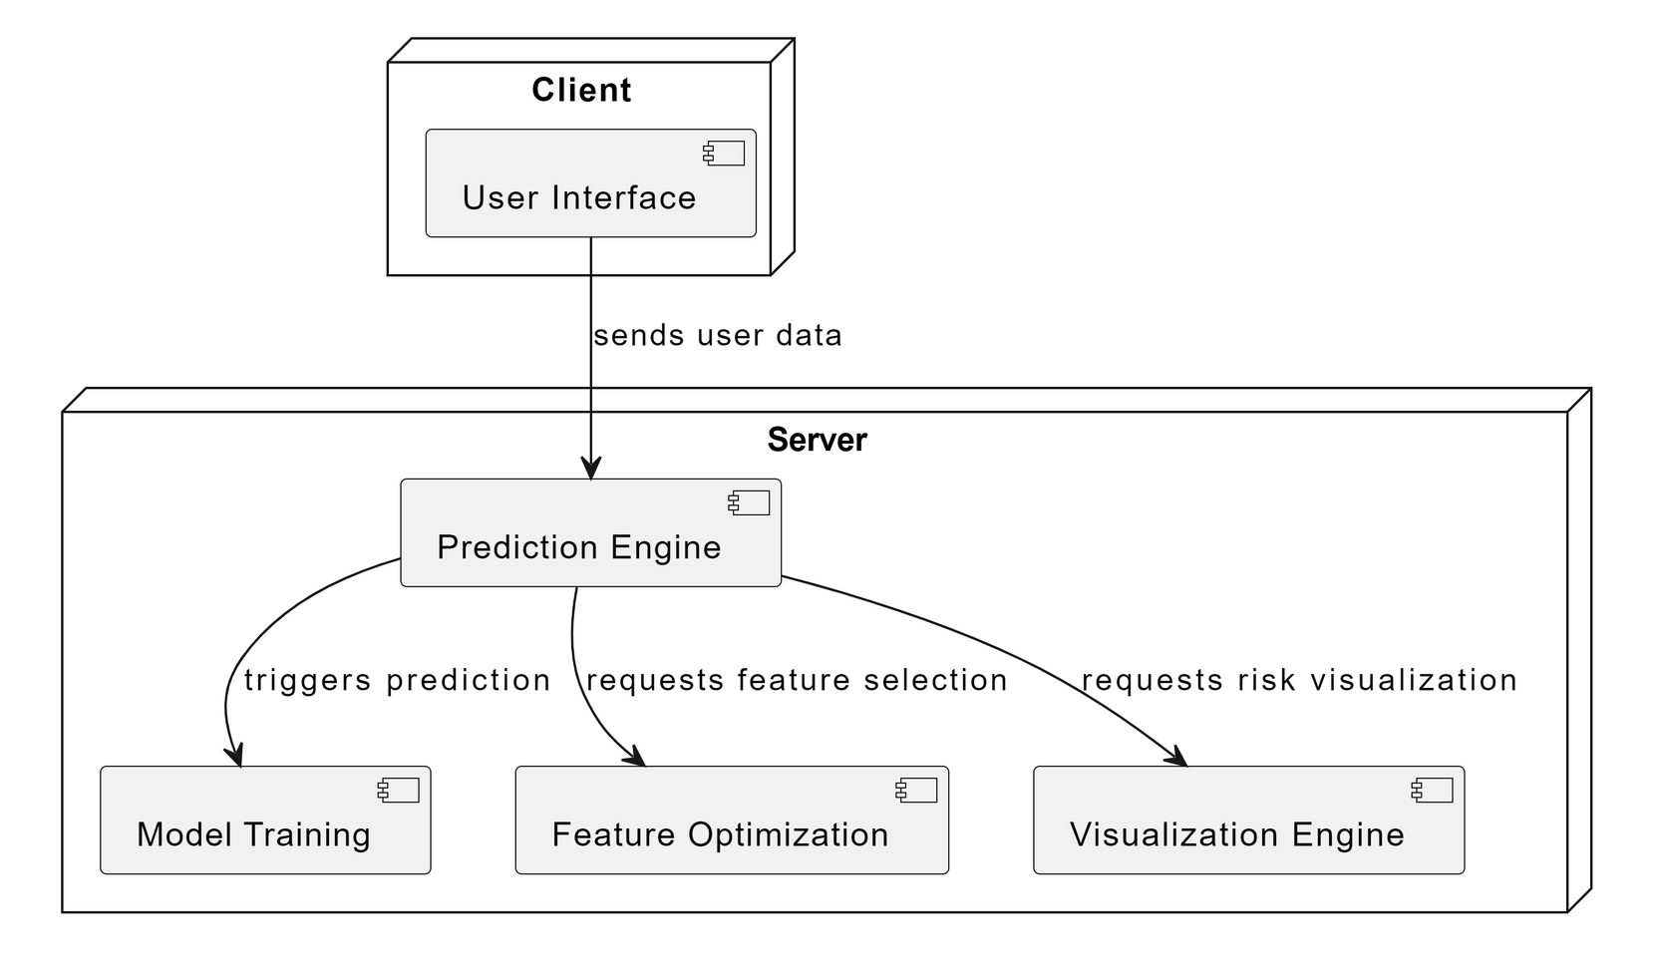
Deployment diagram

Slide 20
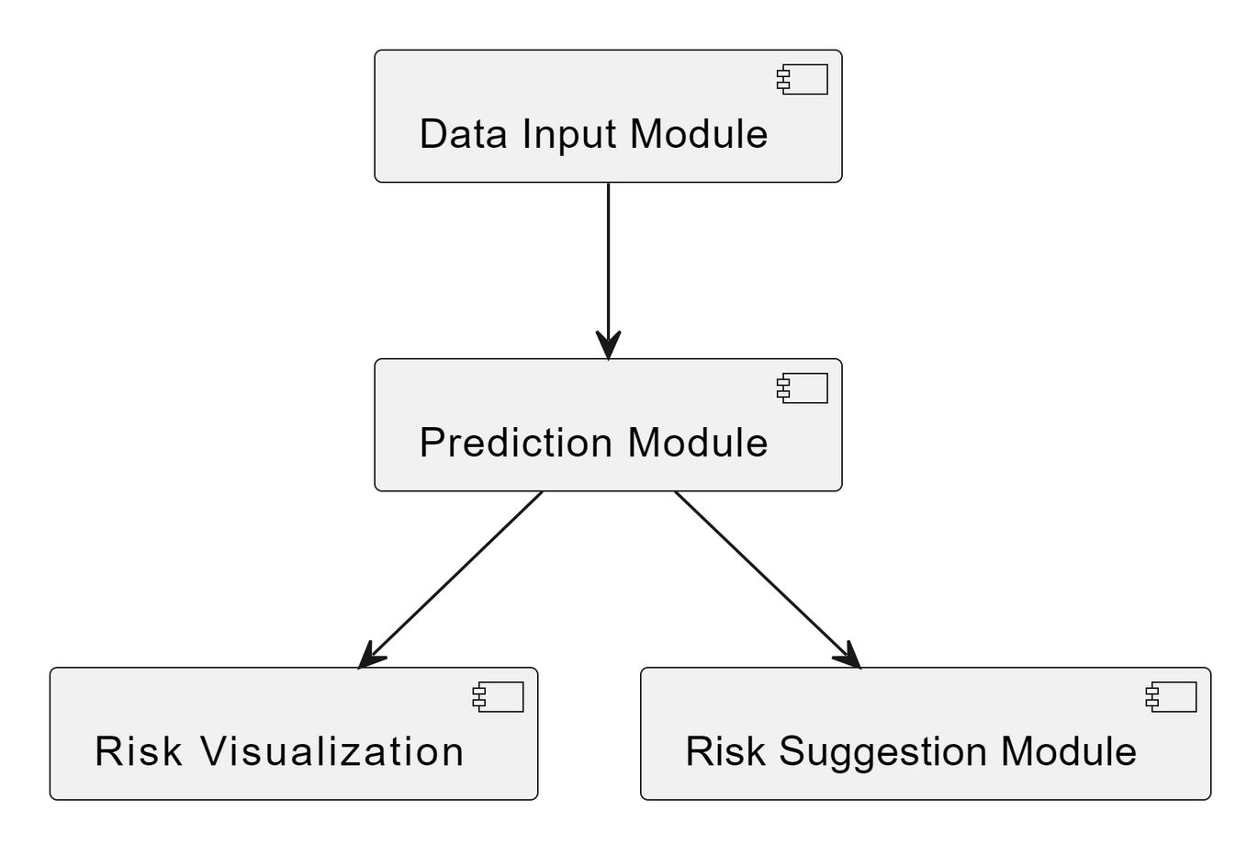
Component diagram

Slide 21
Conclusion
The proposed deep learning model effectively predicts heart attack risk by leveraging optimized feature selection, ensuring improved efficiency and accuracy. The integration of feature optimization enhances model performance, while risk visualization provides a clearer understanding for users. Unlike general heart attack prediction systems, this model is specifically designed for heart attack risk assessment, making it a more focused and reliable solution. This study contributes to advancing predictive healthcare technology, and future improvements could involve real-time monitoring and expanding the dataset for enhanced model generalization.

Slide 22
Thank You

