Slide 1
Heart Attack Risk Assessment Using Deep Learning with Feature Optimization
Project Guide:
Mr.Shashank Tiwari
Project coordinator: Mrs. G.Srisudha
Team Members:
Ch. Rishitha (21AG1A6676)
G. Poojitha (21AG1A6683)
B. Sahith (22AG5A6608)

Slide 2
Abstract
This project aims to develop a deep learning-based system for predicting heart attack risk by analyzing lifestyle and medical data. The system collects user input, including factors like age, cholesterol levels, and heart rate, to assess the likelihood of a heart attack. Using feature optimization, the system selects the most relevant data points and feeds them into a deep learning model to predict the risk. The results are visualized through interactive charts to make the risk level easily understandable. Based on the prediction, the system provides personalized lifestyle recommendations to help users reduce their risk. The ultimate goal is to empower users to make informed health decisions, visualizing the potential benefits of lifestyle changes in reducing heart attack risk.
Keywords: Deep Learning, Feature Optimization, Heart Attack Risk, Visualization

Slide 3
Introduction
Heart attacks remain a leading cause of mortality worldwide, making early risk assessment crucial for preventive healthcare. Traditional methods rely on clinical expertise and statistical models, but recent advancements in deep learning have significantly improved predictive accuracy. This literature survey explores various studies that leverage deep learning techniques for heart attack risk prediction, analyzing their methodologies, feature selection strategies, and model performances.

Slide 4
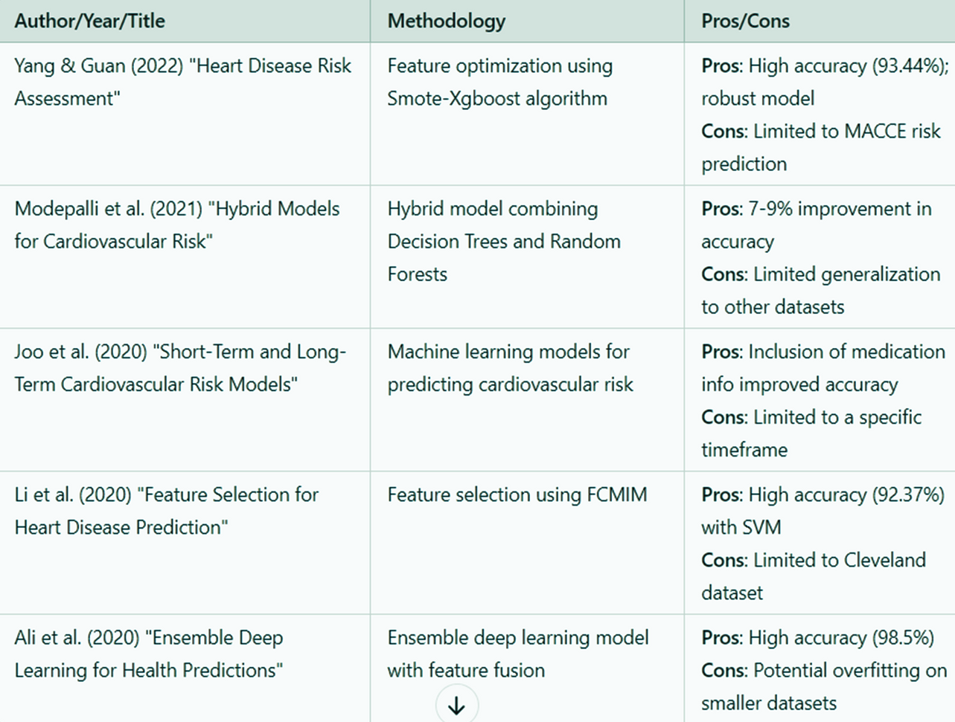
Literature Survey

Slide 5
Methodologies
Data Collection: Patient health records from publicly available datasets like Kaggle.
Data Preprocessing: Standardizing numerical data and encoding categorical features.
Feature Selection: Selecting the most relevant features using optimization techniques.
Model Selection: Using Fully Connected Neural Networks (FCNN) for prediction.
Model Training and Evaluation: Training models with hyperparameter tuning and performance metrics.
Risk Prediction and Interpretation: Predicting risk levels and visualizing results using graphs.

Slide 6
Gaps in Existing Research
Limited Deep Learning Use: Many models rely on traditional ML, lacking deep learning advancements.
Limited Feature Optimization: Lacks feature optimization techniques, which could enhance the model’s ability to focus on the most predictive factors for heart attack risk.
Lack of Risk Visualization: Most models provide predictions but do not visualize risk levels effectively.

Slide 7
Addressing Research Gaps
Deep Learning Integration: Implementing an FCNN model to enhance prediction accuracy.
Feature Optimization: Selecting the most relevant features for improved model efficiency.
Risk Visualization: Presenting risk levels graphically for better interpretation.

Slide 8
Hardware and Software Requirements
Hardware:
Processors such as Intel Core i5 or higher
At least 16 GB of RAM for smooth execution.
A dedicated GPU for deep learning model training.
Sufficient storage space (minimum 500 GB).
Software:
Operating System: Windows 10/11 or a Linux-based distribution.
Programming Environment: Python 3.8 or higher.
Frameworks and Libraries:TensorFlow, Keras, NumPy, pandas, matplotlib.
Tools: Jupyter Notebook,Visual Studio Code for development.

Slide 9
Conclusion
The proposed deep learning model effectively predicts heart attack risk by leveraging optimized feature selection, ensuring improved efficiency and accuracy. The integration of feature optimization enhances model performance, while risk visualization provides a clearer understanding for users. Unlike general heart attack prediction systems, this model is specifically designed for heart attack risk assessment, making it a more focused and reliable solution. This study contributes to advancing predictive healthcare technology, and future improvements could involve real-time monitoring and expanding the dataset for enhanced model generalization.

Slide 10
Thank you

