Slide 1
Fake News Detection using Natural Language Processing
Team Members:
Poojitha Vontela
Indrasena Bogapathi
Sricharitha Katta
Sri Rekha Gaddipati
Lakshmi Sai Prasanna Varikuti

Slide 2
Abstract
Fake news spreads fast on the internet and can mislead people → This causes confusion, panic, and misinformation in society.
Our goal is to detect fake news using deep learning techniques → We used models that read news articles and decide if they are real or fake.
We collected a labeled dataset from Kaggle with both fake and real news → It helped us train and test our models with known correct answers.
Three models were used: LSTM, BERT, and RoBERTa → We compared a simple model (LSTM) with powerful transformers.
RoBERTa gave the best accuracy among all models → It understood the text deeply and made the fewest mistakes.
This system can help journalists and readers quickly identify fake news → It acts like a filter to stop wrong information from spreading.

Slide 3
Introduction
Today, people mostly read news on phones, websites, and social media → It is fast and easy but also makes spreading fake news much easier.
Fake news can cause serious problems like fear, wrong beliefs, and even violence → It can mislead public opinion and affect important decisions.
Manual fact-checking is slow and cannot keep up with thousands of news posts → We need a fast and automatic way to detect fake news in real time.
Our system takes news article text as input and gives a label: Real or Fake → It reads the full text and tries to understand if it can be trusted.
We used three different models to compare performance → A simple LSTM model, and two advanced transformer models: BERT and RoBERTa.
This project was done for our machine learning course → All parts from data collection to results were completed by our team.

Slide 4
Related Work
Earlier methods used simple rules like word counts and sentence length → (Horne & Adali, 2017) showed that fake news often uses short, emotional language.
Studies grouped these into content-based approaches using manual features → (Shu et al., 2017) explained that such features are easy to understand but easy to trick.
Deep learning models like CNNs and LSTMs improved performance → These models learn from raw text and do not need manual features.
Transformers brought a big improvement in fake news detection → (Devlin et al., 2019) introduced BERT, which reads text using attention and context.
RoBERTa made BERT better by training on more data and removing extra steps → (Liu et al., 2019) showed it beats BERT in many text understanding tasks.
Our project uses these models and compares them fairly on the same dataset → We study which model works best and why.

Slide 5
Dataset and Features
We used the "Fake and Real News" dataset from Kaggle → It includes around 45,000 news articles labeled as real or fake.
The dataset was balanced with similar numbers of fake and real articles → This helps the models learn without bias toward one class.
We cleaned the text by removing links, punctuation, stop words, and symbols → This made the data neat and easier for the models to understand.
We converted words into tokens using different tokenizers → LSTM used Keras tokenizer, BERT and RoBERTa used Hugging Face tokenizers.
For LSTM, we created word embeddings and padded sequences to equal length → This helps the model read the text like a timeline.
BERT and RoBERTa used their own learned embeddings and subword tokens → They already know many patterns in English, so they learn faster and better.
We used no images, audio, or extra data—only text → The goal was to check if models can detect fake news using words alone.

Slide 6
Methods
We used three different models: LSTM, BERT, and RoBERTa → This helped us compare how simple and advanced models perform on the same task.
LSTM is a sequence-based model that reads text word by word → It reads in both directions (forward and backward) to understand context better.
LSTM uses word embeddings to represent words as numbers → It processes these embeddings to detect patterns in the writing style.
BERT is a transformer model pre-trained on huge English text data → It uses attention to understand the full meaning of a sentence at once.
We fine-tuned BERT on our fake news dataset → This helped it adapt its language knowledge to detect fake news specifically.
RoBERTa is an improved version of BERT with better training techniques → It was trained longer, on more data, and without certain limitations of BERT.
All three models output a probability score to decide if an article is fake or real → If the score is high, the model predicts the article as fake; if low, as real.

Slide 7
LSTM Results
The LSTM model achieved an accuracy of 98.86% on the test set → It correctly predicted most real and fake news articles.
Precision, recall, and F1-score were all around 0.99 for both classes → This shows that the model was well-balanced and not biased.
The training and validation accuracy increased steadily over 5 epochs → This means the model was learning effectively without overfitting.
The confusion matrix showed very few errors → Only 64 real articles were wrongly predicted as fake, and 38 fake as real.
The model is lightweight and runs fast even on basic hardware → It’s a good option for situations where high-end systems are not available.
LSTM performed well, but may miss deeper meaning in longer or complex texts → It focuses on word order but does not capture full sentence relationships like transformers.

Slide 8
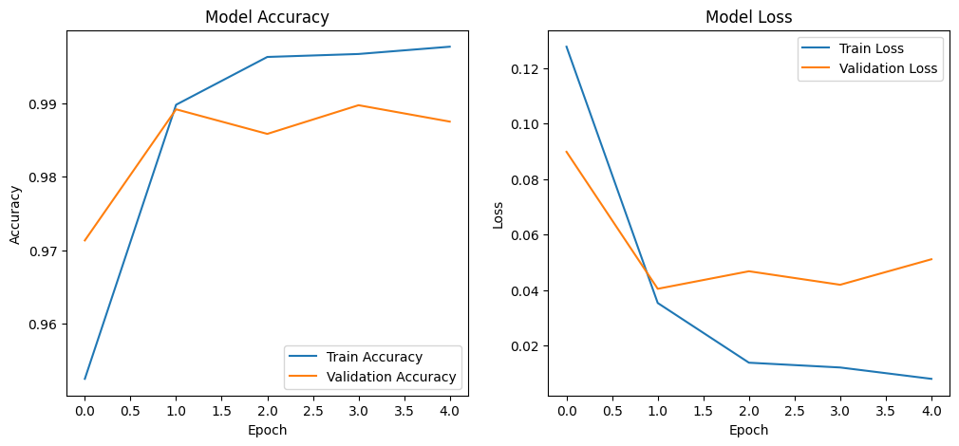
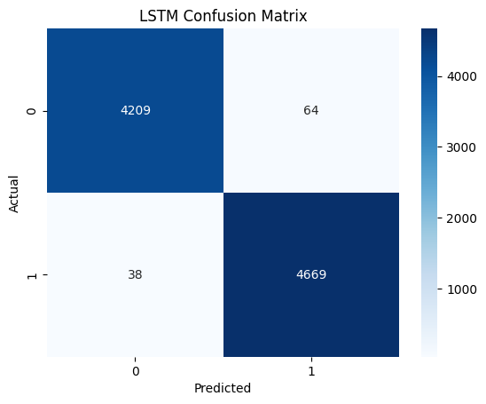
Fig 1: model Accuracy and Model Loss
Fig 2: LSTM Confusion Matrix

Slide 9
BERT Results
The BERT model reached 99.90% accuracy on the test data → It made only a few mistakes out of nearly 9,000 articles.
It was fine-tuned on our fake news dataset for just 2 epochs → BERT learns quickly because it already understands general English well.
Validation loss stayed very low throughout training → This shows that the model was not overfitting and handled unseen data well.
Precision, recall, and F1-score were all near perfect → The model identified both real and fake articles with equal strength.
The model handled tricky or emotional statements better than LSTM → This is because BERT can understand the full context of every sentence.
Although BERT is slower than LSTM and needs more memory, it gives better accuracy → It’s ideal for setups where quality is more important than speed.

Slide 10
RoBERTa Results
RoBERTa gave the highest accuracy: 100% on the test dataset → It correctly predicted every real and fake article except for 3 minor cases.
Training was done for only 2 epochs, yet performance was outstanding → The model learned fast and adjusted perfectly to our dataset.
Precision, recall, and F1-score were all 1.00 (perfect) → This means there were almost no false positives or false negatives.
The confusion matrix showed only 3 misclassified articles → It had the best prediction quality out of all three models.
RoBERTa understood long sentences and deep meanings very well → It uses a powerful attention mechanism that catches even subtle patterns.
Though it needs more time and GPU power, its accuracy makes it worth using → It is suitable for high-quality fake news detection systems in real-world use.

Slide 11
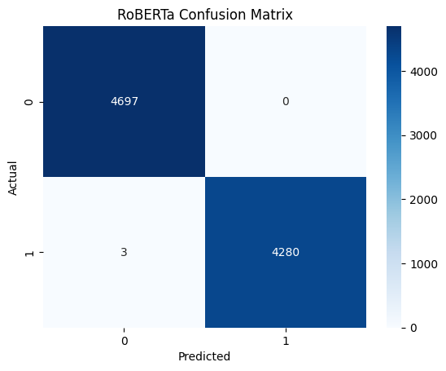
Fig 4: RoBERTa Confusion Matrix

Slide 12
Conclusion / Future Work
Our project compared three models for fake news detection: LSTM, BERT, and RoBERTa → All models gave strong results, but RoBERTa performed the best.
LSTM was lightweight and fast, with 98.86% accuracy → It’s a good option when working with limited hardware.
BERT improved accuracy to 99.90% with better language understanding → It balanced good performance and reasonable resource usage.
RoBERTa achieved nearly perfect results with 100% test accuracy → It understood deep context and handled even difficult examples.
In the future, we can add user behavior data or article sources to improve predictions → This will help models make better decisions in real-world scenarios.
We also plan to build a web app where users can enter news text and get predictions → This would make our system easy to use by anyone.

Slide 13
Team Contributions
Poojitha Vontela worked on data cleaning and LSTM model development → She prepared the text for training and implemented the first model.
Indrasena Bogapathi fine-tuned the BERT model and handled evaluation → He trained the transformer and helped analyze model performance.
Sricharitha Katta focused on implementing and fine-tuning RoBERTa → She ensured the highest-performing model was correctly trained.
Sri Rekha Gaddipati performed exploratory data analysis and helped with writing → She created plots, visual insights, and explained results clearly.
Lakshmi Sai Prasanna Varikuti worked on literature review and formatting → She reviewed existing research and helped organize the final report.
All members supported each other in testing, debugging, and final review → The project was completed through full team collaboration.

