Slide 1


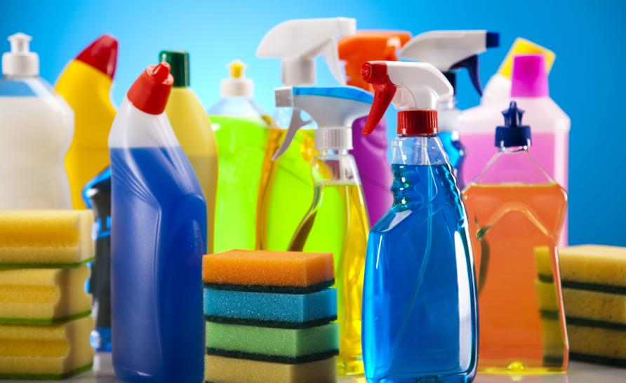
organization wit-ace hackathon team members Poojitha k reinita Thomas Priya dharshini e m college code 1116 type web application topic chemicals that effect our environment

Slide 2
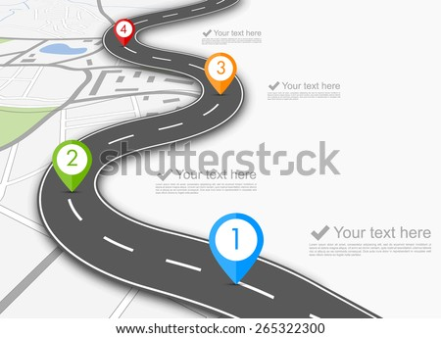
road map 4.machine learning algorithm 3.coding 2.user interface for scanning 1.blue print 1.in blue print we CAN find ingredients data set collection. 2.next we have to scan the product to know the chemicals are present or not. 3. now we want to write the program/code by using some ibm tools , flask ,html to get our output. 4.we use machine learning algorithms to implement our code. 5.thus we can get out output by following the above process.

Slide 3
Our proposal system *take the product and scan the product to know the chemicals present in the product that effcts environment. *for example soaps contains parabens which develops toxicity in the environment and also sodium laureth and lauryl which is hazardous. *shampoos contains sodium laureth sulfate ,parabeans ,ammonium chloride ,frangces , and tooth paste contains fluoride,glycol,triclosan. *sanitizer contains methanol,1-propanol and ingredients such as sugar, chocolate, soya beans, coffee . *the above mentioned are the harmful chemicals which are damaging the environment in a large scale. *so we must try to reduce usage of those chemicals to save our environment.

Slide 4
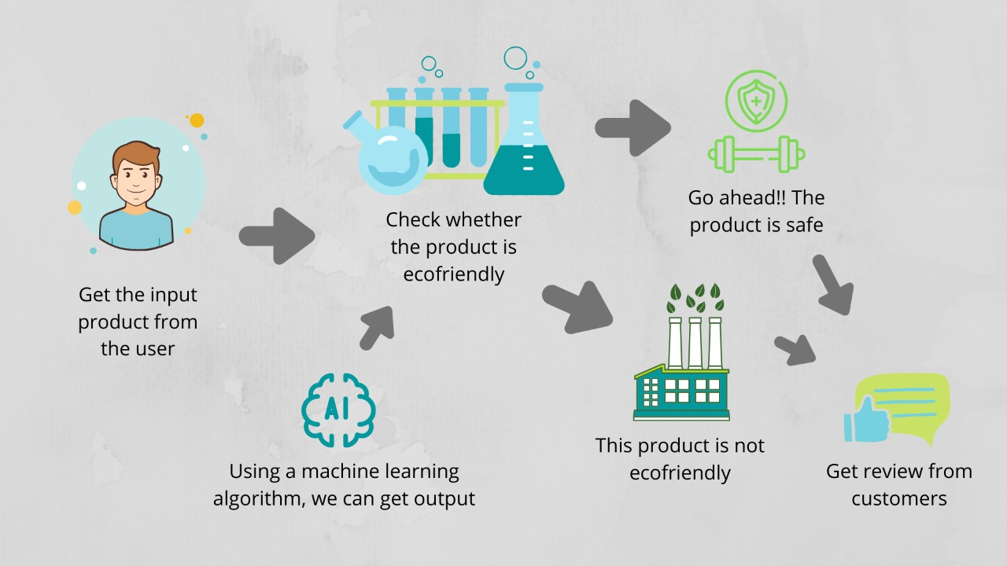
ARCHITECTURE DIAGRAM

Slide 5
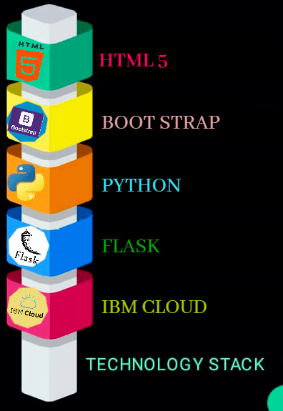
technology stack thank you

