Slide 1
Natural Language Generation
WebNLG
TEAM MEMBERS: HARIKA GORIJALA SAI POOJITHA CHOWDARY PALLOTHU

Slide 2




Table of Contents
Prior work
Problem Statement
Approach
Results

Slide 3
PRIOR
WORK

Slide 4
Initial Exploration
We have started by digging through several articles to understand NLG, its applications and how it is implemented.
We have come across different models such as, Markov Chain, Spark Distributed Markov chain model,RNN, LSTM that could be used to implement NLG. We chose to implement RNN LSTM.
From the given data repository, we have gone through the different datasets and each of us have come up with possible datasets that we could use for our project.
We have decided to use the WebNLG dataset and started building models that could be used for implementing.

Slide 5
PROBLEM
STATEMENT

Slide 6
WebNLG
The WebNLG dataset is made up of Data/Text pairs, with the data being a set of triples retrieved from DBpedia and the text being an articulation of the triples.
We integrated data from 16 different categories in the English WebNLG into a single dataframe using independent xml files.The dataset is divided into five variants, each with a different collection of triples, which are grouped together in the 1 triple folder.
The goal of the challenge is to generate text from the set of RDF triples.
All the input files in 1_triple folder are in the XML format.

Slide 7
Data
The English WebNLG 2020 dataset for training comprises data-text pairs for 16 distinct DBpedia categories.
Different Categories: Airport, Astronaut, Building, City, Comics Character, Food, Monument, SportsTeam, University, and Written Work, Athlete, Artist, Celestial Body, Mean Of Transportation, Politician, Company.
For every input triple set, several references in each language (English, Russian) are provided.

Slide 8
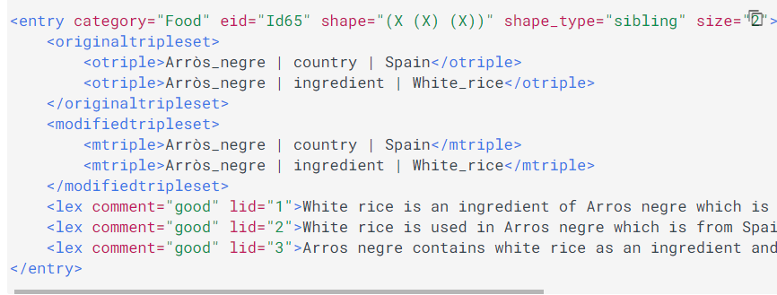
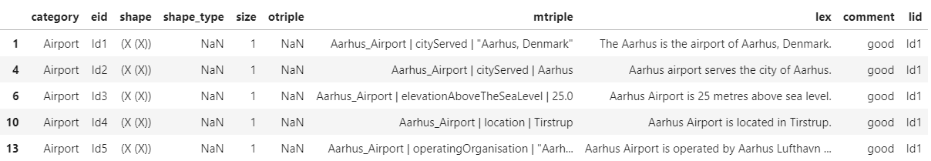
Snapshot of Data
Initial Data:
Modified Data:

Slide 9
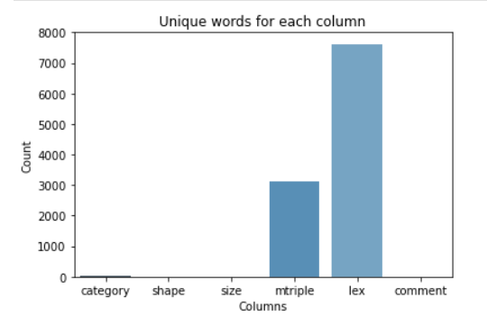
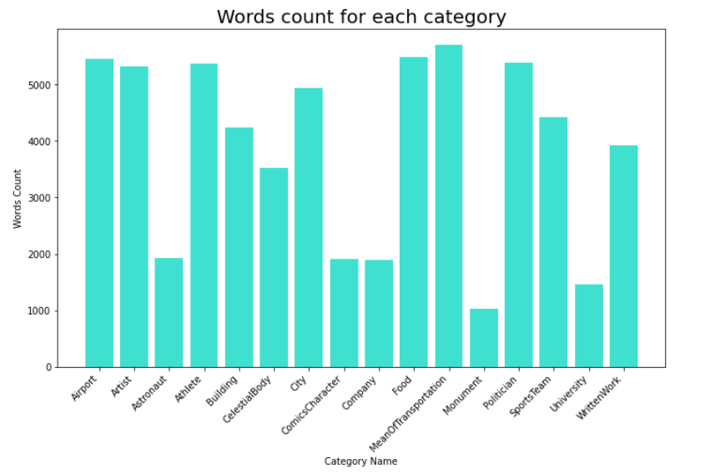
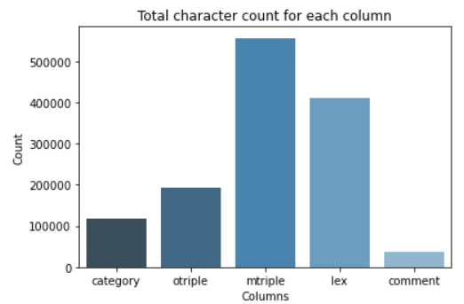
Data Exploration - Word Counts

Slide 10
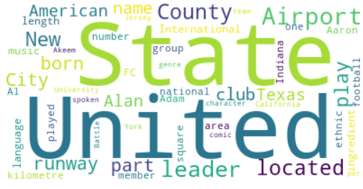
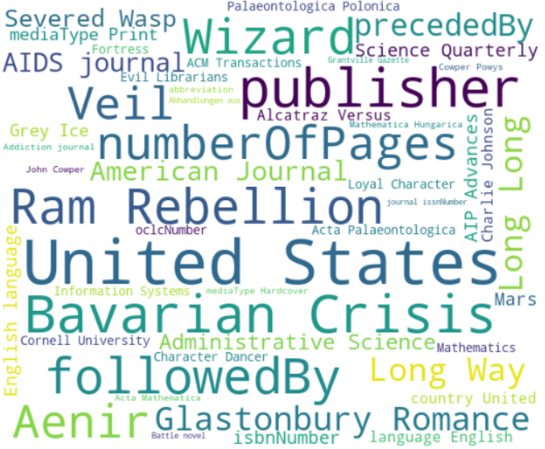
Data Exploration - Word Clouds
Visualizing ‘lex’ column
Visualizing ‘mtriple’ column

Slide 11
APPROACH

Slide 12
Outline
Merge all Datasets
Filter out bad records (comment = ‘good’, id = id1)
Create 2D array using the char “|”
Aarhus_Airport | cityServed | "Aarhus, Denmark"
[“Aarhus_Airport”, “cityServed”, “Aarhus, Denmark”]
Add space at the capital in the 2nd term
cityServed -> city Served
Remove unnecessary characters in both columns and convert to lowercase
Ex: ,_:@#?!&$]
Randomize records then split between train and test
Train RNN LSTM on Lex column
Predict lex column using mtriple (compare to actual)

Slide 13
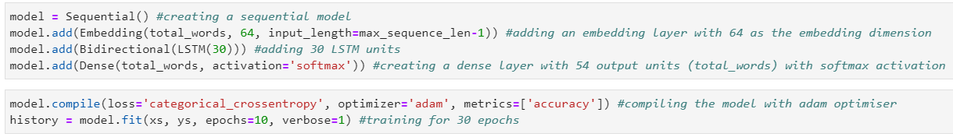
Model Implementation
We define a sequential model wherein each layer has exactly one input tensor and one output tensor.

Slide 14
RESULTS

Slide 15
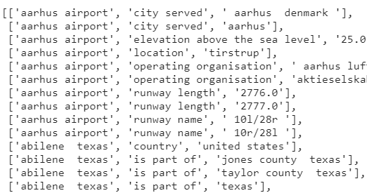
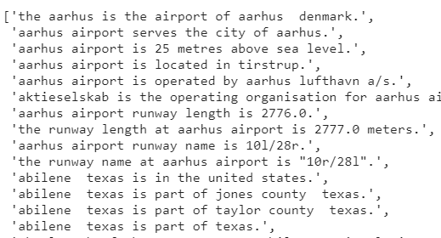
Preprocessing
Mtriple column after preprocessing:
Lex column after preprocessing:

Slide 16
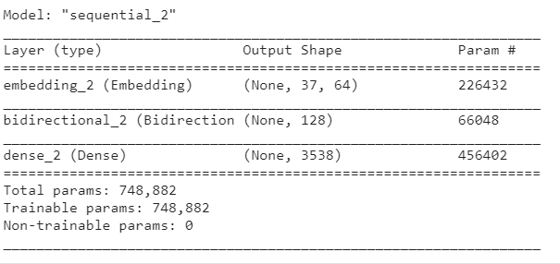
Model Summary
We have built a sequential model with multiple layers such as Embedding layer, Bi- LSTM and dense.
We added a Bidirectional LSTM layer with 30 units.
The activation function used is ‘softmax’ to each of these units and the optimizer used is ‘adam’.
Notes:
For LSTM the baseline was only one directional whereas for the final model we have used bidirectional which has also been a factor to improve the accuracy.

Slide 17
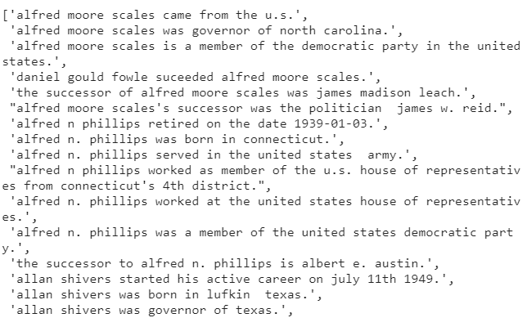
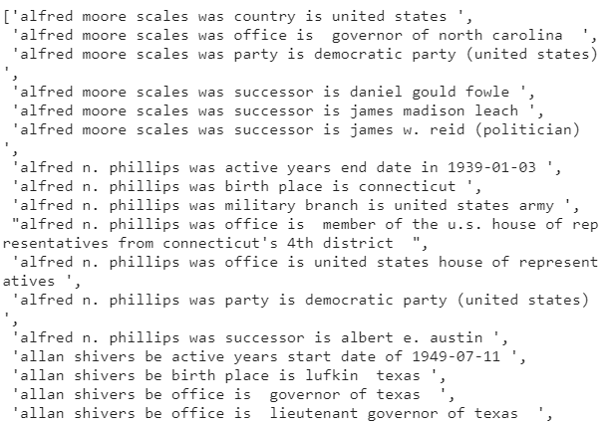
Model Predictions
Actual Output:
Predicted Output:

Slide 18


Accuracy Metrics
For model evaluation we have used BLEU score and Rouge score.
For baseline model we have used character-level prediction whereas, in the final model we have used word-level predictions which improved the performance of the model.
Baseline Model:
Final Model:
Notes:
We can also mention we have used Bidirectional LSTM layer in the final model instead of forward layer in baseline.

Slide 19
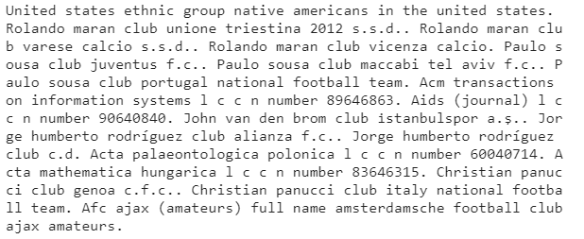
Summary
We have created a summary matrix based on the scores

Slide 20
References
Text Generation With LSTM Recurrent Neural Networks in Python with Keras
Text generation with an RNN
https://narrativescience.com/resource/blog/what-is-natural-language-generation/
https://machinelearningmastery.com/stacked-long-short-term-memory-networks/
https://towardsdatascience.com/natural-language-generation-part-1-back-to-basics-2f0b2654624f
https://medium.com/sciforce/a-comprehensive-guide-to-natural-language-generation-dd63a4b6e548
https://www.kdnuggets.com/2017/12/general-approach-preprocessing-text-data.html
https://www.tensorflow.org/guide/keras/rnn

Slide 21
Thank You!

