Slide 1
Datafetch by
Poojitha KU
1

Slide 2
ABOUT Project
The project is a Java-based web application built with Servlet. It processes requests from web browsers, retrieves data from backend systems, and displays information to users on web pages. It runs on servers, allowing users to interact via web interfaces and get updated information as needed

Slide 3
what I used
Concentrating on the deployment process
Git hub
Used for version control in this project, allowing efficient tracking, webhook, and management of code changes
AWS EC2
Enabling deployment and management of virtual servers for my web applications and workloads
Docker
Simplifies application deployment by containerizing software in lightweight, portable containers, ensuring consistency across different environments
jenkins
Automates software development processes through continuous integration and delivery, streamlining build, and deployment workflows

Slide 4
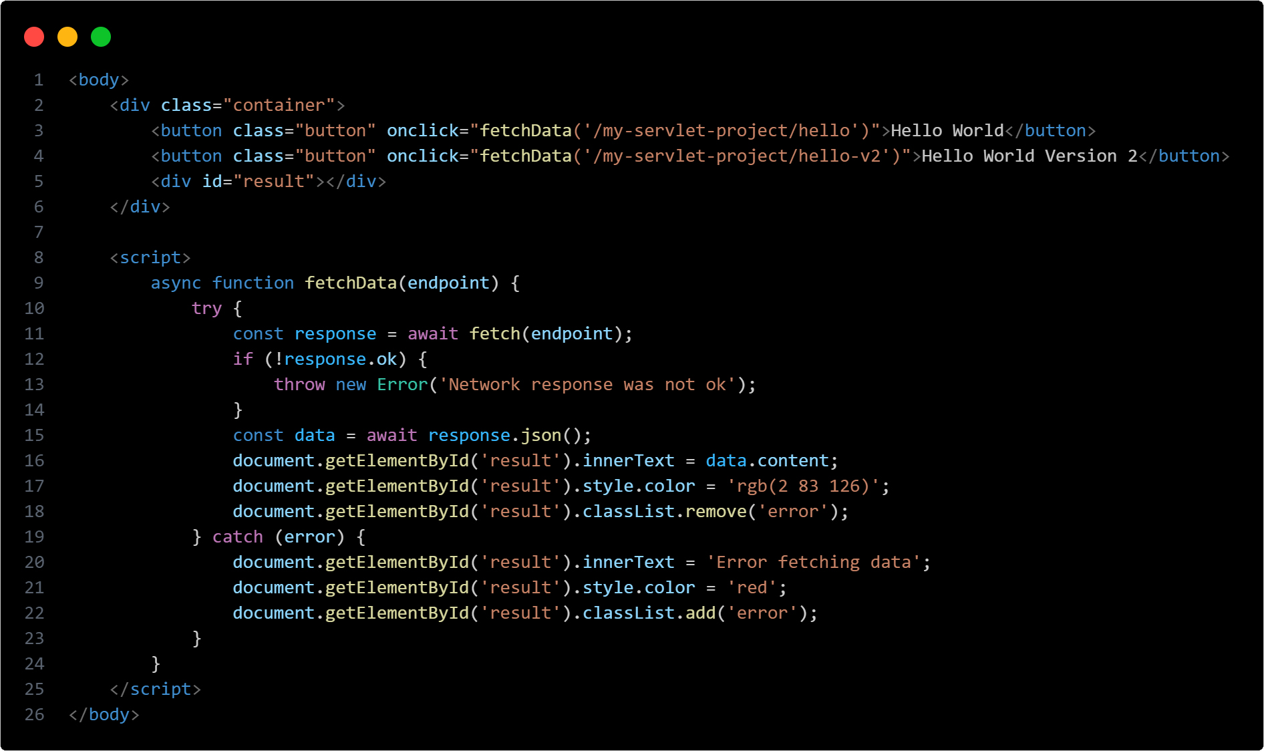
Index

Slide 5
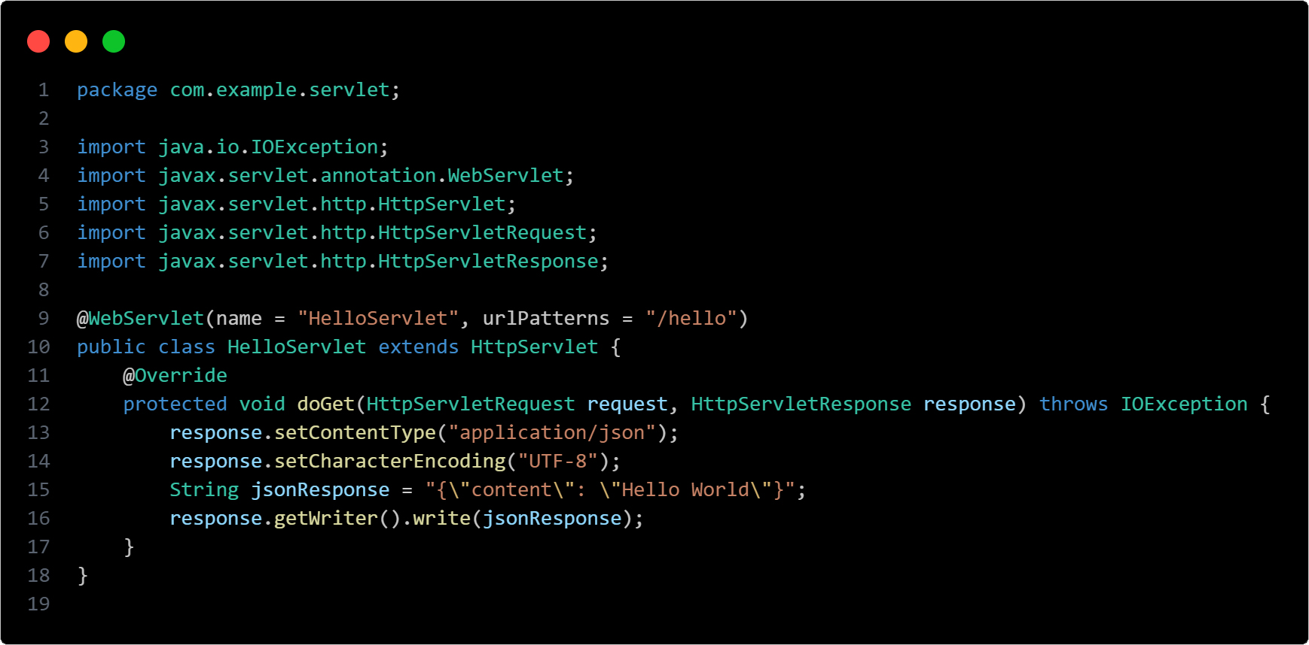
Hello world

Slide 6
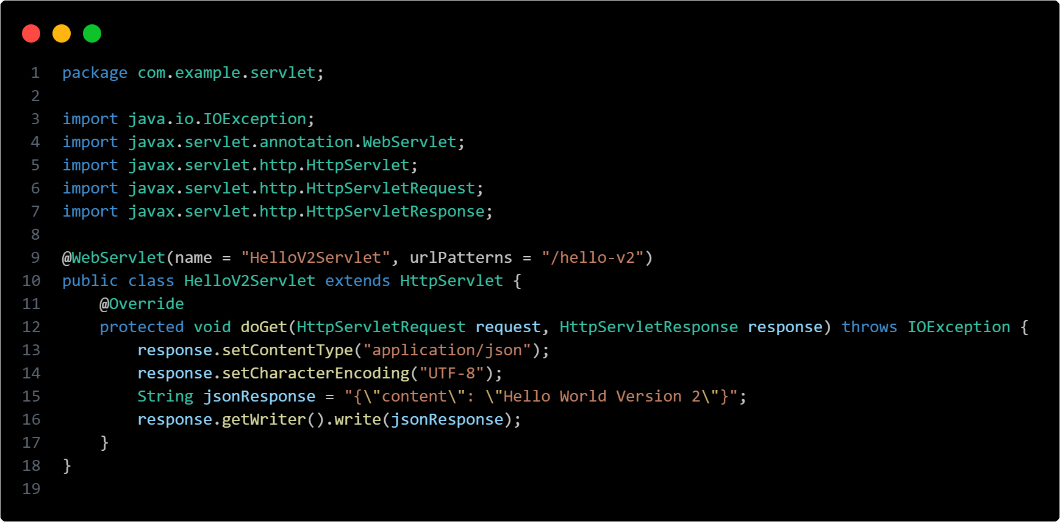
Hello world v2

Slide 7
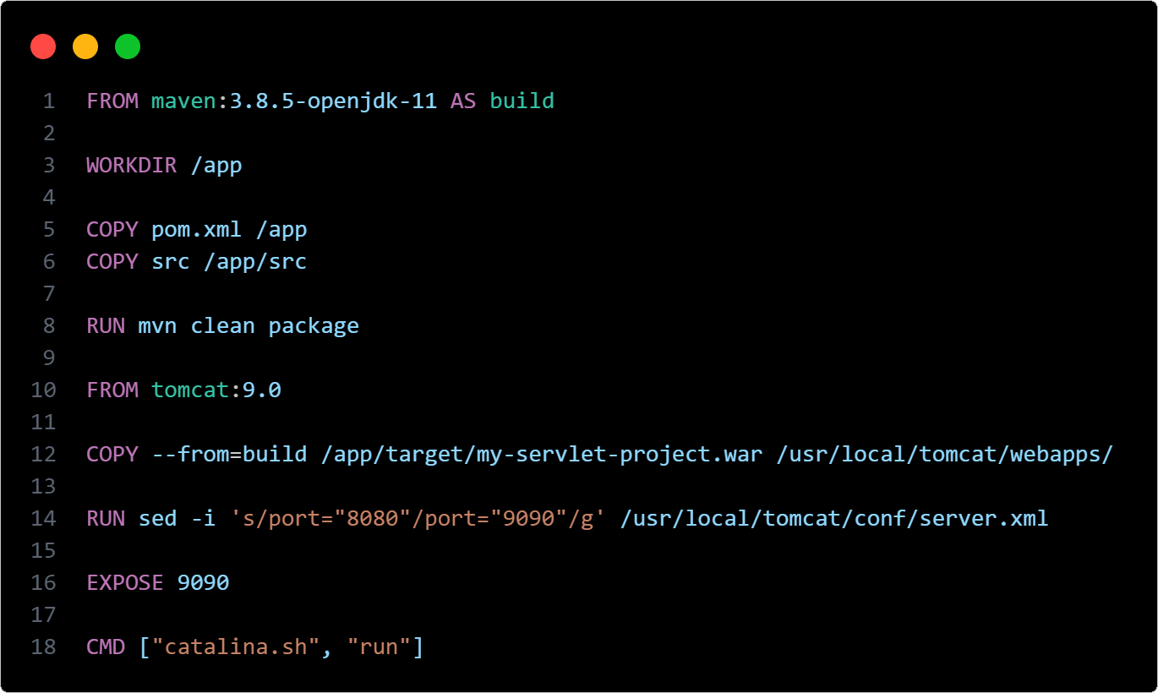
Dockerfile

Slide 8
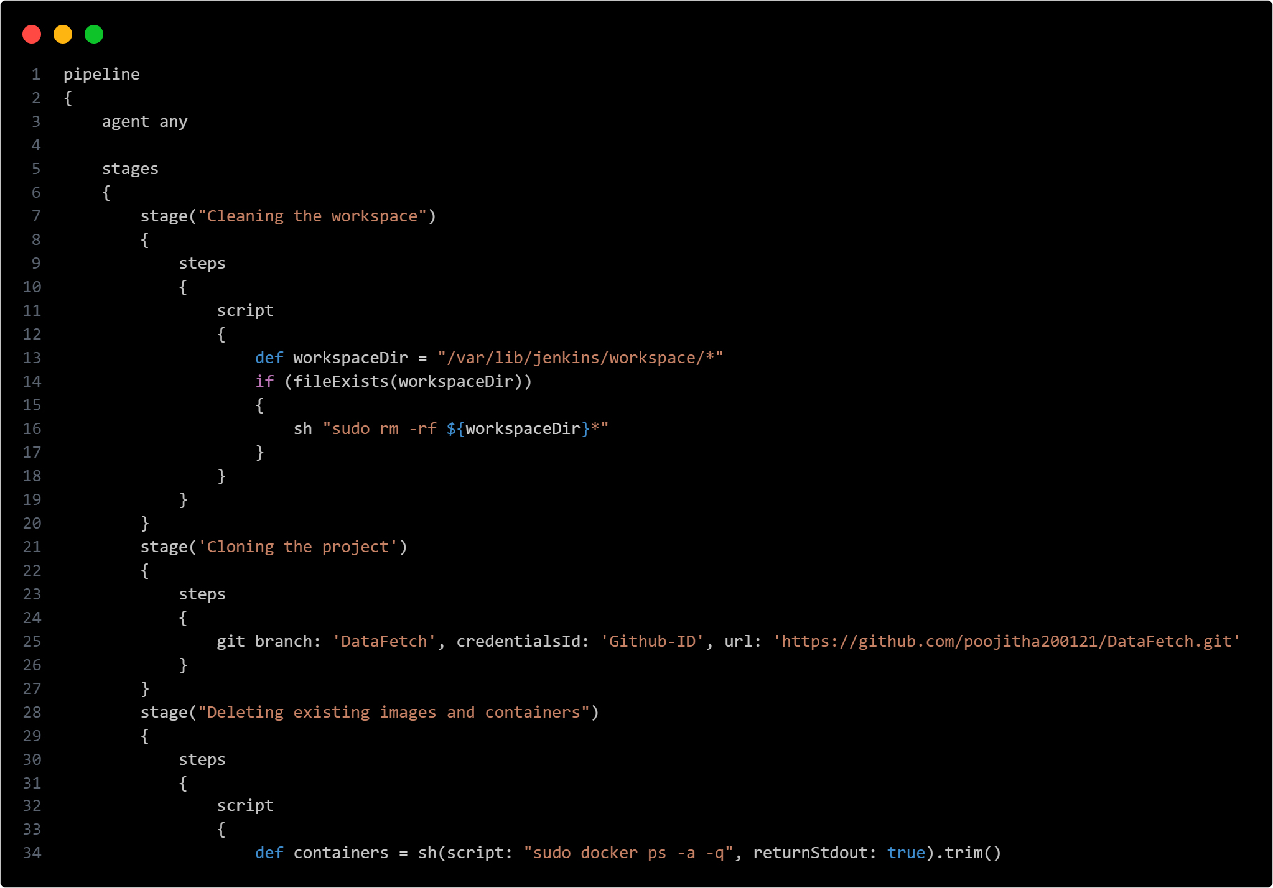
Jenkinsfile

Slide 9
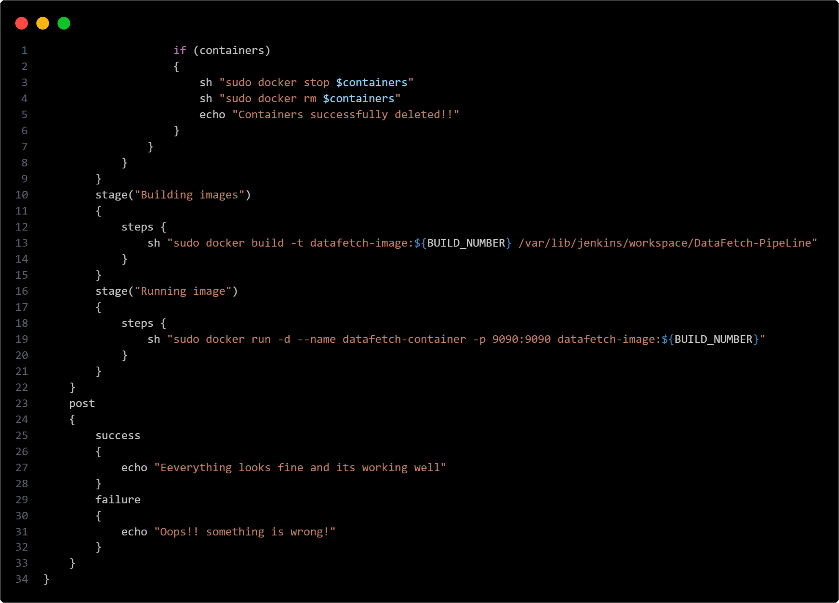
Jenkinsfile

Slide 10
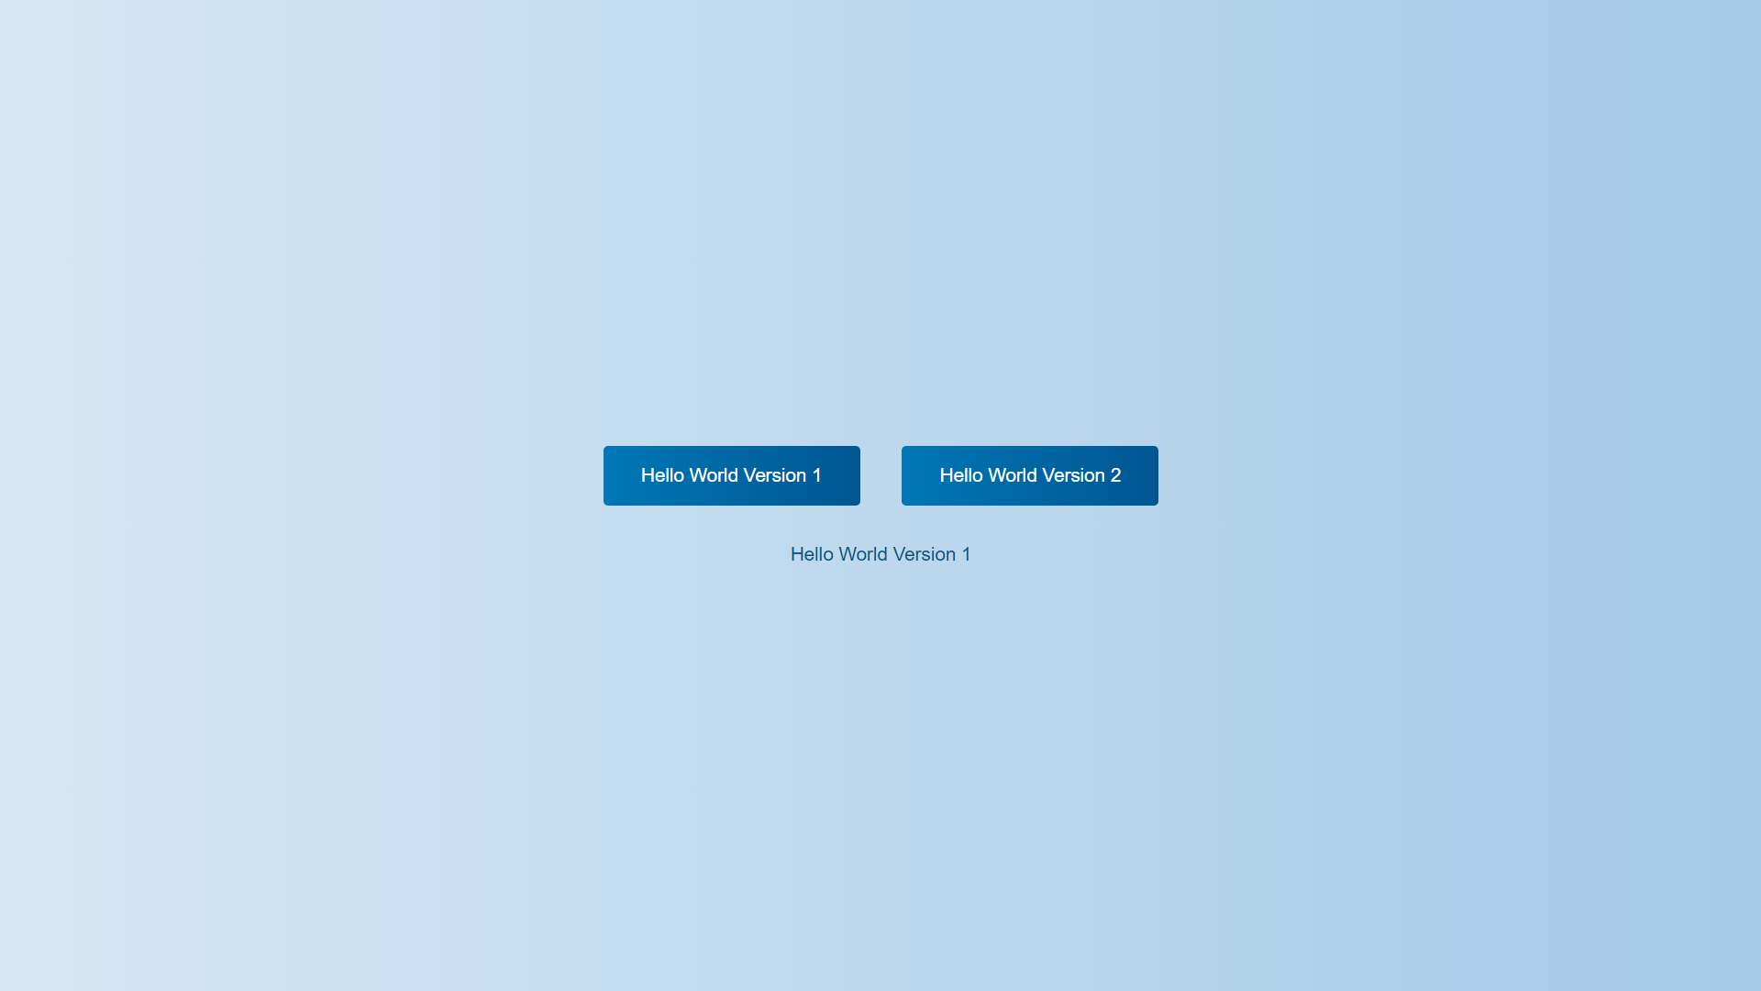
Webpage look

Slide 11
achievement
This project includes deploying a Java web application using Servlets with efficiency and automation
It involves setting up continuous integration and deployment pipelines using Jenkins and Dockerfile
This setup ensures streamlined building, packaging, and deployment processes, optimizing resource utilization and enhancing scalability. Deployed on a server environment
The application facilitates seamless interaction with users via web browsers, ensuring reliable and responsive access to dynamic data
11

Slide 12
THANK YOU
Poojitha KU
74831 42198
poojithaku2001@gmail.com
LinkedIn.PoojithaKU.In

