Slide 1
EDUANALYTICS · ANALYTICS CASE STUDY
EduAnalytics:
Turning student signals into timely support
From raw xAPI records to an intervention-ready Power BI view
POOJITHA KOTHAKONDA

Slide 2


Student outcomes are visible before they decline
One analytical view
Earlier support
Bring engagement, attendance, and academic performance together.
Move from retrospective reporting to explainable intervention.
POOJITHA KOTHAKONDA

Slide 3
This project demonstrates an end-to-end analytics workflow
01
02
03
04
Prepare
Engineer
Explore
Deliver
Clean and prepare education data.
Build interpretable features.
Find relationships and patterns.
Build an interactive Power BI dashboard for decision support.
Python preparation → exploratory analysis → Power BI and DAX decision support
POOJITHA KOTHAKONDA

Slide 4

The xAPI dataset connects classroom behavior to performance
480
student records across 17 columns
Signals include raised hands, visited resources, announcement views, discussion participation, absence days, subject, grade, semester, gender, and class.
No missing values were found in the source data.
POOJITHA KOTHAKONDA

Slide 5
The workflow turns raw records into an intervention-ready view
01
02
03
04
05
Collect
Prepare
Explore
Export
Interpret
Inspect the source data.
Clean records and engineer features.
Review distributions and relationships.
Save the processed dataset.
Build and read the dashboard.
The output is designed for a decision: who needs follow-up, and why?
POOJITHA KOTHAKONDA

Slide 6
Four engineered features make the analysis explainable
Engagement Score
Attendance Risk
Average of four participation signals, scaled 0–100.
1 when absence days are above seven.
Performance Proxy
Risk Status
L = 50, M = 80, H = 95.
Combines attendance, below-median engagement, and low or medium performance.
Project-defined assumptions make the rule inspectable, not ground truth.
POOJITHA KOTHAKONDA

Slide 7

Power BI turns the analysis into three decision views
Executive Dashboard
KPIs, subject performance, risk distribution, and filters.
Performance Analysis
Engagement by gender, semester, grade, and subject.
Student Risk Analysis
At-risk cohorts, absence patterns, and a detailed follow-up table.
POOJITHA KOTHAKONDA

Slide 8
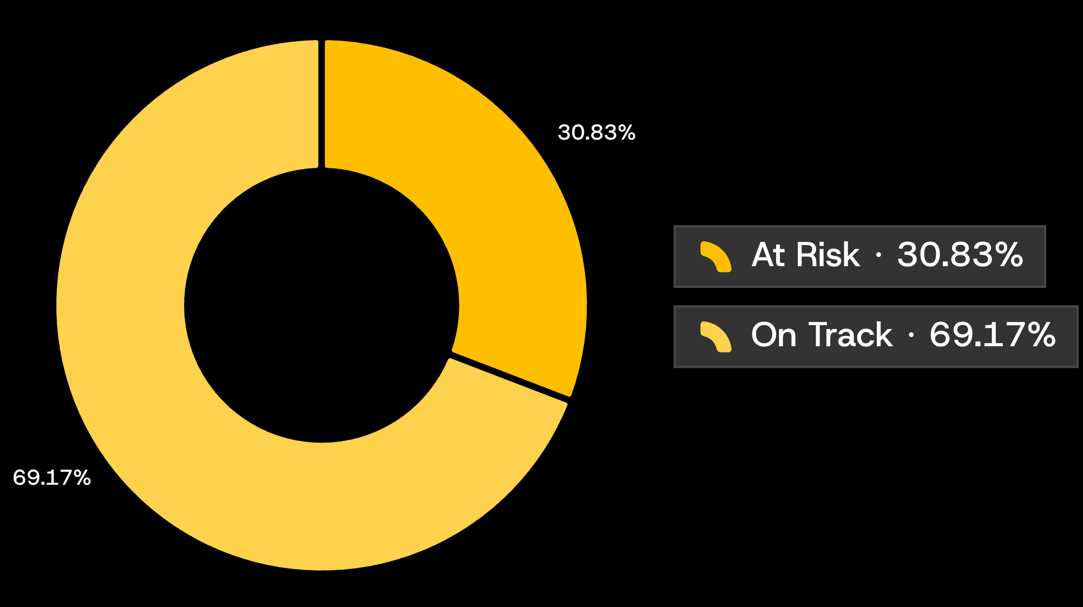
148 of 480 students are flagged for follow-up
EARLY-WARNING RULE
30.8%
are classified as At Risk. The remaining 332 students are On Track.
High absence + below-median engagement + low or medium performance.
The rule is transparent by design, so a reviewer can trace every flag.
POOJITHA KOTHAKONDA

Slide 9


Engagement generally rises with academic performance
Higher engagement
Lower engagement
More high performance and fewer risk flags.
More low or medium performance and more risk flags.
Measured pattern
Decision guardrail
The notebook's scatter analysis shows a positive relationship between Engagement Score and Performance Proxy.
Use engagement as an early signal, not a standalone verdict. Correlation supports prioritization, not causation.
POOJITHA KOTHAKONDA

Slide 10


Subject engagement varies enough to guide targeted action
Biology leads performance at 84.0. IT is lowest at 70.4, while Math and IT show the lowest engagement profiles.
POOJITHA KOTHAKONDA

Slide 11

KEY INSIGHTS
1. Student risk identification
~31%
README reports that approximately 31% of students are classified as at risk. This indicates a need to examine attendance, engagement, and academic performance together.
2. Engagement and performance
Students with higher engagement generally achieve better academic performance, according to README. Engagement includes raised hands, visited resources, announcement views, and discussion participation.
3. Attendance risk
project flags students with more than seven absence days as having attendance risk. This provides a practical starting point for identifying students who may need attendance support.
4. Differences across subjects and grades
dashboard compares performance and engagement by subject, grade, and semester. These comparisons can help identify where additional teaching support may be useful, once the actual chart values are examined.
POOJITHA KOTHAKONDA

Slide 12

BUSINESS RECOMMENDATIONS
Recommendation 1: Introduce an early-warning system
Identify students who have frequent absences, low engagement, and low academic performance. Contact them early and provide individual support.
Recommendation 2: Improve classroom engagement
Introduce group discussions, quizzes, interactive lessons, and question-and-answer sessions in subjects where engagement is relatively low.
Recommendation 3: Provide targeted academic support
Offer remedial classes, mentoring, practice exercises, and revision sessions to students with low or medium performance.
Recommendation 4: Monitor results regularly
Review attendance, engagement, and performance every two to four weeks. Compare results before and after interventions to determine what is working.
POOJITHA KOTHAKONDA

