Slide 1



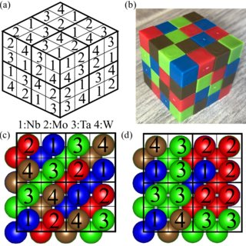
SAVEETHA SCHOOL OF ENGINEERING SAVEETHA INSTITUTE OF MEDICAL AND TECHNICAL SCIENCES
CSA0697 DESIGN AND ANALYSIS OF ALGORITHM FOR LOWER BOUND THEORY
TOPIC:
Efficient Sudoku Generation using Backtracking
FACULTY NAME:
Dr. Gnana Soundari
By,
NAME :V. Poojitha
REG.NO:192210132

Slide 2
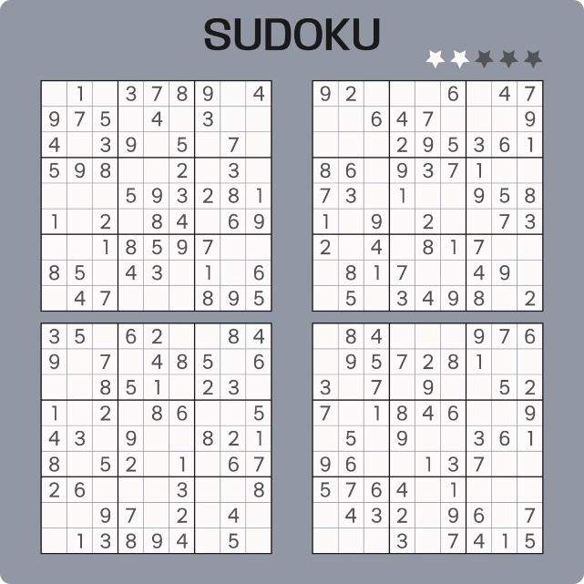
Efficient Sudoku Generation using Backtracking
Sudoku is a popular logic puzzle that involves filling a 9x9 grid with numbers. The goal is to fill each row, column, and 3x3 subgrid with the numbers 1 through 9, without repeating any number within a given row, column, or subgrid.
Sudoku puzzles can be generated using a variety of techniques, but one of the most common and efficient methods is backtracking.

Slide 3


Efficient Sudoku Generation
Sudoku is a popular logic puzzle that challenges players to fill a 9x9 grid with the digits 1-9 without repeating any in a row, column, or 3x3 subgrid. Researchers have explored algorithms to generate these puzzles efficiently, with the backtracking approaach being one of the most effective.
In this presentation, we'll discuss the Sudoku problem, the backtracking algorithm, and its implementation details to create challenging and valid puzzles. We'll also walk through an example to showcase the practical application of this approach.

Slide 4

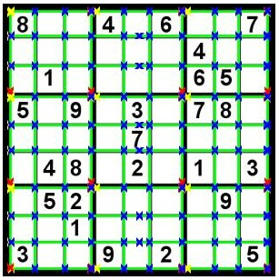
Problem Statement
Sudoku puzzles, a popular logic-based game, present a unique challenge: generating solvable and engaging puzzles. The goal is to develop an efficient algorithm that can create valid Sudoku puzzles with varying difficulty levels, ensuring a satisfying and challenging experience for players.
Traditional methods for generating Sudoku puzzles often involve manual techniques, which can be time-consuming and prone to errors. Therefore, there is a need for an automated approach that can efficiently create a wide range of puzzles while adhering to the constraints of the game.

Slide 5

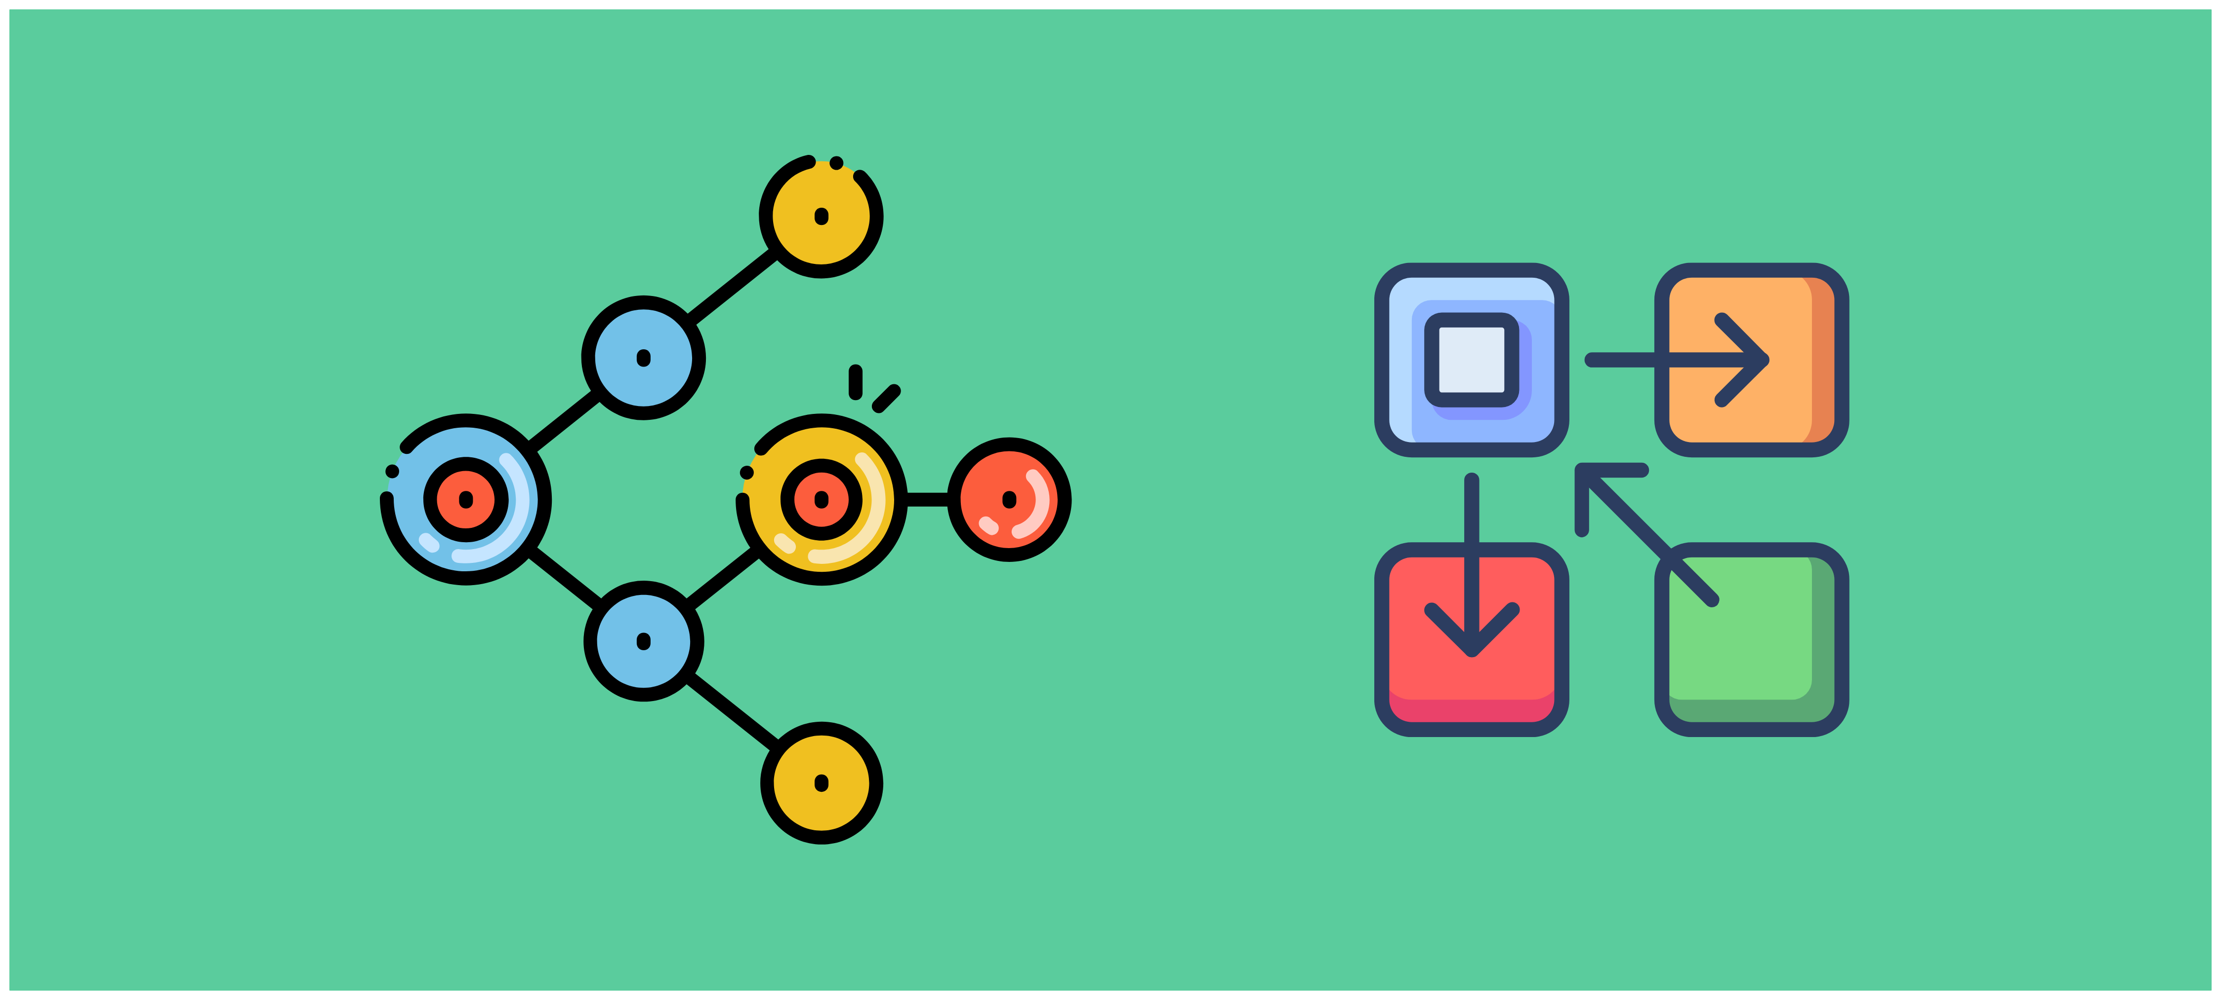
Sudoku Puzzle Constraints
Sudoku puzzles are based on a set of strict rules that ensure a unique solution exists. The puzzle grid is a 9x9 square, divided into nine 3x3 sub-grids, called "boxes." Each row, column, and box must contain the digits 1 through 9, with no repetition.
These constraints guarantee that no digit appears more than once in any row, column, or box. This creates a logical puzzle that players can solve by using deductive reasoning and eliminating possibilities.

Slide 6
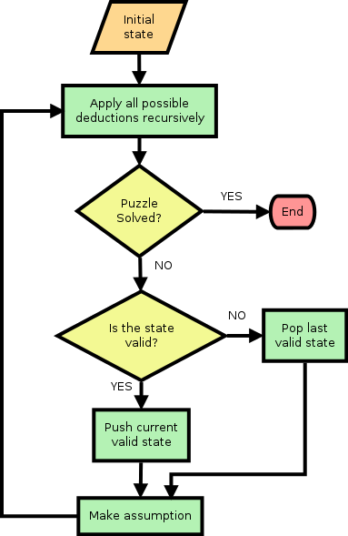
Flow chart

Slide 7
Backtracking Algorithm Overview
Backtracking is a systematic, recursive approach to solving problems by exploring all possible solutions.
It involves building a solution step by step, and if a step leads to a dead end, we backtrack to the previous
step and try a different option.
This algorithm is particularly useful for problems with constraints, like Sudoku, where we need to find a
solution that satisfies all the rules.
Backtracking involves exploring a tree of possibilities, where each node represents a partial solution.
The algorithm systematically explores the tree, branching out at each node and backtracking when a dead end is reached.

Slide 8




Steps in Backtracking
Backtracking is a powerful technique used for solving problems that involve searching for solutions within a large space. It systematically explores potential solutions by building them incrementally, backtracking when a path proves to be unsuccessful.
Choose a Candidate
Select a possible value for the current cell.
1
Check Constraint
Verify if the chosen value satisfies all Sudoku rules.
2
Recurse
If valid, move to the next cell and repeat the process.
3
Backtrack
If invalid, try a different value. If no valid values are found, backtrack to the previous cell.
4

Slide 9


Implementation Details
The backtracking algorithm is implemented using a recursive function that iterates through the Sudoku grid, trying to fill each empty cell with a valid digit.
For each cell, the algorithm checks if the digit is valid according to the Sudoku rules, which include checking rows, columns, and 3x3 sub-grids.
If the digit is valid, the algorithm recursively calls itself to fill the next empty cell. If the digit is not valid, the algorithm backtracks and tries the next digit.
The algorithm continues until all cells are filled or until all possible digits have been tried for a given cell, in which case the algorithm backtracks to the previous cell.

Slide 10


Efficiency Considerations
While backtracking is a straightforward approach to Sudoku generation, its efficiency can be a concern, especially for larger grids. The algorithm can potentially explore a vast number of possibilities, leading to a significant runtime. The choice of backtracking order and pruning strategies can have a significant impact on the performance.
To enhance efficiency, we can implement various heuristics and optimization techniques. For example, we can choose to work on the cell with the fewest possible values first, thus minimizing unnecessary backtracking. This approach, known as the "Minimum Remaining Values" heuristic, can help us quickly eliminate invalid options and focus on the most promising paths.
These optimizations can significantly reduce the search space and improve the overall performance of the backtracking algorithm. However, it's important to strike a balance between the complexity of these techniques and the runtime improvements they provide.

Slide 11
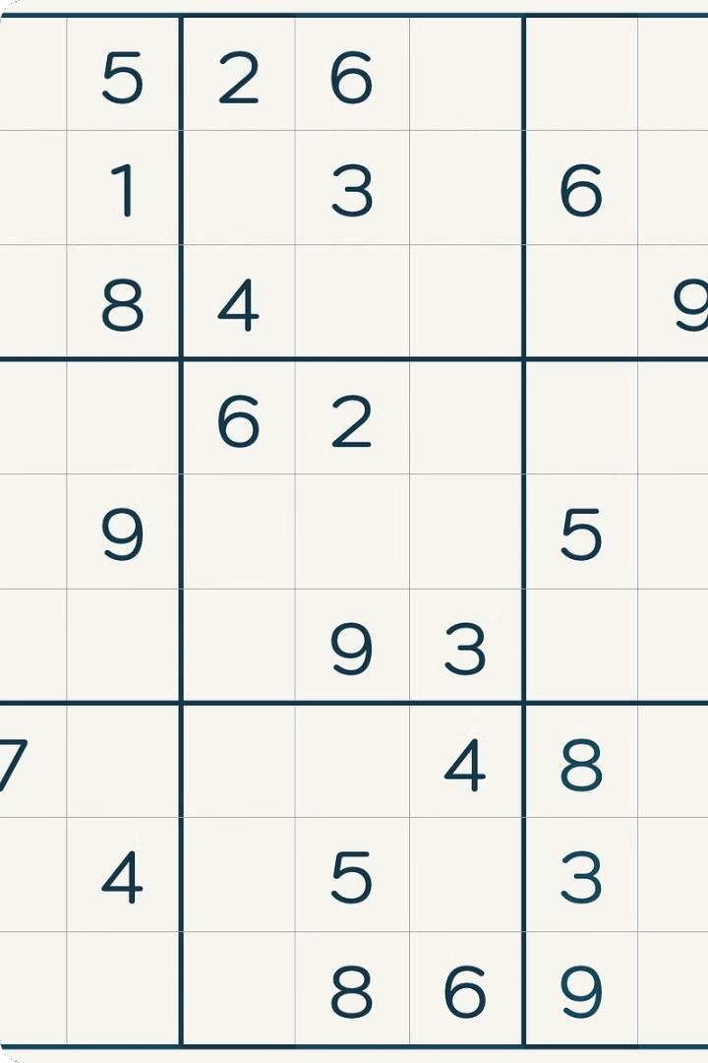
Example Walkthrough
Consider a partially filled 9x9 Sudoku grid. The backtracking algorithm starts by selecting an empty cell. It then iterates through possible values (1-9), checking if each value is valid based on the Sudoku rules. If a valid value is found, it is placed in the cell. The algorithm then recursively calls itself to fill the next empty cell.
If no valid value is found for a cell, the algorithm backtracks to the previous cell and tries a different value. This process continues until either a complete solution is found or all possible combinations have been exhausted. Backtracking ensures that the algorithm explores all potential solutions systematically and efficiently.

Slide 12
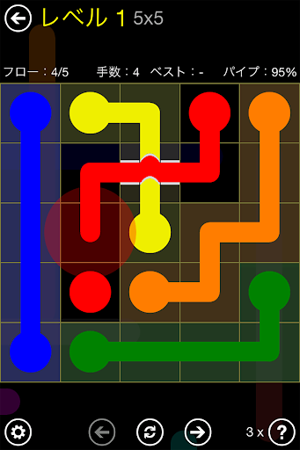
Conclusion
Backtracking is a powerful technique for solving Sudoku puzzles and generating valid Sudoku grids. By systematically exploring possible solutions and eliminating invalid choices, backtracking ensures that a valid Sudoku puzzle is created.
While backtracking can be computationally intensive, it provides a robust and effective approach for generating Sudoku grids that meet the constraints of the puzzle.
The implementation details of the backtracking algorithm are crucial for its efficiency. The use of efficient data structures, such as arrays and hash tables, can significantly speed up the search process. The algorithm can be further optimized by employing heuristics and pruning techniques to reduce the search space.

Slide 13

References
H. Lloyd and M. Amos 2019 Solving Sudoku with Ant Colony Optimization,” IEEE Trans. Games,
pp. 1–1, 2019.
D Ghosh and U Bhaduri 2017 A simple recursive backtracking algorithm for knight’s tours puzzle on standard 8×8 chessboard Int.Conf. on Advances in Computing, Communications and
Informatics (ICACCI), Udupi pp. 1195–1200.
R Szabo 2014 Creation of the chips placement game with backtracking method in Borland Pascal 11th International Symposium on Electronics and Telecommunications (ISETC), Timisoara, Romania pp. 1–4.
M Schottlender 2014 The effect of guess choices on the efficiency of a backtracking algorithm in a Sudoku solver Long Island Systems, Applications and Technology (LISAT) Conference armingdale, NY, USA pp. 1–6.

Slide 14


