Slide 1




TEAM 1
Vikas Miyani
Sneha Vadakkemadathil
Poojitha Amin
Darshit Thesiya
Notes:
1.73 million passengers
10,000 flights
20,000 Airports
29 Commercial Airlines

Slide 2
U.S. Domestic Flight Data Analysis CMPE 297–BIG DATA
ADVISOR: PROF. WEIDER D. YU
Department of Computer Engineering
San Jose State University
TEAM 1
Poojitha Amin (011811306)
Sneha Vadakkemadathil (011810721)
Darshit Thesiya (011424647)
Vikas Miyani (011410152)

Slide 3
INTRODUCTION
Availability and diversity of airspace related data.
Too much data and too many variables; difficult to fix problems manually.
Big events: hurricanes, snowstorms
Smaller disruptions: air traffic control delays, mechanical failures, thunderstorms
Big data analytics can play an important role to deal with the unpredictable problems, the airline industry faces daily.
Notes:
1.73 million passengers
10,000 flights
20,000 Airports
29 Commercial Airlines

Slide 4
5 V’S OF BIG DATA
Volume – Records from historical data to the most recent data. It includes data since 1987.
Velocity – New data set is made available on a monthly basis.
Variety – Multiple sources.
Veracity – Multiple government sources (RITA & BTS); hence, reliable.
Value – Value in terms of predicting and estimation of traffic at different airports, by different carriers, and analysis of the delays causes.
Notes:
Research and Innovative Technology Administration (RITA)
Data expo’09
Bureau of Transportation Statistics

Slide 5
BUSINESS USERS
Big data analytics in airspace has the potential to benefit multiple users:
Airline companies
Help airlines and alliances implement innovative solutions to maximize market position and performance.
Airport authorities
Evaluate performance of airline services and manage operational efficiency.
Passengers and logistic companies
Accurate flight status and day-of-travel information helps passengers and logistic companies.

Slide 6
USE-CASES
Delay Cause Analysis
The major reasons for arrival and departure delays.
The relationship between arrival delay and factors such as time of a day, distance, weather and months of a year.
Performance Analysis
Airline performance
On-time performance trend of large domestic airlines every year.
Comparison of different airline carriers.
Airport performance
Airport’s schedule performance and how it affects arrival delay.
Performance of different airports and its impact on overall delay causes.

Slide 7
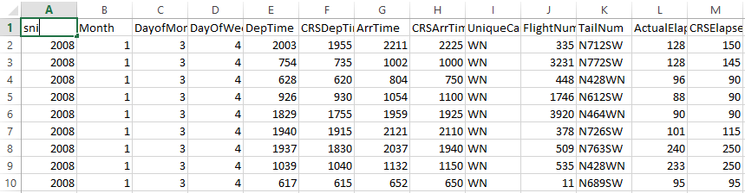
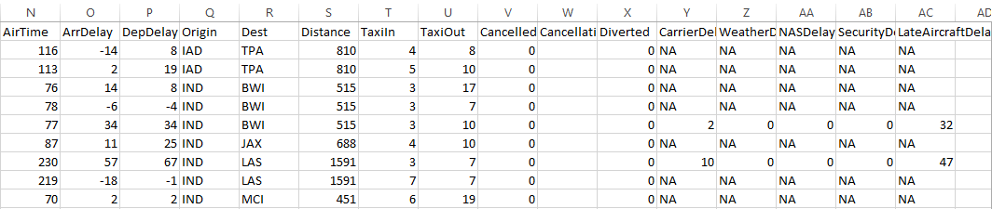
DATA SOURCES
Data sources
http://stat-computing.org/dataexpo/2009/the-data.html
https://www.transtats.bts.gov/Fields.asp?Table_ID=236
Sample Data Set
Notes:
360 Million of records
Around 40 GB

Slide 8
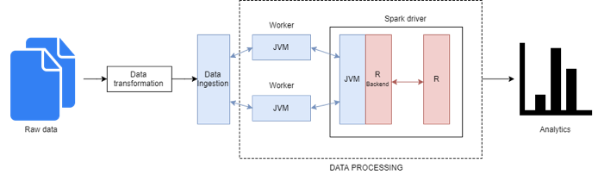
SYSTEM ARCHITECTURE

Slide 9
BIG DATA TOOLS
R
dplyr
sparklyr
plotly
ggplot2
maps
Yarrr
Apache Spark
Spark provides fast, in-memory processing of data.
Apache Zeppelin
We have made use of Apache Zeppelin to create our dashboard with the Spark interpreter for running R queries.

Slide 10
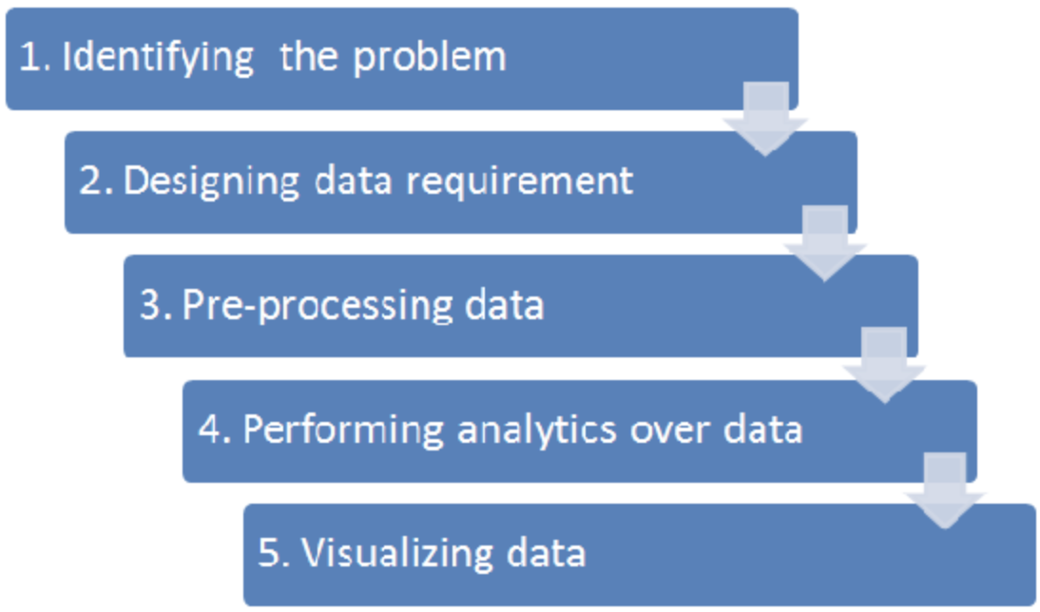
DATA ANALYSIS STAGES

Slide 11
DATA ATTRIBUTES
The major data attributes that we focused on are:
Year: The year in which the flight took place.
Month: The month in which the flight took place.
Day of week: The day of the week in which the flight took place.
Departure Time: Actual departure time of the flight.
Arrival Time: Actual arrival time of the flight.
CRS Departure Time: Scheduled departure time.
CRS Arrival Time: Scheduled arrival time.
Carrier: The initials of the airline corresponding to the flight.
Origin: The airport code for the airport that the flight is departing from.
Destination: The airport code for the airport that the flight is departing to.
Cancelled: was the flight cancelled?
Cancellation Code: reason for cancellation.
Arrival Delay: arrival delay, in minutes.
Departure Delay: departure delay, in minutes.

Slide 12
DATA ANALYSIS USING R
Load required R packages.
Load the data using Sparklyr.
Further clean the data using R, to eliminate incomplete or missing data.
Create custom R functions for specific functionalities.
Perform statistical Analysis on the preprocessed data.

Slide 13
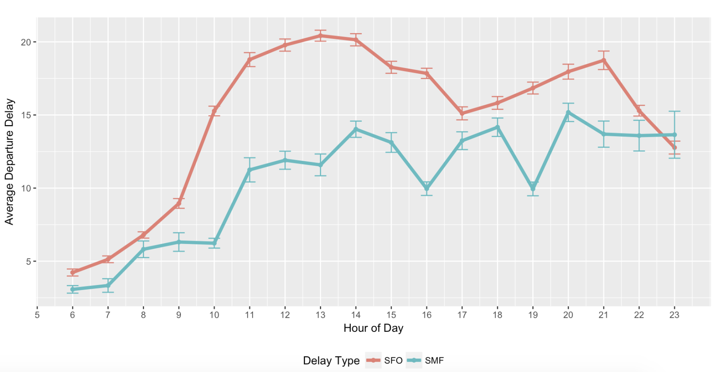
AVERAGE DELAY PATTERN OVER THE COURSE OF THE DAY

Slide 14
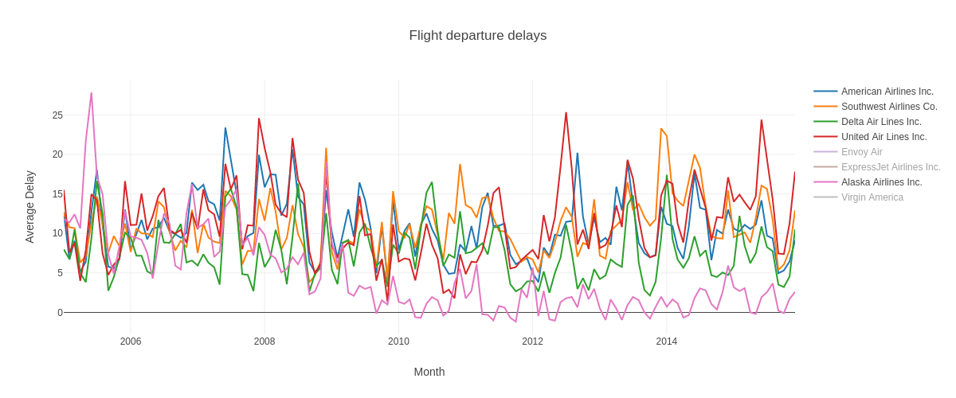
AVERAGE DELAY COMPARISON BY CARRIER

Slide 15
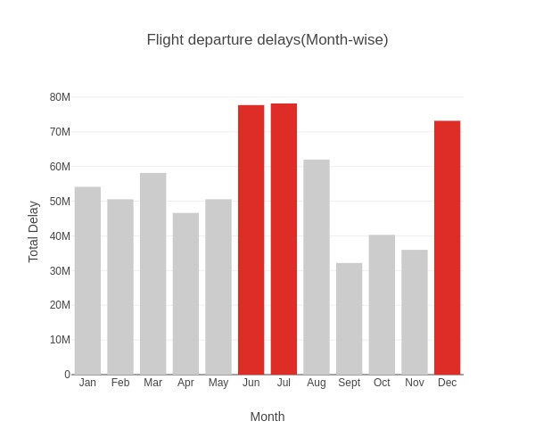
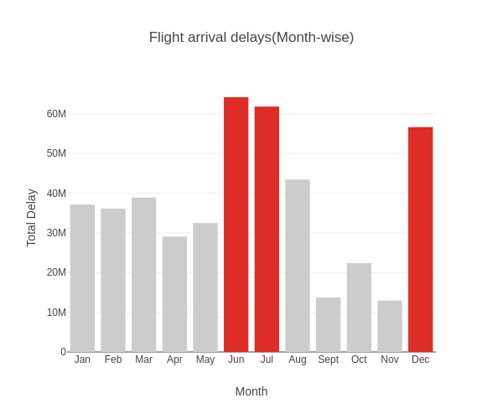
AVERAGE MONTH WISE DELAY PATTERN

Slide 16
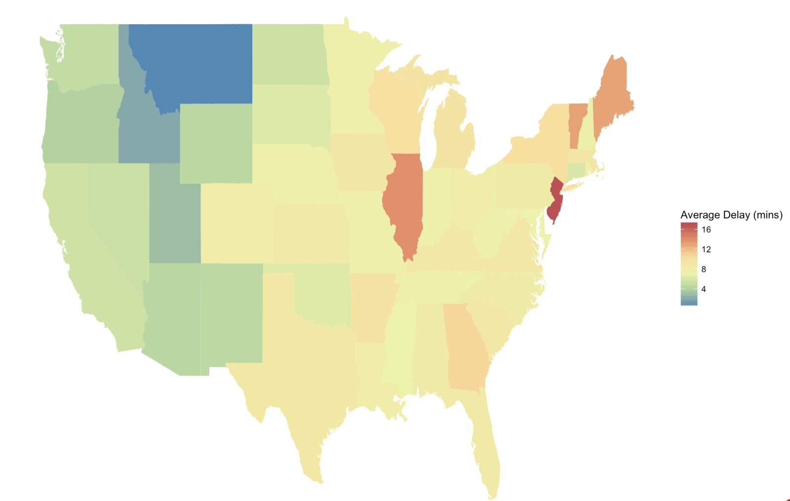
AVERAGE FLIGHT ARRIVAL DELAY BY STATE

Slide 17
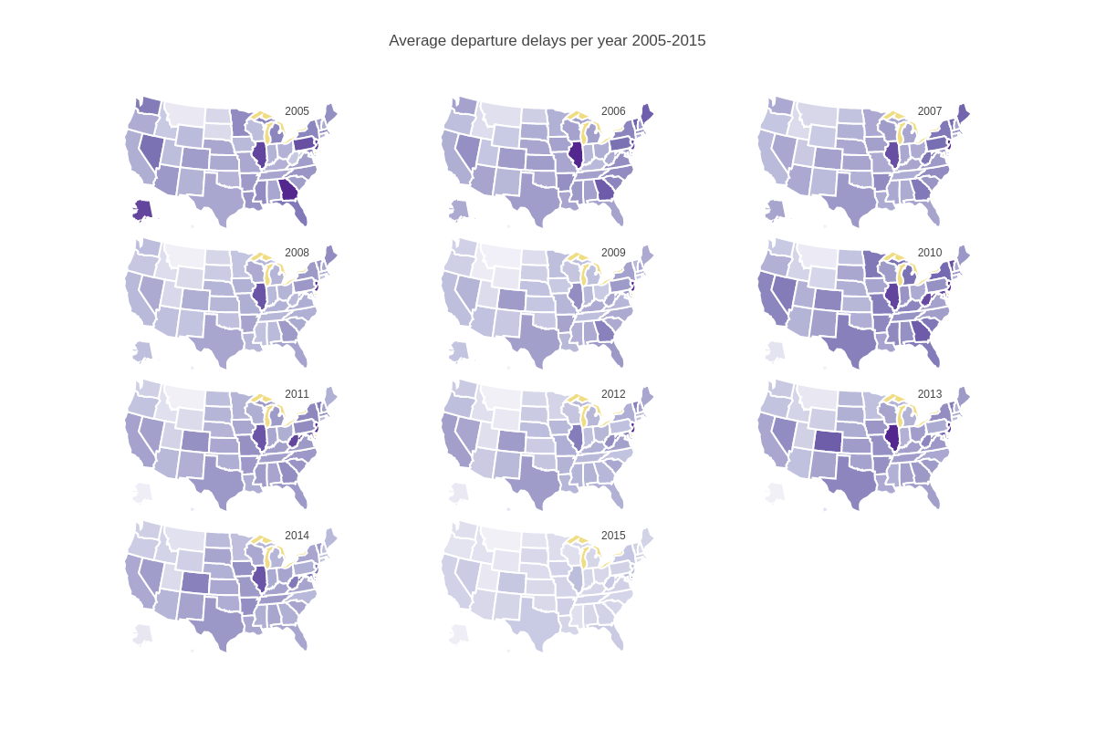
YEAR-WISE AVERAGE DELAY BY STATES

Slide 18
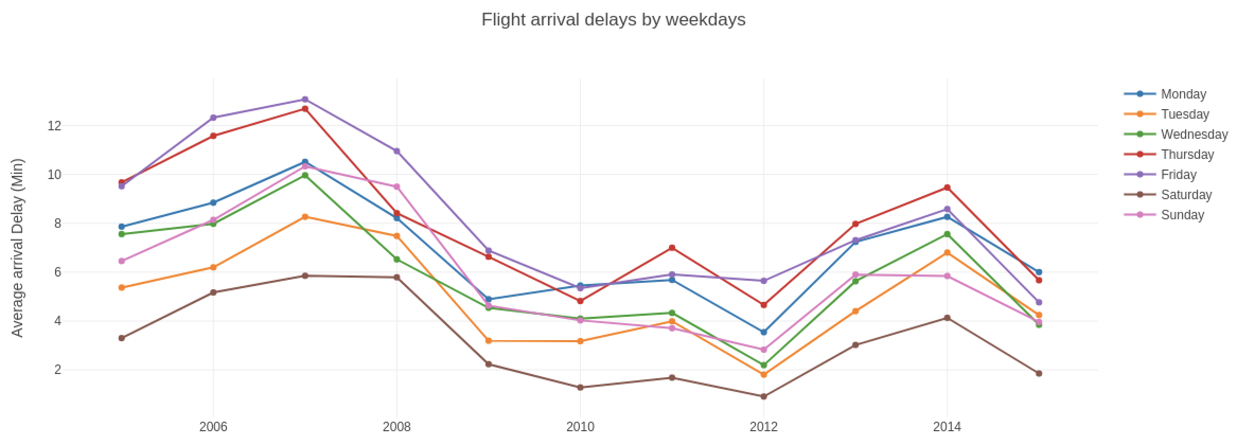
BEST DAYS OF THE WEEK TO FLY

Slide 19
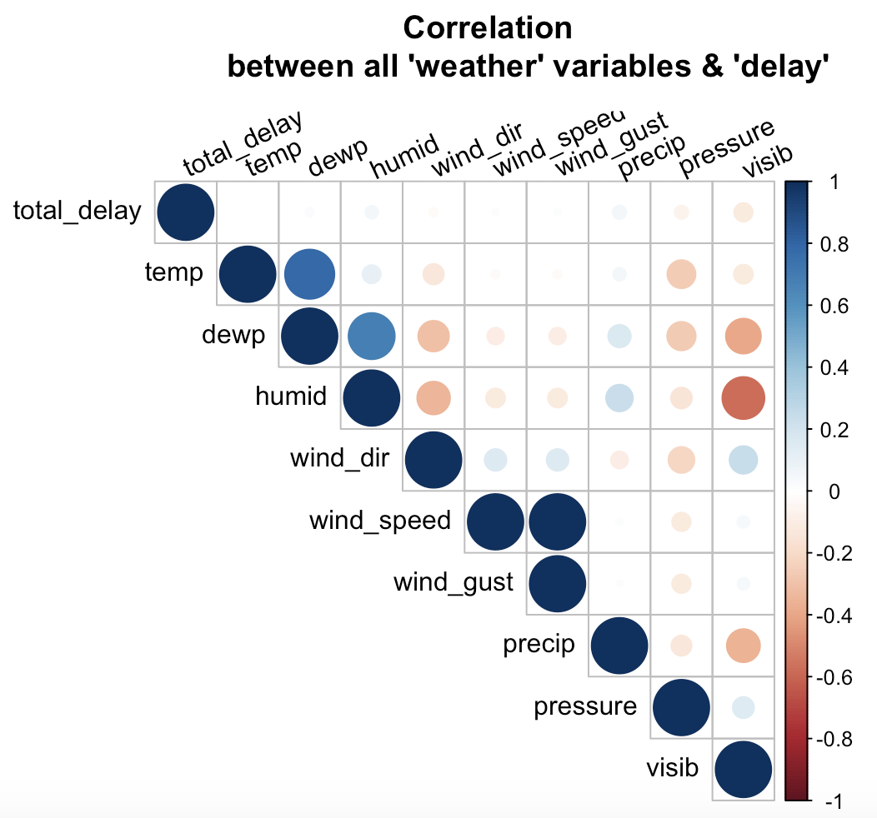
CORRELATION BETWEEN WEATHER AND DELAY

Slide 20
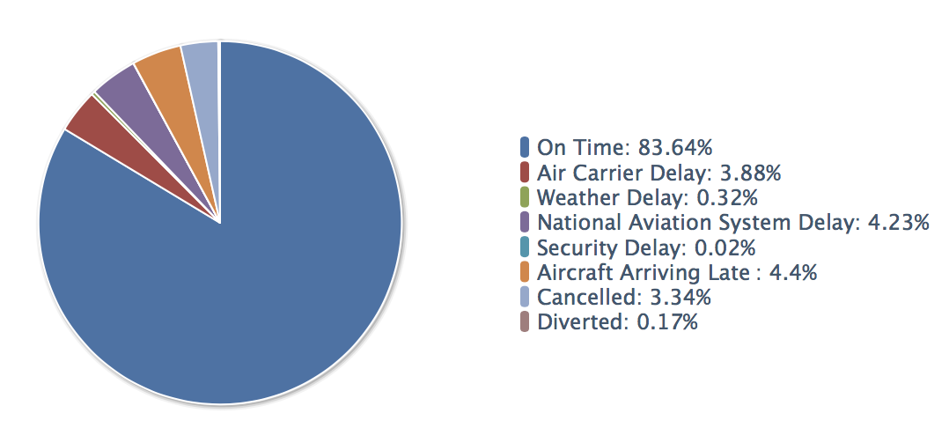
SUMMARY OF FINDINGS
Flight delays are important as it may increase the costs to customers and operational costs to airlines.
Each minute reduced per flight could save US$1.2 million in annual crew cost and US$5 million in annual fuel savings for a mid-sized airline.
Multiply the savings across hundreds of airlines, and the potential savings are huge, besides greater efficiency for airlines and convenience for passengers.

Slide 21
FLIGHT DELAY PREDICTION
Identify the flights that are likely to be delayed.
Identify the months in which the probability for flight delays are more.
Identify the airlines that are more likely to perform better in future.
Identify the airports that are likely to have more flight delays in future.

Slide 22
ANALYTICS DASHBOARD

Slide 23
THANK YOU!

