Slide 1
Personalized Health Monitoring using Predictive Analytics
Project Advisor: Dr. Wencen Wu
Team Members: Nikhitha Reddy Anikireddypally
Poojitha Amin
Sneha Vadakkemadathil
Suraj Ravindra Khurana

Slide 2
Objective
Suggest a new Technique for Early Detection of Heart Diseases.
Use existing Machine Learning models in baseline, and improve on it.
The technique should use commodity hardware for collecting data needed by model.
Make personalised predictions based on the captured vitals and activity details taking into consideration the previous health history, if available.
Notes:
Previous Researches have shown relationship between heart disease and body vitals like blood pressure and heart rate
In todays world , we can easily obtain these body vitals thru common wearables like fitbit.
Our aim in this project, is to use information from these wearables and predict a fitbit user heart condition. Specifically, we want to alert the user if he is at risk of heart diseases in the future
So how are we different from the previously done research ? - previous papers used electronice medical records, whereas we would be using continuous data generated from wearables to make predtctions.

Slide 3
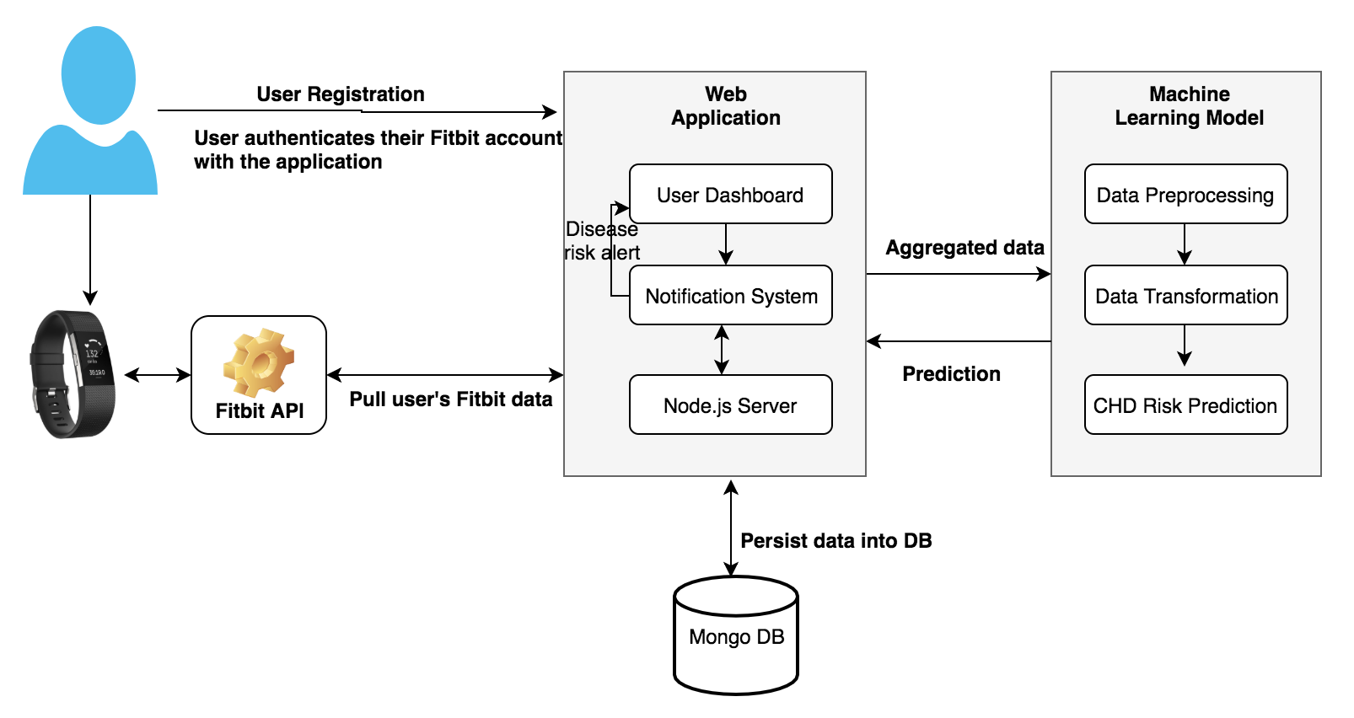
Project Architecture

Slide 4

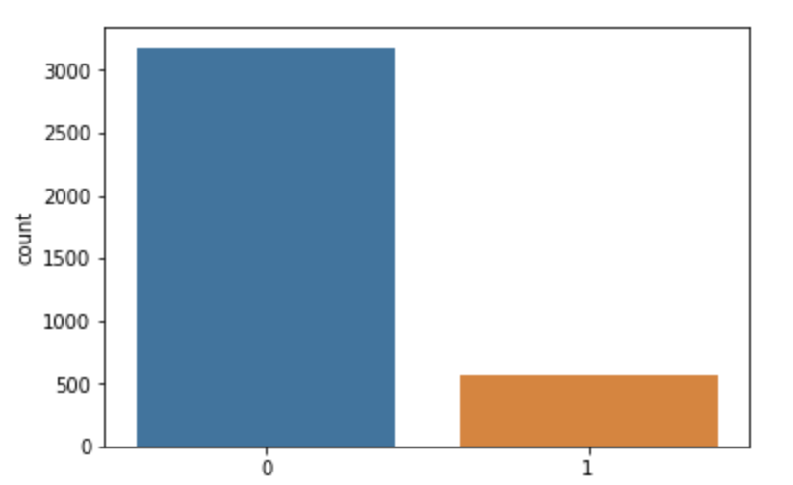
Methodology
Data Collection:
The dataset used for training the machine learning model is a subset
of the Framingham Heart Study dataset.
Data Preprocessing:
Handle missing values.
Chi square test and backward feature elimination
Feature Normalisation.
SMOTE and random undersampling.

Slide 5
Model Construction
Experimented with different Machine Learning Classification Algorithms.
Random Forest
Gradient Boosting
Logistic Regression
Outlier Detection
Evaluated the performance of the algorithms.
Built an ensemble of above models by combining the predictions of multiple base estimators using average predicted probabilities to improve the robustness of the model.

Slide 6
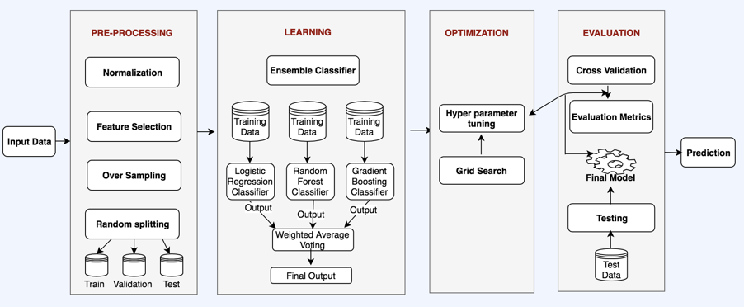
ML Block Diagram

Slide 7
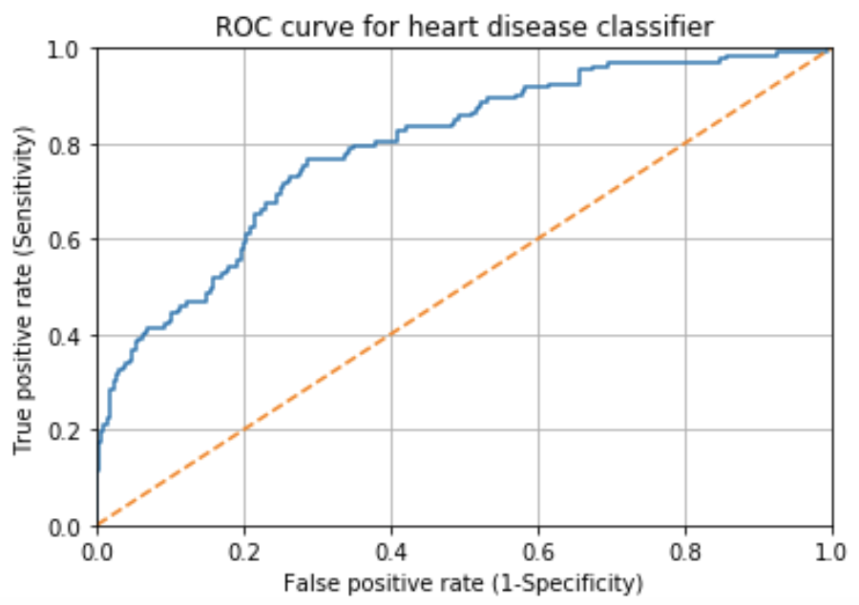
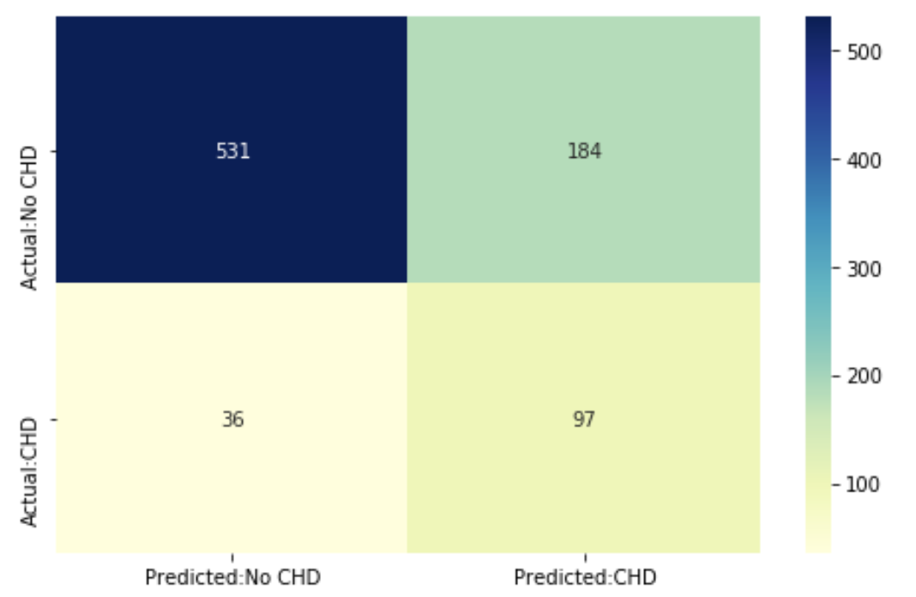
Experimental Results
Ensemble Model Confusion Matrix
ROC curve

Slide 8
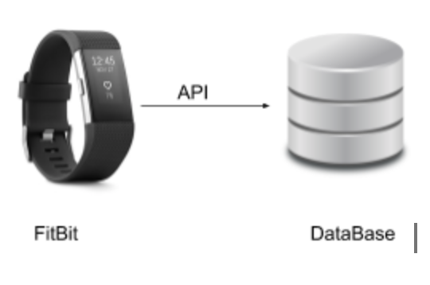
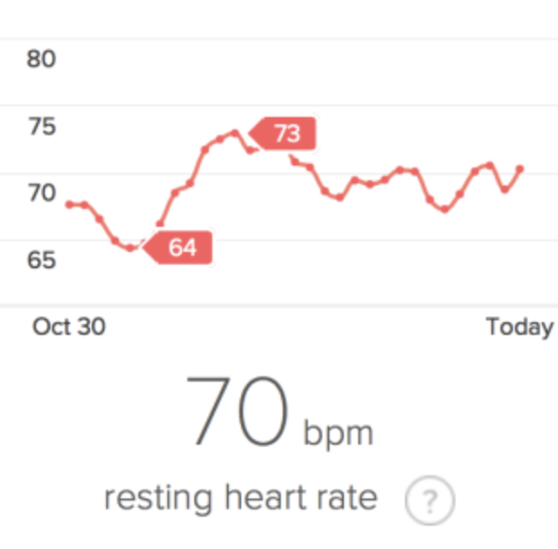
Data Collection using Fitbit API
Fitbit provides some API’s for the developers to interact with the fitbit data. We can extract the following information from the device API:
Calorie burned
Heart rate
Steps
Distance
Minutes Sedentary
Minutes Active
Activity Calories
Minutes of Sleep
Minutes of Being Awake
Length Of Rest In Minutes

Slide 9
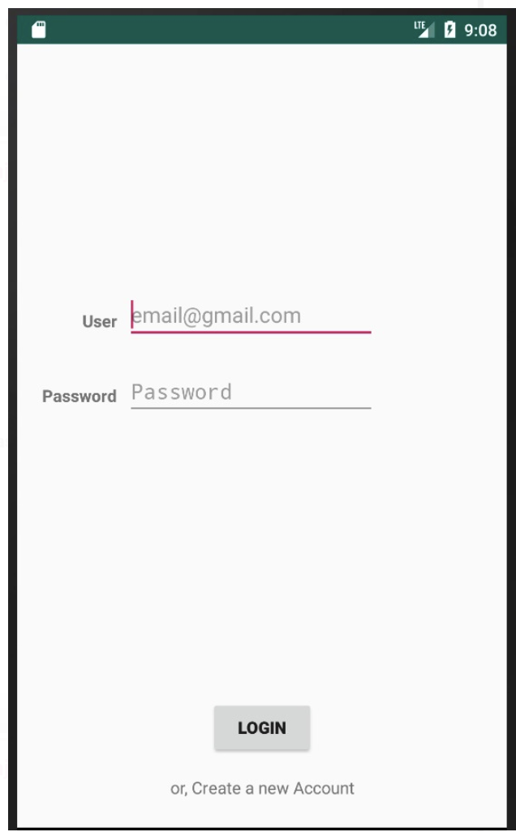
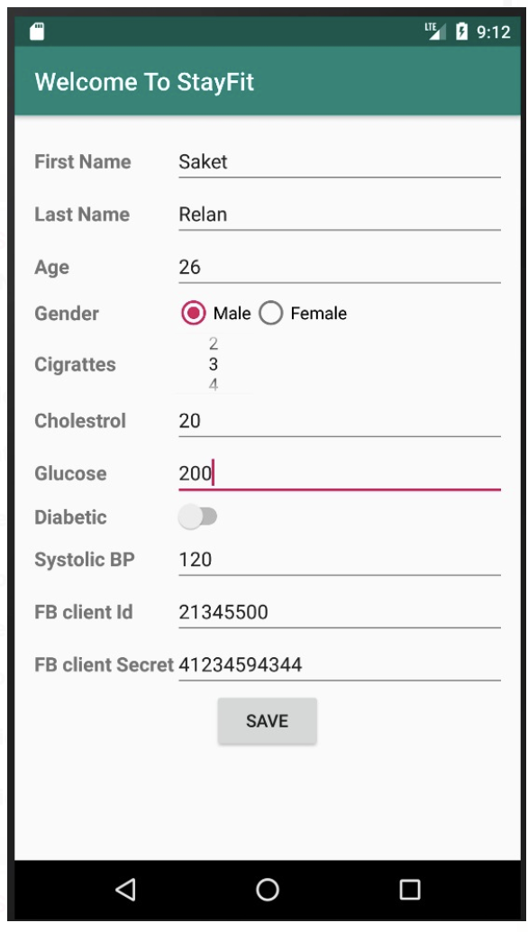
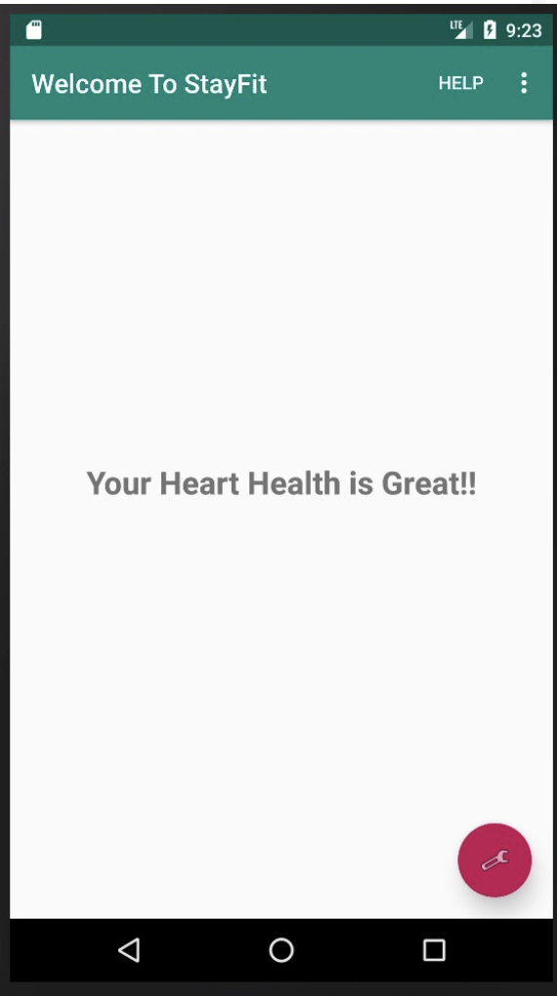
UI

Slide 10
Future Work
Include sleep pattern analysis and its effect on heart disease.
Extend the system to use with other devices like BP monitor.

Slide 11
References
[1] B. Ballinger, J. Hsieh, A. Singh, N. Sohoni, J. Wang, G. Tison, G. Marcus, J. Sanchez, C. Maguire, J. Olgin and M. Pletcher, "DeepHeart: Semi-Supervised Sequence Learning for Cardiovascular Risk Prediction", Arxiv.org, 2018. [Online]. Available: https://arxiv.org/abs/1802.02511.
[2] S. Palaniappan and R. Awang, “Intelligent heart disease prediction system using data mining techniques,” 2008 IEEE/ACS International Conference on Computer Systems and Applications, 2008.
[3] S. Bae, A. K. Dey, and C. A. Low, “Using passively collected sedentary behavior to predict hospital readmission,” Proceedings of the 2016 ACM International Joint Conference on Pervasive and Ubiquitous Computing - UbiComp 16, 2016.
[4] Garcia. E.A and He. H, "Learning from imbalanced data", in IEEE Transactions on Knowledge and Data Engineering, 2009, pp. 1263‐1284.
[5] A. Sathyanarayana, J. Srivastava, and L. Fernandez-Luque, “The Science of Sweet Dreams: Predicting Sleep Efficiency from Wearable Device Data,” Computer, vol. 50, no. 3, pp. 30–38, 2017.

Slide 12
Thank You !

