Slide 1
CMPE 281 PROJECT - SMART CITY ADVISOR- DR. JERRY GAO
Team 10
Poojitha Amin (011811306)
Sneha Vadakkemadathil (011810721)
Anupama Upadhyayula(011325041)
Abinethri Santhanam (008634782)

Slide 2
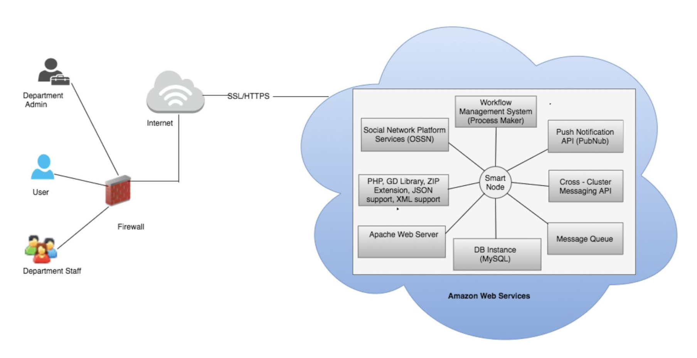
OVERVIEW
Smart City Social Network Platform, is a service-oriented community platform for city residents to collaborate with the government, and vice versa. It not only helps the city residents to communicate with each other, but acts as a one-stop solution for the citizens to easily file and track service requests

Slide 3
1. COMMUNITY MANAGEMENT COMPONENT
Community management component supports the management of different communities.
This component provides the admin with a Graphical User Interface that makes the management of the nodes easier.
Community managers are provided with a GUI to enter the details about the community and create a request.
Each new community is automatically launched in the cloud environment using the snapshots of basic configuration of previously created nodes.

Slide 4
FUNCTIONS
Function | Description
Create community | Creates a new node and add it to the cluster.
Update/Configure community | Configure and update the community according to the request.
View community | Provides an interface to view the existing communities.
Delete community | Allows termination/deletion of a node and associated resources.

Slide 5
USERS AND USE CASES
There are three kinds of users for the community management component:
Administrator | Create, configure and terminate community instances.
Community manager | Place community management requests.
Moderator | Perform tasks like adding staffs/users and creating groups in a community.

Slide 6
COMPONENT DESIGN
The component is designed to support one virtual server per community in the selected cloud infrastructure (AWS)– This improves scalability and resiliency.
Amazon Machine Images(AMIs) are used to automate the community creation process. - AMIs acts as a customized template containing all necessary information to launch a community.
Amazon EC2 API is used to implement the automatic instance management for this component - Provides direct interface to EC2 instances from the code.
AWS SDK for JavaScript is used to programmatically manage community instances – Provides cross-platform runtime and links the GUI with AWS services.
ProcessMaker is used to develop GUI and workflow for community management. Provides Dynaforms, workflow design and notification functionality.

Slide 7
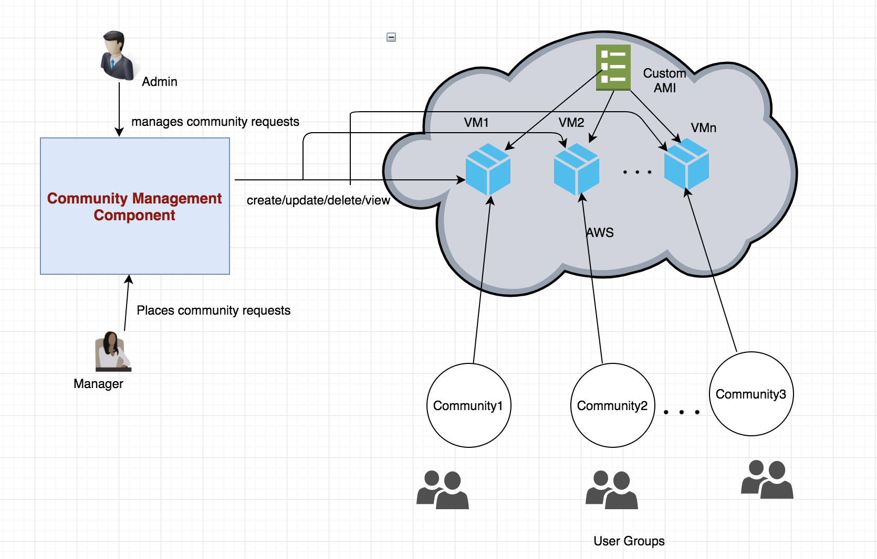
COMPONENT DESIGN CONTD..

Slide 8
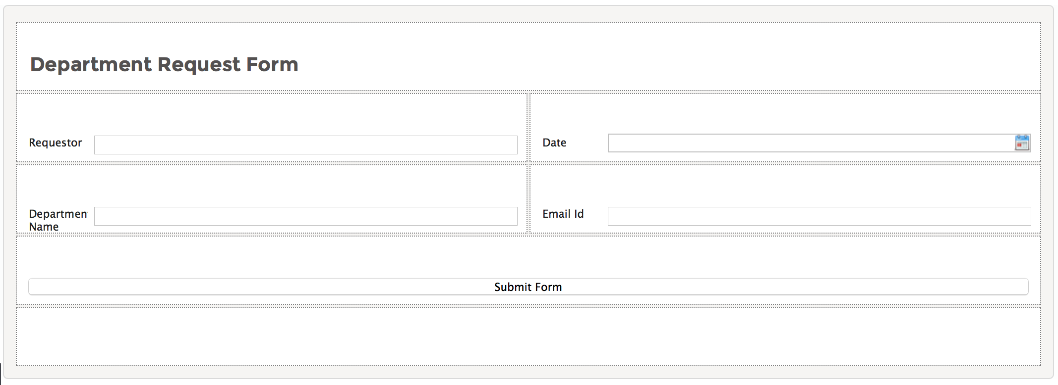
COMMUNITY MANAGER REQUEST FORM

Slide 9
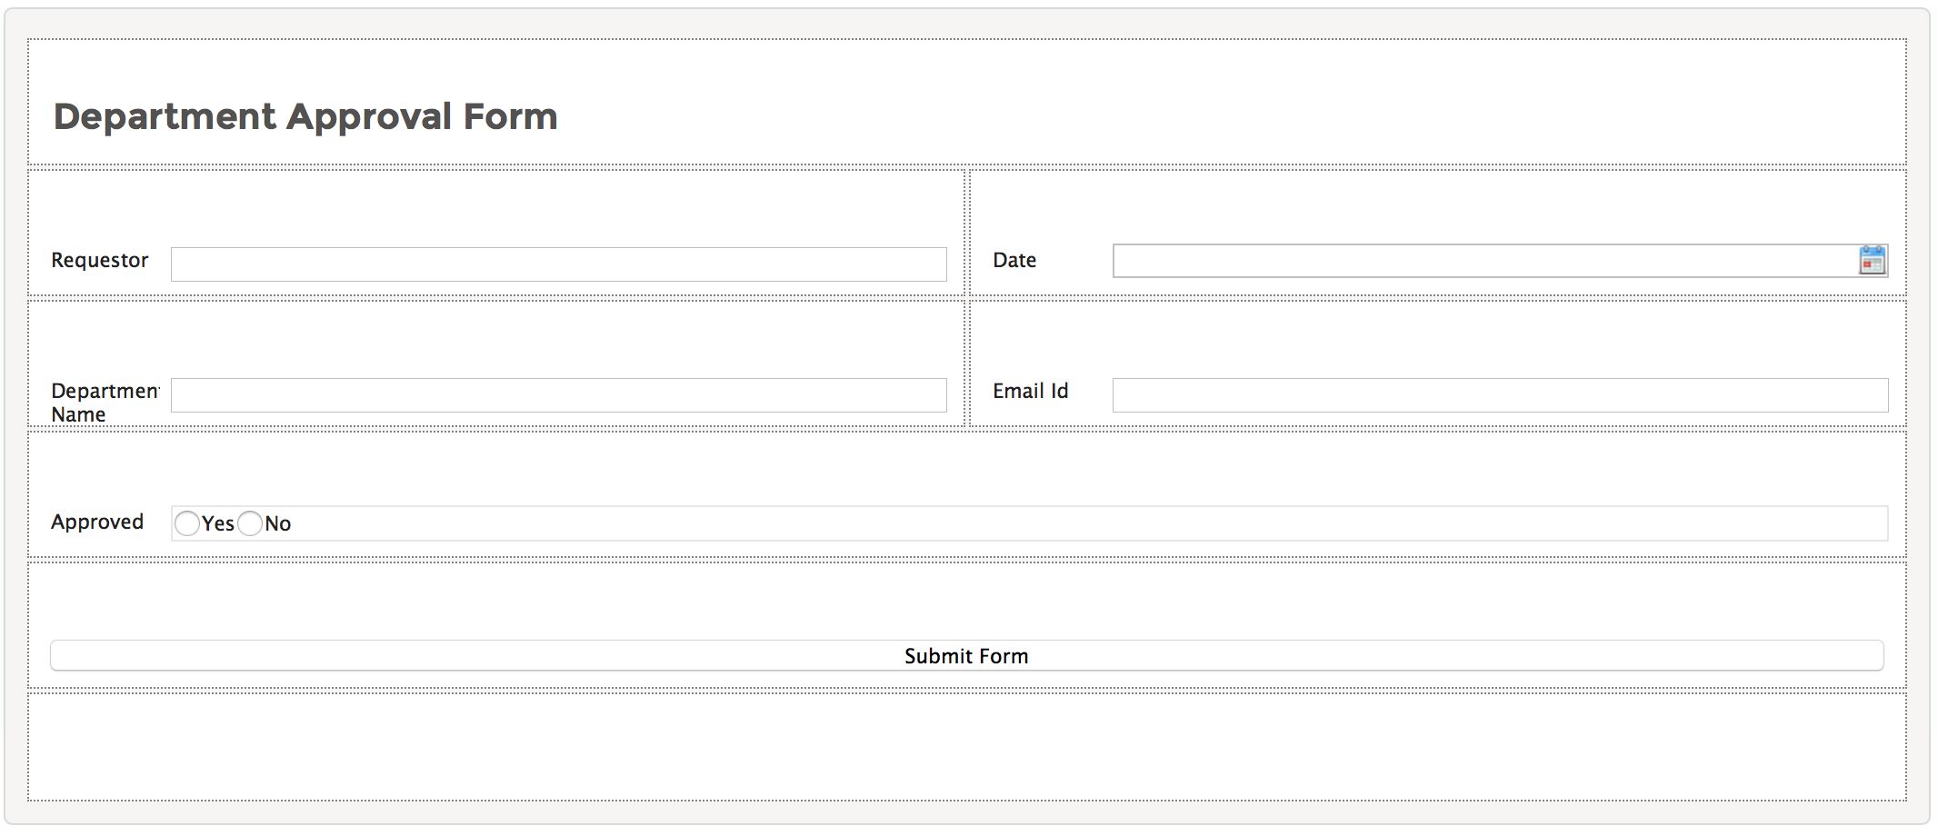
COMMUNITY MANAGER APPROVAL FORM

Slide 10
2.WORKFLOW MANAGEMENT COMPONENT
ProcessMaker open Source BPM and workflow solution is used for designing the operation workflows, case management, operations, cross department collaborations, regulatory enforcements.
Benefits of using ProcessMaker
It is an open source
Active community support of users
Flexible workflow management
Easier tracking
Streamlines process
Drag and drop interface
Automate notifications
Easy and fast development and deployment.
Dashboard feature

Slide 11
USERS AND USE CASES
User | Use Cases
Application Admin | Creation of users/groups. Approve Department Creation Requests Design the process Monitor the dashboard Send and receive notifications
Application Manager | Places Department Creation requests on behalf of Moderators. Send and receive notifications
Department Moderator | Receive notifications on new departments created.
Department Staff | Manage user incidents Route user requests Respond to users
Citizens/Users | Report incidents Receive response Check request status

Slide 12
WORKFLOW MANAGEMENT FUNCTIONS
Application Area | Functions
New Department Creation Request | 1. Request Routing
 | 2. User/Role management
 | 3. Request approval/disapproval
 | 4. Information Validation
 | 5. Notification
 | 6. Check for an existing request
 | 7. Case tracking

Slide 13
WORKFLOW MANAGEMENT FUNCTIONS CONTD..
Application Area | Functions
Create User Request Cases | 1. Request Re-Routing
 | 2. User/Role management
 | 3. Mark request pending/complete/rejected
 | 4. Information Validation
 | 5. Notification
 | 6. Check for an existing request
 | 7. Case tracking

Slide 14
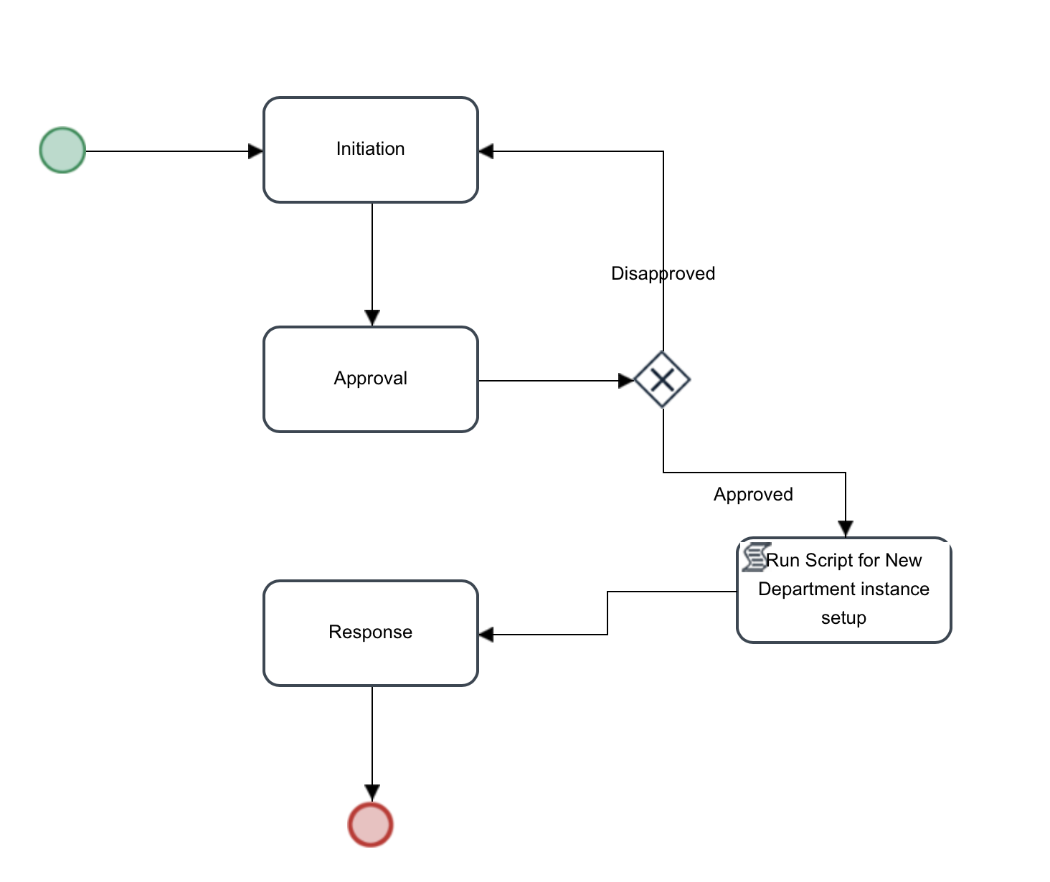
WORKFLOW DESIGN
Community Manager Workflow

Slide 15
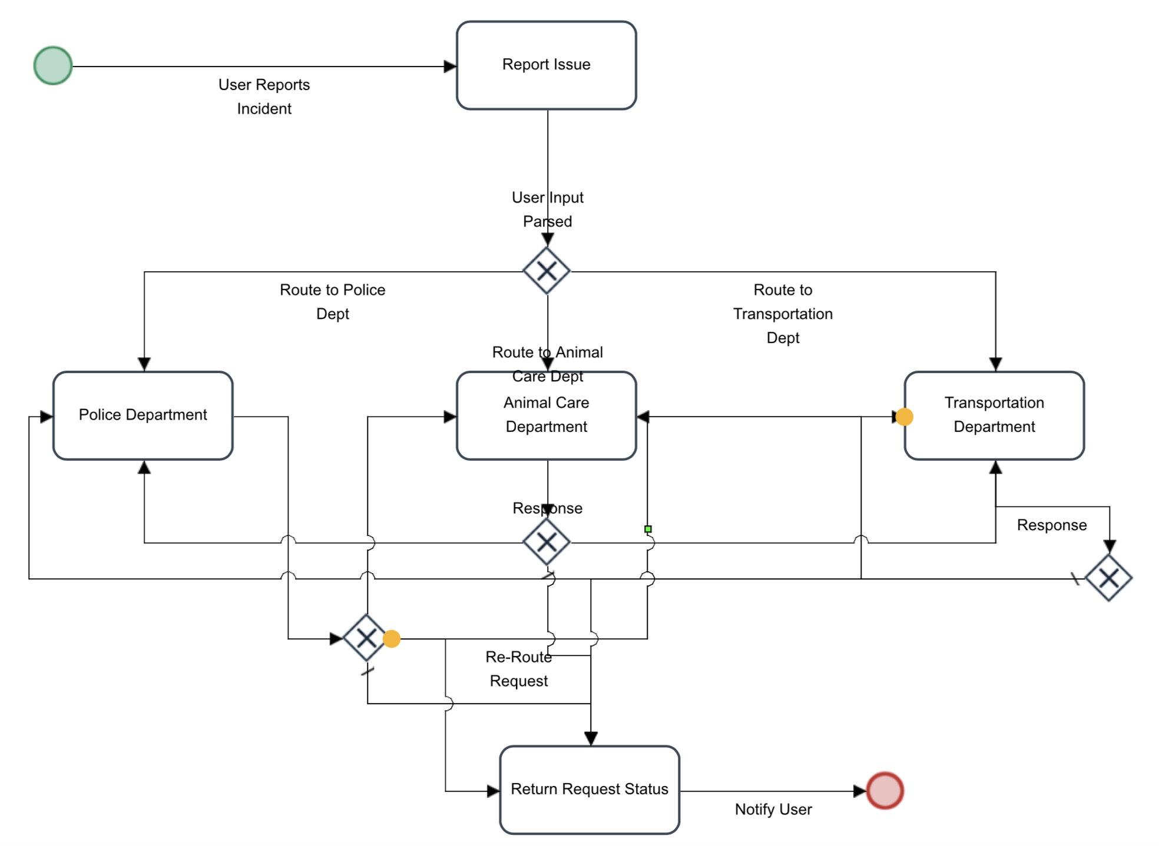
WORKFLOW DESIGN CONTD..
High-level Inter Department Request Routing Workflow

Slide 16
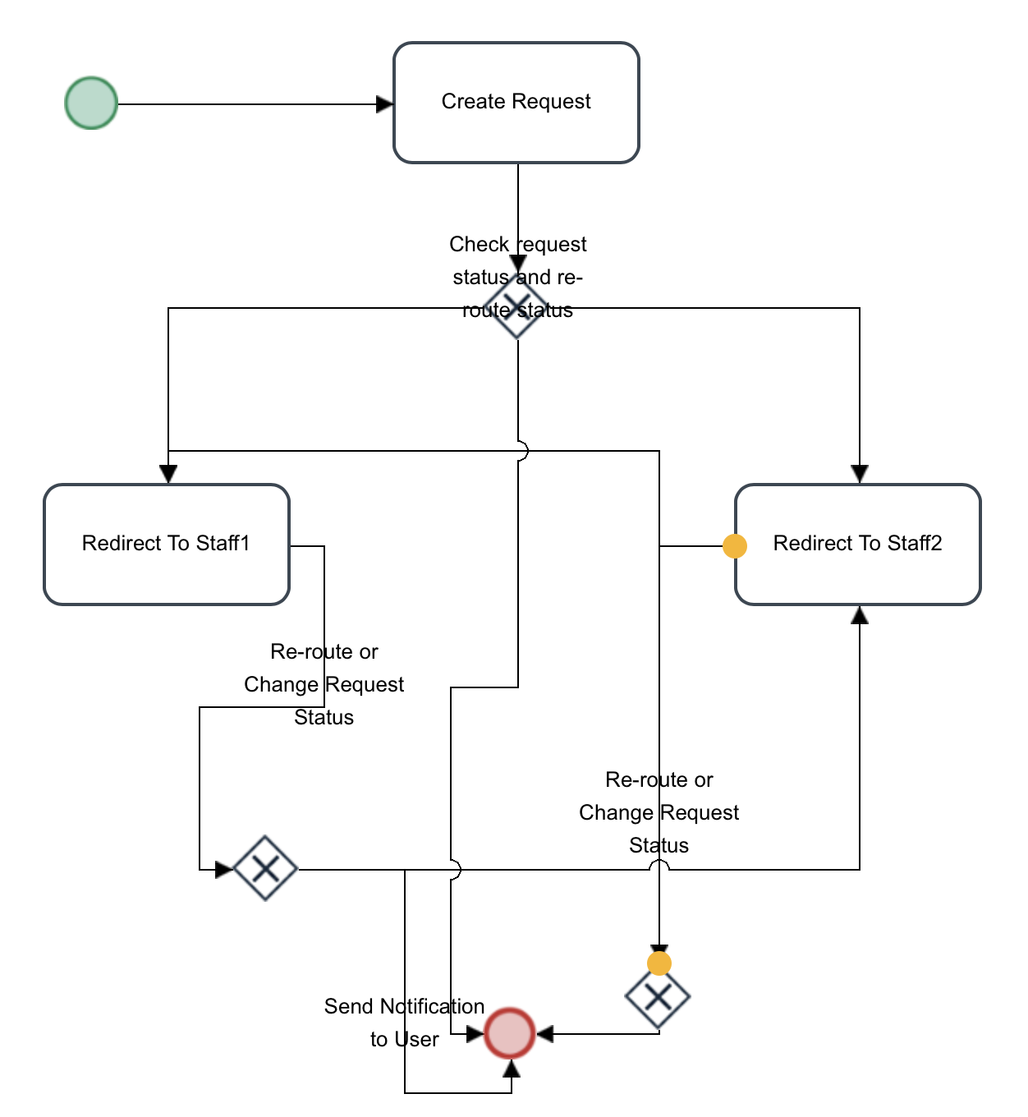
WORKFLOW DESIGN CONTD..
Request Re-Route within a Department Workflow

Slide 17
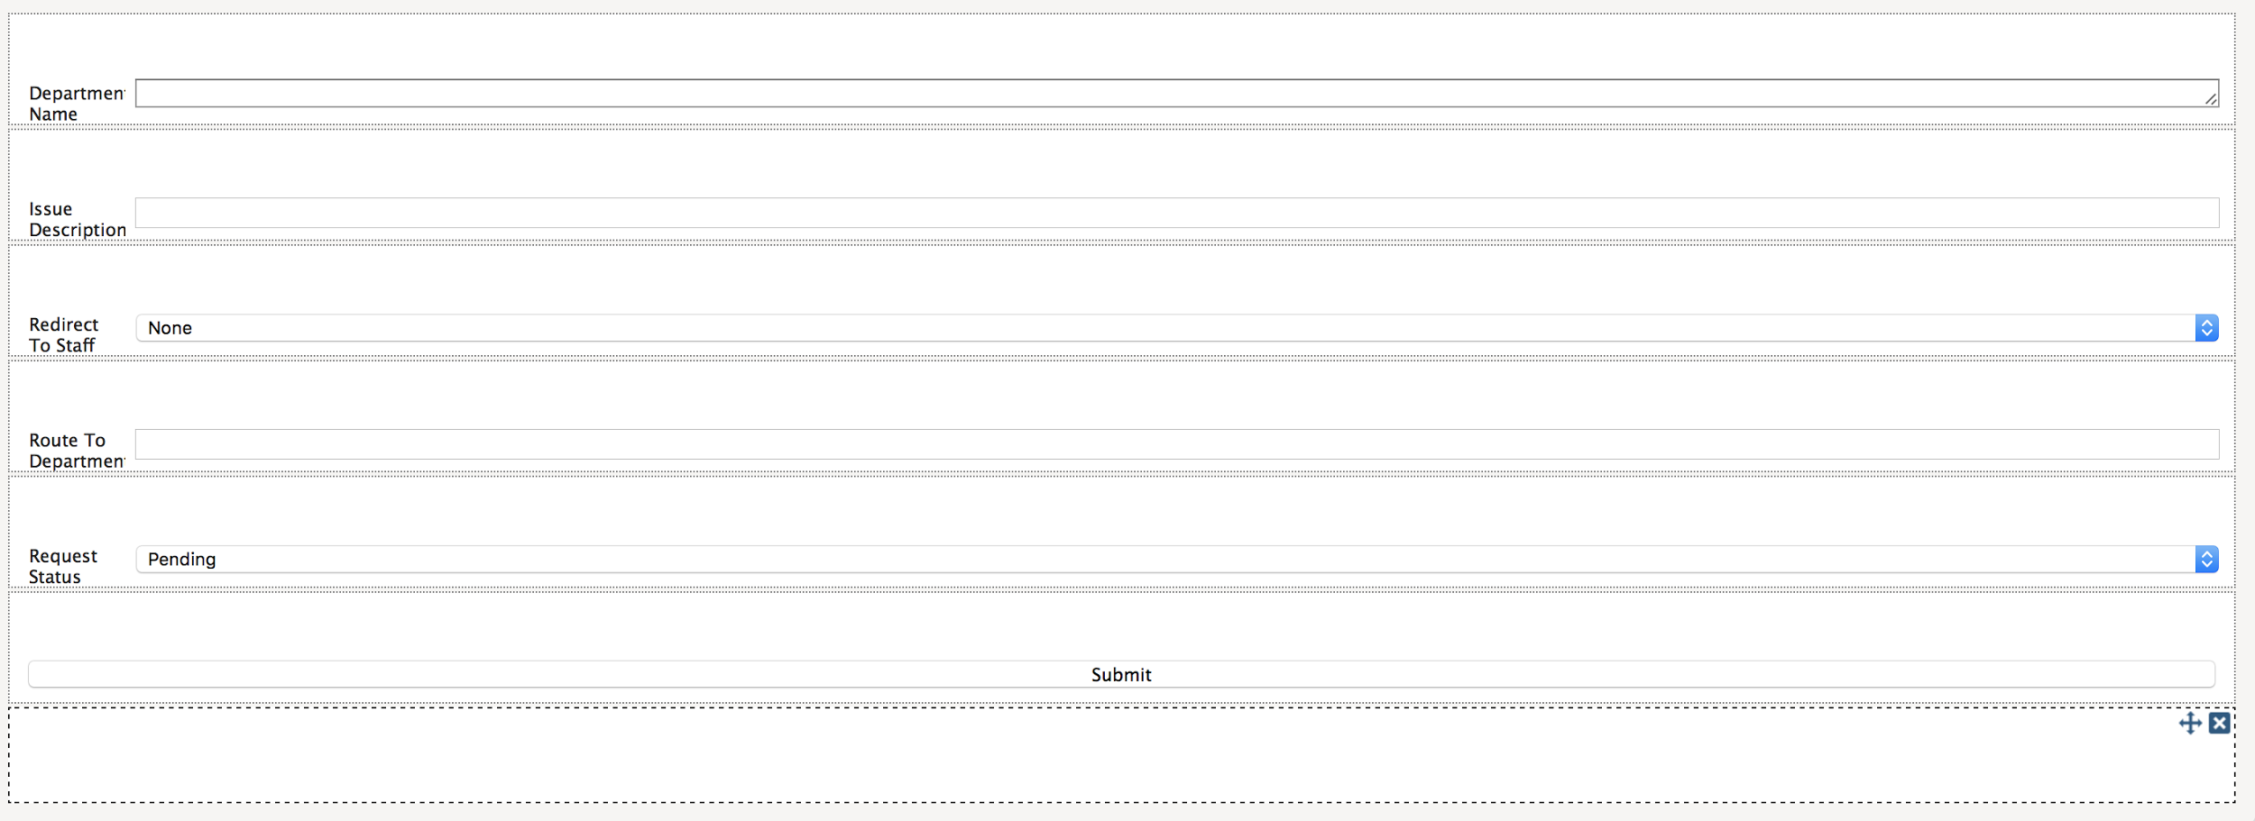
WORKFLOW DESIGN CONTD..
User Request Handle Form

Slide 18
3.DASHBOARD COMPONENT
Dashboard is a data visualization tool
It displays the status of the key performance indicators
Instantly track social media data.
Broadcasts live metrics from the social community so that we can prioritize actions.
It helps the community manager track issues for that specific community

Slide 19
FUNCTIONS
Function | Description
Track crime issues | When an user posts any issues in the crime department they will be seen in the dashboard
Track animal protection issues | User posts related to the waste management community posted are seen in the dashboard
Track number of users created | Number of users created per month are shown using graphs
Users online | Shows the number of users available

Slide 20
USE CASES
Tracking issues based on communities
Tracking the number of users online
Tracking the number of users created

Slide 21
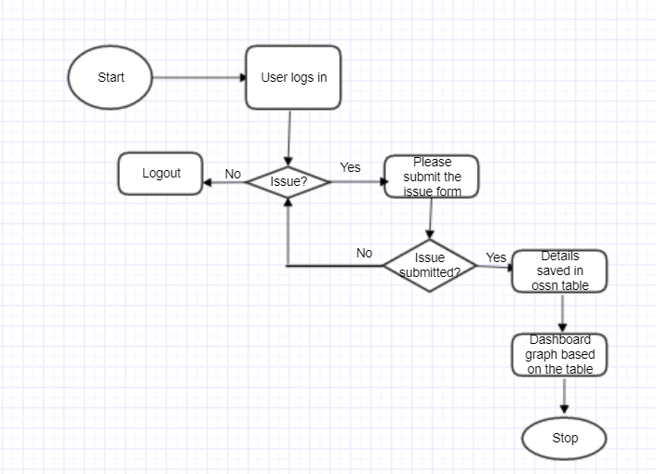
Work flow of dashboard

Slide 22
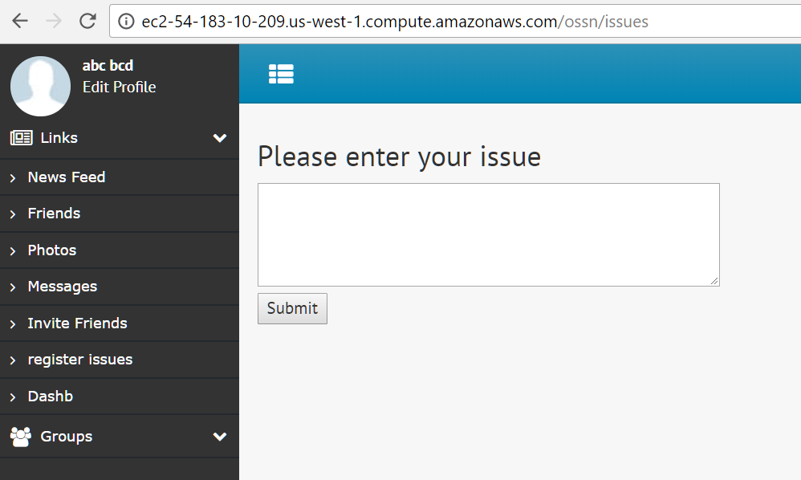
DASHBOARD

Slide 23
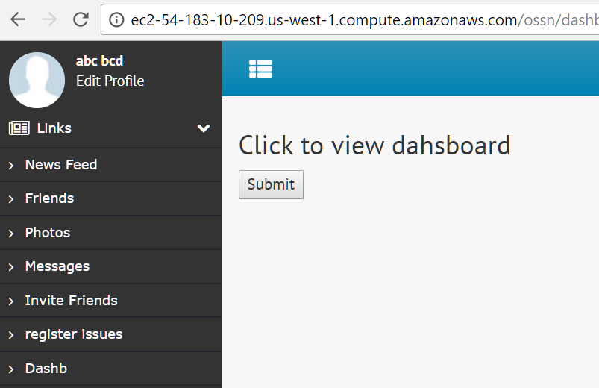
DASHBOARD

Slide 24
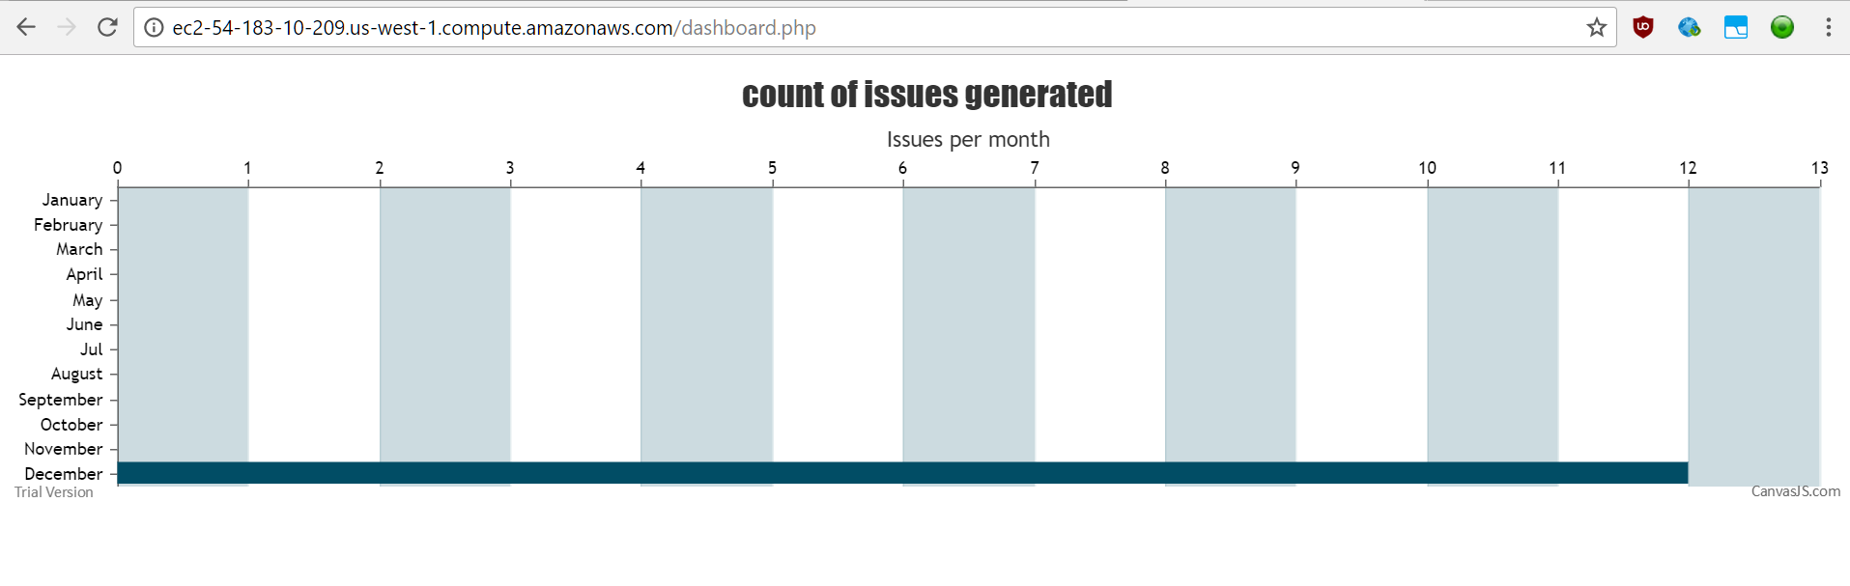
Bar graph showing the issues generated in a month

Slide 25
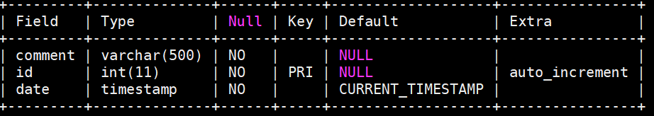
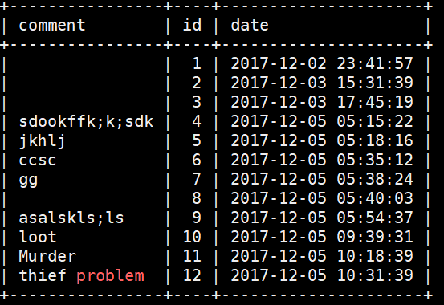
Database table structure
Sample data:

Slide 26
4.MESSAGING COMPONENT
Messaging component has the following features
Supports group messaging within a group
Supports group messaging across multiple instances of the same Smart City Social network
Users can seamlessly switch between different registered groups and send group messages
Users can dynamically join groups

Slide 27
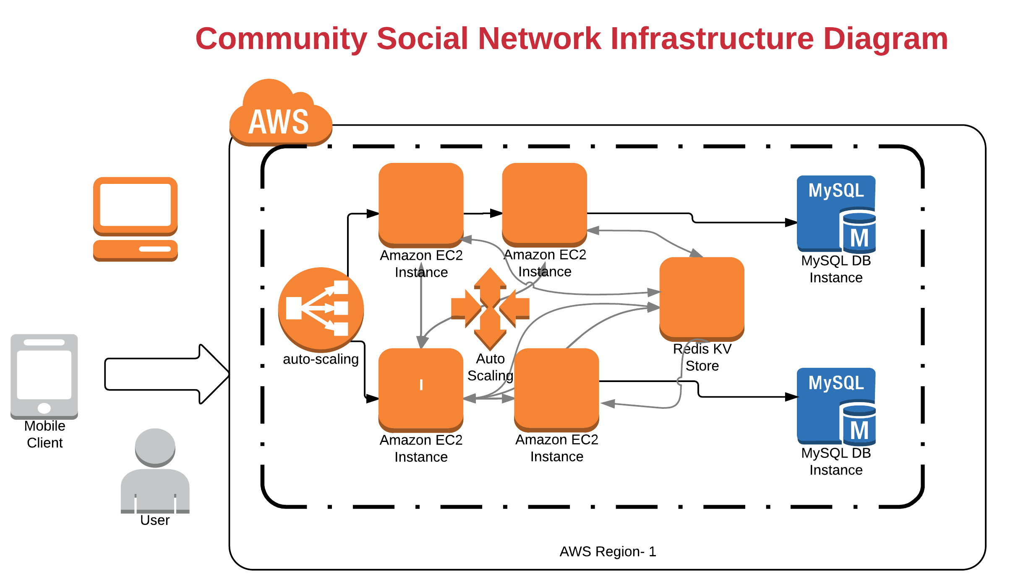

Slide 28
USER AND USE CASES
User | Use Case
Social Network user | Send message(s) to Police Department about suspicious/criminal activities
Police Department | Respond to Social Network user’s complaints
Social Network user | Send message(s) to Fire department about fire hazards
Social Network user | Send messages(s) to Animal Department about stray animal incidents, etc.
Animal Welfare Department | Respond to Social Network user’s complaints
Police Department | Issue safety warnings to users about criminal activities

Slide 29
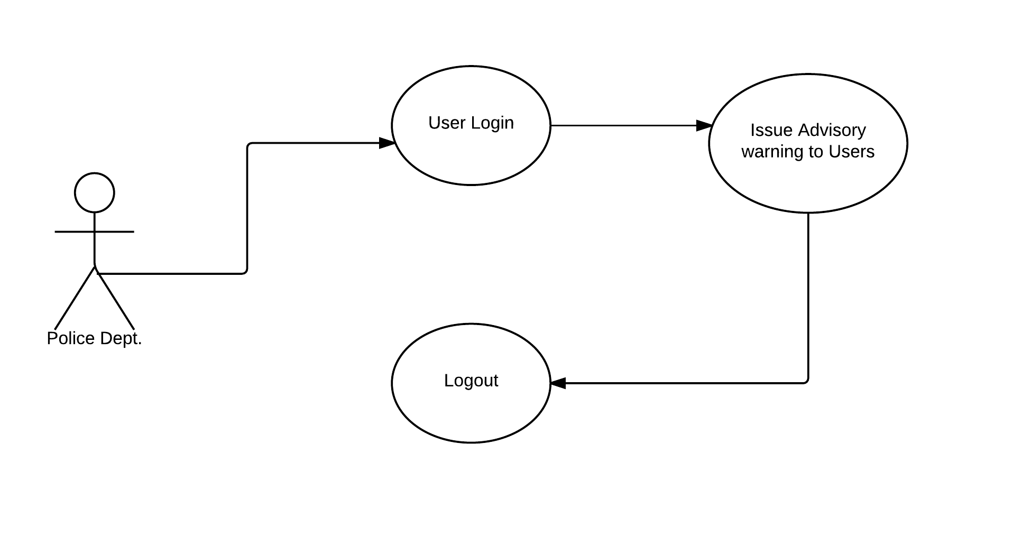
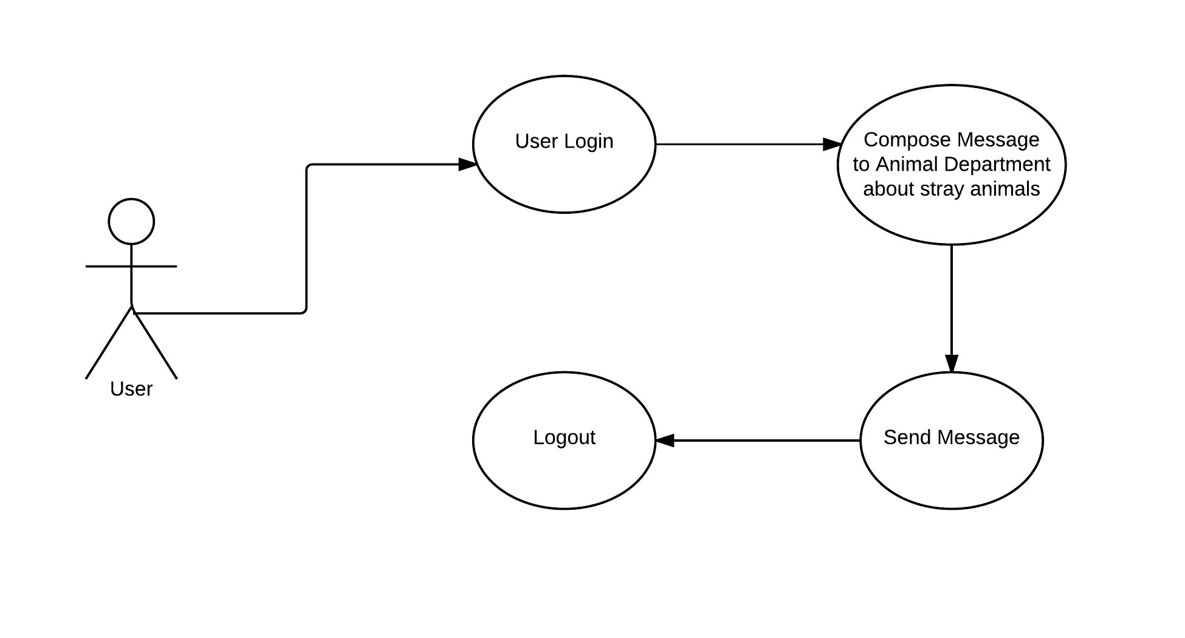
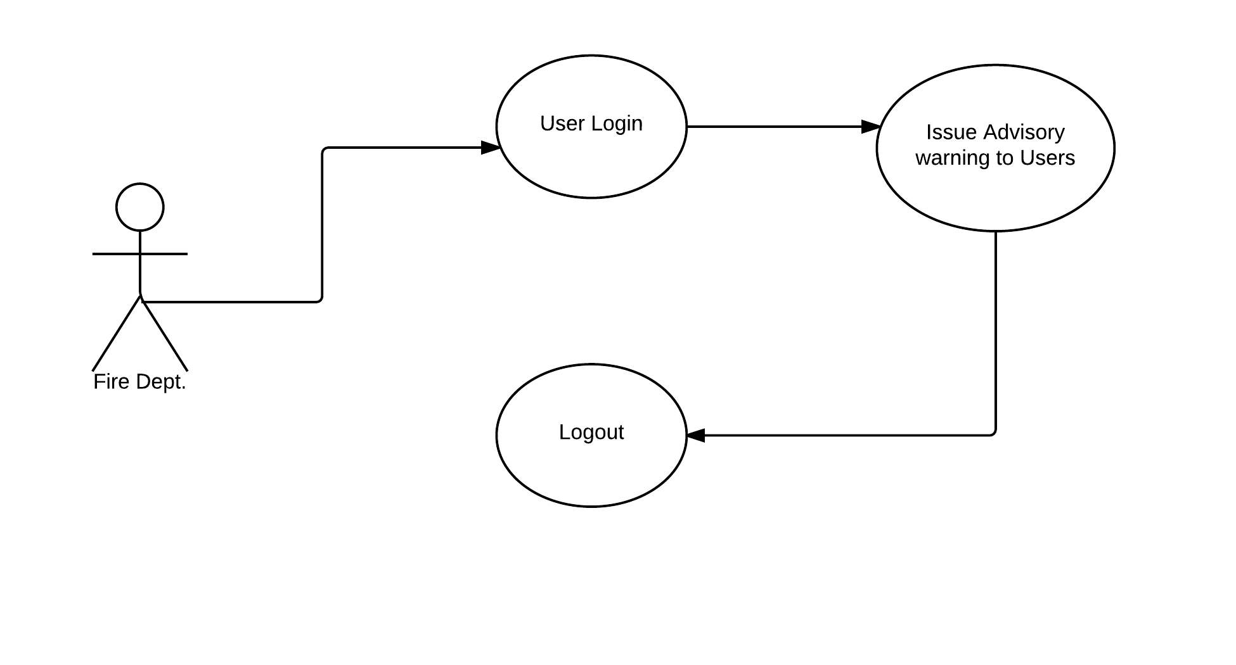
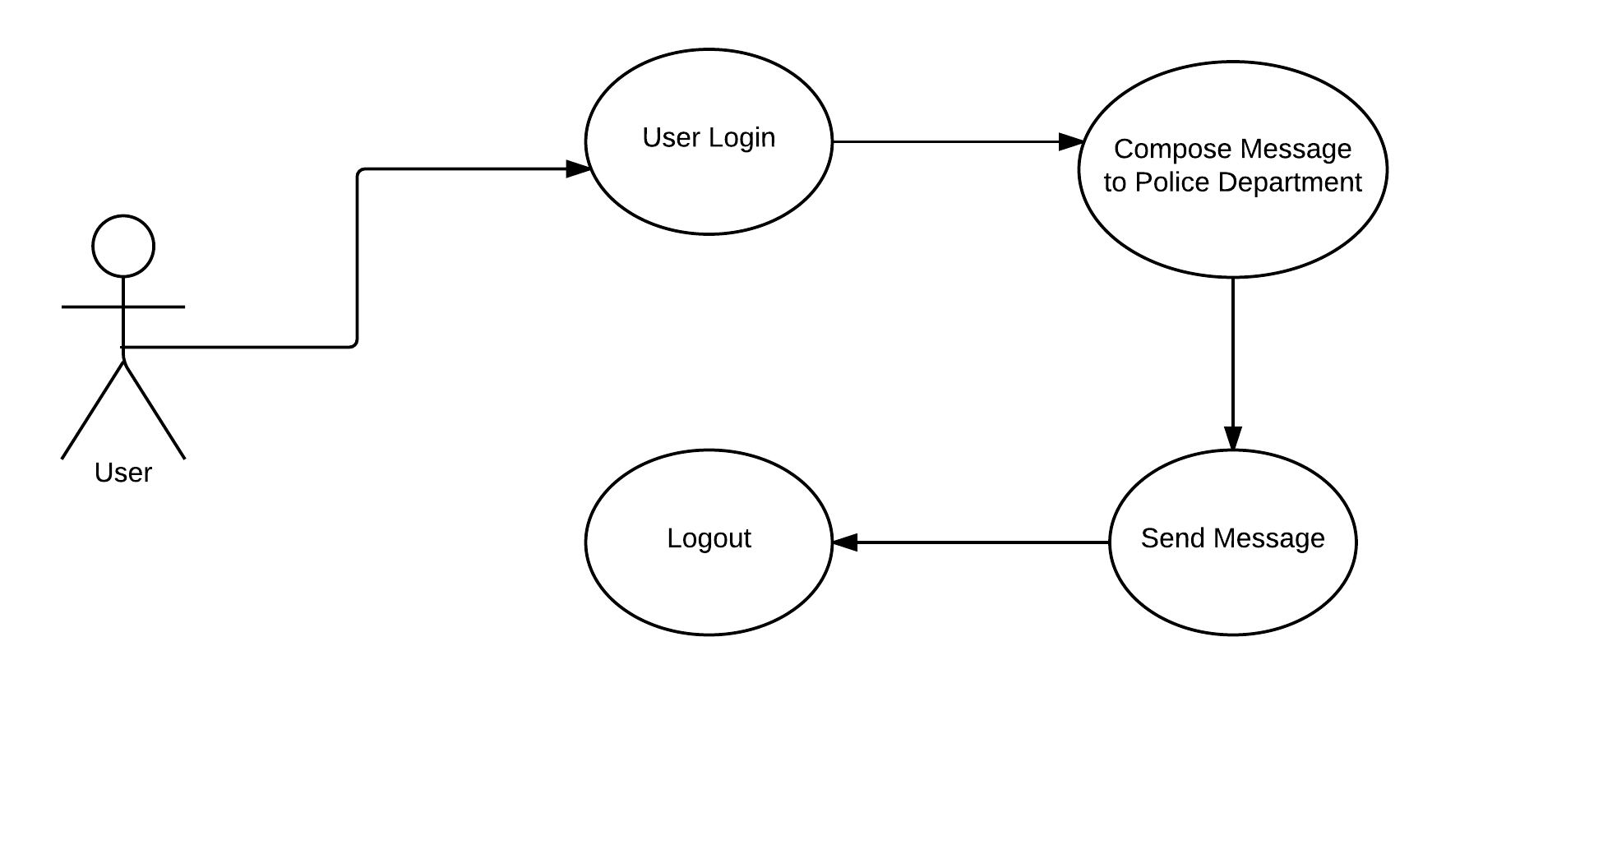

Slide 30
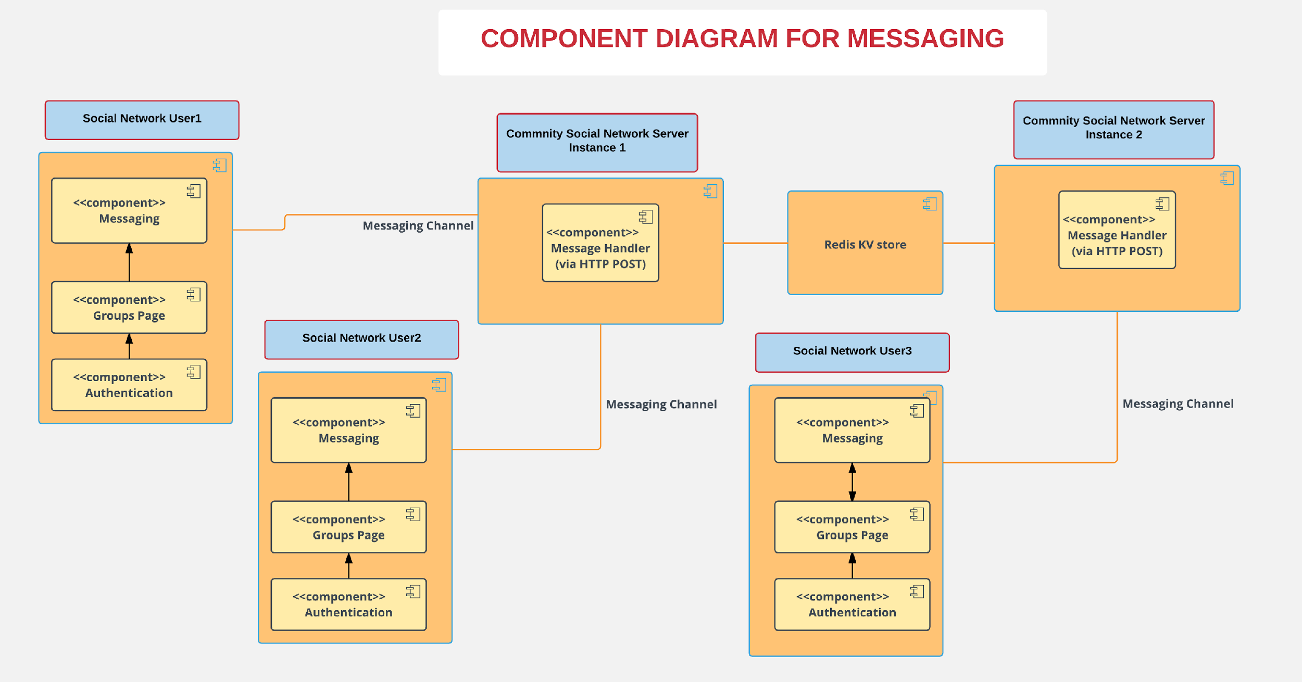
COMPONENT DESIGN

Slide 31
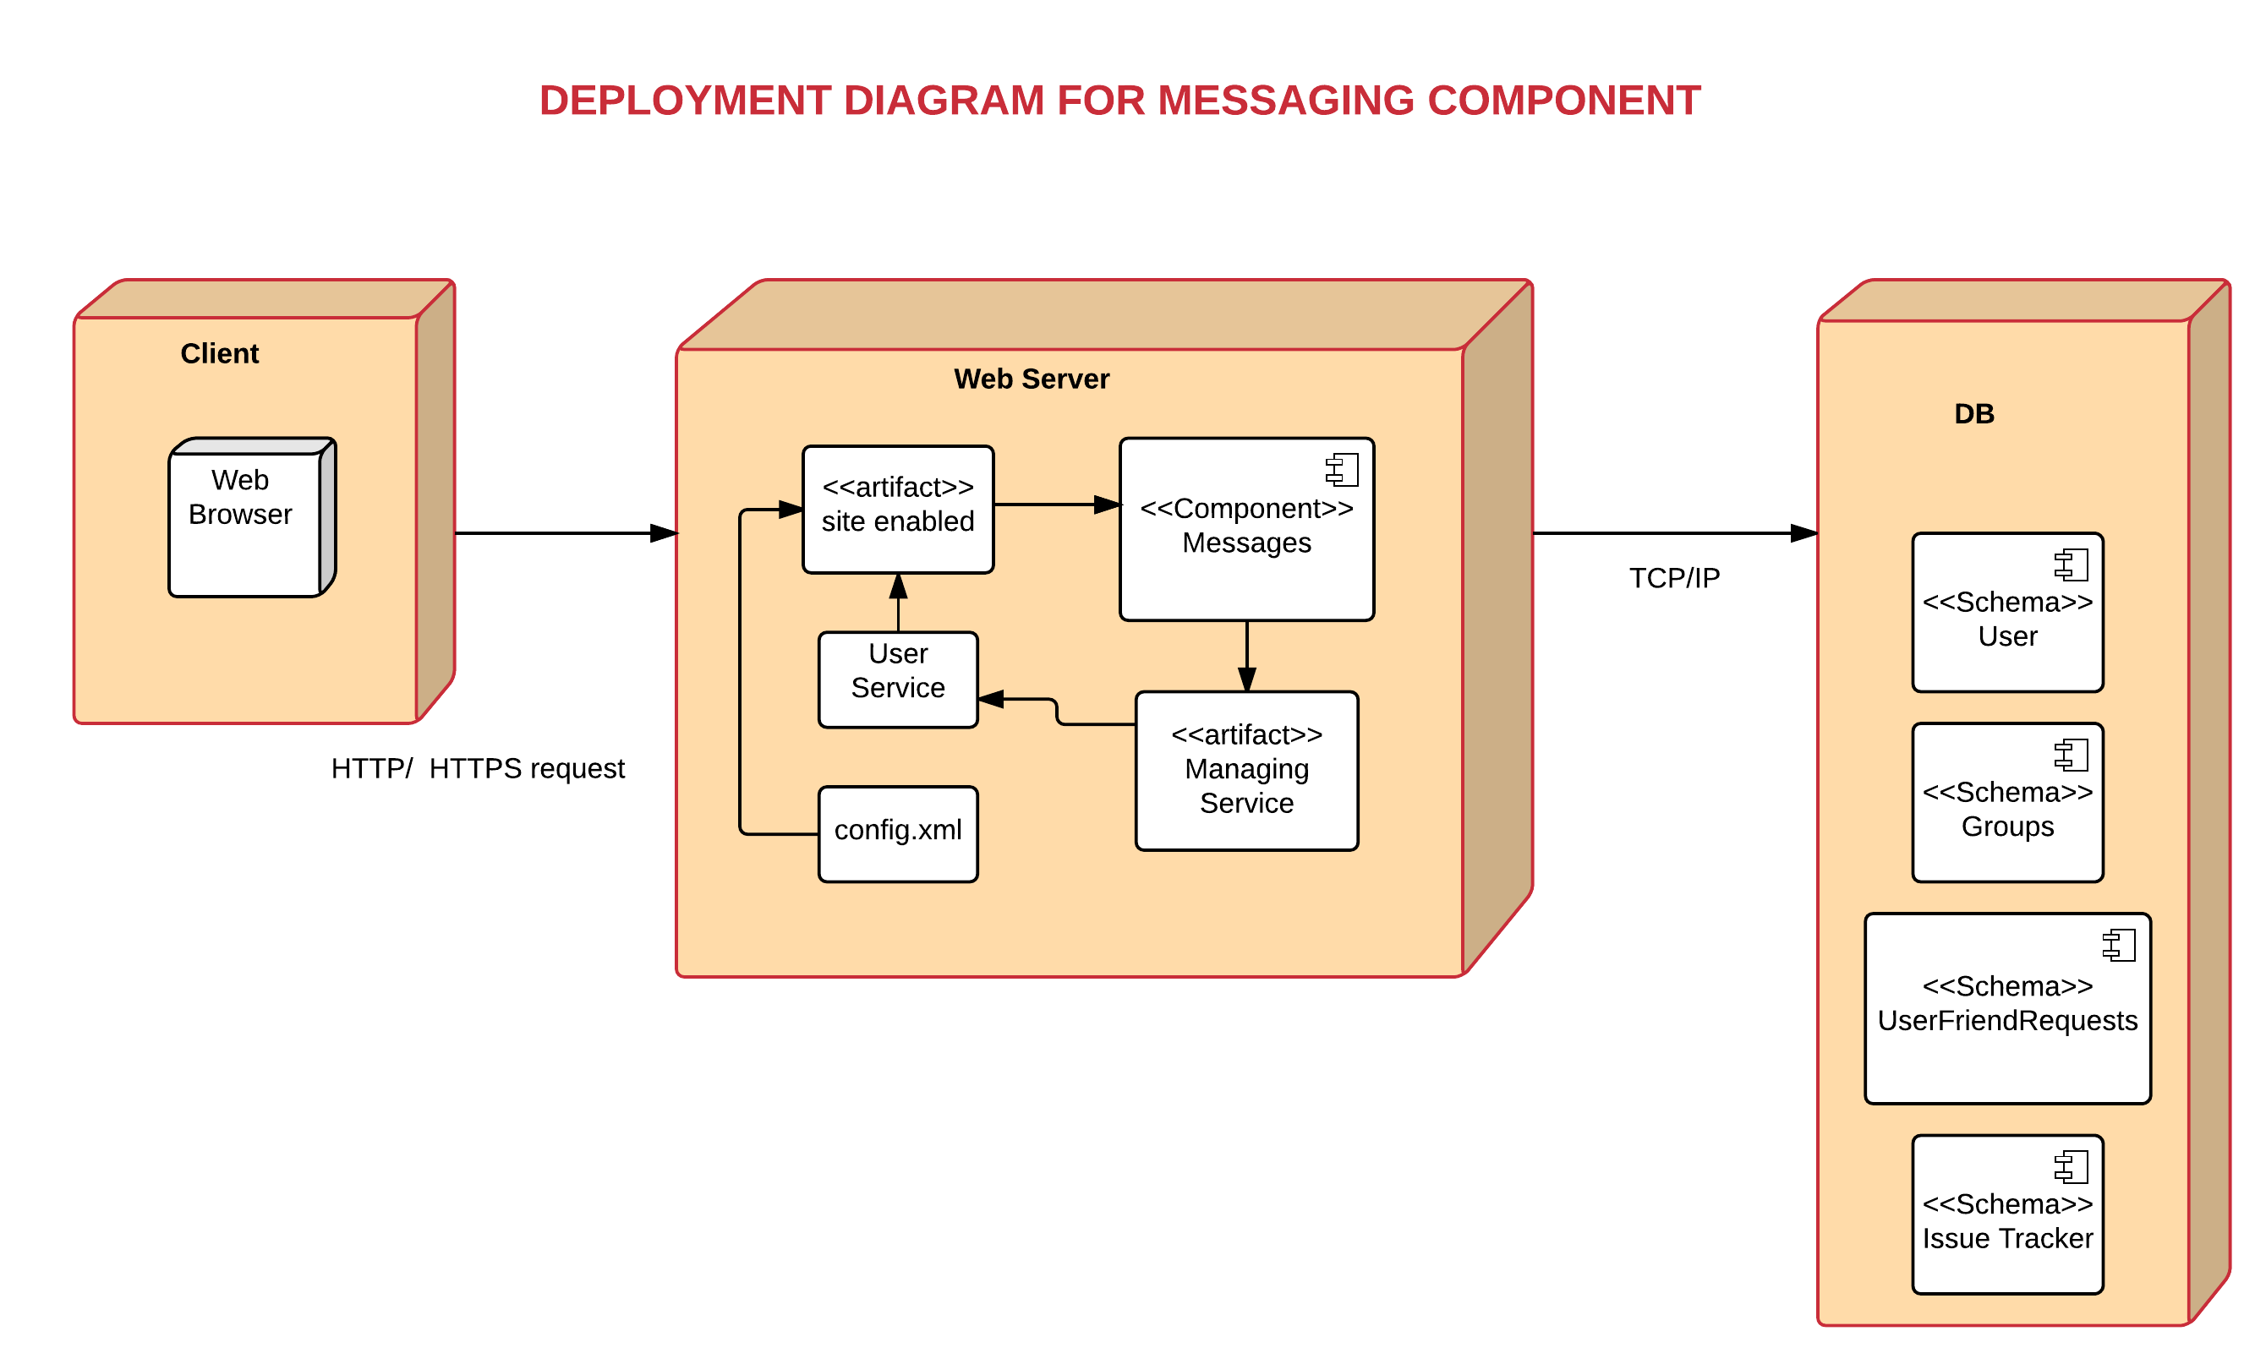

Slide 32
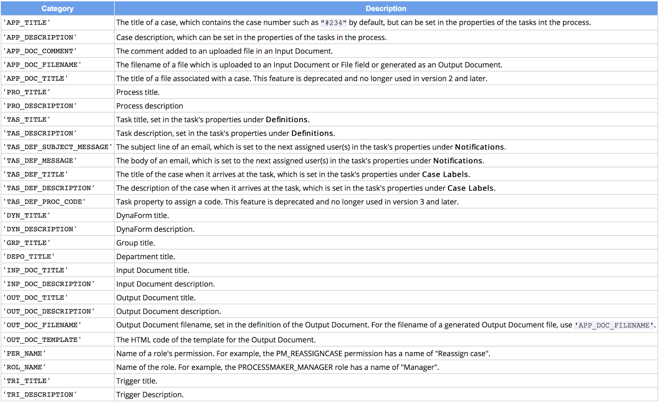
PROCESSMAKER OBJECTS

Slide 33
CURRENT PROJECT STATUS
Tasks Completed
All functionalities of the components.
Unit testing of individual components.
End-to-end integration of the components.
System testing

