Slide 1
Methodology: TabNet and Lightning Flash
• Split recipe and counts were reconstructed from eda.ipynb (80/20, stratified, seed 42) because the original shared train/test files were not available. Train 5,090,096 rows, test 1,272,524 rows (1,643 frauds); counts match the XGBoost notebook.
• Same 13 features (target excluded). Money columns log-scaled, then standardised. Target isFraud used as a number (regression).
• PyTorch TabNet (TabNetRegressor): fitted on 4,890,096 rows (train minus a 200,000-row validation slice). 4 epochs, about 6 minutes on 1 CPU. The checkpoint with the best validation RMSE was kept.
• Lightning Flash (TabularRegressor): fitted on about 675,000 rows of a 750,000-row stratified sample (968 frauds), because full-size runs ran out of memory here. Scored on the full test set.
• Metrics from sklearn.metrics: RMSE, R2, MAE on the test set.
Person 3 section: TabNet, Lightning Flash and the 5-framework comparison
1

Slide 2
Results on the full test set
Framework | RMSE | R2 | MAE
XGBoost | 0.00208 | 0.9966 | 0.00002
Keras MLP | 0.00437 | 0.9852 | 0.00032
fastai Tabular | 0.01174 | 0.8931 | 0.00967
PyTorch TabNet | 0.00300 | 0.9930 | 0.00060
Flash (750k sample) | 0.01597 | 0.8022 | 0.00259
Limits: XGBoost, Keras and fastai are the teammates' runs (classifiers scored by predicted probability, fastai on a 1M-row sample), not re-run. TabNet was fitted on 4.89M rows, Flash on about 675k, so the rows are not like for like. Flash settings were chosen after seeing a weaker first test score (R2 -0.30), so its result is not fully blind. Lower RMSE and MAE are better; higher R2 is better.
Person 3 section: TabNet, Lightning Flash and the 5-framework comparison
2

Slide 3
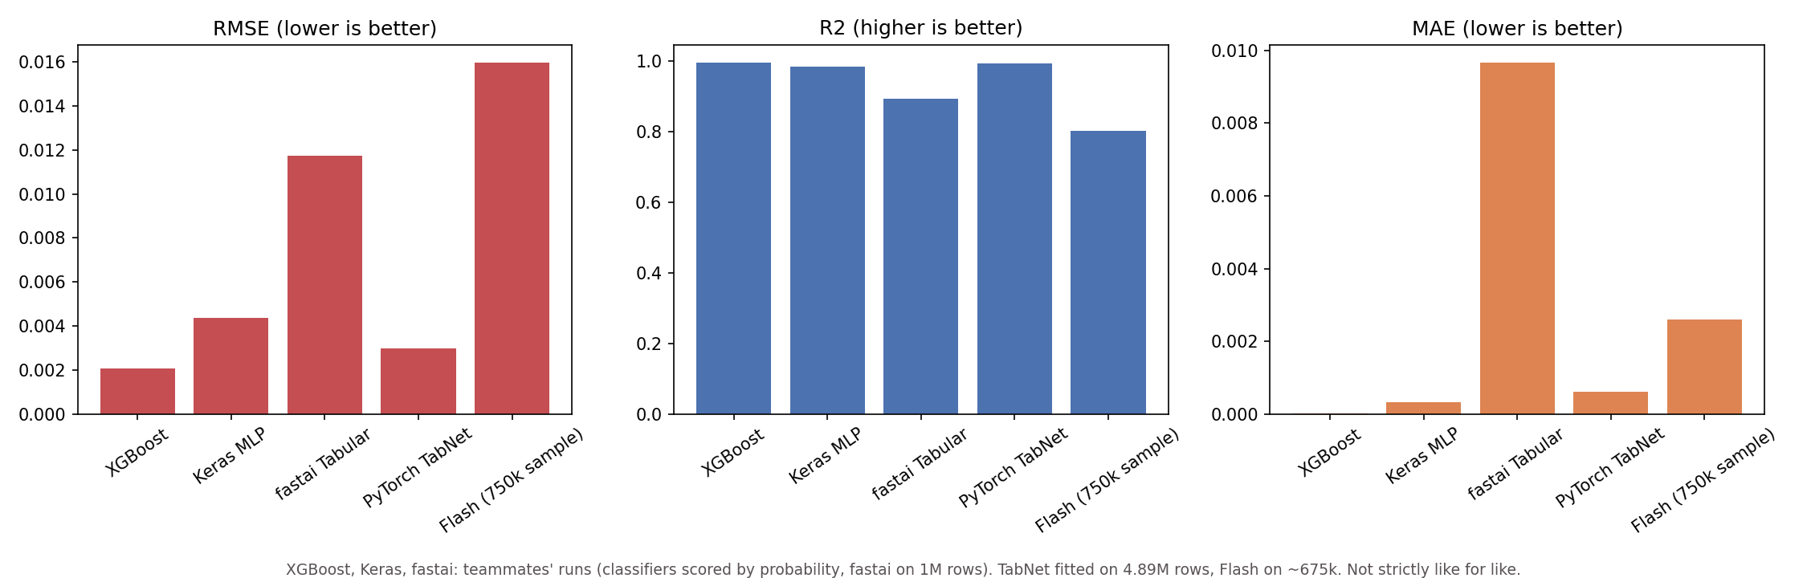
Comparison chart: RMSE, R2 and MAE
Same numbers as the table. Bars for XGBoost, Keras and fastai come from the teammates' runs and are not strictly like for like with TabNet and Flash.
Person 3 section: TabNet, Lightning Flash and the 5-framework comparison
3

Slide 4
Simplicity, transparency and efficacy
• Our assessment, not measured results. Simplest: XGBoost, Keras and Flash were short to set up. Flash needed one data module and one model call, but installing it was awkward (the [tabular] extra failed, plain lightning-flash worked).
• Most transparent (our view): XGBoost, with trees and feature importance. Among the neural networks TabNet is the most open, with attention masks over features (we did not plot them). Flash hides most choices behind defaults.
• Most effective in our table: XGBoost (R2 0.9966), then TabNet (0.9930), then Keras (0.9852).
• Flash and fastai scored lowest, but they were fitted on far fewer rows (about 675k and 1M), so this does not show those libraries are worse in general.
Person 3 section: TabNet, Lightning Flash and the 5-framework comparison
4

Slide 5
Why the results differ
• Different amounts of training data: 4.89M rows for TabNet, about 675k for Flash, 1M for fastai.
• Different loss and class handling: the classifiers used class weights, TabNet and Flash used plain MSE.
• Different preprocessing and tuning effort. TabNet's validation RMSE moved a lot between epochs (0.0057, 0.0081, 0.0083, 0.0036, 0.0082, 0.0112).
• Fraud is only 0.13% of rows, so almost every target is 0. R2 depends mostly on how well the few fraud rows are predicted, so small changes in catching fraud move R2 a lot.
Person 3 section: TabNet, Lightning Flash and the 5-framework comparison
5

Slide 6
Conclusion
• On this split XGBoost gave the best regression scores. TabNet was close (R2 0.9930 vs 0.9966).
• Our recommendation: XGBoost. Best scores in the table, and in our view easiest to explain. This is our assessment, not measured superiority: rows are not like for like.
• TabNet is a reasonable neural option if feature attention is wanted.
What is still open: Flash was fitted on a sample and run twice. A full-data Flash run on a bigger machine is needed for a fair comparison. TabNet's checkpoint was identified by matching its validation score, and its run was cut short by a machine restart.
Person 3 section: TabNet, Lightning Flash and the 5-framework comparison
6

