Slide 1

FEDF PROJECT
Blood Bank Management System
A unified digital platform connecting donors and hospitals for faster,
safer, and smarter blood supply management.
Full Engineering Design Framework (FEDF) — Project Documentation
Donor Module · Hospital Module · Admin Dashboard
Team-19
Poojitha Sai [2520030103]
Anushka Kulkarni [2520030501]
T

Slide 2

SECTION 01
Purpose
Why this system exists
The Blood Bank Management System digitizes the entire blood donation and distribution lifecycle — from donor registration to hospital fulfillment — replacing manual registers and phone-based coordination with a single, reliable digital platform.
Built for Two Audiences
DONORS
Register, check eligibility, book donation slots, and track history.
Connect Donors & Hospitals
Provide one platform where donors register and hospitals manage supply, instead of fragmented manual systems.
Reduce Response Time
HOSPITALS
Cut the time between a hospital's blood request and donor mobilization during emergencies.
Manage live inventory, find nearby donors, track expiry, and raise requests.
Improve Inventory Visibility
Give hospitals real-time visibility into stock levels, blood groups, and expiry across their blood bank.
02

Slide 3




SECTION 02
Problem Statement
Blood banks today still rely heavily on manual registers, spreadsheets, and phone calls to track donors and inventory. This creates avoidable delays and risk exactly when speed matters most.
No Real-Time Stock Visibility
Slow Emergency Response
Manual Compatibility Checks
Wastage from Expired Units
Hospitals cannot see live unit counts by blood group, leading to over- or under-ordering.
Locating compatible, nearby donors during a crisis depends on manual calling chains.
Staff cross-check donor/recipient blood group compatibility by hand, risking human error.
Without expiry tracking, units lapse unused instead of being dispatched first.
03

Slide 4





SECTION 03
Goals
Unify donor & hospital workflows
Speed up emergency fulfilment
Automate compatibility logic
One platform replacing scattered registers, spreadsheets, and calls.
Geo-based donor search to cut response time for urgent requests.
Built-in blood-group compatibility engine removes manual lookup errors.
Minimise inventory wastage
Give hospitals decision-ready data
Ensure safe, role-based access
Expiry tracking and a use-first dispatch priority list for near-expiry stock.
Live dashboards summarising stock, demand, and donor counts.
Separate, secure donor and hospital login/registration flows.
04

Slide 5


SECTION 04
Scope
In Scope
Out of Scope
Donor registration, login & profile management
Hospital/admin registration, login & profile management
Live third-party Maps & GPS API integration (currently simulated)
Donation appointment booking & history ledger
Native mobile applications (iOS / Android)
Blood group compatibility checker (give/receive logic)
Hospital inventory management with expiry tracking
Automated SMS / email notification systems
"Use-first" dispensation priority for near-expiry stock
Live weather-API based safety interlocks (currently simulated)
Geo-location based nearby donor search
Blood allocation request pipeline
Admin dashboard with stock & donor summary stats
05

Slide 6


SECTION 05
Users
Donor
Hospital / Blood Bank Admin
Individual willing to donate blood.
Institution managing blood supply.
Register / login with personal & medical details
Register facility with license & contact details
Check eligibility & blood group compatibility
Monitor live inventory by blood group
Book and manage donation appointments
Track expiry & dispatch priority
View personal donation history
Search nearby donors & raise allocation requests
06

Slide 7
SECTION 06
Functional Requirements
Donor Module
Hospital Module
FR1: Register & login as a donor
FR6: Register & login as a hospital
FR2: Manage personal & medical profile
FR7: View & update live unit inventory
FR3: Book / cancel donation appointments
FR8: Track expiry & use-first priority list
FR4: View donation history ledger
FR9: Run compatibility cross-match queries
FR5: Check own blood-group compatibility
FR10: Raise & track allocation requests
07

Slide 8



SECTION 07
Non-Functional Requirements
Performance
Security
Usability
Compatibility lookups and inventory updates must reflect on screen instantly (client-side state, sub-second response).
Role-based access keeps donor and hospital data and workflows fully separated; required-field validation on all forms.
Clear two-role login (Donor / Hospital), simple forms with icons & labels, mobile-responsive grid layouts.
Availability
Maintainability
Scalability
Core flows (profile, inventory, booking) must remain usable even when simulated external services (maps, weather) are slow.
Component-based architecture (shared dashboard shell, reusable Field components) for easy extension.
Inventory and donor data structures designed to scale from in-memory state to a real backend/database later.
08

Slide 9
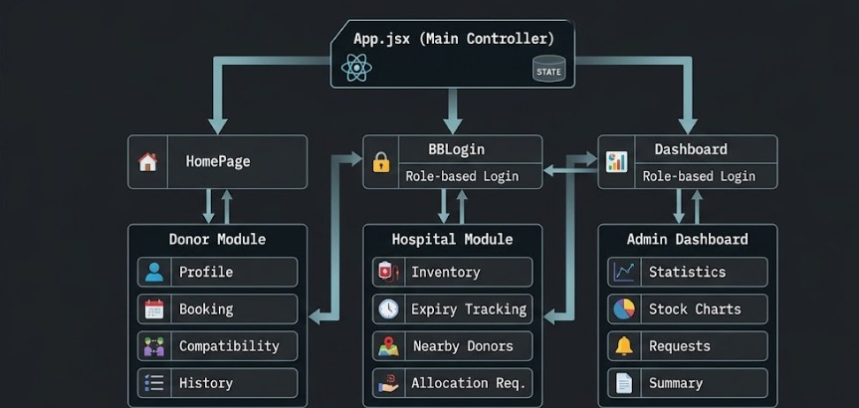
Project Architecture
08

Slide 10
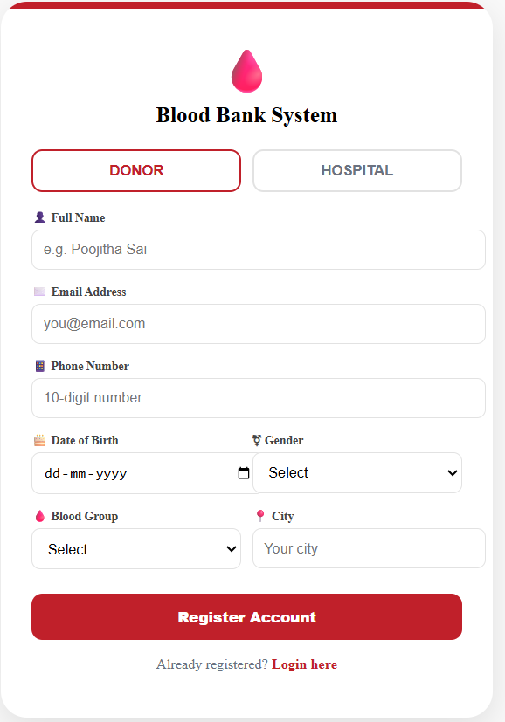
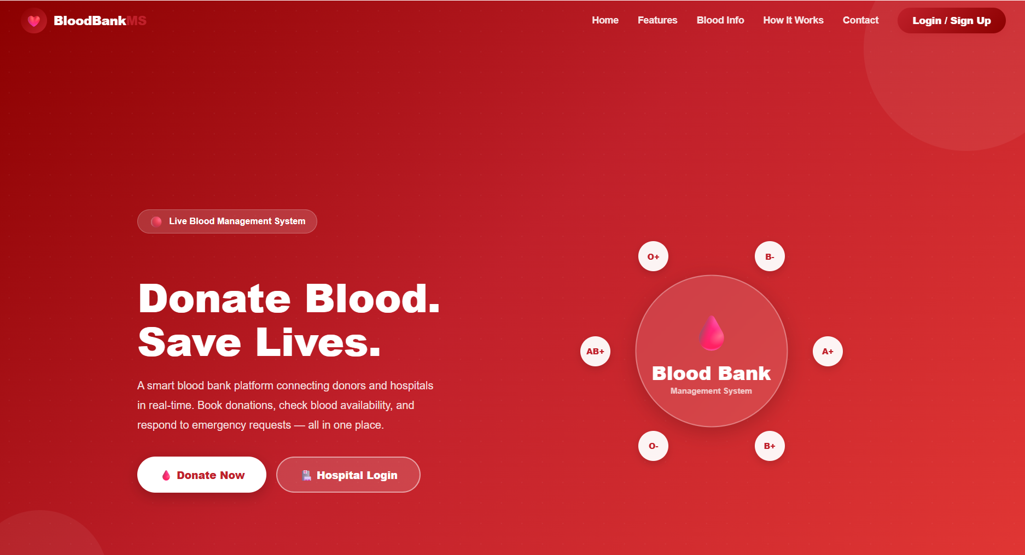
Outputs
08

Slide 11
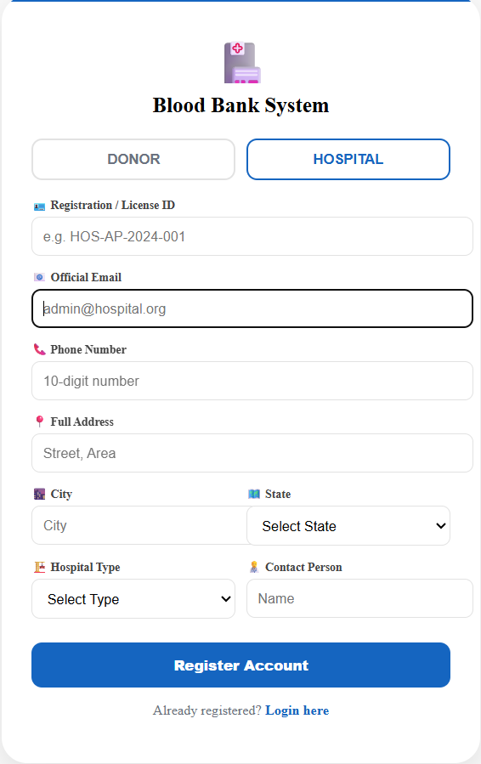
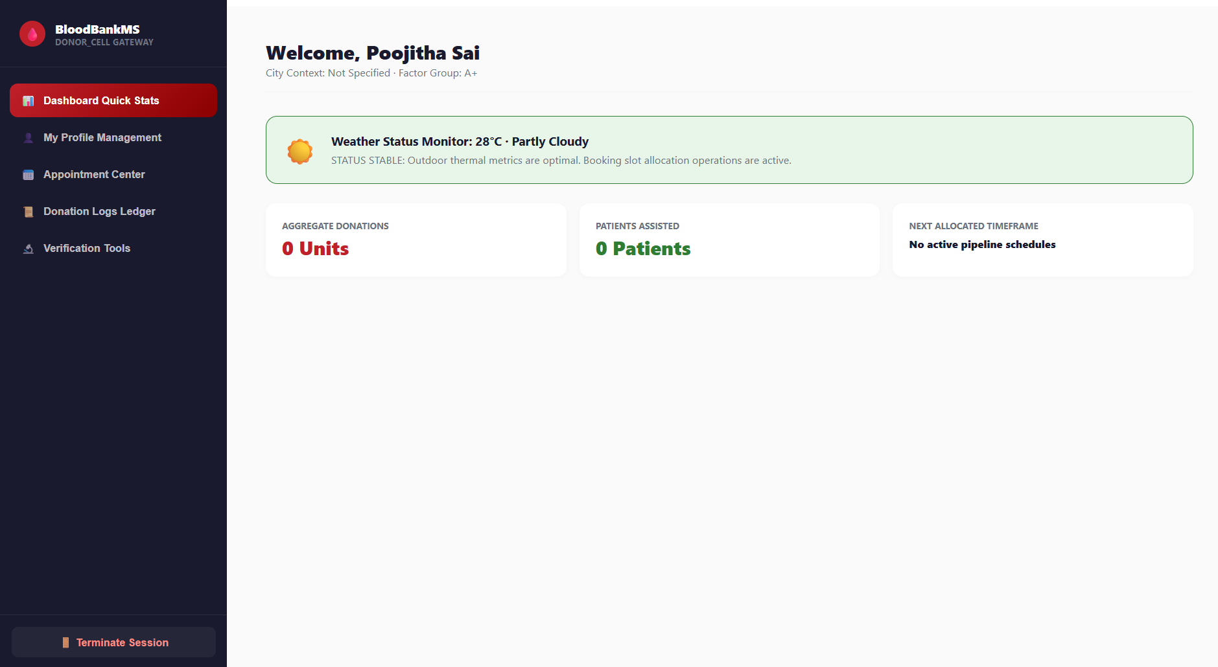
08

Slide 12
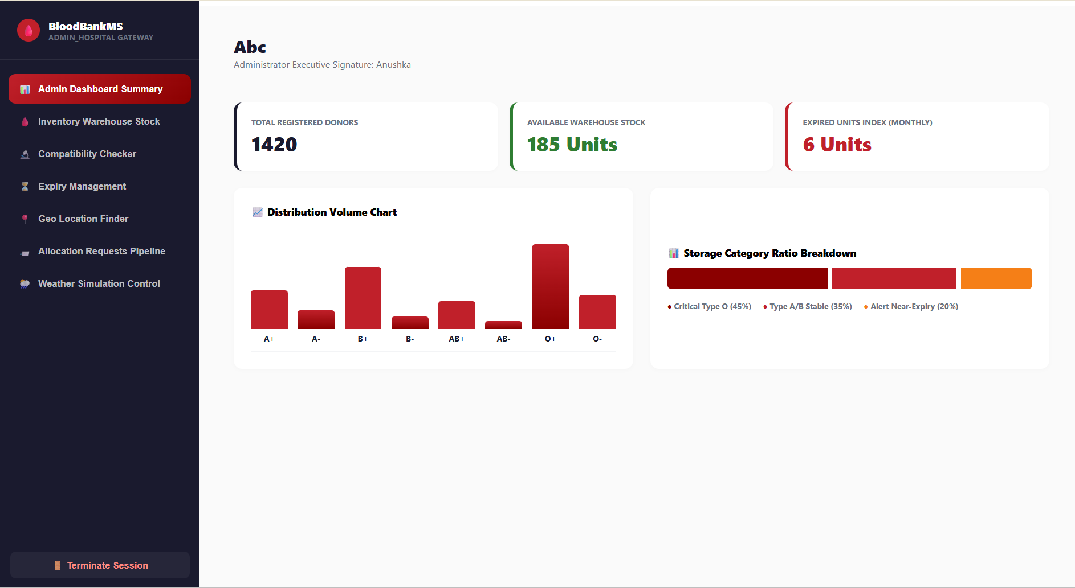
08

Slide 13


SECTION 08
Assumptions
These assumptions define the boundaries the current build operates within; they should be revisited before production deployment.
Data is stored client-side
GPS data is simulated
Users self-report accurately
Donor, hospital and inventory data live in component state for this prototype, not a persistent database.
Donor locations and distance calculations use mock coordinates and the Haversine formula, not a live Maps API.
Donor eligibility (age, last donation date, medical fitness) is assumed accurate as entered by the user.
Single hospital context
Stable network & device
Authentication is illustrative
Each hospital session manages its own inventory; cross-hospital sharing is out of scope for this version.
The system assumes a modern browser with stable connectivity; offline support is not assumed.
Login forms validate presence of fields but do not yet implement production-grade password security.
09

Slide 14

SECTION 09
Acceptance Criteria
A donor can successfully register, log in, and view/edit their profile details.
A hospital can successfully register, log in, and view its admin dashboard summary.
Selecting a patient blood group correctly returns all compatible donor/recipient groups per the compatibility map.
Inventory unit counts update immediately when an admin edits stock for any blood group.
Units with expiry ≤ 5 days are visibly flagged and appear at the top of the use-first priority list.
Running the geo-finder returns only donors within the selected radius, sorted by distance.
Submitting an allocation request adds it to the active request log with a Pending status.
All required form fields block submission until completed (no silent failures).
10

Slide 15
THANK YOU!

