Slide 1
Swiggy data analysis

Slide 2
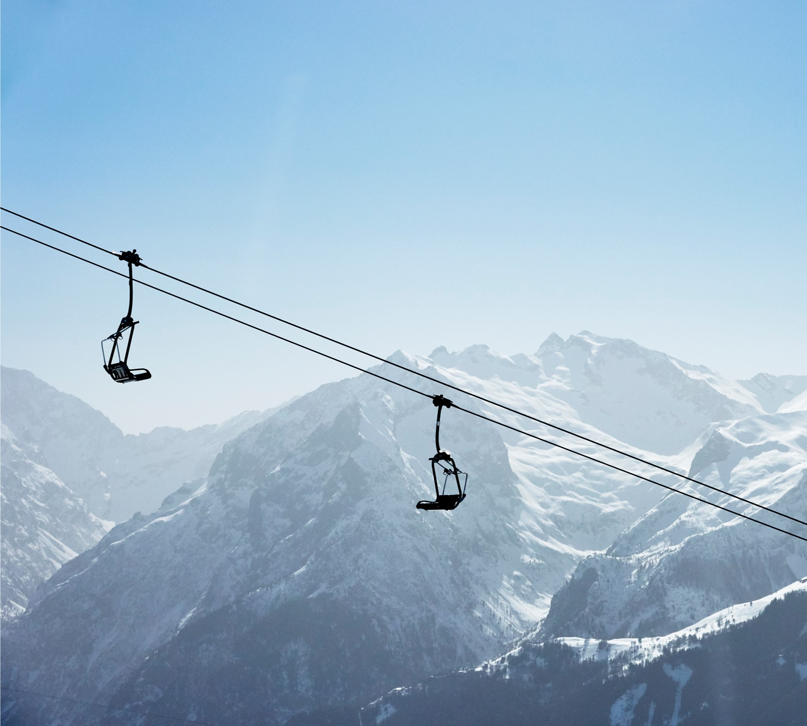
Agenda
The aim is to analyze and visualize the restaurant data to extract meaningful insights that can help in making informed business decisions.

Slide 3
findings
As of we see in the presentation ROHINI area had highest number of restaurant's in area wise with number of 257.
As of given ratings there are almost 51.06% restaurant’s who has a rating of 4.5 and there 25.08 of 4.6 and 14.5 of4.7 and 4.38 of 4.8 and 2.27 of 4.9 and 2.72 of 5 rating restaurant’s
Kolkata has maximum number of restaurant’s of 1346 and surat has least in number 512.
When we compare with price to avg rating most of the ratings has given to price having from 1 to 1500 it contains both high and low ratings but when it comes to 1500 to 3000 the ratings are less but the given ratings are high .

Slide 4
findings
When compared average ratings with the total ratings using the parameter of price we can see most ratings have come to price 1 to 1500 , there so many had given rating containing ratings from 2 to5.0 but most of them given above the 3.5 to 5.0 ratings
When it comes to price , most of the restaurant’s are from around 150 to 1000 , in that price of 200 to 300 are very high.
Heavens kitchen has taking highest delivery time of 109. mins while scoops and wah ji wah has taking only 21 mins.
La Pino Z pizza has offering maximum number of food types pf 13 when compared to others.
Most of the people has given 2.9 rating who are around 3279 and 792 members are giving 4.3 ratings.

Slide 5
INSIGHTS
For further enhancement

Slide 6
Effective delivery techniques
1. Reasonable prices to get high interest
mostly people taking low prices that means when we offer more and more minimum prices they often more attract to it
2 focusing on rating.
mostly there are 4.5 rating restaurant’s , it is quiet good. But we have to focus on 5.0 rating because if we try to give the best to customers it definitely makes them to have a good trust.
3. Fast delivery
Most of the restaurant’s had giving fast delivery . But some of them taking too much time , it will make customers to lost the patience towards company, so make as fast you can to deliver it.

Slide 7
ENGAGEMENT WITH CUSTOMERS
Generating more engagement
If we see most them are engaging with the price from 1 to 1500 and also having high rating to it. Which means focusing on these pricing food types and restaurant’s with a good rating and also introducing new varieties can make them more engage.
5. Marketing
through we got the reviews and rating make more marketing , mostly focus on the job holders and in metropolitan cities it will further make close to them.

Slide 8
Thank you
Poojitha velagala

